Slide 1


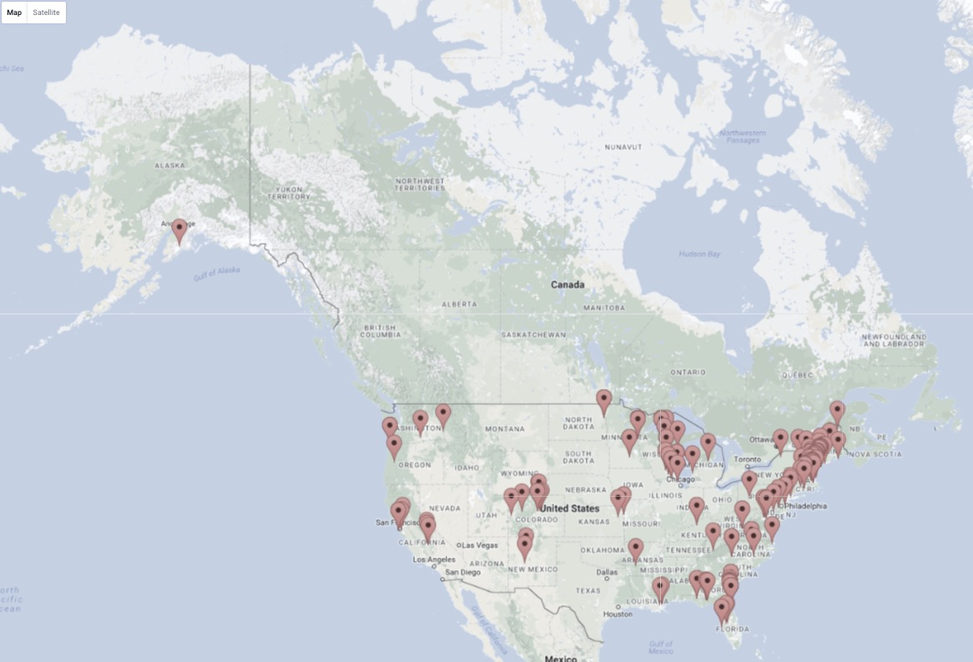
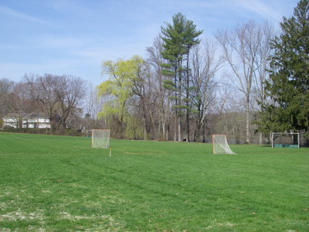
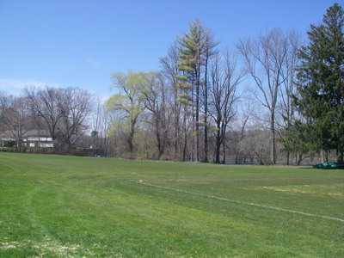
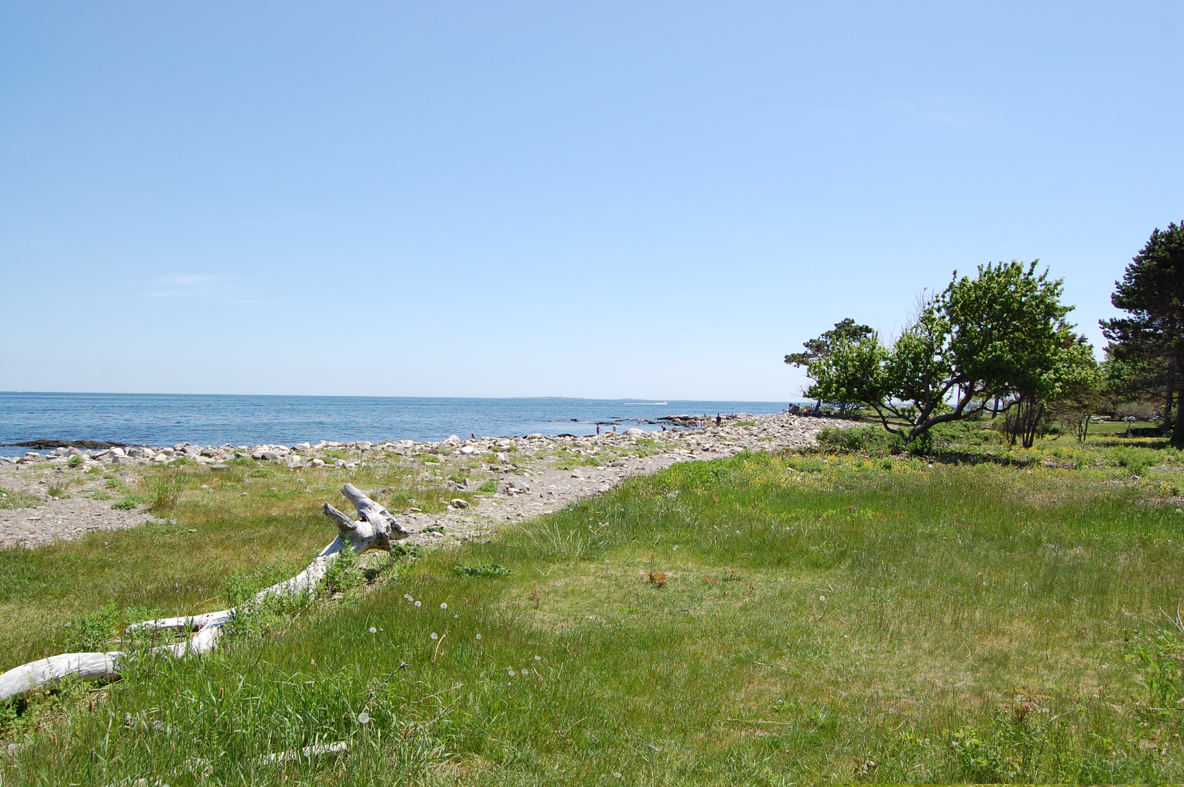
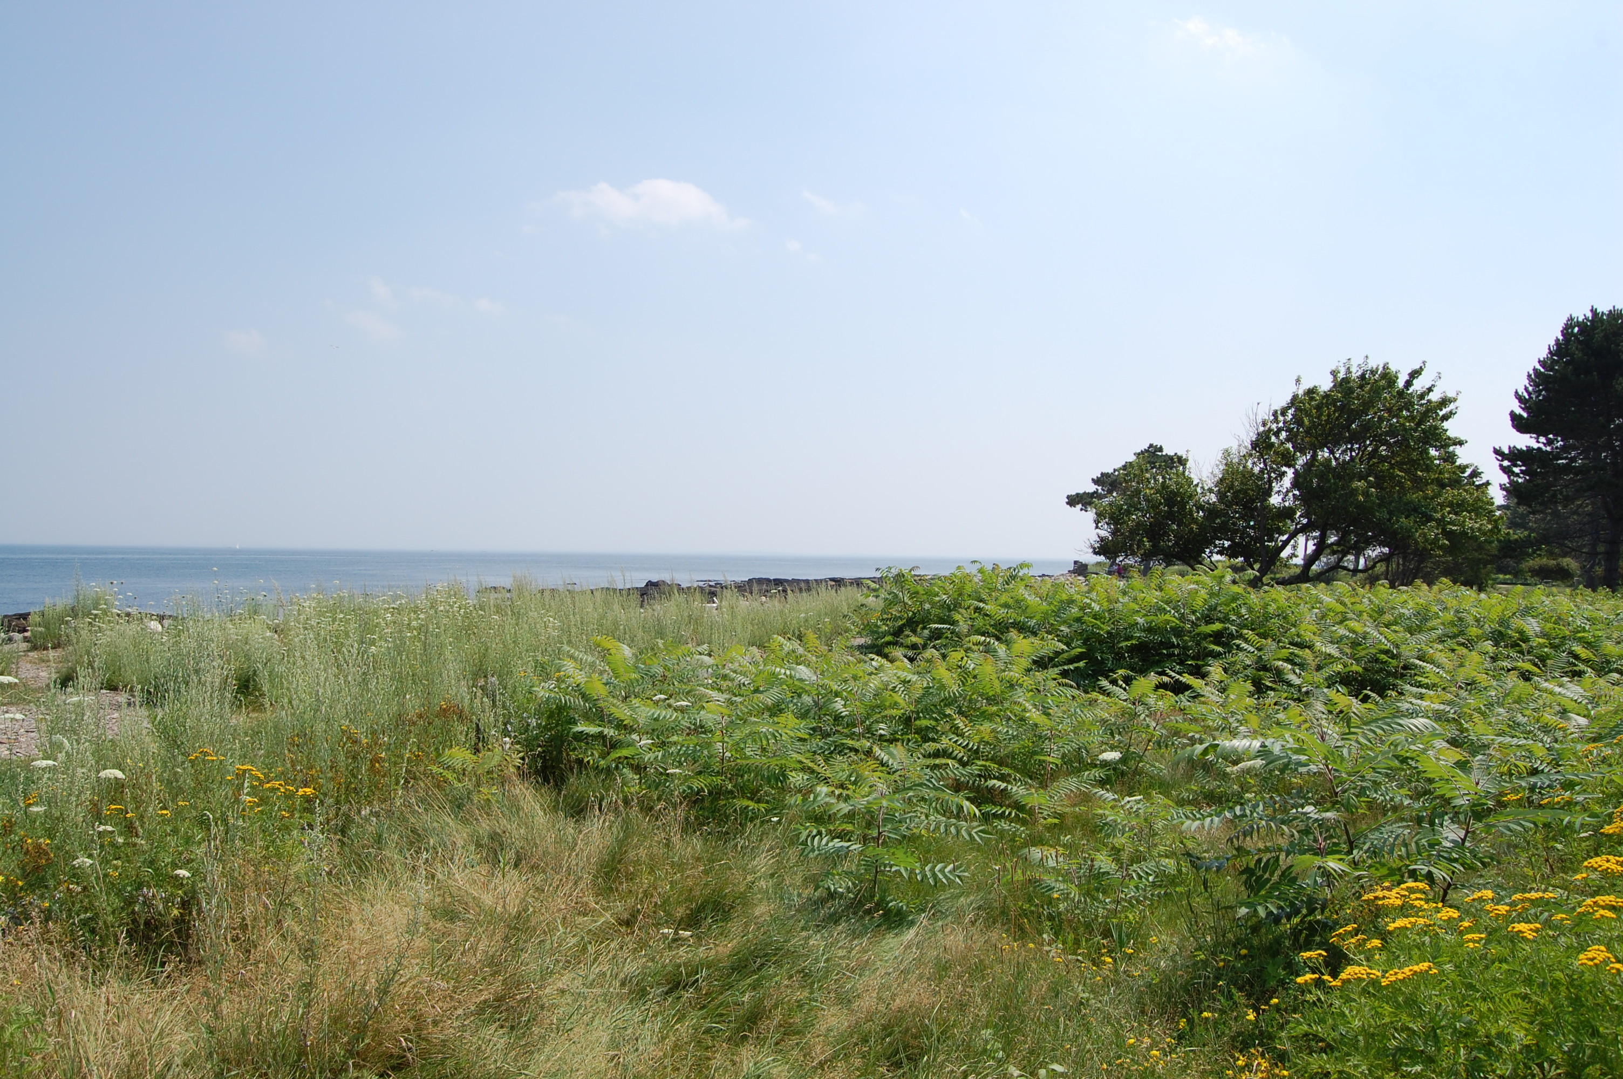
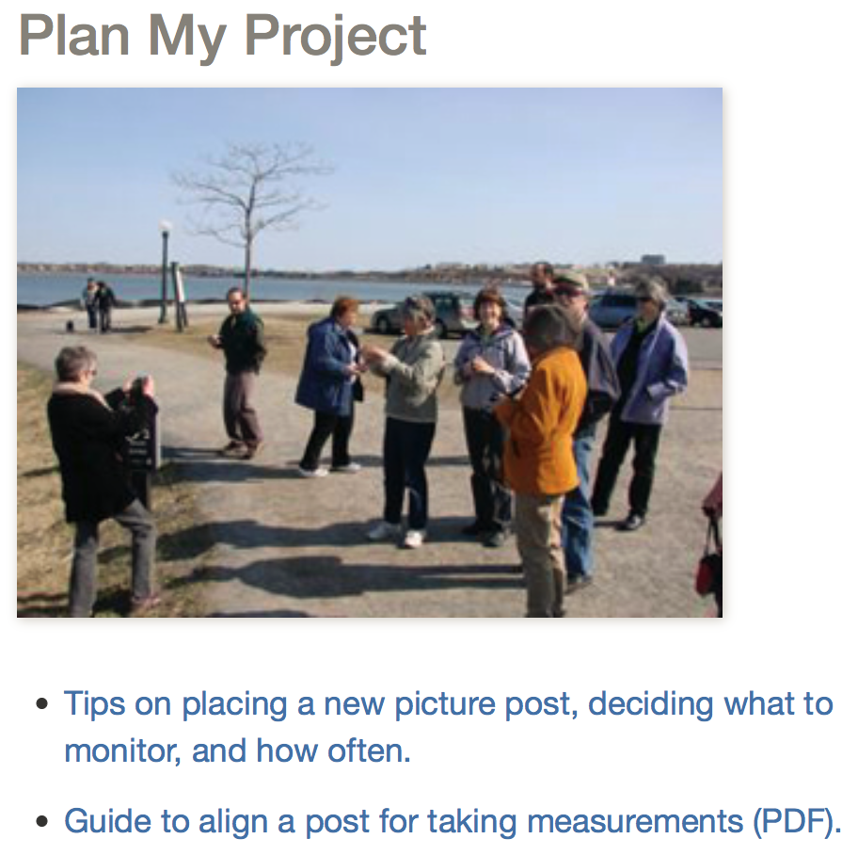
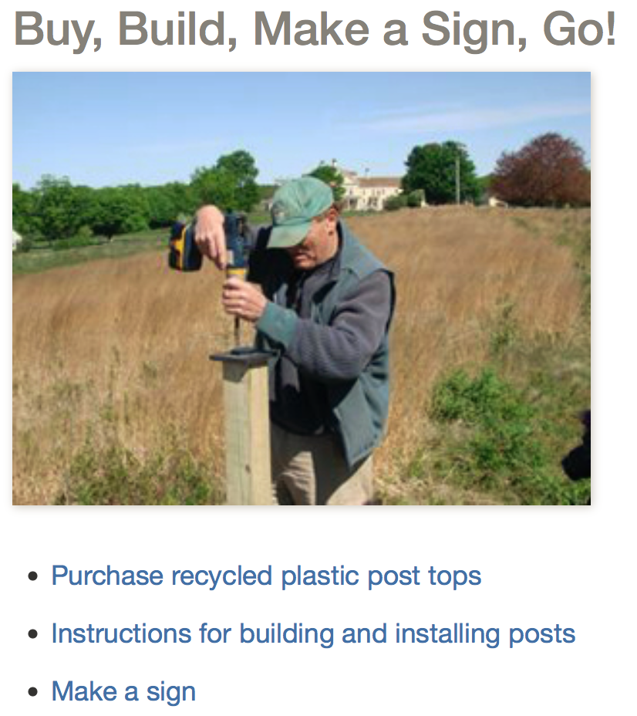
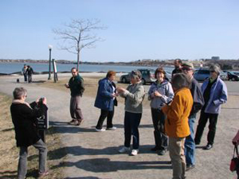
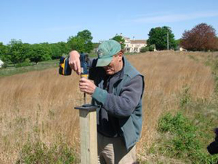
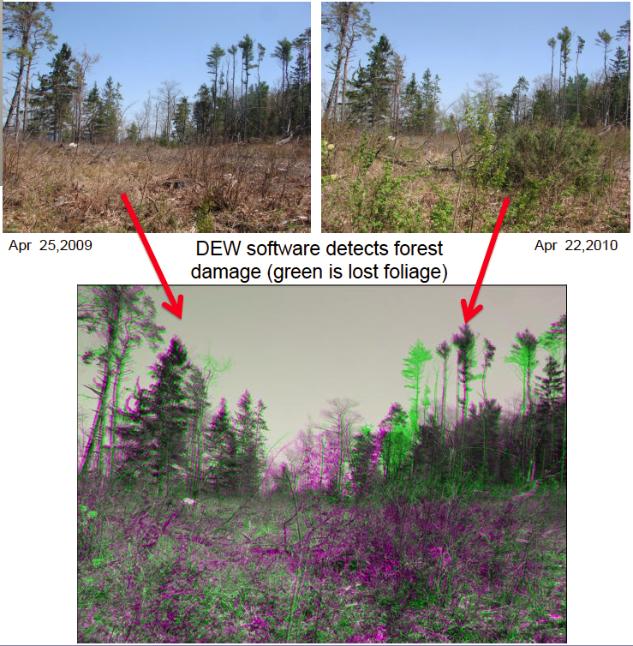
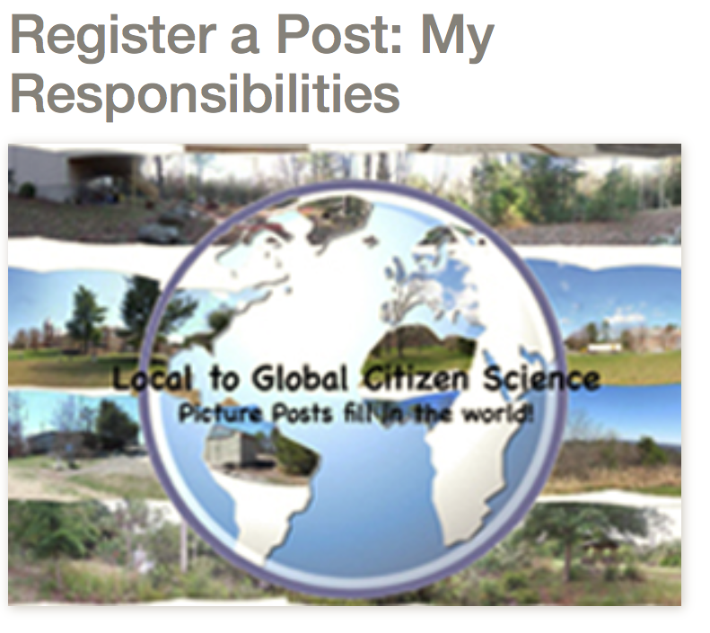
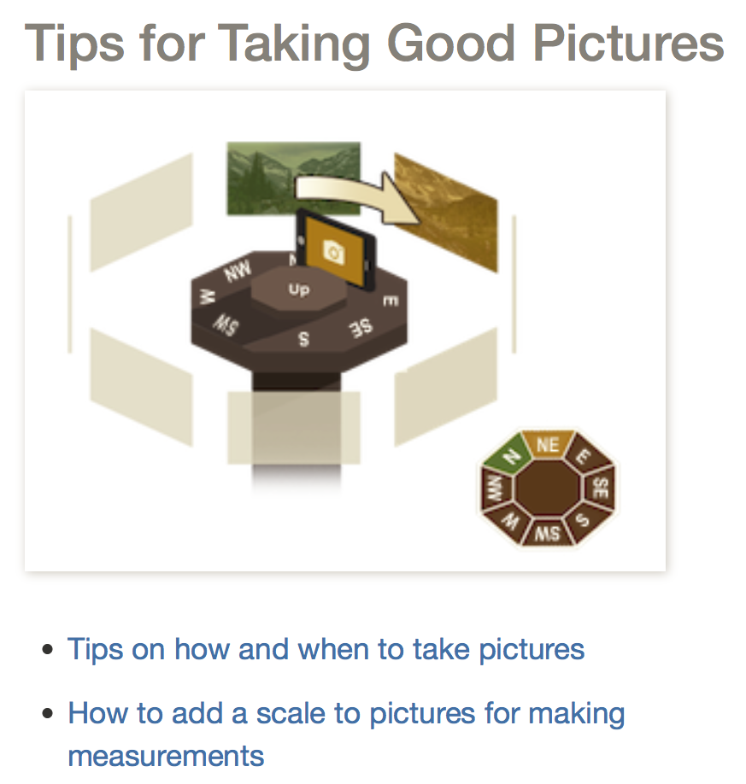
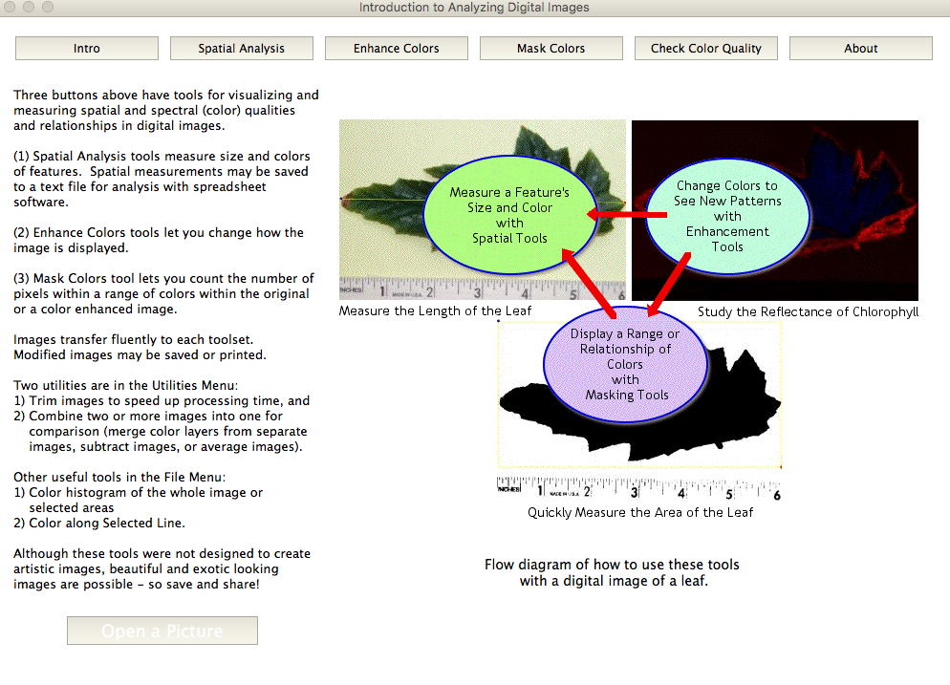
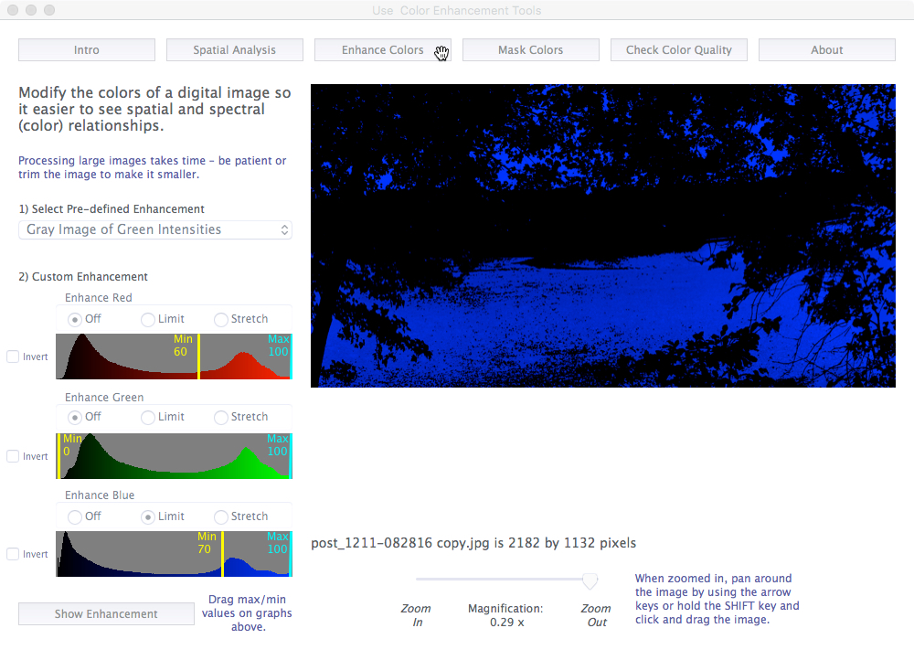
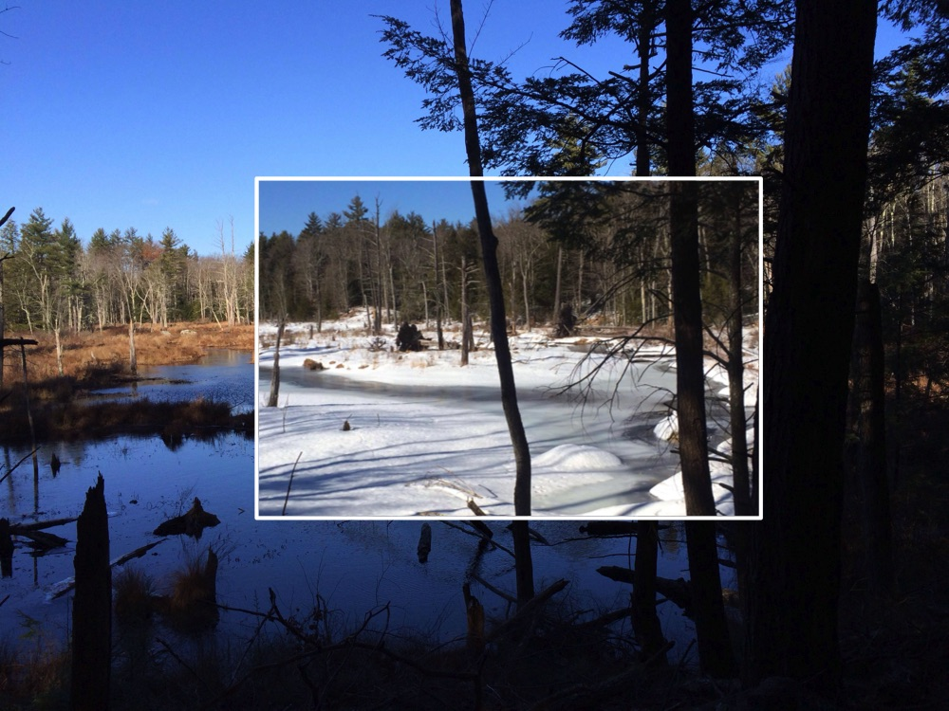
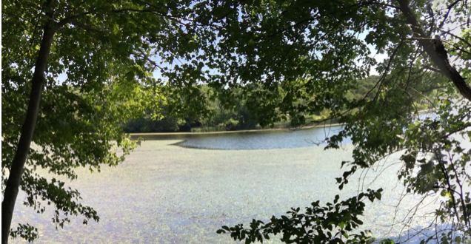

The Picture Post
a Tool to Engage Citizens in Collecting Photographic Data for Lakes
How can I participate?
Going further with DEW
Anyone can install one or more posts and add them to the Picture Post network.
Once you have determined what it is you want to monitor, who the responsible parties will be, and have located, constructed, and installed your post, you will be ready to register your post and upload and share photographs with the rest of the Picture Post network and social media.
All the information you need
is on the website,
examples are shown here.
Often, changes in the landscape are so subtle that we cannot see them without the help of modern technology. DEW offers a set of low-cost tools designed to observe changes in the environment. DEW’s Analyzing Digital Images (ADI) software was used in these examples.
Map of current Picture Post locations
Plant Health
Annotations and Measurements
Invasive Species
Change Detection
Apr 25 2009
Apr 22 2010
Green areas show loss of vegetation damage on Mackworth Island ME from the Patriots Day Storm.
Communicate Your Findings
Social Media
Blog
Newsletter
Simple messages
ADI gives users the capability to explore and make measurements in digital images using colors (r,g,b) and pixels (size and distance).
A picture is worth a thousand words – one Picture Post is worth a thousand pictures.
This example separates out the area of the lake covered by vegetation.
Tips for Lake Photographers
Build a post top that points the camera 45º towards the water.
For comparison and measurements, take pictures at the same time each day – the actual time will depend on sun angle, shadows, etc, at your site.
Please use a Post-it with your tips to help us make Picture Post more valuable as a tool for lake managers and citizen scientists.
Thank-you!
Pictures tell the story: Beaver Pond in NH, Nov & Dec 2014
DEW and Picture Post have been developed with support from NASA & the National Park Service.
picturepost.unh.edu panopicturepost.tumblr.com dew.globalsystemsscience.org
Annette Schloss, Jeffrey Beaudry, John Pickle
For more information, contact Annette Schloss
annette.schloss@unh.edu

