Slide 1



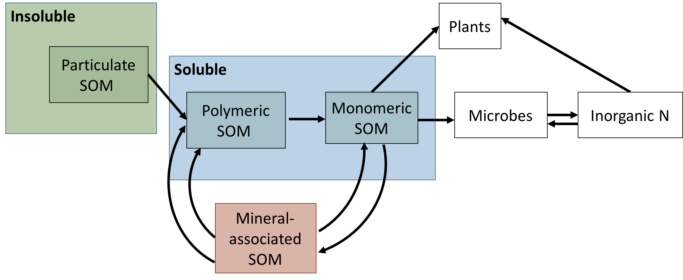
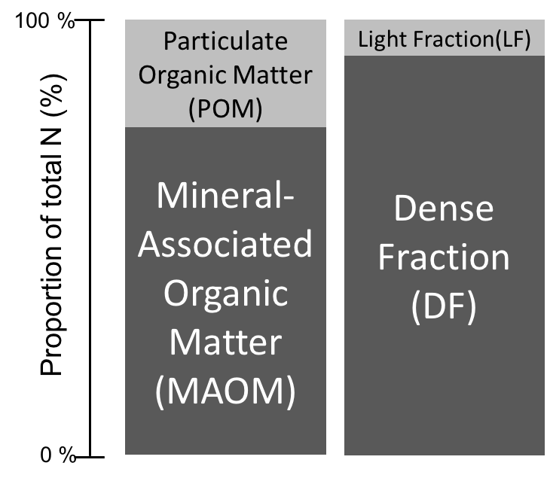
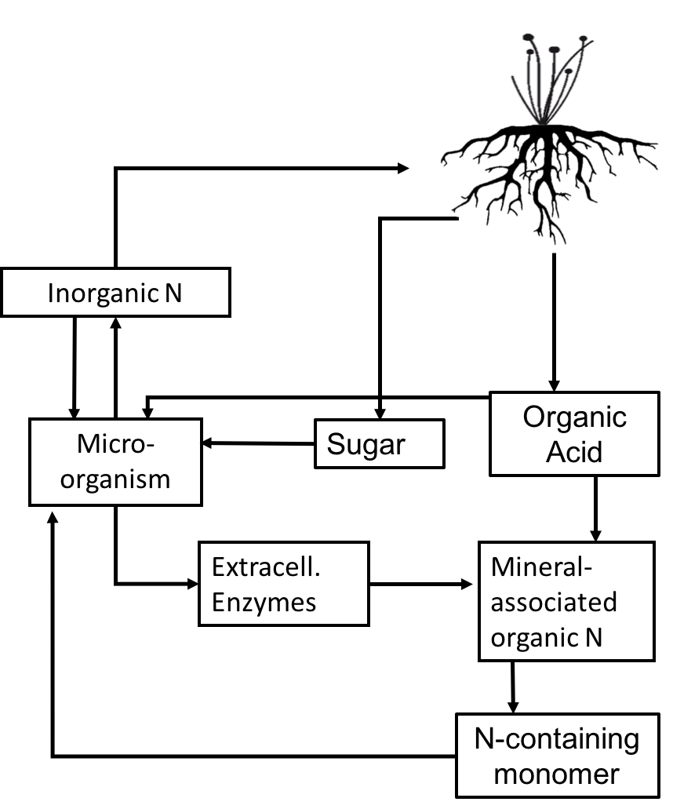
Clay minerals: Critical mediators of nitrogen availability in the rhizosphere
Andrea Jilling¹ and A. Stuart Grandy¹
¹Department of Natural Resources and the Environment, University of New Hampshire, Durham, NH, USA
Introduction
Proposed conceptual model
Experimental approach: MAOM fractions incubated with glucose and oxalic acid substrates
Recent research on soil N dynamics has shifted in focus from net mineralization to soil organic matter (SOM) depolymerization as being the rate-limiting step for N availability. To that end, Schimel and Bennett (2004) argued that depolymerization and subsequent plant-microbial competition for N-containing organic monomers regulates N availability. Building upon this model, we present a new conceptual framework arguing that along with depolymerization, mineral-organic associations may proximally regulate the provisioning of bioavailable organic N monomers and polymers, especially in the rhizosphere.
CO₂ respiration following substrate additions
Control
Conceptual diagram that extends upon the Schimel & Bennett (2004) model of N availability to include minerals as mediators of organic nitrogen availability.
Glucose
Oxalic Acid
CO₂ Respiration Rate (µg CO₂-C h⁻¹ g⁻¹)
Background
In cultivated soils, MAOM stores 5-20x more N than particulate or physically accessible fractions. Fine fractions also preferentially accumulate N compounds such as proteins, amino acids, and nucleic acids. While largely protected from degradation, a portion of these mineral-associated compounds can undergo rapid exchange with the soil solution via sorption-desorption reactions. Moreover, clay minerals vary significantly in charge characteristics and crystalline structure—properties that can have variable influence on the chemistry, strength, and extent of mineral-organic associations.
Plant roots continuously deposit low molecular weight compounds via exudation and can significantly influence SOM mineralization. Known as the “priming effect”, root exudates can stimulate the associated microbial community and modify the chemical environment. As the strength and form of mineral-organic associations are responsive to their biological and chemical microenvironment, it is possible that concentrated modifications to the rhizosphere soil solution could significantly enhance MAOM stabilization and destabilization processes. Alternatively, mineral surfaces vary considerably in structural and surface properties and these differences may mediate how strongly or loosely organic matter is held. Mineral surface properties may thus influence how MAOM responds to rhizosphere processes such as priming.
Enzyme activities following three substrate additions
Hydrolytic Enzymes
Glucose stimulated CO₂ respiration and the production of hydrolytic and oxidative enzymes. Oxalic acid suppressed CO₂ respiration initially,
but by the third addition exhibited an incremental increase in respiration. This possibly indicates a delayed response by a specialized microbial community (to be assessed via phospholipid fatty acid analysis). In contrast to the observed suppression of hydrolytic enzyme activity in oxalic acid treatments, phenol-oxidative enzyme activity trended toward an increase.
Majority of organic N associated with mineral surfaces, especially in cultivated soils.
Control
Enzyme Activity (nmol h⁻¹ g⁻¹)
Glucose
Oxalic Acid
Biotic and abiotic pathways to MAOM-N destabilization
Hypotheses
b
a
b
a
a
b
b
a
b
Mineral-associated organic matter (MAOM-N) is a potentially mineralizable and important source of nitrogen in the rhizosphere of agricultural soils.
Root-deposited carbon inputs facilitate the biotic and abiotic destabilization and subsequent bioavailability of MAOM-N.
Biotic: Low molecular-weight rhizodeposits, such as glucose, stimulate microbial activity and the spatially concentrated production of extracellular enzymes.
Labile carbon consumption induces a microbial N limitation and N mining response that targets the N-rich compounds of MAOM.
Abiotic: Organic acids released on or near mineral particles can destabilize bound organic matter by directly interfering with metal-organic bonds.
3. Following labile C inputs, the competitive balance between the potential fates of N-
containing monomers—stabilized on mineral surfaces or dissolved and available for
assimilation—depends on the specific influence of clay composition on the mineral-bound
organic matter, soil solution, and the microbial community.
β -Cellobiosidase
β -Glucosidase
Chitinase
Leucine-
Tyrosine-
Aminopeptidases
Oxidative Enzymes
Forthcoming analyses to assess whether changes in microbial respiration and enzyme activity are associated with increased destabilization and degradation of MAOM-N:
→ Gross N mineralization, ammonium/nitrate, free amino acids, and dissolved metals in solution
Enzyme Activity (µmol h⁻¹ g⁻¹)
Phenol-oxidase
Peroxidase
Acknowledgements and References
This work was funded by the USDA-NIFA-Grant #2014­67019­21716, USDA-NIFA-GRANT 20116700330343, and NSF-GRFP.
References: Balabane, M., 1996. Turnover of clay-associated organic nitrogen in the different aggregate-size classes of a cultivated silty loam. European Journal of Soil Science 47, 285–291. doi:10.1111/j.1365-2389.1996.tb01402.x ; Schimel, J.P., Bennett, J., 2004. Nitrogen Mineralization: Challenges Of a Changing Paradigm. Ecology 85, 591–602. doi:10.1890/03-8002
Notes:
The vast majority of a plant’s nitrogen needs are supplied by a pool that is physically unprotected and chemically labile. Often defined operationally as the light- or particulate organic fraction, this pool is in general considered distinct from mineral associated organic matter. We propose that the fine fraction and rapidly cycling nitrogen pools are not mutually exclusive across all agricultural soils.
These measures included soil total nitrogen content (TN), particulate organic matter nitrogen content (POM-N), the ratio of POM-N to total N (POM:TN), soil texture and potential N mineralization. Mineralogical classifications—specifically, the relative abundances of specific clay minerals—were also determined for each soil using the Natural Resources Conservation Service soil characterization. Due to the limited dataset and the degree of multicollinearity between explanatory variables, we applied partial least squares regression (PLSR) to assess the relationships between soil mineralogical and textural classifications and all N-related variables. PLSR distills the information in dependent and independent variables into linear combinations, or latent variables, such that the covariance between the latent x variables maximally explains the variation in the response variable. The contribution of specific variables is assessed based on the variable importance in projection (VIP) and its calculated weight.

