Slide 1

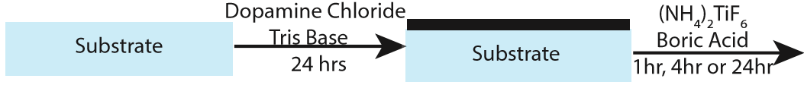
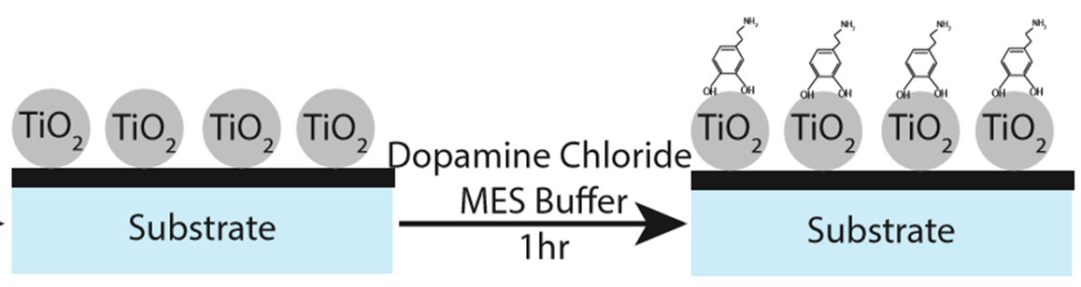
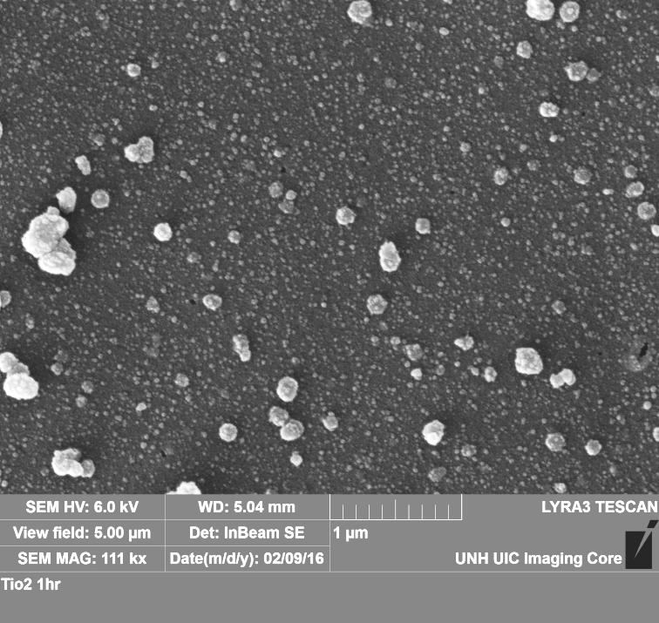
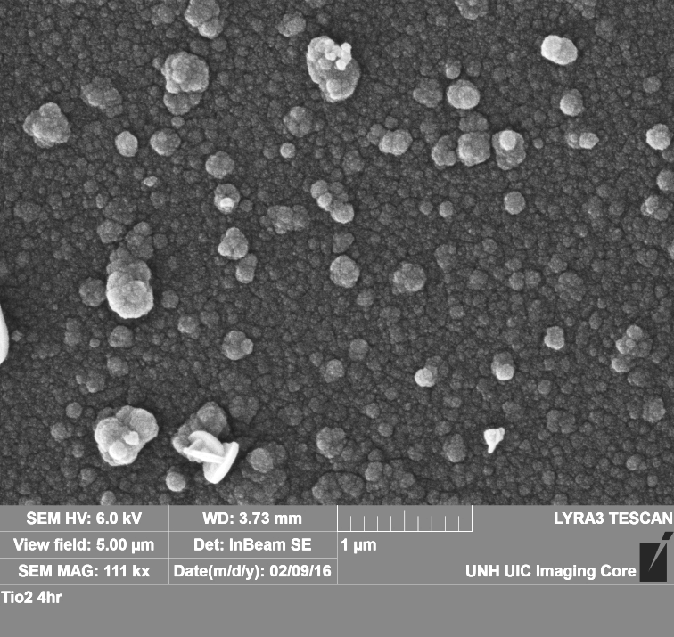
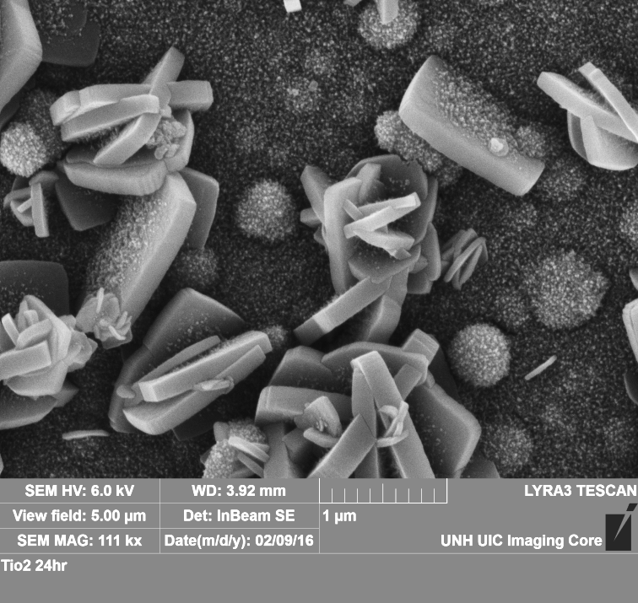
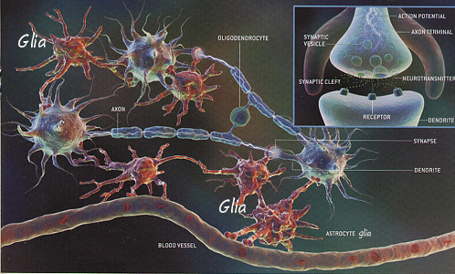
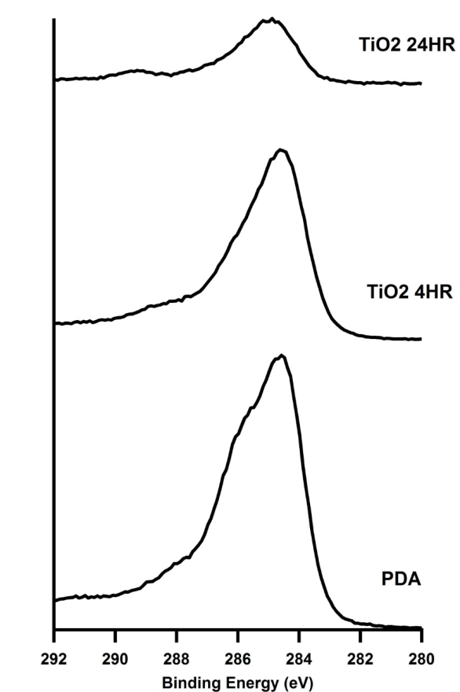
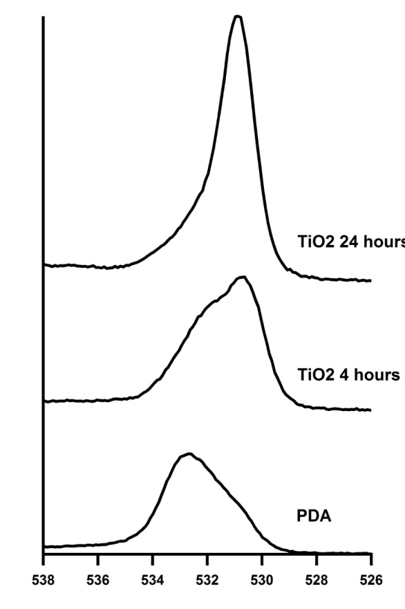
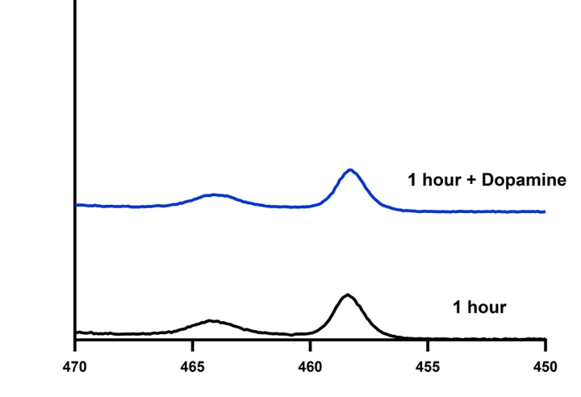
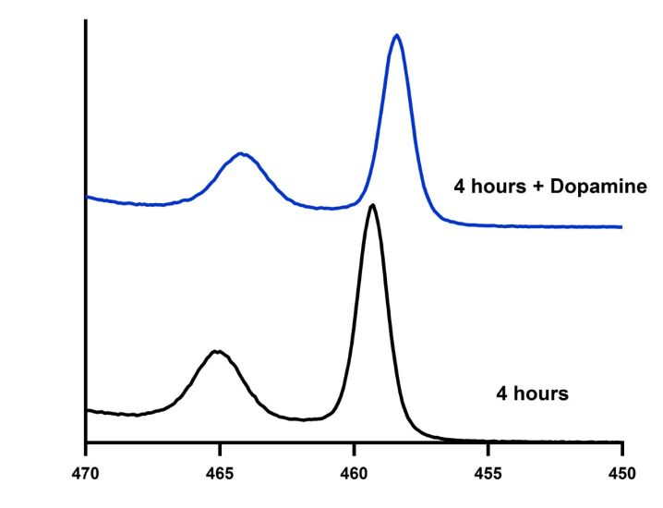
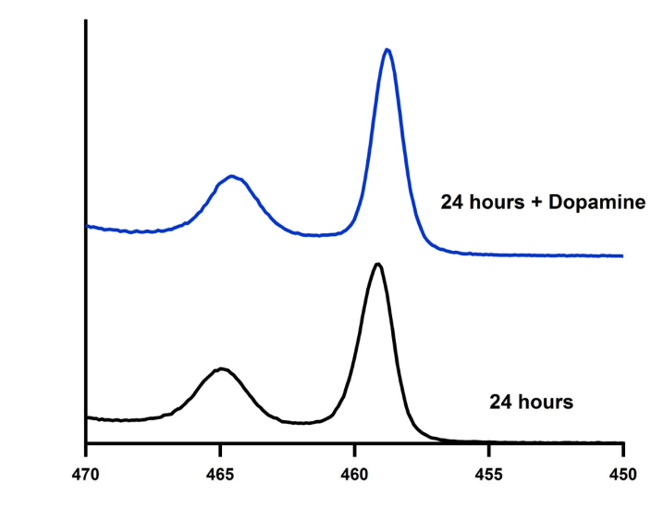
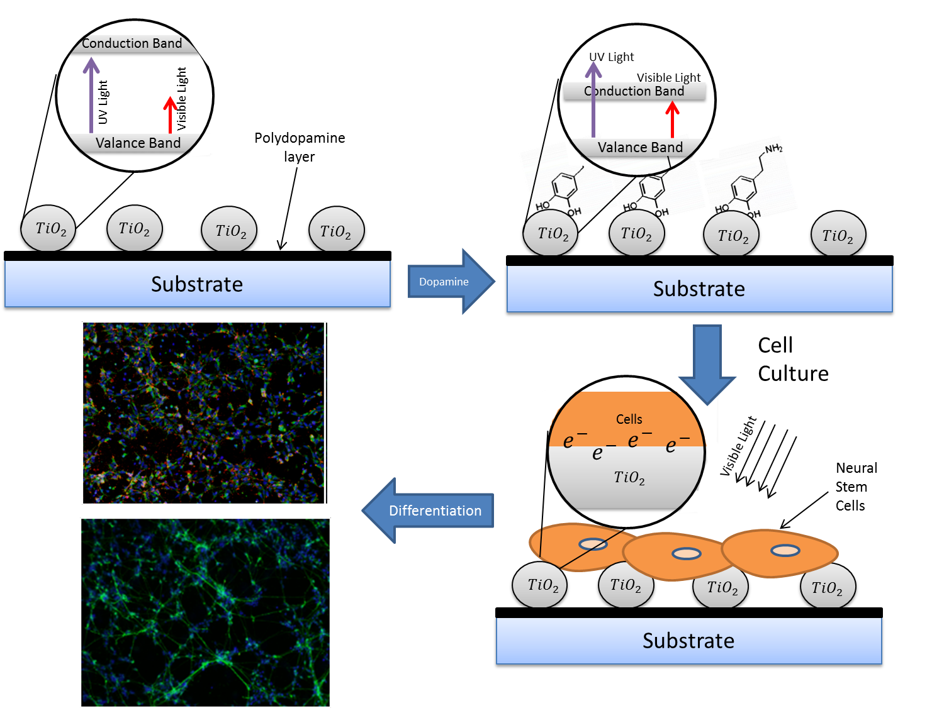
Light-Triggered Differentiation of Human Neural Stem Cells to Neurons
Alison Deyett , Salimah Hussien, and Kyung Jae Jeong
Department of Chemical Engineering, University of New Hampshire , Durham, NH, USA
Abstract
Methods
Reactive Oxygen Species (ROS)
Neural tissue engineering aims to regenerate irreversibly damaged neural systems (either peripheral or central nervous systems) by differentiation of neural stem cells into neurons on three dimensional scaffolds by providing various chemical and physical cues. One physical cue that has received much attention is electrical stimulation by an external electric potential on conducting substrates such as graphene. One potentially useful method of achieving electrical stimulation of neural stem cells is by free electron generation on the surface of titanium oxide (TiO₂) nanoparticles by light irradiation. However, the band gap of TiO₂ nanoparticles is in the UV range which can be harmful to cells and has many limitations in clinical applications. The goal of this research is to develop a novel method to achieve visible light-triggered differentiation of human neural stem cells (hNSCs) into neurons. We have discovered that TiO₂ grown on polydopamine (PDA) coated substrates exhibits an absorption peak in the visible light range. The surface chemistry was confirmed by various surface characterization methods including XPS, SEM and FT-IR. Using this substrate, we investigated the effect of laminin on hNSC adhesion, surface free electron generation on TiO₂ by visible light irradiation, and preferential differentiation of hNSCs into neurons. The results from this research open up a new possibility for implantable neural tissue engineering scaffolds that can be activated by light irradiation.
ROS was measured to determine the amount of free electrons on the surface of the TiO₂ nanoparticles
The dopamine coating showed to generate higher amounts of ROS than others samples.
Relative Reactive Oxygen Species
Glass
24 hr-TiO₂
24-hr TiO₂+Dopamine
Cell Attachment
Surface Characterization
Scanning Electron Microscopy (SEM)
TiO₂ Deposition - 1hr
TiO₂ Deposition - 4hr
TiO₂ Deposition - 24hr
As the reaction time increased the particle density of TiO₂ also increased.
Crystalline structures begin to form after 24 hours
The 24 hr-TiO₂ hr compared to the 1 hr-TiO₂ appeared to enhance cell adhesion
The addition of dopamine to the samples also enhanced cell adhesion to the surface
Background
X-ray Photoelectron Spectroscopy (XPS)
Carbon
Oxygen
As TiO₂ is deposited on the surface, carbon peak begins to lose some of its characteristic peaks. This is caused by the titanium using the C-O as a binding site.
The oxygen peak changes significantly as the surface is coated with titanium. The bottom peak is representative of what the oxygen peak looks like for polydopamine, while the 24 hour sample peak matches the peak for TiO₂
Important for the future treatments many neurological conditions: stroke, spinal cord injury, ALS, Alzheimer’s disease, etc
Summary
TiO₂ nanoparticles can be grown on polydopamine coated surfaces using (NH₄)₂ TiF₆
Adding dopamine to the TiO₂ nanoparticles adjusts the absorbance peak on the TiO₂ and generates free electrons on the surface under light irradiation
The addition of more nanoparticles and dopamine enhances cell adhesion to the surface and promotes cellular elongation
Neural stem cells can be differentiated into two distinct lineages: neurons, or glial cells
Inducing an electric field on the cells can cause them to differentiate toward neurons [1].
Future work
Unfortunately inducing electrical field can be cytotoxic [1]
A current method relies on the generation of free electrons on the surface of titanium dioxide (TiO₂) by UV irradiation [2].
UV irradiation causes chromosomal damages to the cells and has short tissue penetration.
Visible light is not harmful to cells and can penetrate tissue for implantable devices
Titanium
Further ROS measurement tests to determine the necessary length of irradiation to generate free electrons
Long term cell study with light irradiation to and determine percentage of cells that differentiate into neurons over glia cells
Long term study with mesenchymal stem cells to determine if these cells can be turned into neurons using this technique.
Objective
The titanium peak increases with reaction time indicating that more titanium oxide has been deposited on the surface
The peak also shifts to a lower binding energy in the addition of dopamine.
References
To generate surface that generates free electrons under visible light irradiation to induce differentiation of hNSC into neurons.
Heo C and Yoo J. "The control of neural cell-to-cell interactions through non-contact electrical field stimulation using graphene electrodes" Biomaterials (2011) 32, 19-27.
[2] Kobelt LJ, Wilkinson AE, McCormick AM, Willits RK and Leipzig ND. “Short duration electrical stimulation to enhance neurite outgrowth and maturation of adult neural stem progenitor cells”. Annals of Biomedical Engineering (2014) 42, 2164–76
Absorbance
Deposition of TiO₂ on polydopamine substrate results in a peak in the visible light range (420~430nm) that corresponds to ~2.8eV.
The addition of dopamine slightly increases the peak.
Acknowledgement
Benjamin Stewart , Department of Physical Chemistry
Gonghu Li, Department of Physical Chemistry
Shujie Hou, Department of Chemical Engineering
Nancy Cherim and John Wilderman, University Instrument Center
McNair Scholar Program

