Slide 1

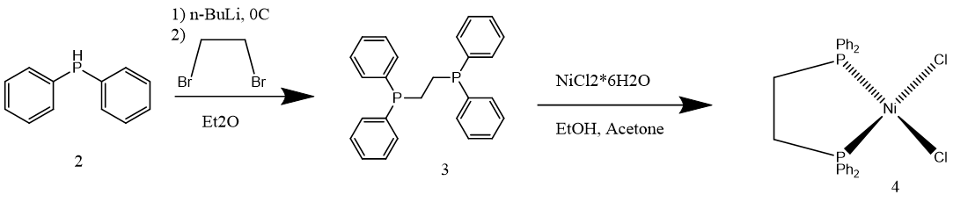
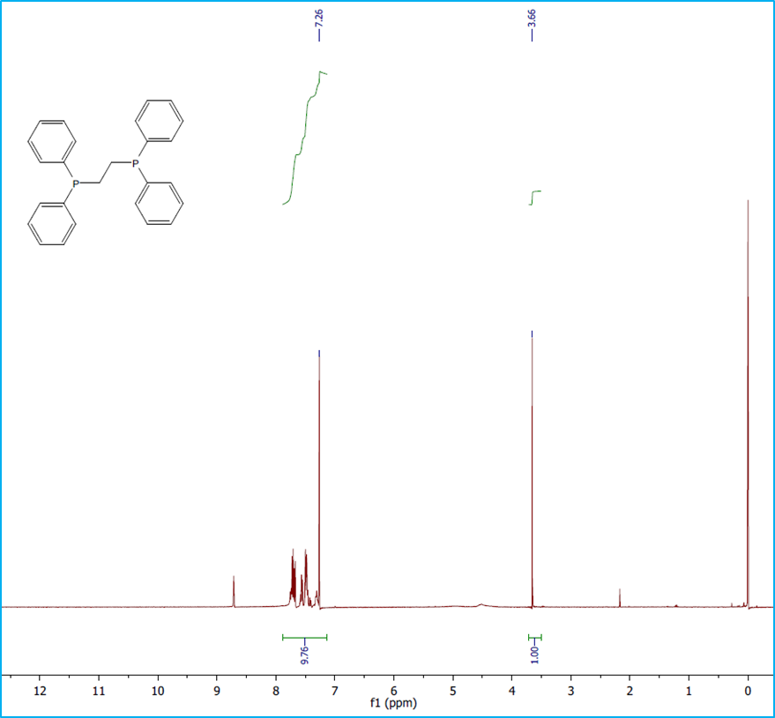
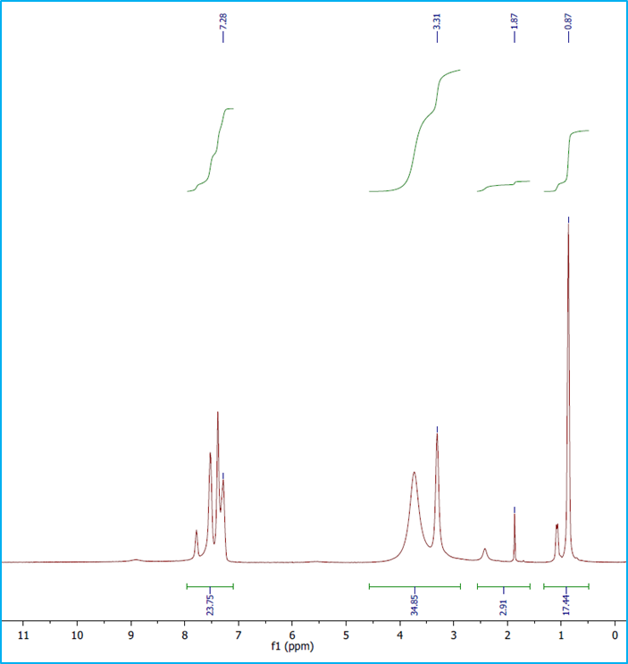
Systematic Synthesis of a Nickel-Bound Catalytic Precursor for Carboxylation with Olefins
Matthew Reuter, Roy Planalp, Luke Fulton, Mahmoud Abdalrahman mbr2003@wildcats.unh.edu, Department of Chemistry, University of New Hampshire, Durham, NH
12/09/16
INTRODUCTION
“One-pot” reactions are incredibly important to the synthesis of industrial acrylates – the ideal syntheses utilize carbon dioxide and ethylene in the inorganic binding process¹. However, elimination reactions with the β-Hydrogen do not readily go, and only similar reactions to produce acrylamides from nickel catalysts have been successful². However, several recent studies have illustrated several catalytic precursors that may drive the reaction in a kinetically and thermodynamically favored reaction.
RESULTS AND DISCUSSION
The deprotonation of diphenylphosphine with n-butyl lithium worked well to produce 1,2-bis(diphenylphosphino)ethane. The reaction with nickel (II) dichloride worked well to produce the catalytic precursor, however, the low yield of this reaction halted any forward reactions from taking place.
FUTURE WORK
With the successful synthesis of the nickel precursor, future work could be aimed at synthesizing higher yielding and higher purity products. Furthermore, the nickel precursor could be oxidized to yield a product that could participate in the one-pot binding reaction.
CONCLUSIONS
The synthesis successfully produced both the 3 and 4 products, however, further oxidative and nucleophilic additions are needed to produce a functional and effective catalyst.
~ 52%
~ 4%
Scheme 3. Completed Experimental Reactions
Scheme 1. Ideal synthesis of a catalytic precursor
ACKNOWLEDGEMENT
I would like to acknowledge the Planalp research group and the UNH Department of Chemistry for their support.
EXPERIMENTAL
The synthetic route when 1,2-bis(diphenylphosphino)ethane 3 was formed from diphenylphosphine 2 and 1,2-dibromoethane, catalyzed from n-butyllithium³. The catalytic precursor 4 was formed from Nickel(II) dichloride and the 3⁴. A further oxidation step could yield the catalyst that could partake in reactions, and the addition of an electron-donating group would help reactivity of that product. ¹H-NMR was used to analyze the presence and purity of the products.
Figure 1.
¹H NMR of 3
REFERENCES
Bru, M.; Gordillo, A.; Hoffmann, P.; Huguet, N.; Jevtovikj, I.; Khalimon, A.Y.; Lejkowski, M.L.; Limbach, M.; Lindner, R.; Rominger, F.; Schunk, S.A. Chem. Eur. J. 2014, 20, 16858 – 16862.
(2) Blumel, J.; Haubrich, S.; Merckle, C.; Tsiavaliaris, G. Synlett. 2001, 3, 391 – 393.
(3) Harry, D.; Marsman, J.W.; Noltes, J.G.; Thewissen, M.W.; Timmer, K. Inorganic Chimica Acta. 1985, 97, 143 – 150.
(4) Chow, K.K.; McAuliffe, C.A. Inorganic Chimica Acta. 1974, 10, 197 – 202.
Figure 2.
¹H NMR of 4
Scheme 2. Experimental synthesis of the catalytic precursor

