Slide 1

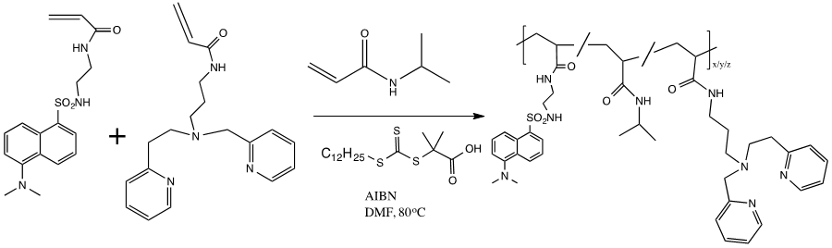
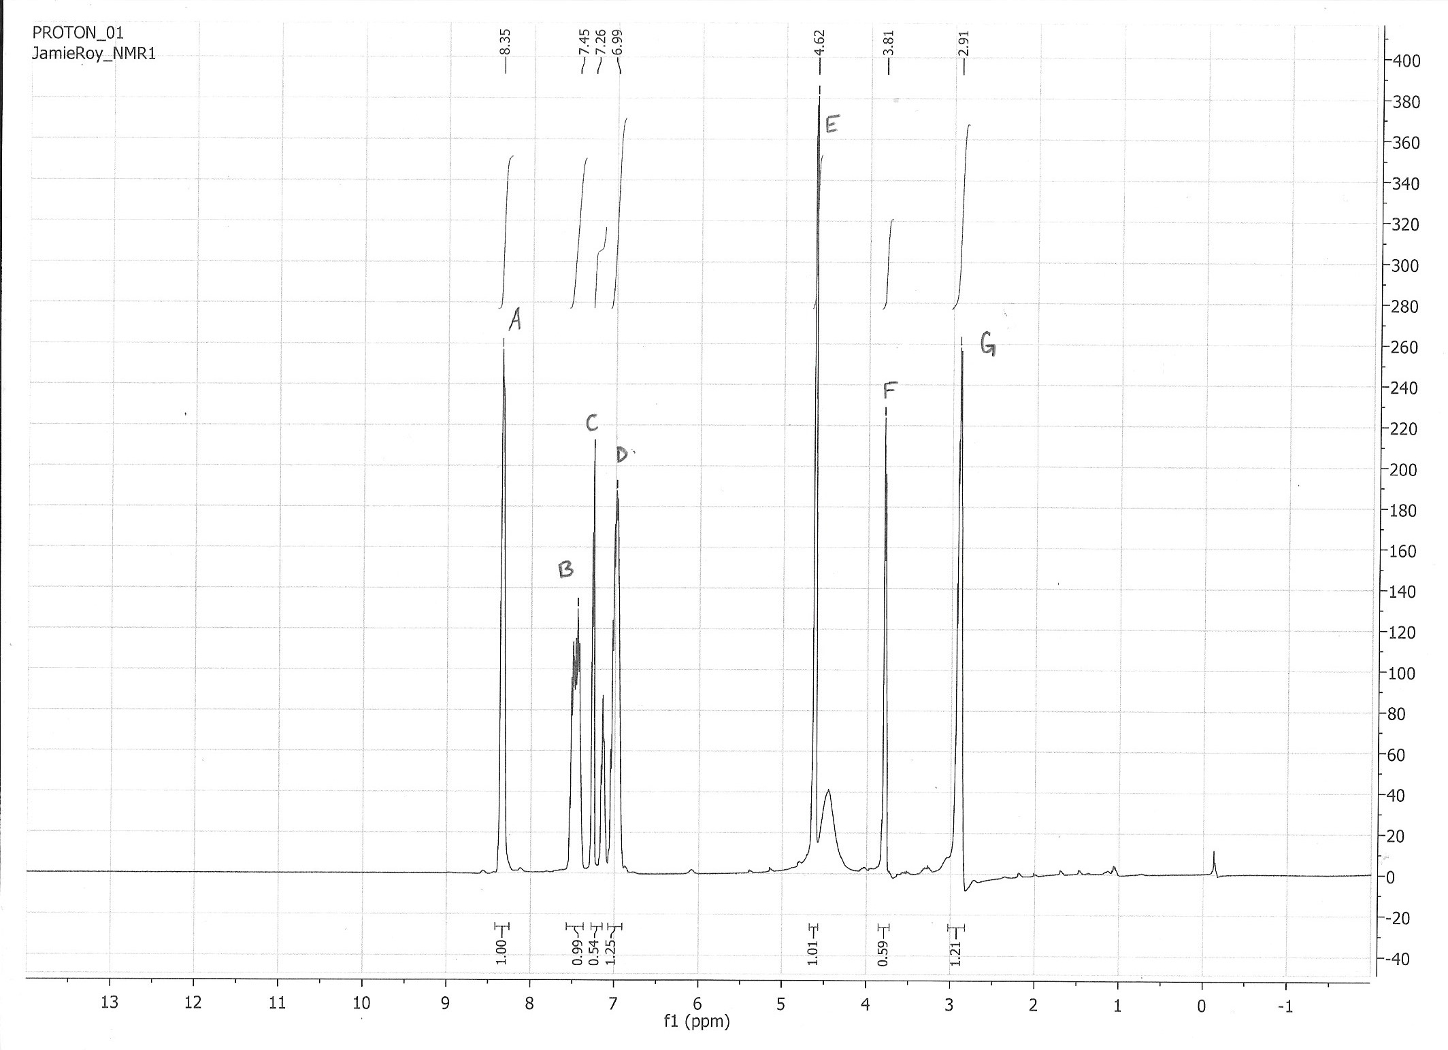
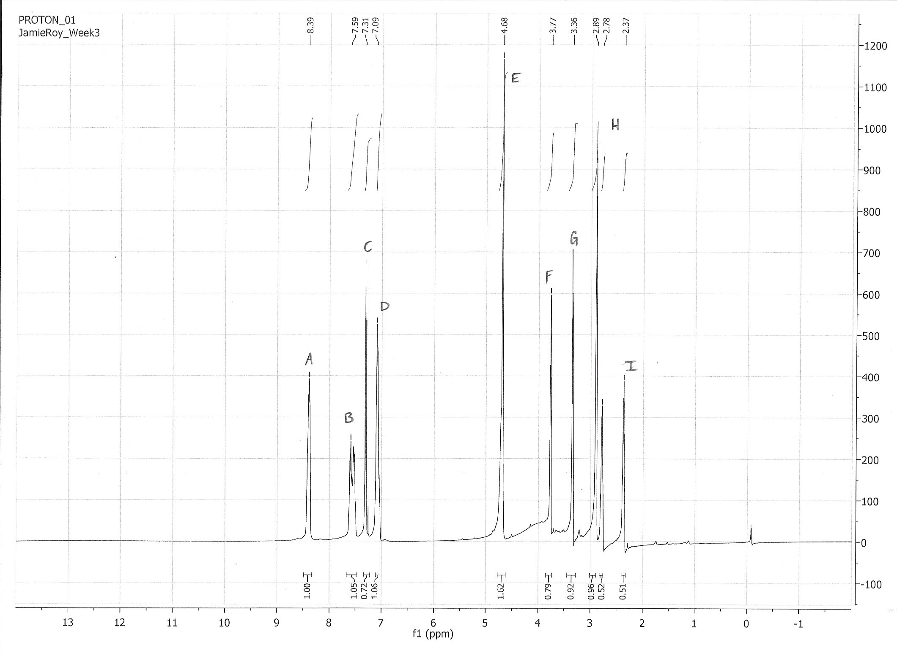
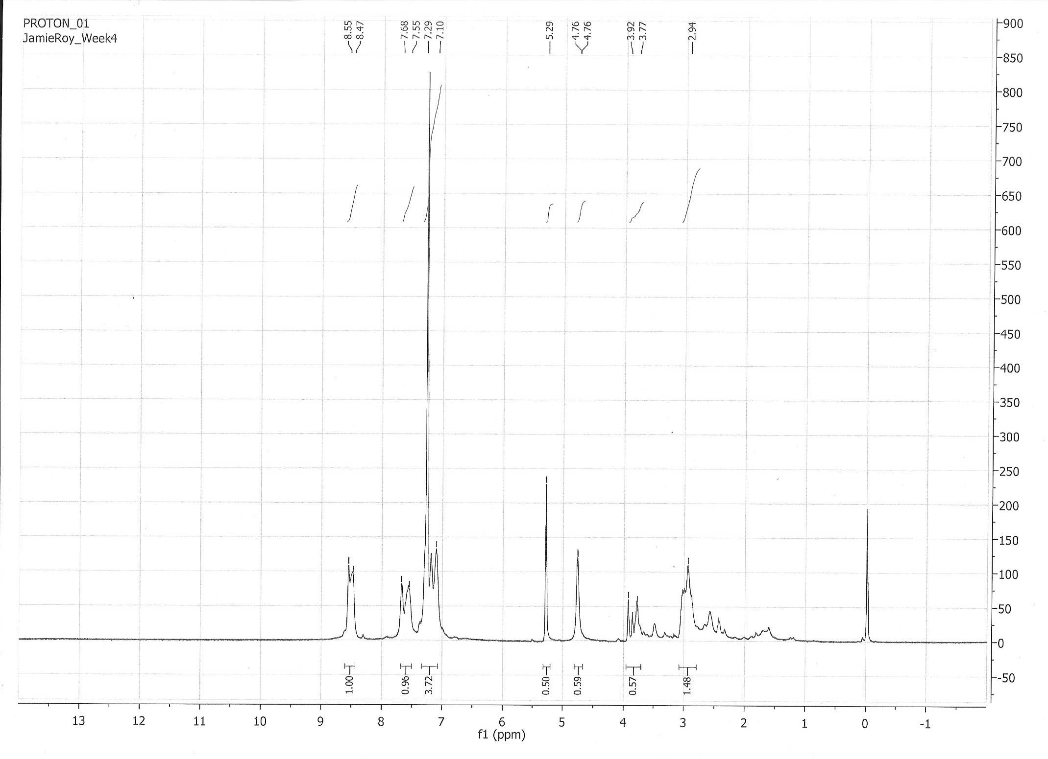
Partial synthesis of PEPMA-C3-acrylamide and PEPMA-C3-model ligand for use as high affinity Cu(II) ligands
Jamie Roy, Roy Planalp, Lea Nyiranshuti
jlr1001@wildcats.unh.edu, Department of Chemistry, University of New Hampshire, Durham, NH
11/21/16
Introduction:
Results and Discussion
Future Work:
Detection of accurate levels of copper in aquatic environments, placed there by poor waste disposal and mining, is a prevalent environmental issue.^{1,2} While copper is necessary for many natural biological processes in humans, it can be fatal for species in aquatic environments.¹ Most sensors used currently utilize “turn-off” sensors and can only detect total concentrations of copper, where it has been proven that free or weakly bound copper is the cause of metal toxicity. Ratiometric sensors, however, avoid issues of turn off and turn on sensors by not being effected by environmental conditions of indicator concentration.^{1,2,3,4} A ratiometric polymer ligand was therefore synthesized, along with PEPMA-C3-acrylamide (5) which was created to directly correlate with Cu(II) ability of Jahn-Teller distortion and to yield a higher formation constant compared to prior Cu(II) turn-on sensors.
The synthesis of 3 through reductive amination and Michael Addition worked well with NMR evidence proving formation of the product. The synthesis of 4, however, proved difficult with insufficient evidence towards it formation, either by impurities in the sample or a paramagnetic product in the NMR, possibly residual Raney-Ni. There was insufficient product formation outside of the NMR sample to continue the synthesis, and the products were not purified between each step.
Further work would
include the synthesis of
N- (3-((2-(pyridin-2-yl) ethyl)(pyridin-2-ylmethyl) amino propyl isobutyramide (5) through hydroamination in Et₃N and PEPMA-C3-model ligand (6) through amine alkylation (Scheme 3). A ratiometric polymer ligand can then by synthesized (Scheme 4).
Scheme 3: Continued synthesis towards (5) and (6).
Scheme 2: Completed Experimental Work Toward Synthesis
Scheme 4: Synthesis of ratiometric polymer ligand
Experimental Design:
Conclusion:
A multistep synthesis was performed starting with 2-(2-ethylamino) pyridine (1) to yield N-(2-pyridinyl ethyl) 2-pyridinemethanamine (PEPMA) (2) through reductive amination. The addition of acrylonitrile then proceeds through a Michael Addition to yield 3-((2-(pyridin-2-yl) ethyl)(pyridin-2-ylmethyl) amino) propane (3). This synthesis stops upon creation of (4) by way of Raney-Ni catalyst in methanol, activated by NaOH and NaBH₄.
The synthesis of 3 was completed, however the final product, 4, provided insufficient evidence towards its formation and requires further studies. To create more pure products, they should be purified between steps of the synthesis.
Figure 3: H NMR of Crude 2
Figure 4: H NMR of Crude 3
References:
1. Nyiranshuti, L.; Rheingold, A. L.; Seitz, W. R.; Planalp, R. P. Ratiometric fluorescent Cu(II) sensor based on Poly(N-isopropylacrylamide) thermal phase transition and high affinity Cu(II) ligand, PEPMA-C3-acrylamide. University of New Hampshire, Durham NH, University of California San Diego, La Jolla, CA, 2016.
2. Awual, M. R.; Ismael, M.; Yaita, T.; El-Safty, S.A.; Shiwaku, H.; Okamoto, Y.; Suzuki, S. Trace copper(II) ion detection and removal from water using novel ligand modified composite adsorbent. Chem. Eng. J. 2013, 222, 67-76.
3. Nolan, E.M.; Lippard, S.J. A “Turn-On” Fluorescent Sensor for the Selective Detection of Mercuric Ion in Aqueous Media. J. Am. Chem. Soc. 2003, 125, 14270-14271.
4. Royzen, M.; Dai, Z.; Canary, J.W. Ratiometric Displacement Approach to Cu(II) sensing by Fluorescence. J. Am. Chem. Soc. 2005, 127, 1612-1613.
Scheme 1. Synthetic route to N- (2-(pyridin-2-yl) ethyl)-N- (pyridin-2-ylmethyl) propane-1, 3-diamine
Figure 5: H NMR of Crude 4

