Slide 1
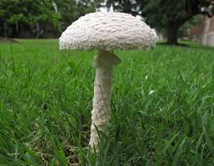
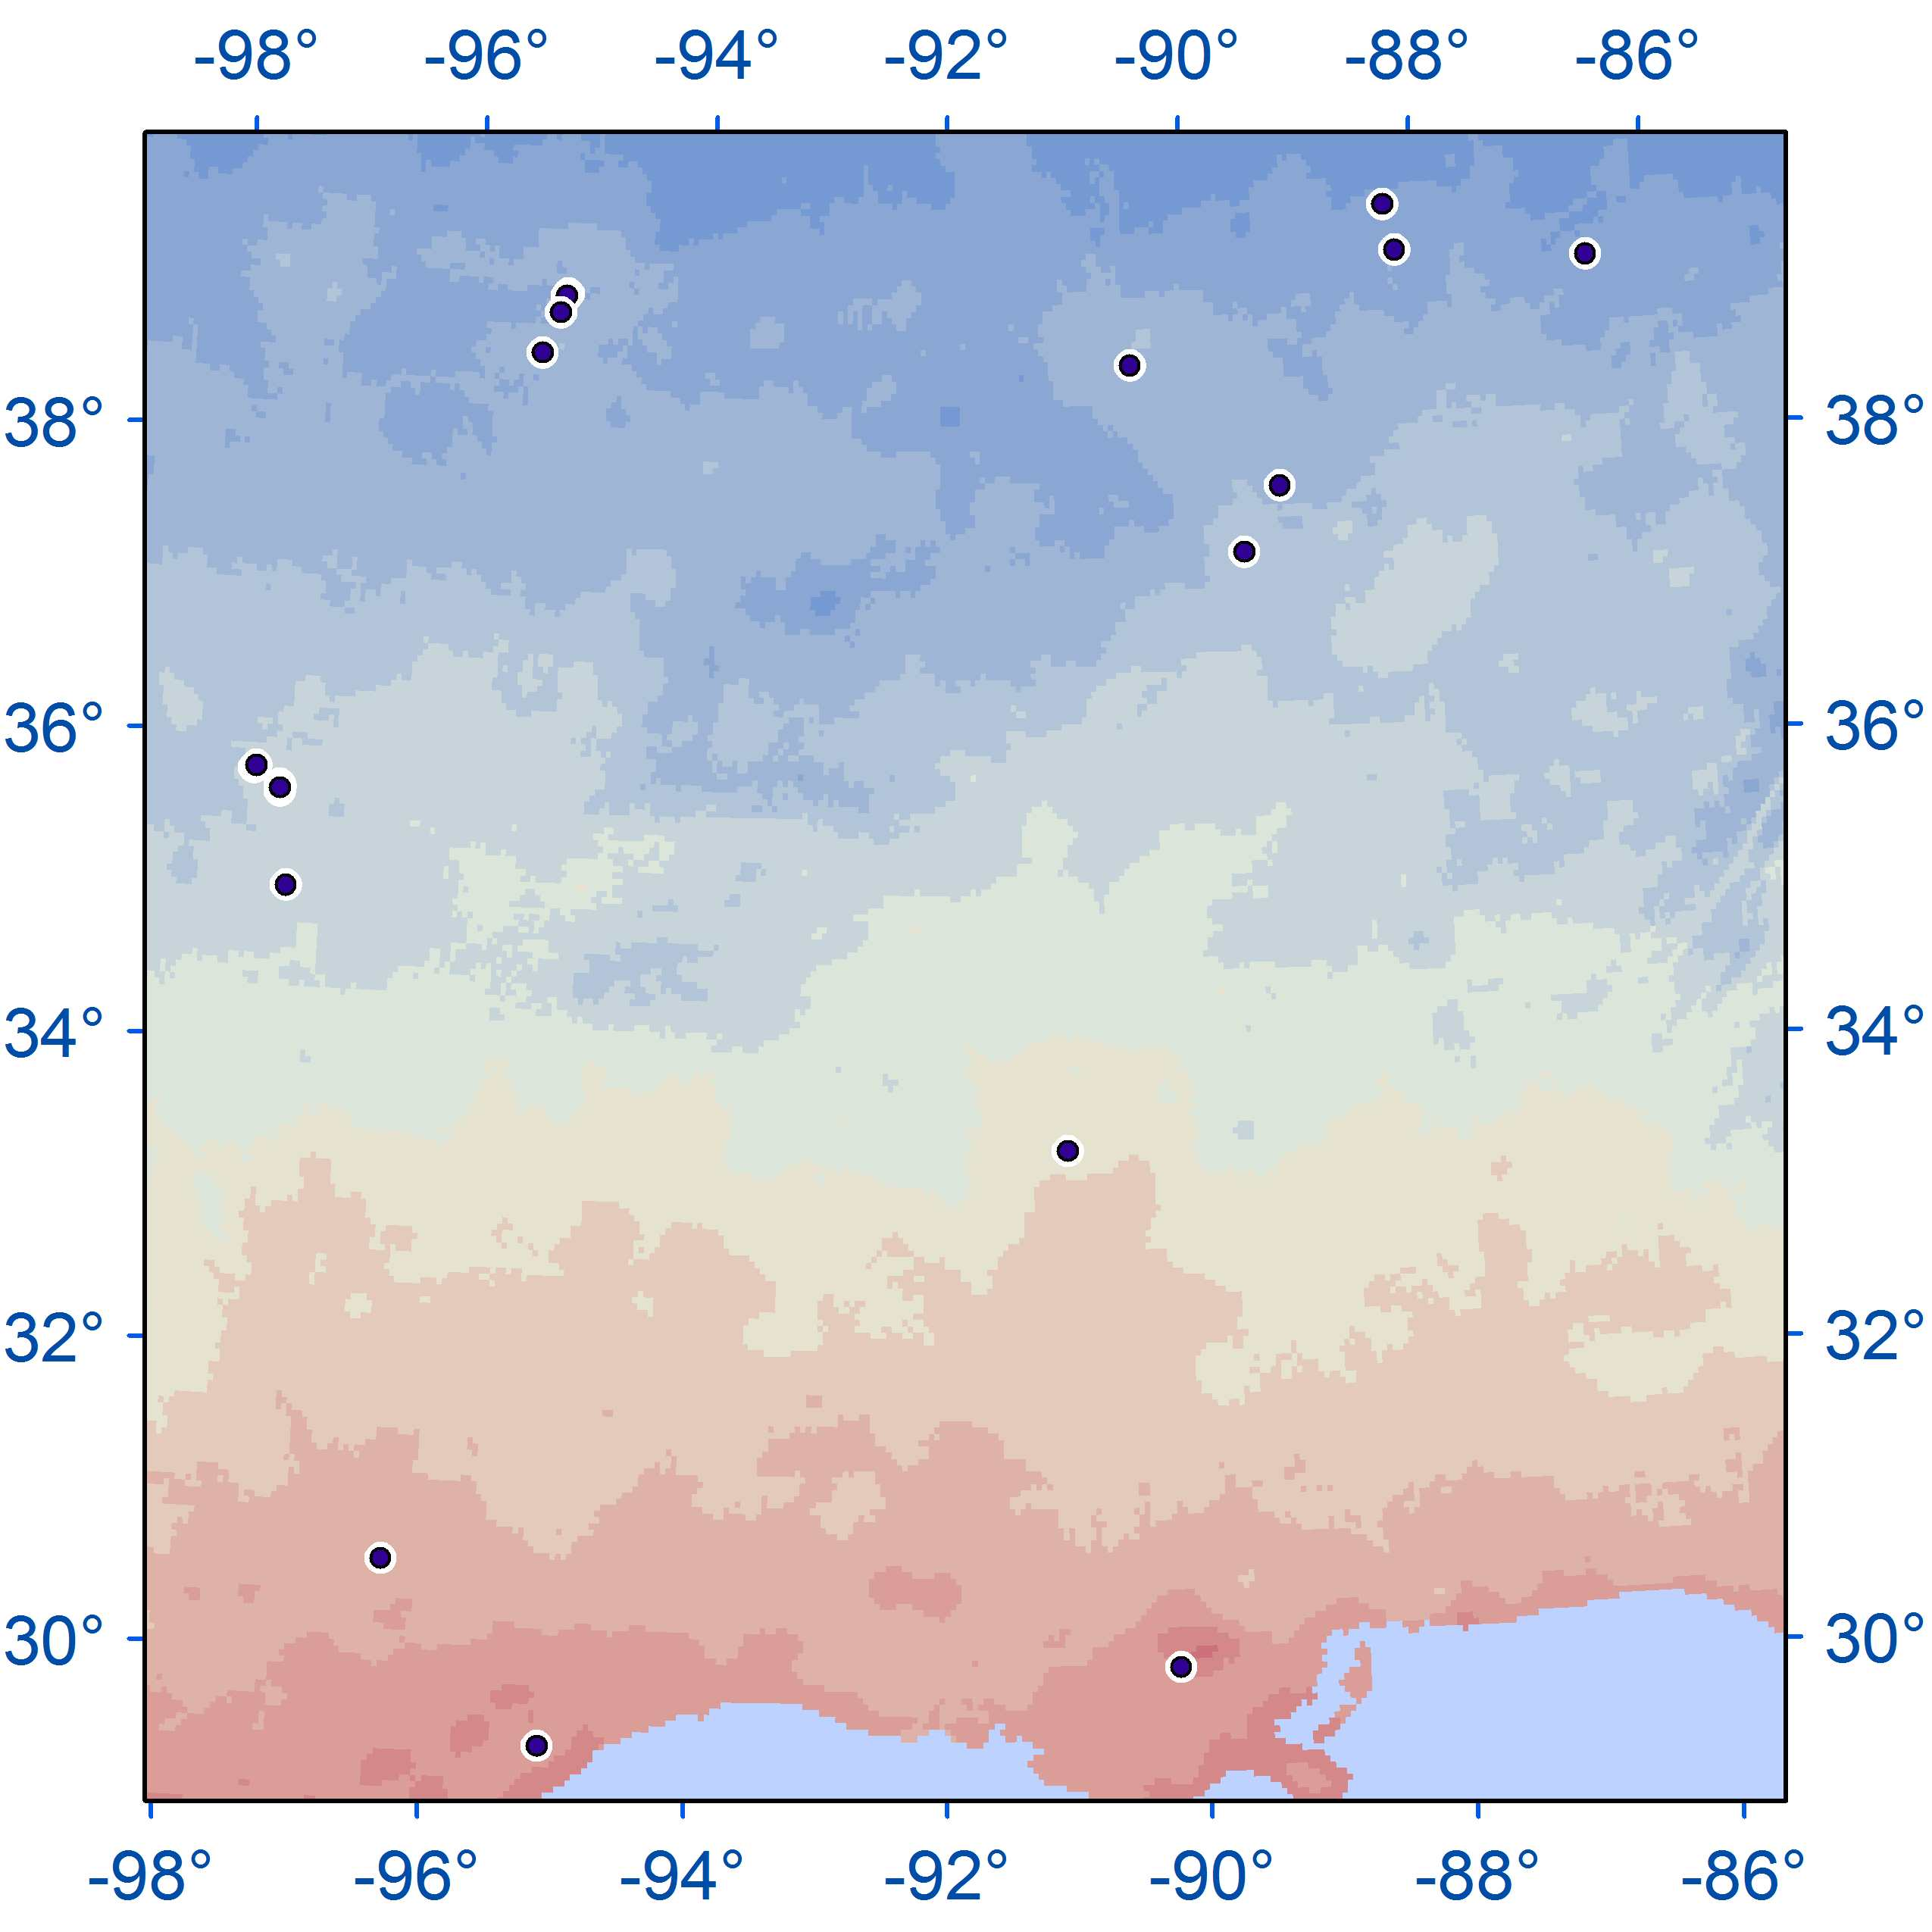
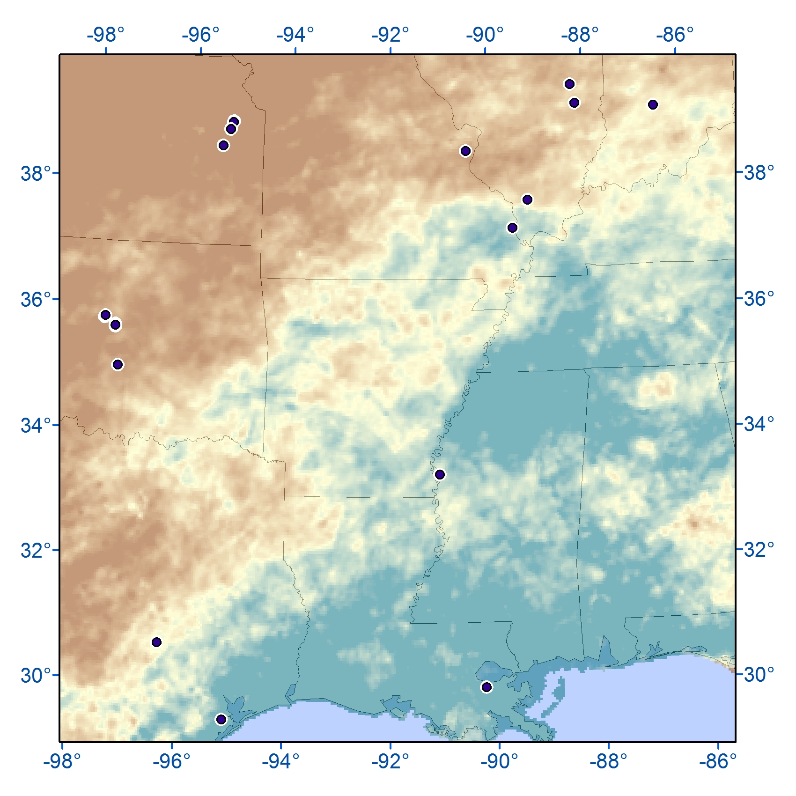
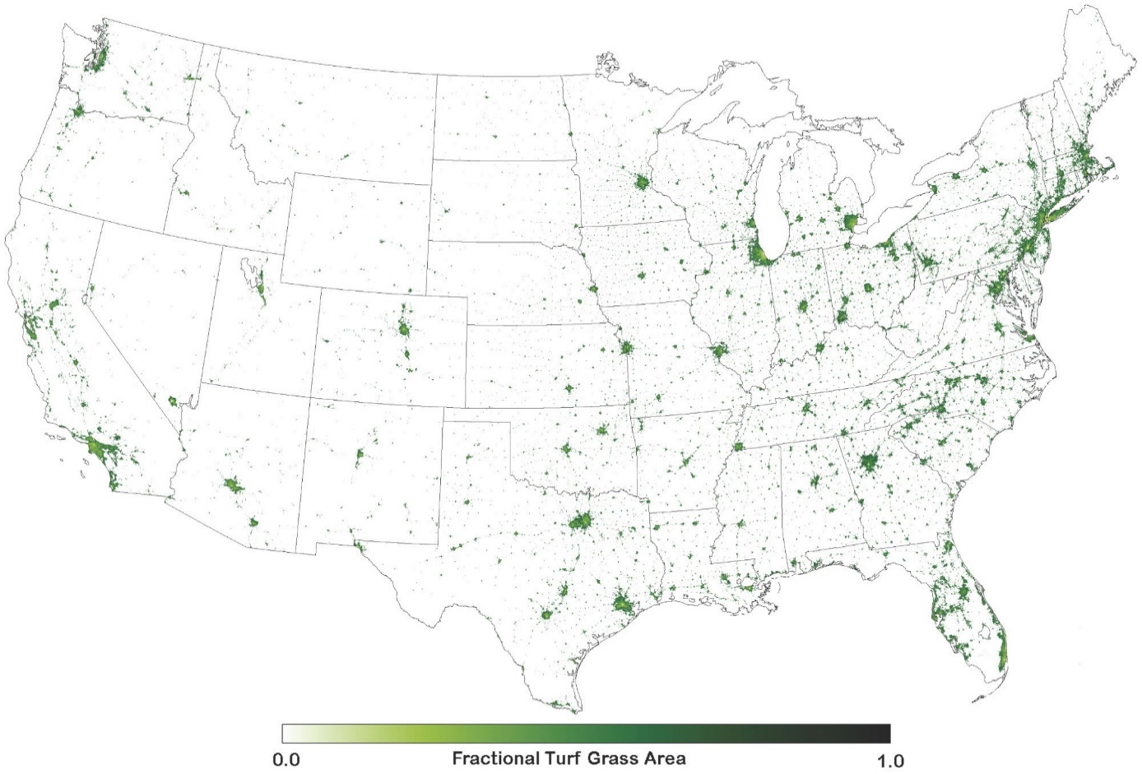
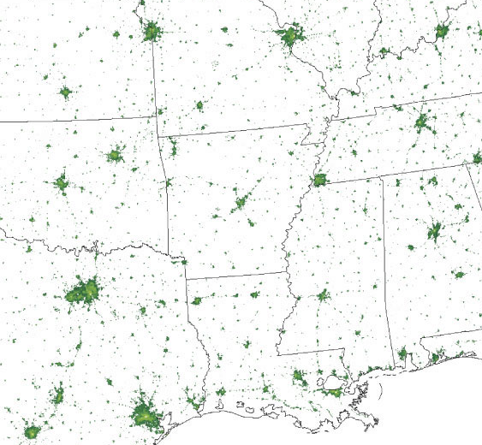


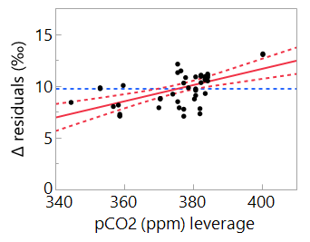
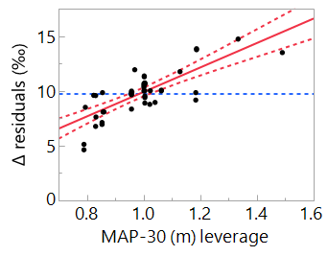
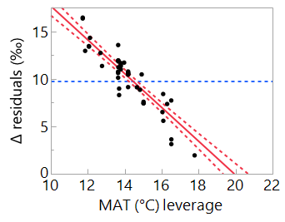
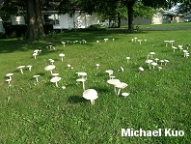
δ¹³C in the saprotrophic fungus Amanita thiersii reveal increased C₃ productivity of Midwestern lawns since 1982
Erik A. Hobbie¹, Brian A. Schubert², Joseph M. Craine³, Ernst Linder⁴, and Anne Pringle⁵
¹Earth Systems Research Center, UNH. ²School of Geosciences, U Louisiana at Lafayette. ³Jonah Ventures, Manhattan, KS, 66502.
⁴Dept. Mathematics & Statistics, UNH. ⁵Depts. Botany & Bacteriology, U Wisconsin, 430 Lincoln Drive, Madison, WI, 53706.
Introduction: How climate and rising carbon dioxide concentrations (pCO₂) have influenced competition between C₃ and C₄ plants over the last 50 years is a critical uncertainty.
∙ We used carbon isotope (δ¹³C) values of the saprotrophic lawn fungus Amanita thiersii to integrate the signal of C₃ and C₄ carbon in samples collected between 1982 and 2009 from the Midwest (Fig. 1).
∙ We calculated ¹³C fractionation (Δ) to assess the balance between C₃ and C₄ photosynthesis as influenced by mean annual temperature (MAT, Fig. 2), mean annual precipitation over a 30-year period (MAP-30, Fig. 3), and pCO₂.
Fig. 1. Lawns are the largest ‘crop’ in the US.
MAT
MAP (mm)
Fig. 2. MAT(°C) at sites.
Fig. 3. MAP (mm) at sites.
Results: Sporocarp Δ correlated negatively with MAT and positively with MAP and pCO₂. (Table 1 and Figure 4).
∙ 20% of Δ-pCO₂ correlation stems from reduced photorespiration with rising pCO₂.
∙ 80% stems from increased assimilation of C₃-derived carbon by Amanita thiersii; C₃ grasses increase production with rising pCO₂.
Discussion: Correlations with MAT and MAP reflected the relative productivity of C₃ and C₄ grasses in lawns under differing climates.
∙ Amanita thiersii δ¹³C may integrate the physiological responses of turf grasses to rising CO₂ concentrations.
∙ The 47 ppm rise in pCO₂ 1982-2009 increased the contribution of C₃ photosynthesis to Amanita thiersii C by 18.5%.
Table 1. Regression model of Δ in Amanita thiersii. Adjusted r² = 0.970, n = 48, p < 0.0001.
Term %Variance Estimate±se p
Intercept -- -1.39±10.33 0.8939
MAT (°C) 79.3 -1.74±0.15 <0.0001
MAP-30 (m) 15.4 9.52±2.28 0.001
pCO₂ 5.2 0.072±0.025 0.0071
Conclusions
Carbon isotopes in a lawn fungus integrated C₃ and C₄ productivity in lawns between 1982 and 2009.
Higher temperatures favored C₄ productivity and higher precipitation favored C₃ productivity.
The relative productivity of C₃ grasses increased 18.5%; this was most likely caused by rising pCO₂.
Figure 4. Leverage plots of MAT, MAP-30, and pCO₂ vs. Δ.
Acknowledgements
We thank Hope Jahren, Fernando Lattanzi, Lixin Wang, and two anonymous reviewers for comments on earlier drafts, thank Michael Routhier for assistance with graphics, and thank Ben Wolfe for access to original data. This project was supported by grant DEB1146328 from the U.S. National Science Foundation and a grant from the U.S. Department of Agriculture.
Photo credit: Kuo, M. (2016, August). Amanita thiersii. Retrieved from the MushroomExpert.Com

Slide 2
Abstract: How climate and rising carbon dioxide concentrations (pCO₂) have influenced competition between C₃ and C₄ plants over the last 50 years is a critical uncertainty in climate change research. Here, we used carbon isotope (δ¹³C) values of the saprotrophic lawn fungus Amanita thiersii to integrate the signal of C₃ and C₄ carbon in samples collected between 1982 and 2009 from the Midwestern USA. We then calculated ¹³C fractionation (Δ) to assess the balance between C₃ and C₄ photosynthesis as influenced by mean annual temperature (MAT), mean annual precipitation over a 30-year period (MAP-30), and pCO₂. Sporocarp Δ correlated negatively with MAT (-1.74‰ °C⁻¹, 79% of variance) and positively with MAP (9.52‰ m⁻¹, 15% of variance), reflecting the relative productivity of C₃ and C₄ grasses in lawns. In addition, Δ values correlated positively with pCO₂ (0.072‰ ppm⁻¹, 5% of variance). Reduced photorespiration with rising pCO2 accounted for 20% of this increased Δ, but the remaining 80% is consistent with increased assimilation of C₃-derived carbon by Amanita thiersii resulting from increased productivity of C₃ grasses with rising pCO₂. The 47 ppm rise in pCO₂ between 1982 and 2009 increased the relative contribution of C₃ photosynthesis to Amanita thiersii carbon by 18.5%. The δ¹³C value of Amanita thiersii may integrate both lawn maintenance practices and the physiological responses of turf grasses to rising CO₂ concentrations.

