Slide 1


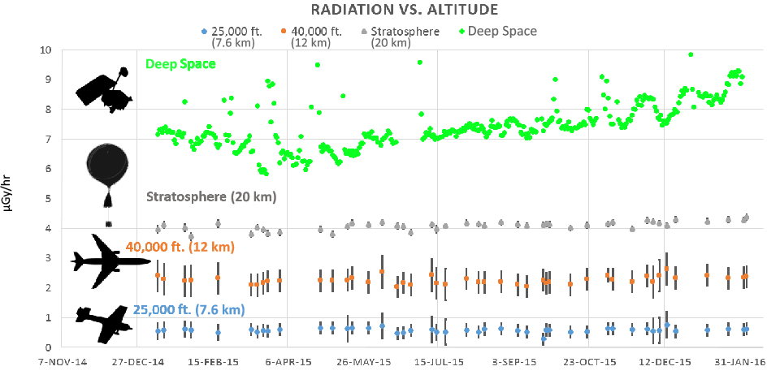
Atmospheric radiation modeling of galactic cosmic rays using LRO/CRaTER and the EMMREM model with comparisons to balloon and airline based measurements^{[1]}
C. J. Joyce,¹ N. A. Schwadron,¹ L. W. Townsend,² W. C. deWet,² J. K. Wilson,¹ H. E. Spence,¹ W. K. Tobiska,³ K. Shelton-Mur,⁴ A. Yarborough,⁵ J. Harvey,⁵ A. Herbst,⁵ A. Koske-Phillips,⁵ F. Molina,⁵ S. Omondi,⁵ C. Reid,⁵ D. Reid,⁵ J. Shultz,⁵ B. Stephenson,⁵ M. McDevitt,⁵ and T. Phillips.⁶ ¹University of New Hampshire, ²University of Tennessee, ³Space Environment Technologies, ⁴Federal Aviation Administration, ⁵Earth to Sky Calculus, ⁶Spaceweather.com.
Email: cjl46@wildcats.unh.edu
Questions:
How hazardous is galactic cosmic ray (GCR) radiation to airline passengers?
How accurately can we model GCR radiation at airline altitudes using a simple model based on dose lookup tables?
The Model:
GCR dose rates measured by LRO/CRaTER are used as input to compute the modulation potential (MP, average energy lost by GCRs in transit through heliosphere) as shown in Fig. 1.
The MP is used as input to the Badhwar-O’Neil model ^{[2]}, which computes incident GCR spectra.
The spectra are then modified using the Nymmik geomagnetic cutoff model^{[3]}, accounting for the effect of the magnetosphere.
Atmospheric dose rates are then computed using EMMREM-generated lookup tables (Fig. 2).
Figure 5: Balloon based radiation measurements for 25 launches from Bishop, CA.
Figure 6: Model vs. measurements for 2 simultaneous balloon launches in CA and NH.
Figure 1: CRaTER GCR dose rate, computed modulation potential, and sunspot number during LRO mission.
Balloon Comparison:
New measurements made on high-altitude balloons as part of the Earth to Sky Calculus program^{[7]} offer an additional means of comparison (Fig. 5).
Fig. 6 shows GCR dose rates modelled and measured for two simultaneous launches in 2015 from CA and NH.
Because the balloon instruments measure secondary gamma and X-rays, while model uses primary GCRs and secondary particles , the comparison demonstrates which species dominate the dose as a function of altitude.
Figure 2: Modelled GCR dose rates at Bishop, California
(lat: 37.5º, long: -118.9º) for altitudes 11-36 km.
Figure 4: Variations in the measured dose rates are mainly due to differences in magnetic cutoff rigidity.
Conclusion:
Radiation hazards to airline passengers appear to be minimal, though risk enhancing factors such as transpolar flights, SEP events and NASA’s plans for future supersonic flights require further study.
Despite its simplicity, the model is able to accurately model GCR radiation at airline altitudes.
We plan to make the model available to the community on the PREDICCS website and the Community Coordinated Modeling Center.
What is the radiation risk for airline travel?
The average flight time is 7.3 hours, with an average equivalent dose of 3.99 µSv/flight.
Thus, 25 flights are equivalent to one chest X-ray^{[5]} and it takes ~1830 flight hours or ~250 flights to exceed the ICRP yearly public radiation limit^{[6]}.
Airline Comparison:
We compare dose rates computed at 11 km to dosimeter measurements made during 117 aircraft flights as a part of the ARMAS project (Figs. 3,4).
We find the model overestimates the aircraft dose rates by 20% on average (and 7% on average for flights 41-117), falling within the ICRU error limit of 30%^{[4]}.
References:
[1]Joyce, C. J., et al. (2016), Space Weather Journal, 14, 659–667.
[2] O’Neil, P. M. (2006), Advanced Space Research, 37, 1727.
[3] Nymmik, R. A., et al. (2009), Cosmic Research,47,3,191-197.
[4] ICRU, (2010), Journal of the ICRU, Vol. 10, #2, Report 84.
[5] Mettler, F. A., et al. (2008), Radiology, 248, 25463.
[6] ICRP, (2007), ICRP Publication 103, Ann. ICRP 37 (2-4).
[7] Phillips, T., et al. (2016), Space Weather Journal, 14, 697–703.
Figure 3: Model vs. ARMAS dose rates for 117 aircraft flights from 2013-2016.

