Slide 1



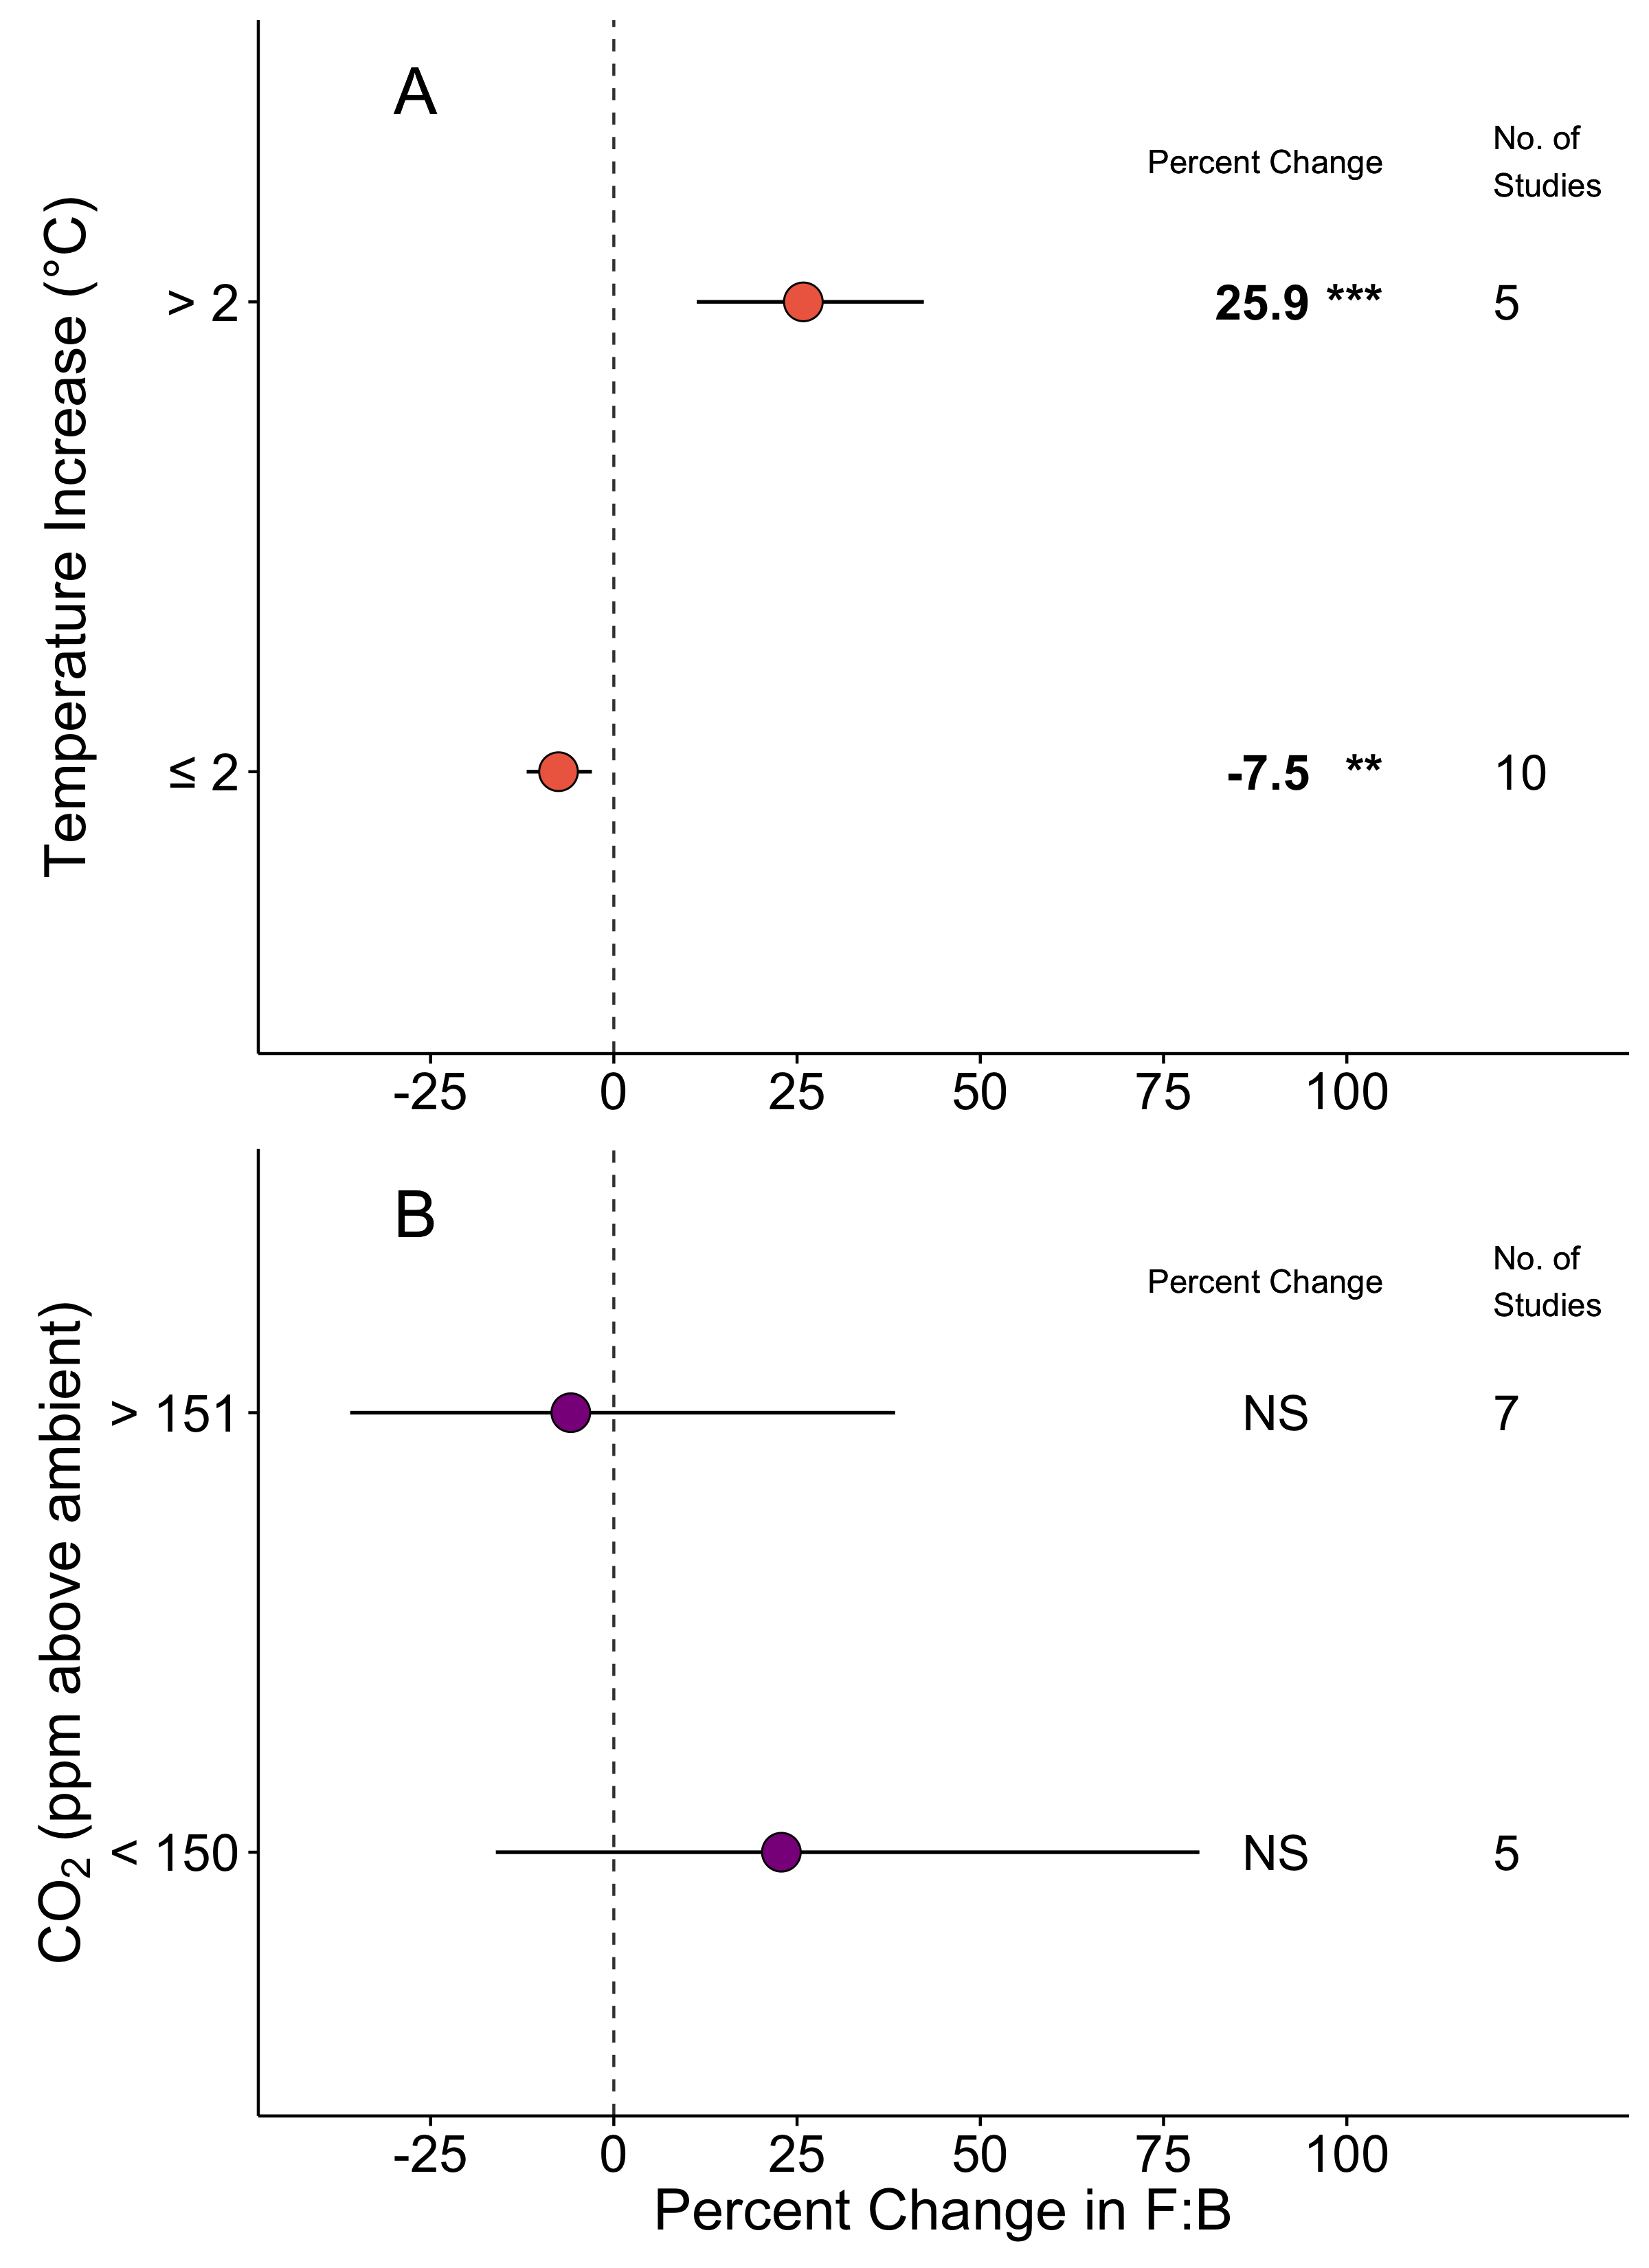
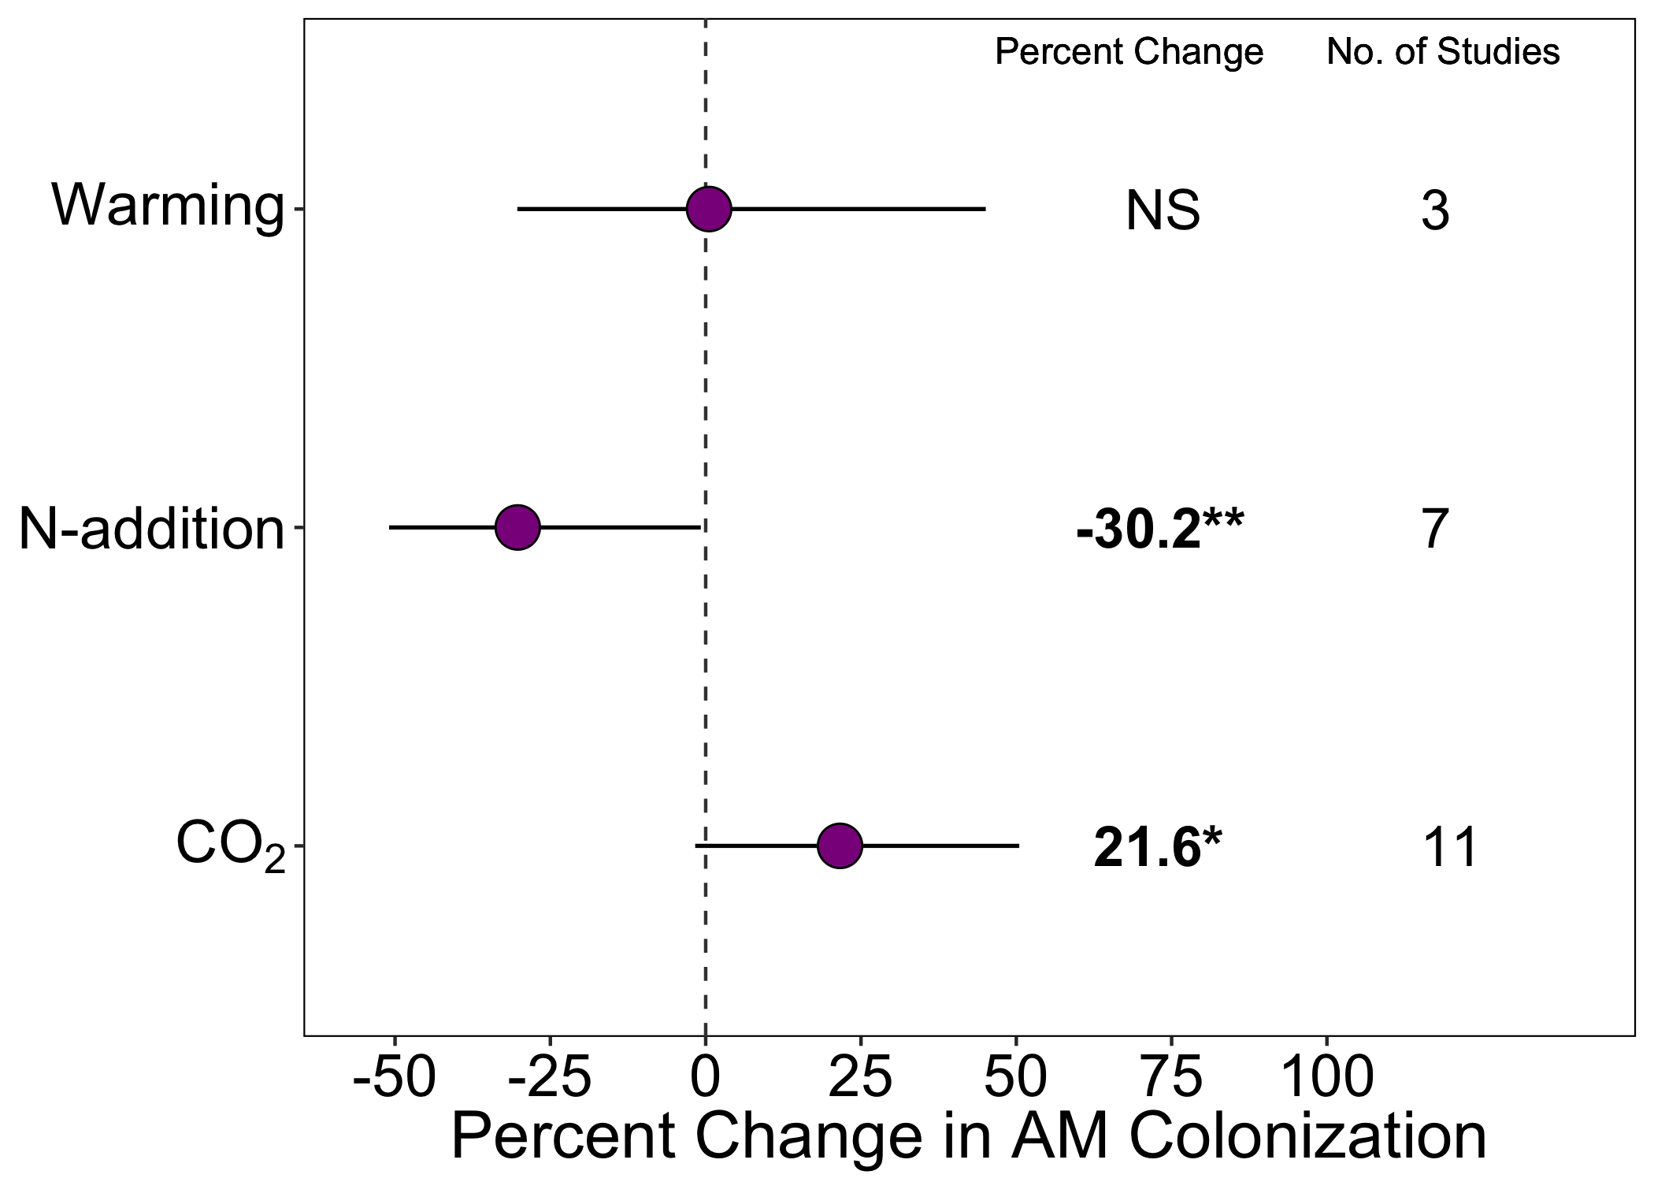
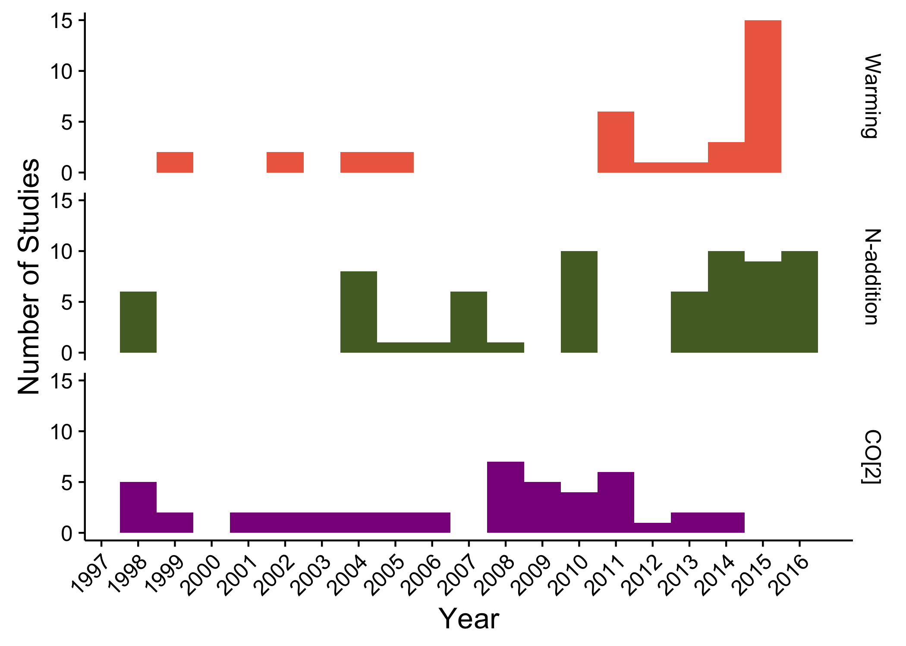
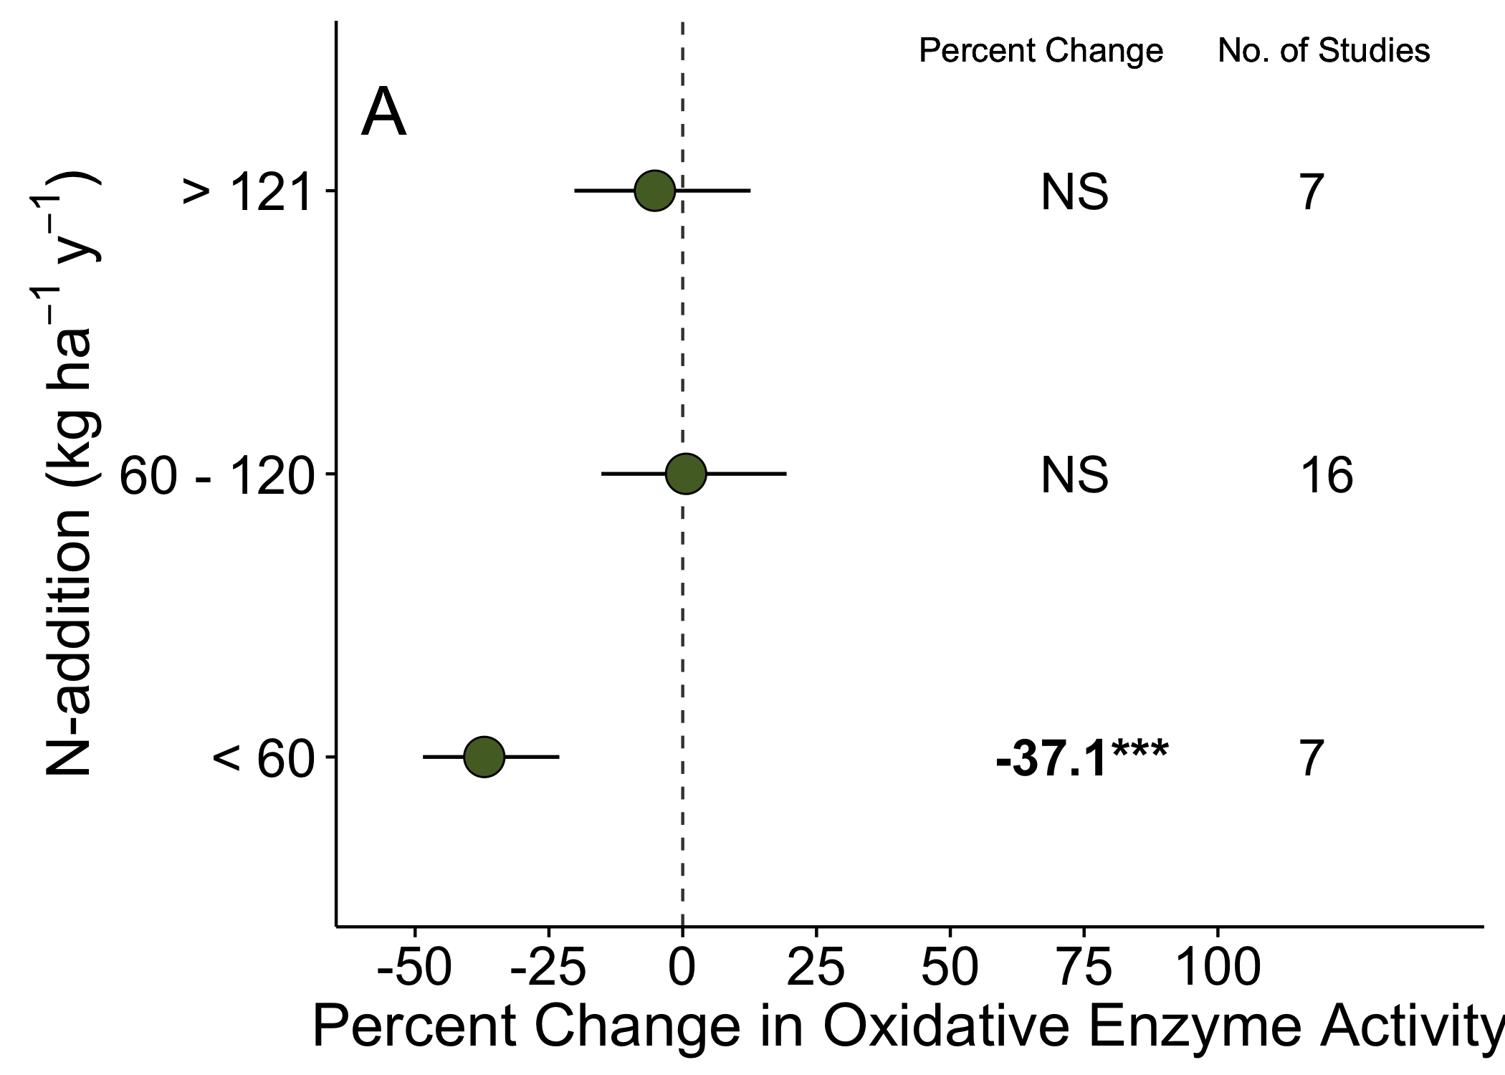
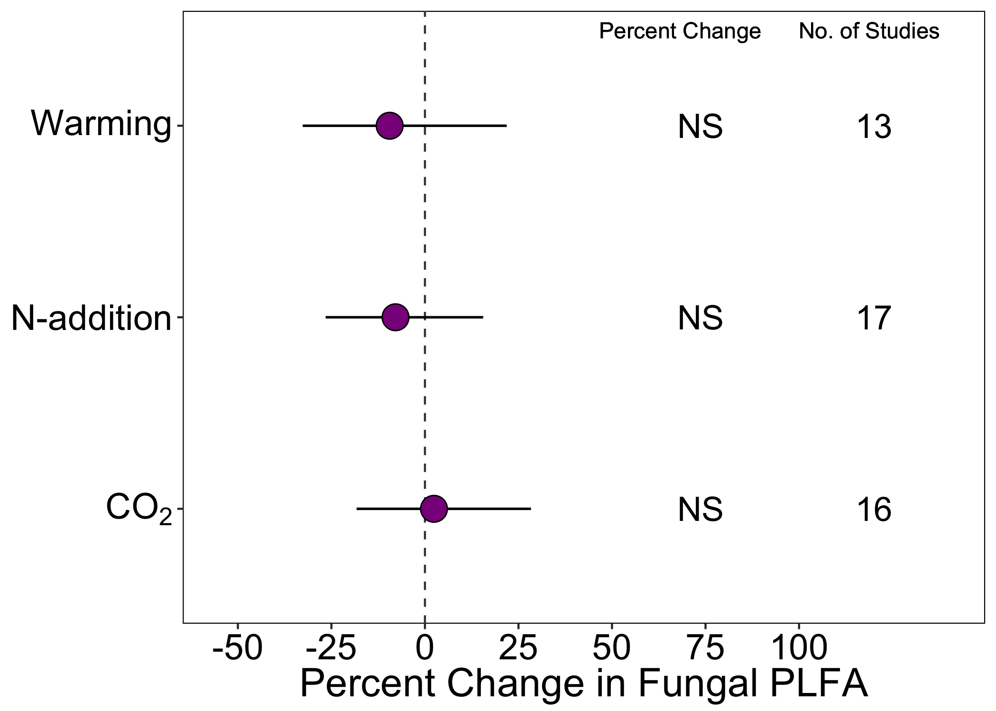
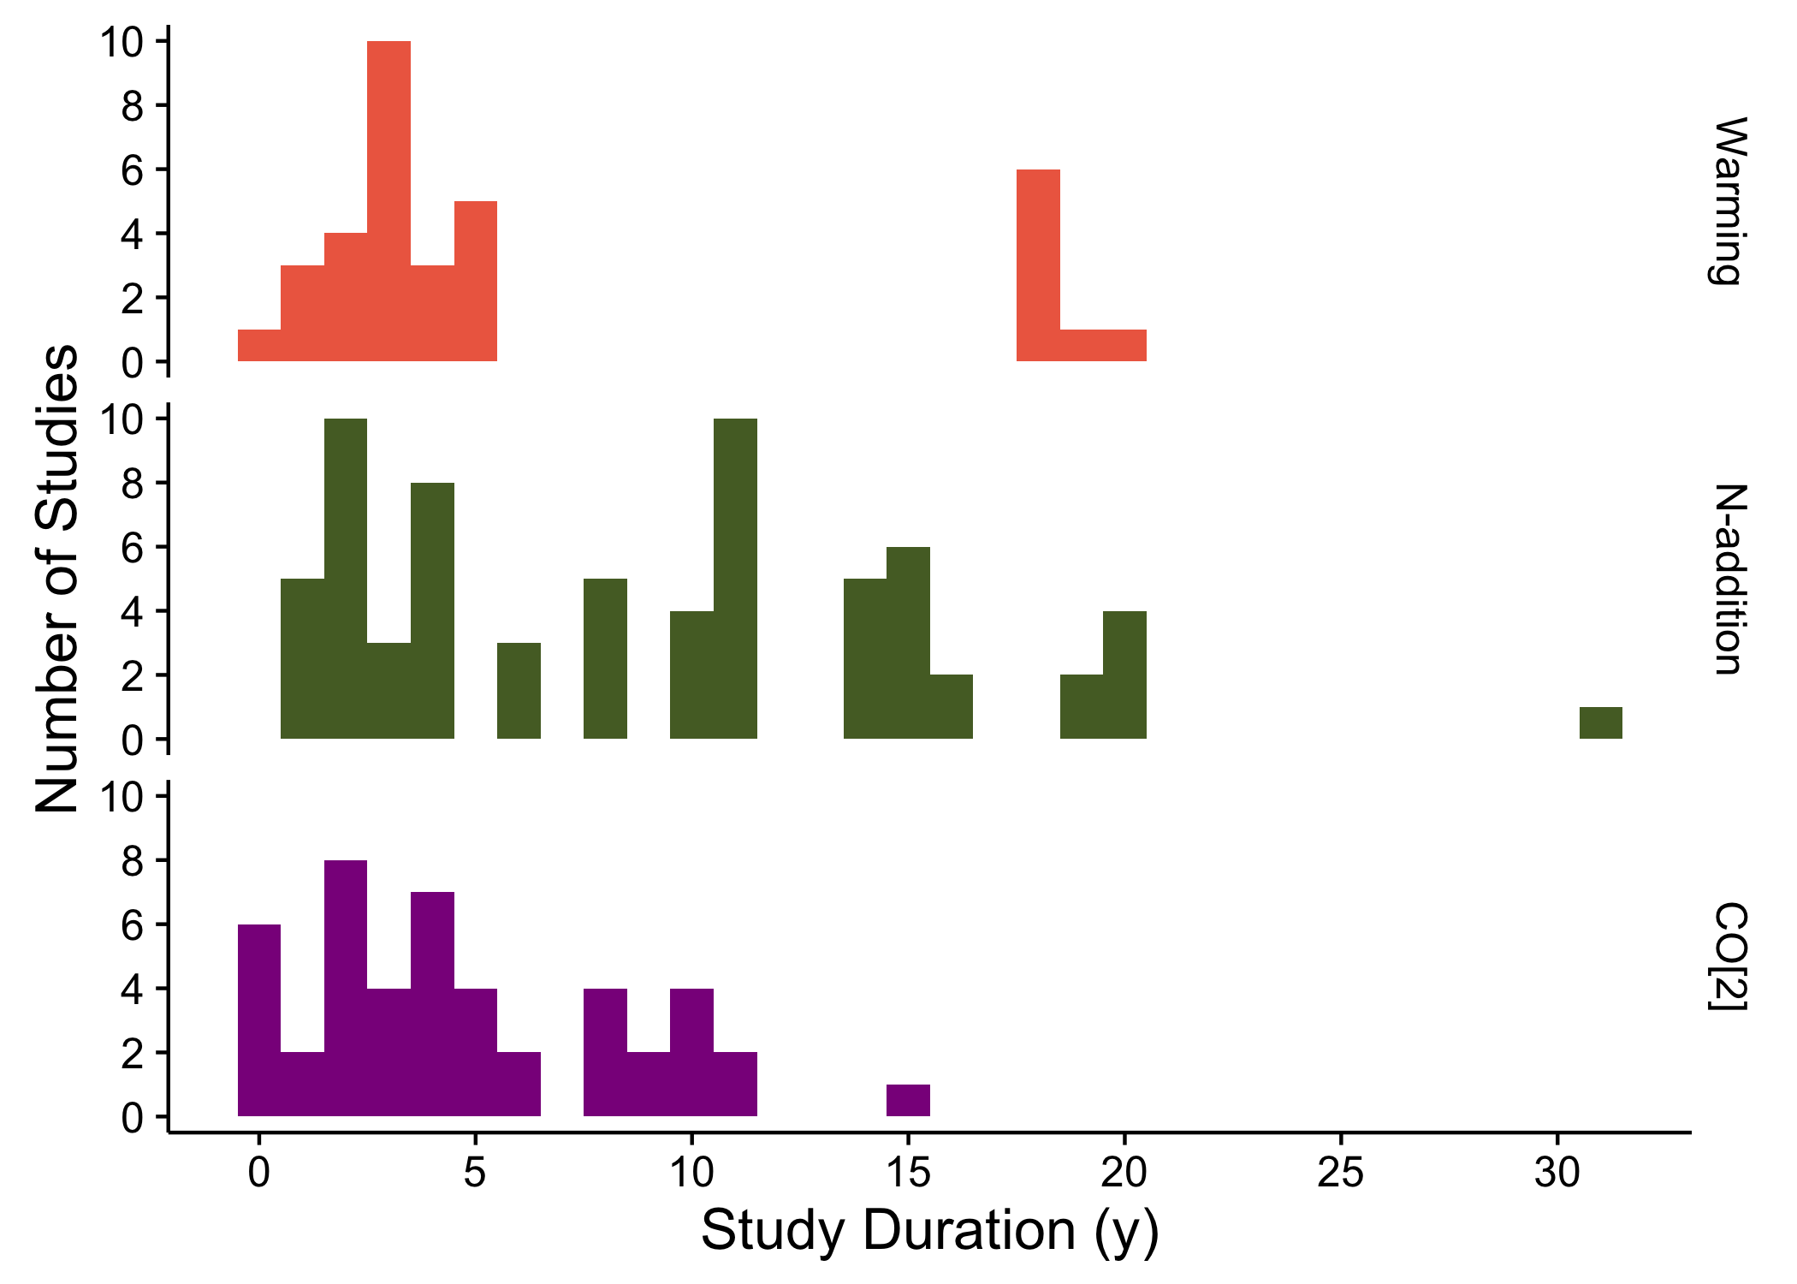
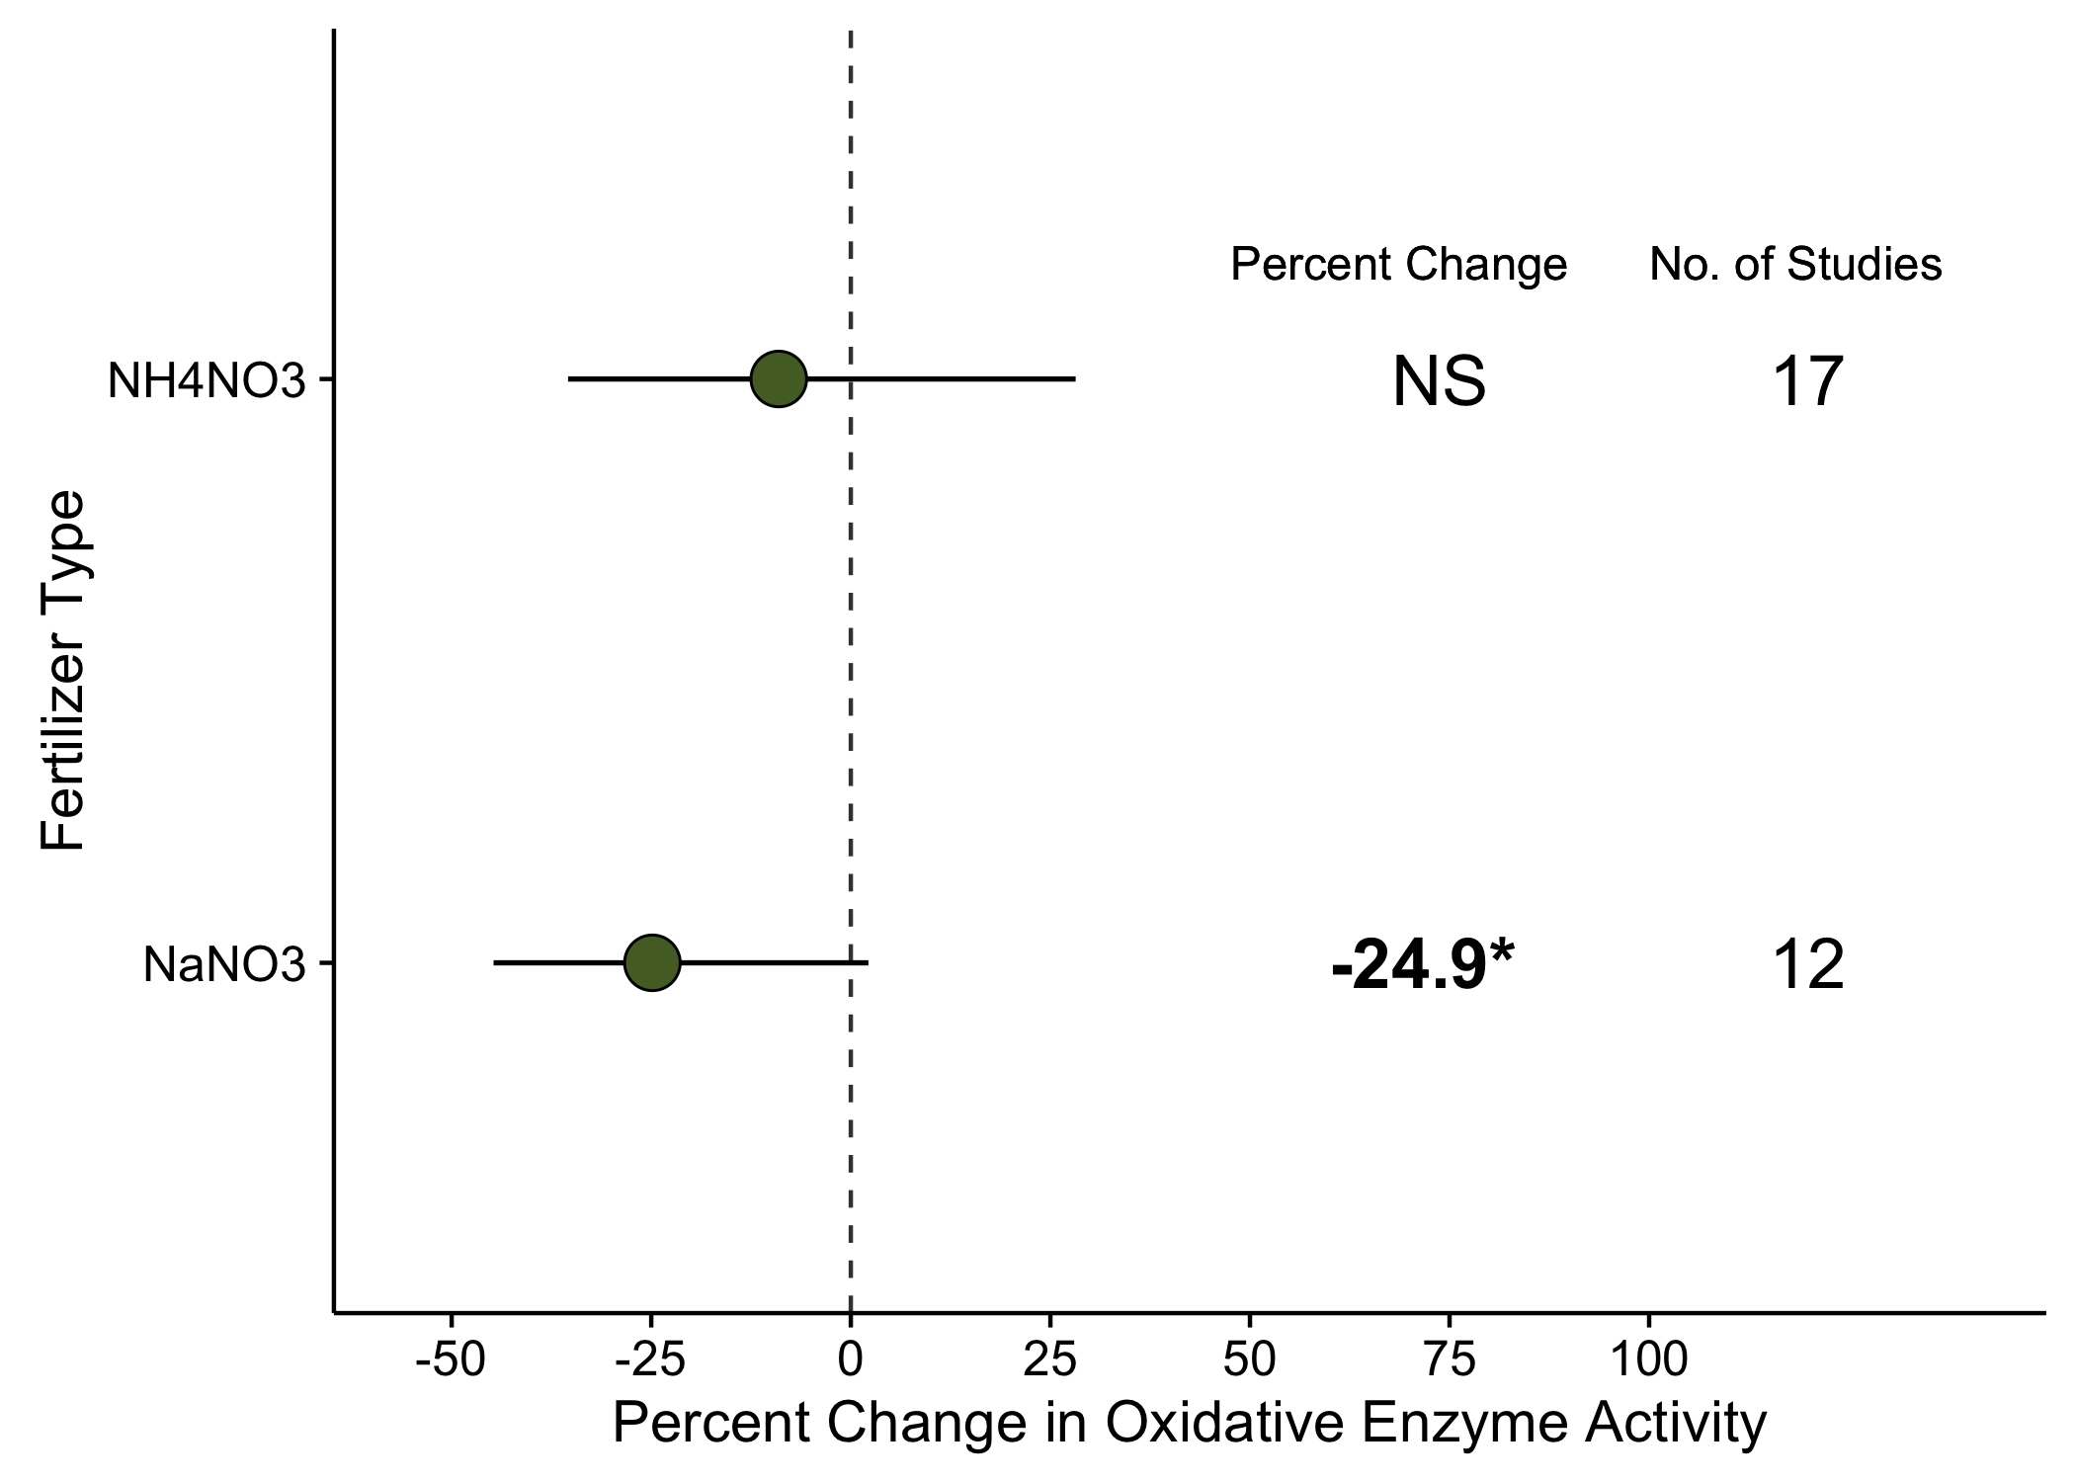
Global changes alter soil fungal communities
and rates of organic matter decomposition
Jessica A. M. Moore and Serita D. Frey
University of New Hampshire, Durham, NH USA
@jessicaammoore
Jessica.Moore@unh.edu
How have soil fungi responded to warming, nitrogen addition, and rising atmospheric [CO₂]?
Fungal abundance increased with warming and CO₂, but decreased with nitrogen addition
Fungal enzyme activity was reduced by nitrogen
Soil fungi use oxidative enzymes to break down lignocellulose in organic matter. Nitrogen addition reduced oxidative enzyme activity by 37.1% (p < 0.001, Z = -4.51, Fig. 3A), but only in studies adding less than 60 kg N ha⁻¹ y⁻¹. At higher rates of N-addition there was no effect on enzyme activity (60 – 120 kg N ha⁻¹ y⁻¹ : p = 0.94, Z = 0.07, Fig 3A; > 121 kg N ha⁻¹ y⁻¹ : p = 0.55, Z = -0.61, Fig 3A).
Adding NaNO₃ reduced oxidative enzyme activity by 24.9% (p = 0.07, Z = -1.82, Fig 3B) while NH₄NO₃ had no effect on enzyme activity (p = 0.59, Z = -0.54, Fig. 3B).
Global change is altering ecosystem processes. The balance between soil carbon (C) accumulation and decomposition is determined in large part by the activity and biomass of detrital organisms such as fungi, yet their sensitivity to environmental change remains unresolved. Using a meta-analysis of 148 field studies (Fig. 1A) spanning three decades (Fig. 1B), we determined general patterns in fungal abundance, biomass, and activity in response to warming, nitrogen (N) addition, and elevated CO₂.
Fig. 2A: The ratio of soil fungal to bacterial biomass (F:B) was reduced by 7.5% relative to control when temperature was increased 2°C above ambient (p = 0.001, Z = -3.19), but it decreased by 25.9% relative to control at higher temperatures (p < 0.001, Z = 3.67).
Fig. 2B: Arbuscular mycorrhizal (AM) colonization was reduced by 30.2% with N-addition (p = 0.05, Z = -2.00) and increased by 21.6% with CO₂ enrichment (p = 0.07, Z = 1.80).
1A
3A
Warming
N-addition
CO₂
NH₄NO₃
1B
NaNO₃
3B
Warming
NH₄NO₃
N-addition
Fig. 2C: Enrichment of CO₂ did not affect F:B at low (< 150 ppm: p = 0.29, Z = 1.06) or high enrichment (> 151 ppm: p = 0.76, Z = -0.31).
Fig. 2D: Fungal phospholipid fatty acids (PLFA, 18:1⍵9), an indicator of fungal biomass, was not affected by increased temperature (p = 0.51, Z = -0.65), N-addition (p = 0.48, Z = -0.71), or CO₂ enrichment (p = 0.84, Z = 0.21).
CO₂
NaNO₃

