Slide 1

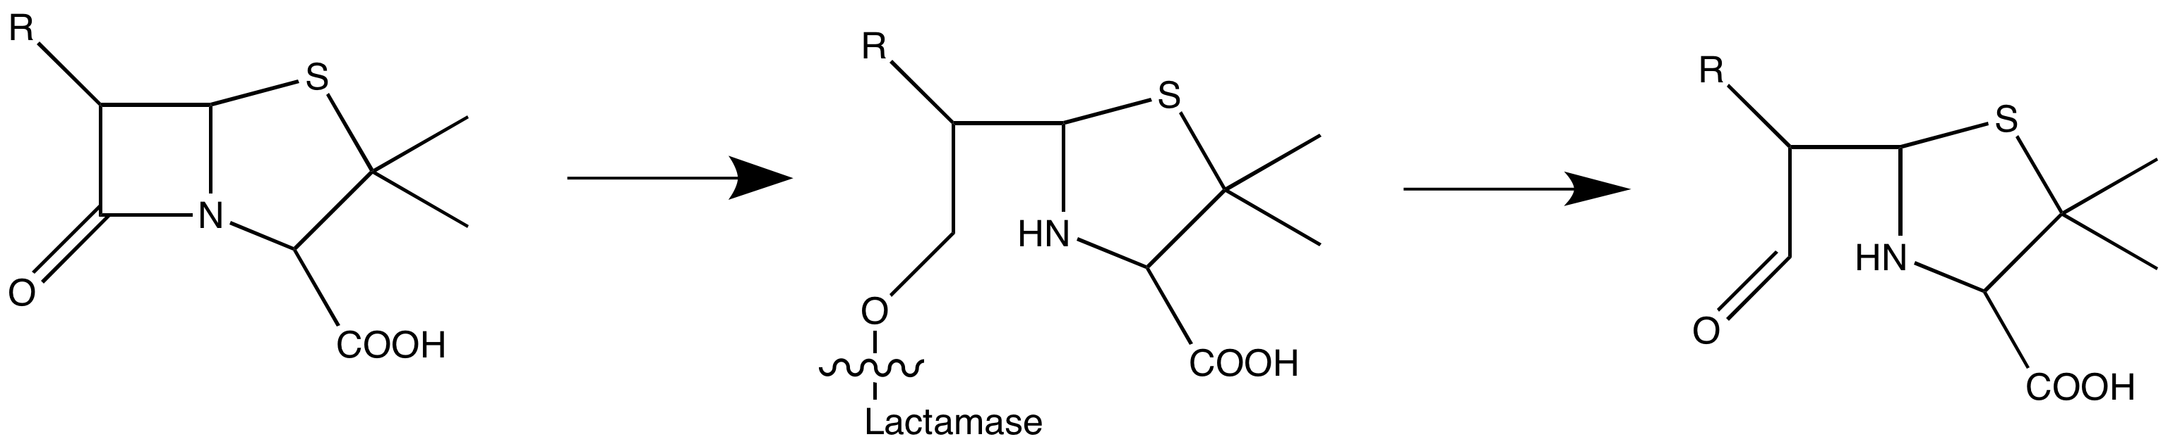
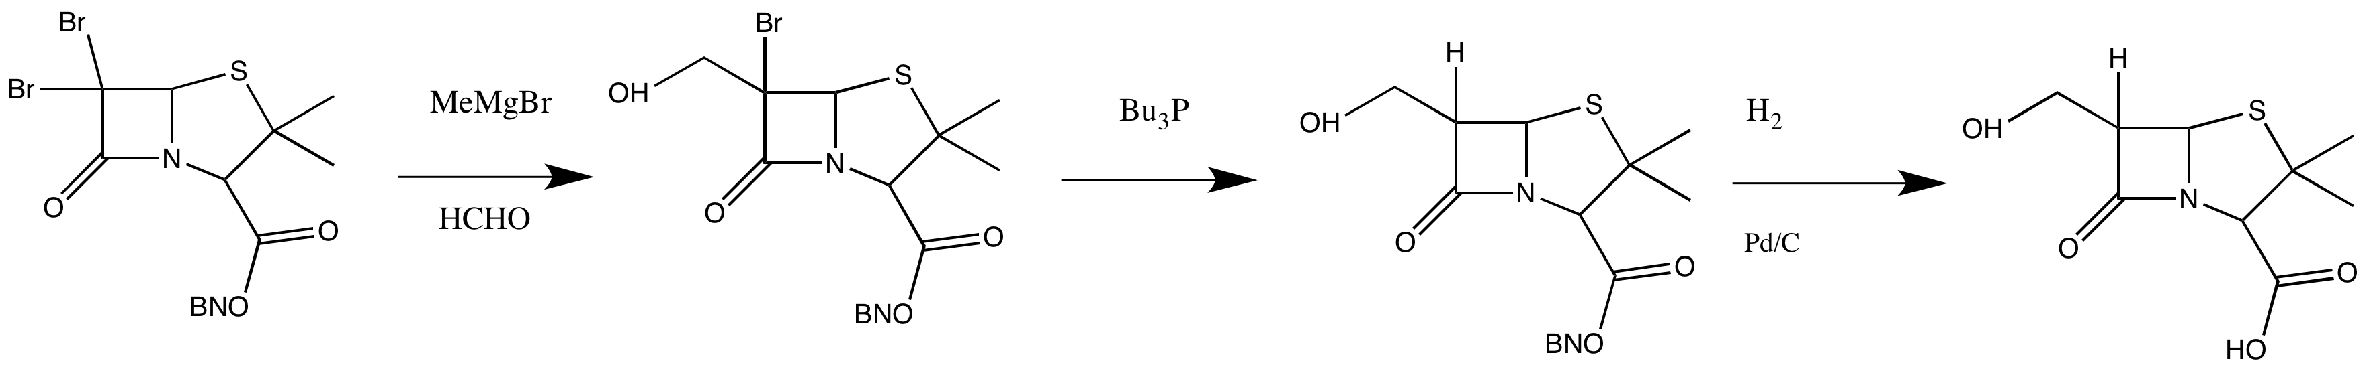
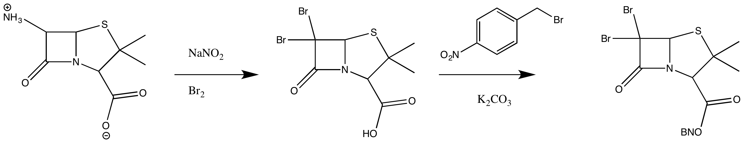
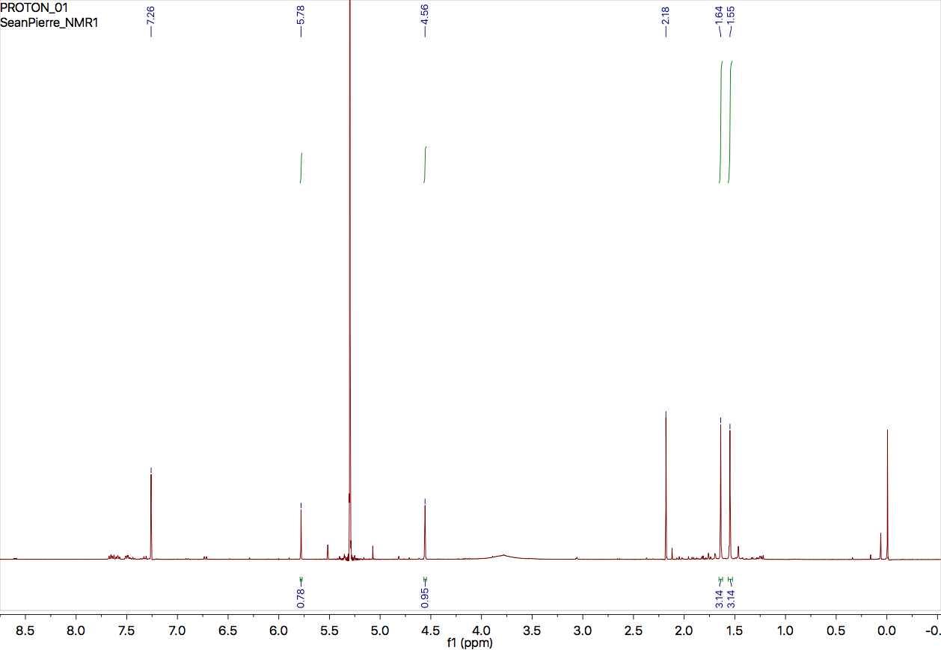
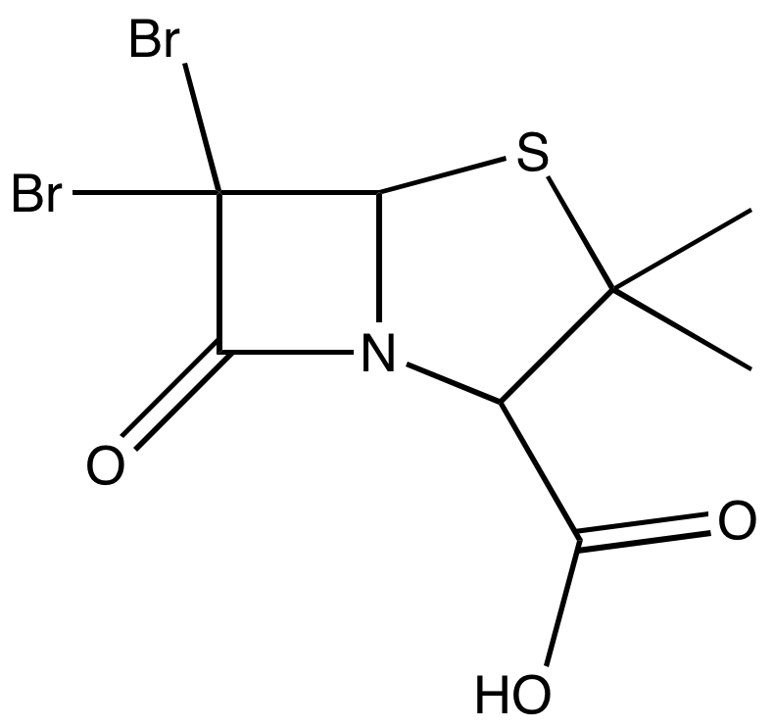
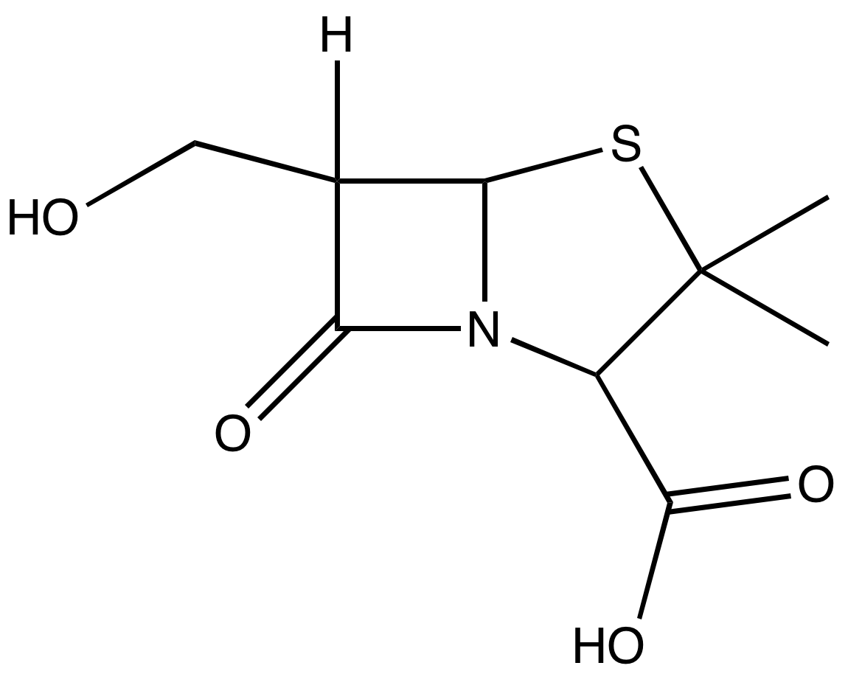
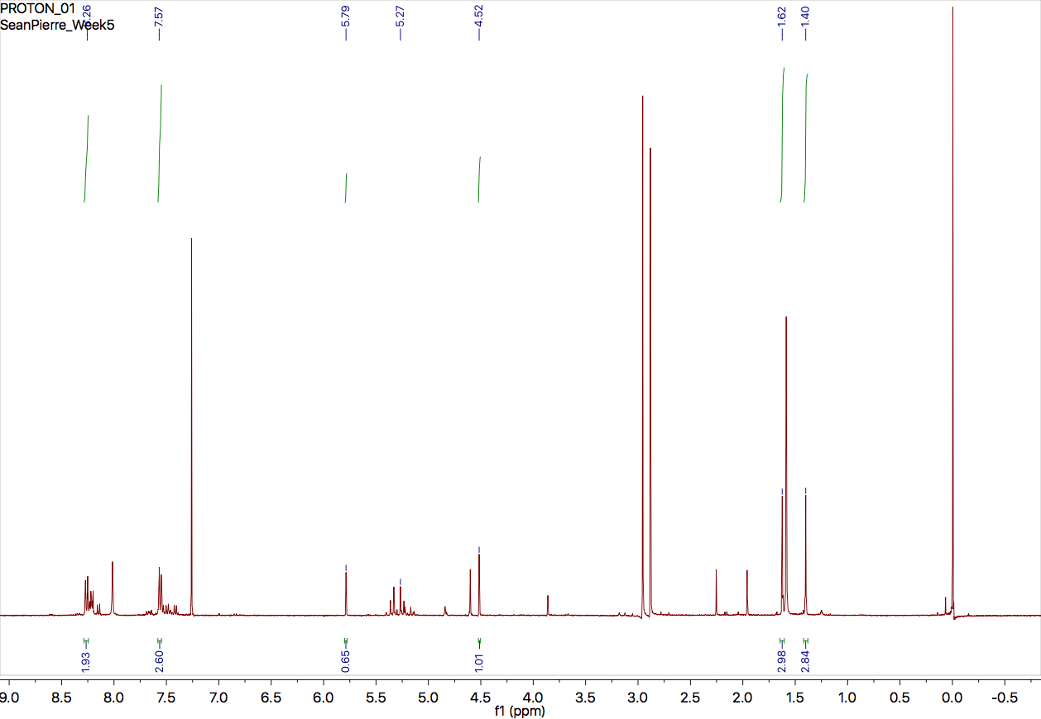
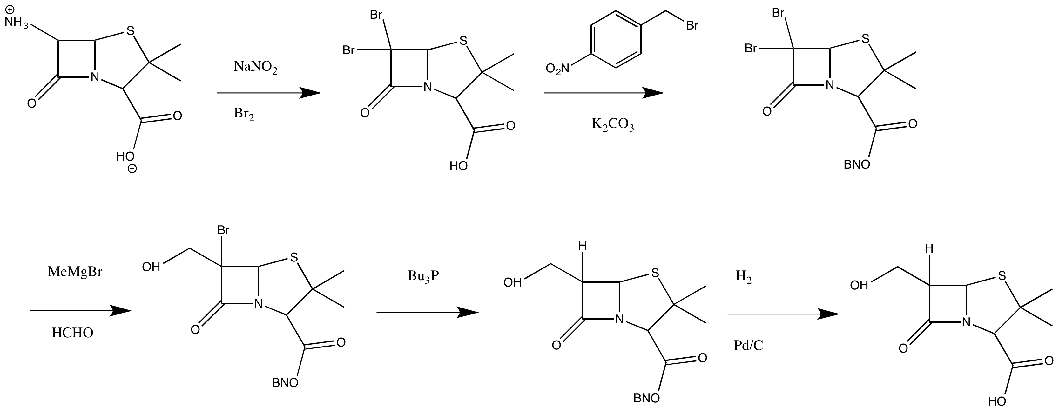
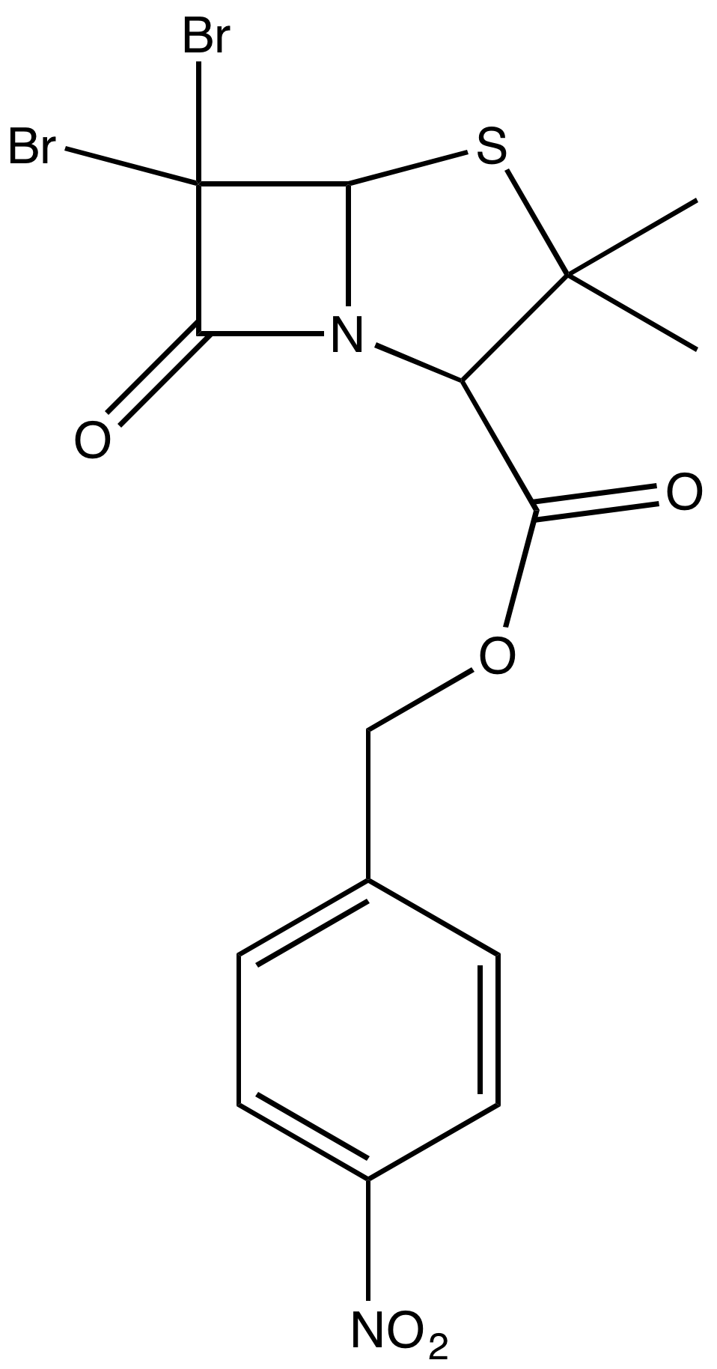
Progress towards the synthesis of β-lactamase inhibitor, 6-a-(hydroxymethyl) penicillanic acid
Sean Pierre-Louis, Marc Boudreau, Bill Butler
sp2029@wildcats.unh.edu, Department of Chemistry, University of New Hampshire, Durham, NH
12/09/2016
6α-(hydroxymethyl)penicillanic acid, Figure 2 is a form of penicillanic acid that acts as an inhibitor for β-lactamase. The β-lactamase enzyme is responsible for breaking down the structural integrity of β-lactams ring which results in bacterial resistance. After the enzyme binds and effectively busts open the four membered ring, the enzyme detaches through hydrolysis to continue attacking other β-lactams rings.
Figure 1. β-lactamase ring opening mechanism
When introduced to 6α-(hydroxymethyl)penicillanic acid, the enzyme still attacks at the β-lactam carbonyl group but unlike with other β-lactam antibiotics the enzyme is then unable to detach. This creates an inactive intermediate that remains inactive until it undergoes hydrolysis to reform the original enzyme. 6α-(hydroxymethyl)penicillanic acid displaces the water molecule needed for hydrolysis causing prolong enzyme inhibition.¹
New variants of β-lactamase have been identified calling for the development of new types of β-lactamase inhibitors to counter the increased resistance.² 6α-(hydroxymethyl)penicillanic acid aims to prolong inhibition of the lactamase enzyme in order to preserve its β-lactam ring and kill bacteria. 6α-(hydroxymethyl)penicillanic acid, like all β-lactam antibiotics, kills bacteria by inhibiting the penicillin binding proteins responsible for managing the bacteria’s cell wall.
Figure 2. 6α-(hydroxymethyl)penicillanic acid
Scheme 1. Proposed Synthetic Route to 6α-(hydroxymethyl)penicillanic acid
A larger quantity of starting material is required to resynthesize p-Nitrobenzyl 6,6-Dibromopenicillanate and run the full reaction. p-nitrobenzyl 6β-hydroxymethyl-6α-bromopenicillanate (4) could then be prepared by a slight variation of the method of DiNinno et al.³ The bromo groups in the compound p-Nitrobenzyl 6α-Bromo-6β-(hydroxymethyl)penicillanate could be reduced via a halide reduction using tributylphosphine. Such reduction would gave mostly inversion of stereochemistry, which after chromatography would afford the compound p-Nitrobenzyl 6α-(hydroxymethyl)penicillanate (5).⁴ Hydrogenolysis of compound 5 over 10% Pd/C, and fractional crystallization, produces the desired compound, 6α-(hydroxymethyl)penicillanic acid (6).
Scheme 3. Future Experimental Work Towards Synthesis
Further study is required to continue developing an efficient synthesis of 6α-(hydroxymethyl)penicillanic acid. It was found that impurities and low yield of the brominated product led to the untimely end of the synthesis.
Experimental Design:
Introduction:
6β-aminopenicillanic acid (1) was brominated using sodium nitrite and bromine to give 6,6-dibromopenicillanic acid (2). The carboxyl group of was then protected with the p-nitrobenzyl ester and potassium carbonate to give p-Nitrobenzyl 6,6-Dibromopenicillanate (3). The products were analyzed and identified using ¹H NMR spectroscopy.
The products of both reactions were successfully obtained but in very low yield. The bromination of 6-aminopenicillancic acid yielded a product in 17%. The protected product was collected in a yield of less than 5%. ¹H NMR was used to verify the identities of both products. No purification techniques were done due to the low quantities and thus the products were analyzed as crude.
Scheme 2. Attempted Experimental Synthesis
Future Work:
Results:
1
2
3
Conclusions:
A
B
D
C
DCM
Starting Material
SM
B
c
Acknowledgements:
D
A
I would like to thank the Boudreau research group, Bill Butler and the UNH Department of Chemistry.
Figure 3. ¹H NMR Spectra of crude 2
References:
Kazuyuki Miyashita, Irina Massova, Pascale Taibi, and Shahriar Mobashery Journal of the American Chemical Society 1995 117 (45), 11055-11059
Drawz, Sarah M., and Robert A. Bonomo. “Three Decades of Β-Lactamase Inhibitors.” Clinical Microbiology Reviews 23.1 (2010): 160–201. PMC. Web. 13 Oct. 2016.
DiNinno, F.; Beattie, T. R.; Christensen, B. G. J. Org. Chem. 1977, 42, 2960.
A
B
Unreacted SM
DMF
DMF
D
C
E
1
2
3
F
H₂0
G
G
F
D
E
A
B
C
4
5
6
Figure 4. ¹H NMR Spectra of crude 3

