Slide 1
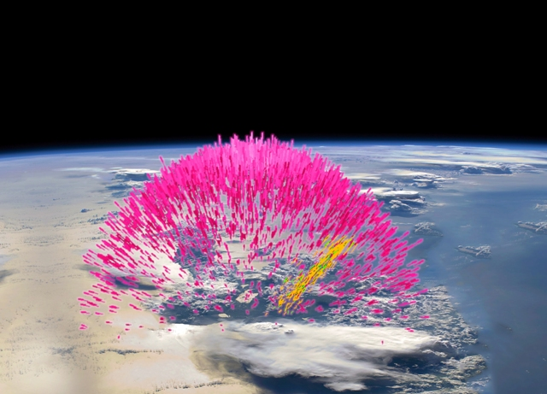

Lightning leader and relativistic feedback discharge models of terrestrial gamma-ray flashes
AE33A-0435
Joseph R. Dwyer¹, Ningyu Liu¹, J. Eric Grove², Hamid Rassoul³, and David M. Smith⁴
¹Department of Physics and Space Science Center (EOS), University of New Hampshire, Durham, NH, ²Naval Research Laboratory, Washington DC,
³Department of Physics and Space Sciences, Florida Institute of Technology, Melbourne, FL, ⁴Physics Department and Santa Cruz Institute for Particle Physics, University of California, Santa Cruz, CA
Abstract
Lightning leader models of terrestrial gamma-ray flashes (TGFs) are based on the observations that leaders emit bursts of hard x-rays. These x-rays are thought to be generated by runaway electrons created in the high-field regions associated with the leader tips and/or streamers heads. Inside a thunderstorm, it has been proposed that these runaway electrons may experience additional relativistic runaway electron avalanche (RREA) multiplication, increasing the number and the average energy of the electrons, and possibly resulting in a TGF. In contrast, relativistic feedback discharge models generate large numbers of RREAs through a positive feedback effect caused by backward propagating positrons and backscattered x-rays. Because both models predict that TGFs should occur during the propagation of the upward negative leader between the main negative and positive charge centers, it is challenging to come up with observational tests that distinguish between the two models. In this work, we calculate the current moments caused by the runaway electrons and their associated ionization. By comparing these current moments inferred from the gamma-ray data with the current moments inferred from the radio data, it should be possible to tell if the currents are mostly being generated by the runaway electrons and their associated ionization or by conventional discharge processes, thus helping to identify which of the two models is correct.
The Standard TGF
The total number of runaway electrons is often used to describe the size of a TGF, 10¹⁷ runaway electrons being a typical number. However, this number is model dependent, depending on the electric field configuration used. A better choice for describing the runaway electrons in the source region is the total grammage (in units of g/cm²) traversed by all the runaway electrons, Ξ. For a standard TGF gamma-ray fluence of F₀ = 0.1 cm⁻² at a spacecraft altitude of 500 km, TGFs have total grammages close to Ξ₀ = 10¹⁸ g/cm², which we refer to as the standard total grammage. Using REAM Monte Carlo simulations, the total grammage, Ξ, for TGFs is inferred from the gamma-ray fluence at the spacecraft. Other TGF properties such as the current moment and the optical emission may then be calculated directly from Ξ and its time derivative.
Figure 3. REAM Monte Carlo calculations of the total number of >1 MeV gamma rays emitted at the source versus atmospheric column depth for a TGF near the nadir point for a 30° beam width. The dashed line and data are for a RHESSI TGF with 100 counts; the solid line and data are for 25 counts and the dotted line and data are for 10 counts.
Figure 5. The total grammage versus atmospheric column depth for a standard TGF with a fluence of 0.1 cm⁻² (> 100 keV) at a spacecraft altitude of 500 km. The top three lines and data are for polar angles between 30° and 40°, and the bottom three are for polar angles between 0° and 10°.
Figure 2. Geometry of the TGF and spacecraft (S/C). In the figure, R_{E} is the radius of the Earth; h_{SC} is the altitude of the spacecraft; h_{TGF} is the altitude of the TGF; r is the radial distance from the TGF to the spacecraft; d is the horizontal distance (arc length) from the nadir point below the spacecraft to the point on the ground below the TGF, and θ is the polar angle.
Figure 6. The peak vertical current moment versus atmospheric column depth for a standard TGF with a fluence of 0.1 cm⁻² (>100 keV) at a spacecraft altitude of 500 km. For this figure, a TGF duration T₅₀ = 50 μs is used. The top three lines and data are for polar angles between 30° and 40°, and the bottom three are for polar angles between 0° and 10°.
Figure 4. TGF fluences for gamma-ray energies >100 keV versus polar angle. The three curves in each panel are for a 0° beam width, a 30° beam width, and a 45° beam width.
NASA
Summary
The gamma–ray fluence at the spacecraft is used to find the total grammage, Ξ, in the source region. Ξ, which is not sensitive to the electric field configuration in the source region, is then used to calculate the current moment produced by the energetic electrons and their associated ionization. This predicted current moment may then be compared with LF-VLF radio observations to determine whether or not additional lightning currents are present, potentially testing whether the lightning leader or the relativistic feedback discharge model of terrestrial gamma-ray flashes is correct.
Figure 1. Artist’s impression of a TGF.
Acknowledgements
This work has been supported in part by the NRL grant N00173-15-1-G014. In addition, this material is based upon work supported by the Air Force Office of Scientific Research under award number FA9550-16-1-0396.

