Slide 1



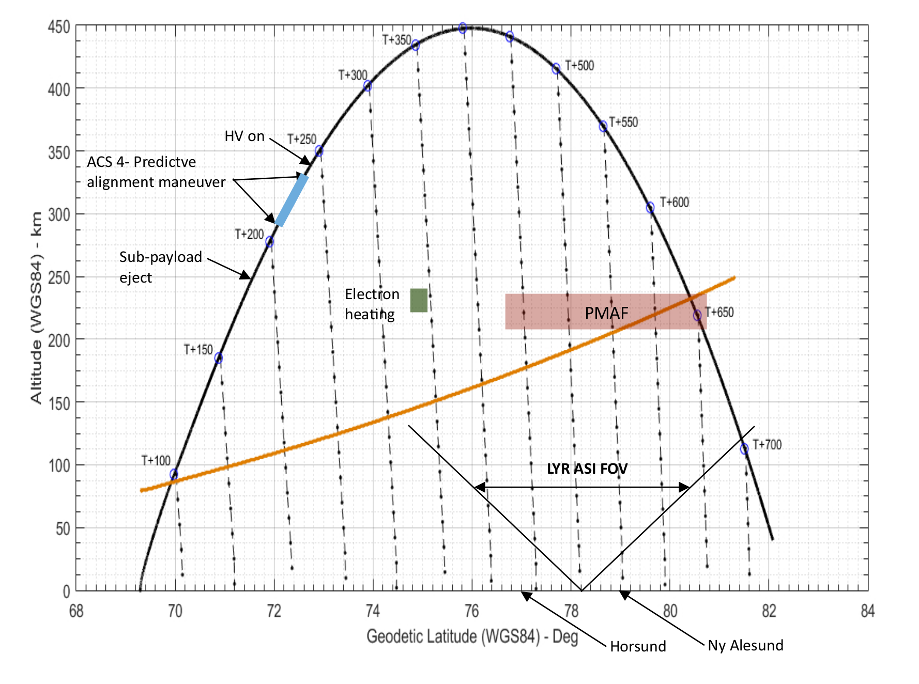
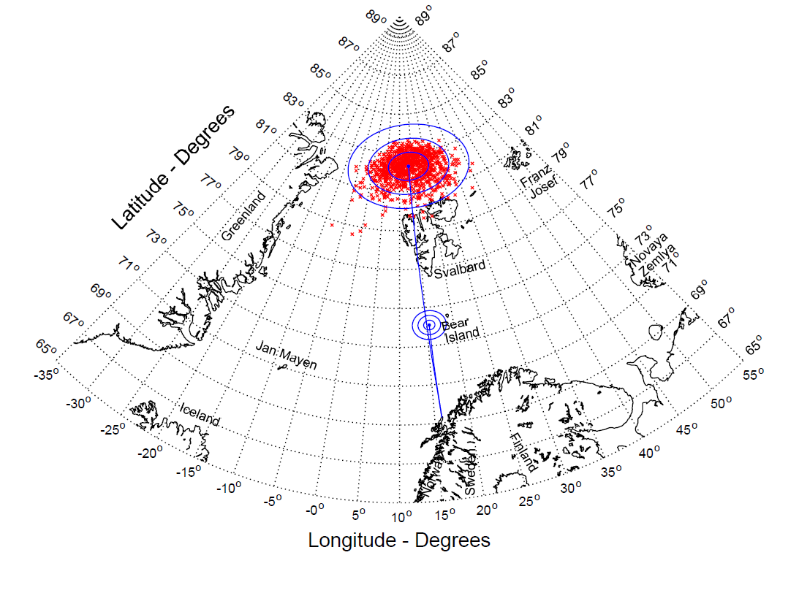
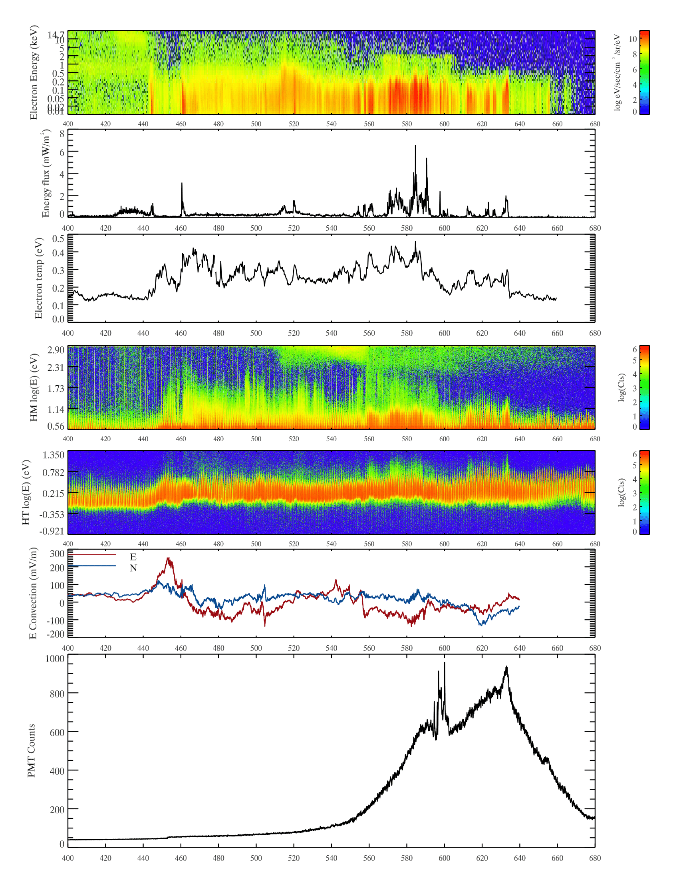
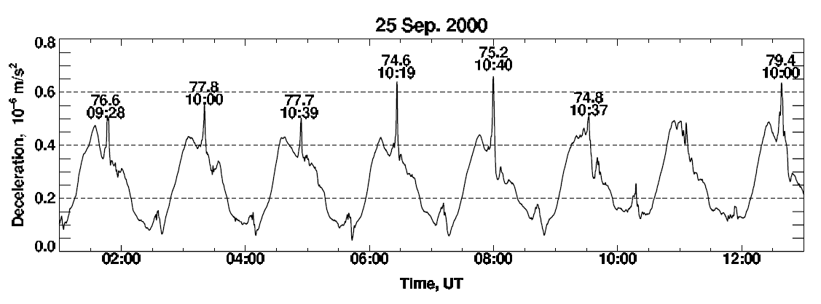
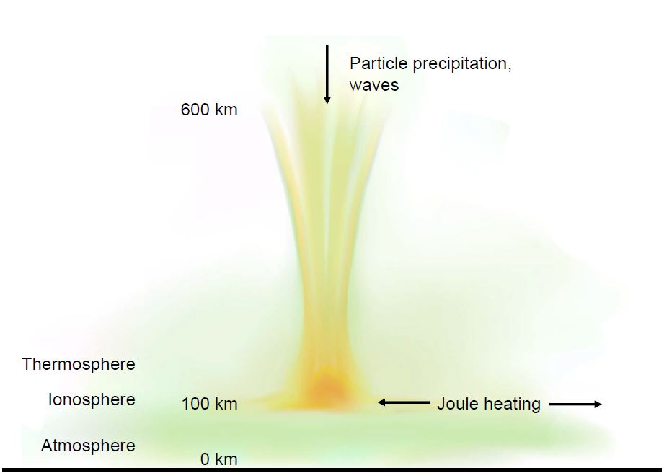
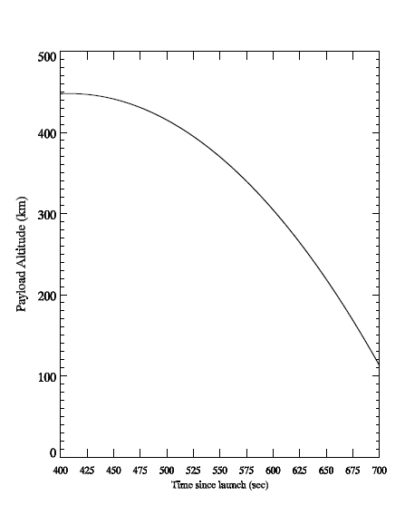
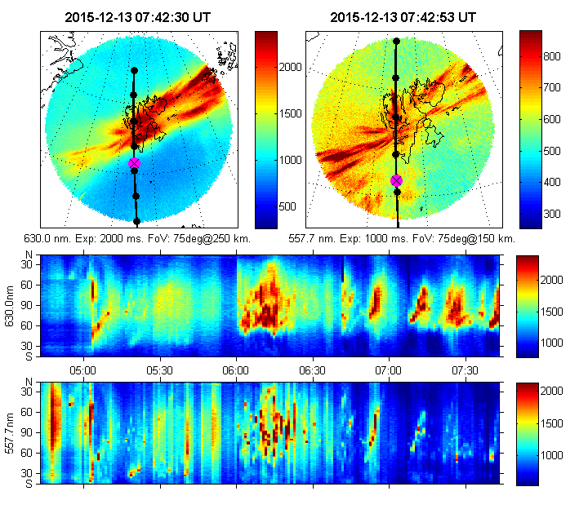
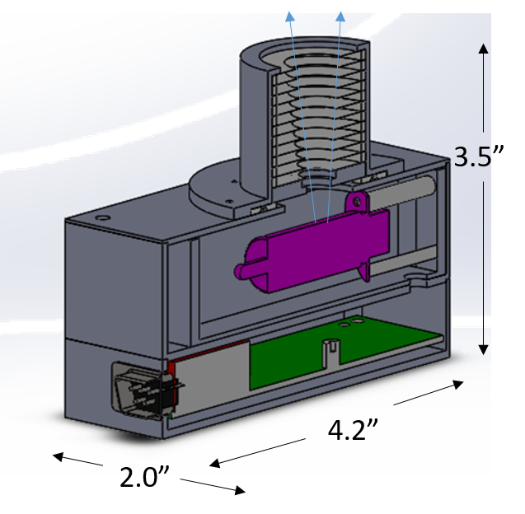
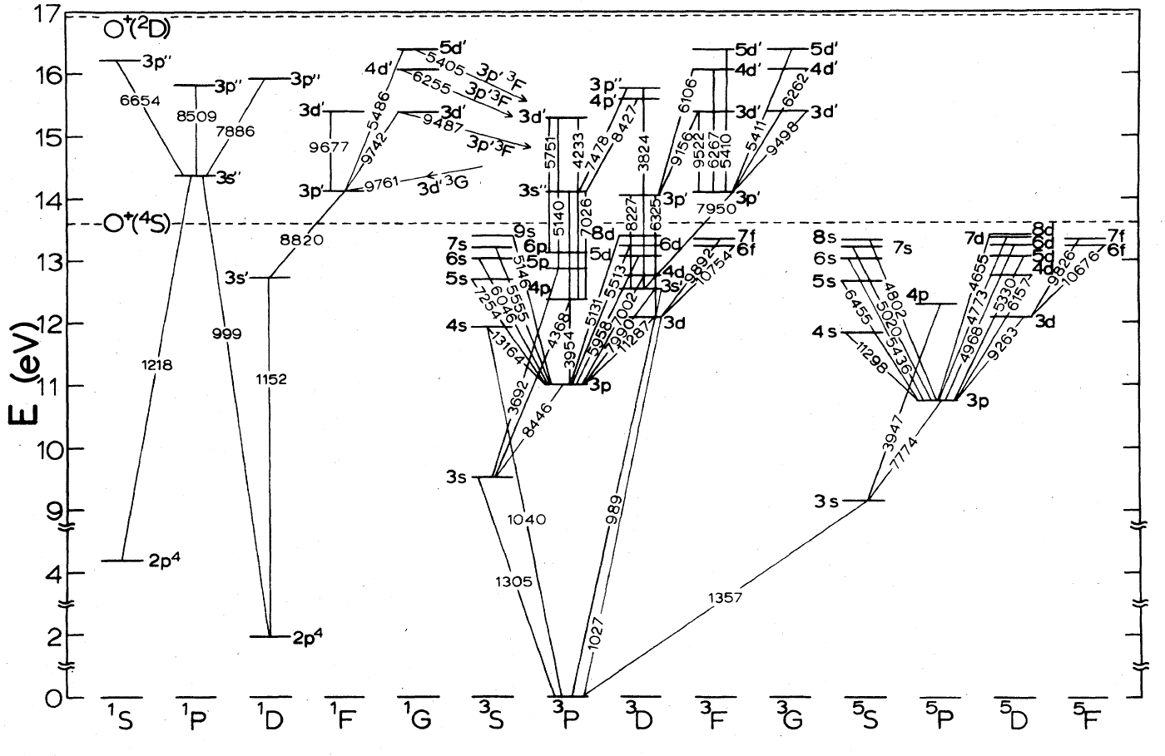
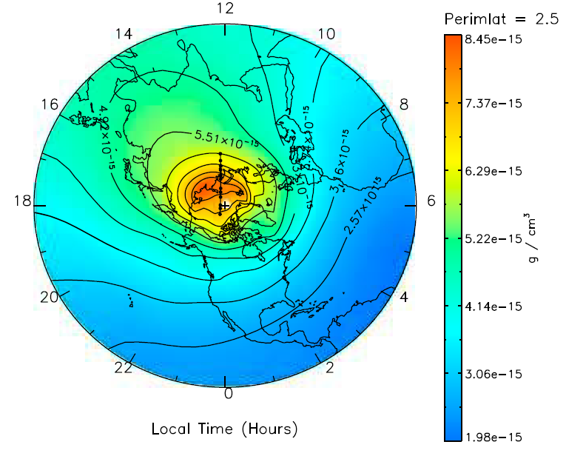
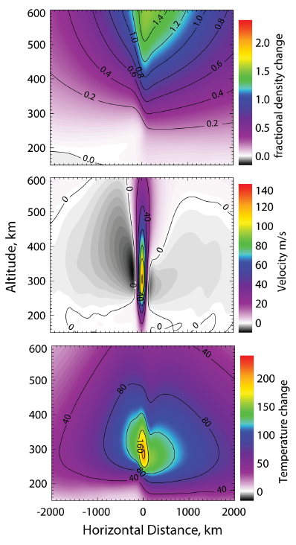
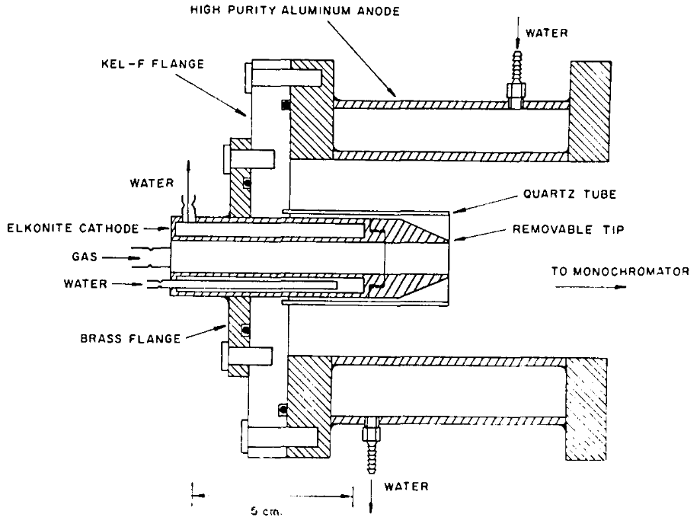
RENU 2 UV Measurement of Atomic Oxygen in the Cusp
Bruce Fritz¹, Marc Lessard¹, David Kenward¹, Jim Clemmons², Jim Hecht², Kristina Lynch³, David Hysell⁴, Geoff Crowley⁵, Tim Cook⁶
1. University of New Hampshire, Space Science Center, Durham, NH; 2. Aerospace Corporation, El Segundo, CA; 3. Department of Physics, Dartmouth College, Hanover, NH; 4. Department of Earth and Atmospheric Sciences, Cornell University, Ithaca, NY; 5. ASTRA, Boulder, CO; 6. Lowell Center for Space Science and Technology, U. Mass. – Lowell, Lowell, MA
Funded by NASA Mission 52.002
Abstract
Launch
The Rocket Experiment for Neutral Upwelling 2 (RENU 2) launched from the Andøya Space Center, Norway on 13 December, 2015 into the dayside cusp region. An ultraviolet photometer (UV PMT) built by the Magnetosphere-Ionosphere Research Laboratory (MIRL) at the University of New Hampshire was oriented on the payload to look up along the local magnetic field line as it passed through a poleward moving auroral form (PMAF). The UV PMT measured a clearly enhanced signal in the topside ionosphere as the payload descended through a region of soft electron precipitation. The bandpass filter on the PMT isolated emissions of atomic oxygen at both 130.4 nm and 135.6 nm, but was flown uncalibrated. A PMT flight spare will be calibrated using a Paresce UV light source. The flight data luminosity may be approximated using the spare instrument calibration. The luminosity, as well as other flight data from RENU 2 will be used in a radiative transport model to infer structure of upwelling neutral atomic oxygen above the PMAF.
Nominal trajectory
Launch Site
RENU 2 Background
RENU 2 Measurements
Mission Objectives
Electron PLASma Instrument (EPLAS)
Top-hat electrostatic analyzer
360° pitch angle resolution
Isotropic plasma sheet electrons measured prior to ~440 s.
Population becomes mostly field-aligned after 440 s
Energy flux calculated for field-aligned electrons
For details on EPLAS calculations, see poster SM51C-2508 by D. Kenward
1. To measure neutral gas, ion, and electron temperature enhancements, which will provide an initial assessment of the upwelling process
2. To measure large- and small-scale Joule heating in the cusp during the RENU 2 overflight. Large-scale data will be acquired by EISCAT; small-scale data (perhaps associated with Alfven waves) will be acquired using onboard electric field measurements
3. To measure the precipitating electron energy input. Theory and observations suggest that various types of electron precipitation contribute to neutral upwelling; knowledge of the precipitating population is critical for understanding this effect
4. To use measured quantities as inputs to “thermodynamic” and “electrodynamic” models for comparison to the observed upwelling
Isotropic
Field Aligned
The original motivation for this mission comes from CHAMP satellite measurements made in 2000, as reported by Luhr et al [2004]
Thermal electron instrument
(ERPA)
Temperature enhancements align with spikes in EPLAS energy flux
Figure from Luhr et al [2004]. Air drag measured by the accelerometer on board CHAMP. The harmonic variations indicate the range of change over an orbit. Superimposed are small-scale features. The peaks in air drag are labeled by their corrected magnetic latitude and magnetic local time
Several processes in the ionosphere are likely to contribute to the small-scale density enhancements, but two in particular are of interest:
HEEPS-M
Super Thermal Ions (3 – 790 eV)
(Stepped ion population?)
Joule heating
Convective heating heats the thermosphere-ionosphere, which expands vertically
Related to “Type 1” ion outflow
Soft electron precipitation
Soft electron precipitation (100 eV) heats ambient ionospheric electrons. The heated electrons expand upwards, lifting ions. The ions drag the neutrals along as they accelerate upward.
Related to “Type 2” ion outflow
HEEPS-T
Thermal Ions (0.1 – 22 eV)
Electric Field (COWBOY)
0-20 kHz, 0-1 kHz VLF
Convection DC E-field
Field measurements imply convection speeds on the order of 2 km/s, faster than the actual speed of the arcs (>1 km/s)
January 18, 2007
60 km
Lühr, H., M. Rother, W. Köhler, P. Ritter, and L. Grunwaldt (2004), Thermospheric up-welling in the cusp region: Evidence from CHAMP observations, Geophys. Res. Lett., 31, L06805, doi:10.1029/2003GL019314.
UV PMT
UV PMT
Hamamatsu R10825 PMT
Detects atomic oxygen (O I) emissions at 130.4 nm and 135.6 nm
- Excludes Lyman-α (121.6 nm)
FOV = 12.5°
10 Hz sample rate
Uncooled
UiO All-Sky Imagers
Located at Ny-Alesund & Longyearbyen
Upwelling models
Conclusions
Upwelling is fundamentally driven by Joule heating (TIME-GCM)
Figure from: Crowley, G., D. J. Knipp, K. A. Drake, J. Lei, E. Sutton, and H. Lühr (2010), Thermospheric density enhancements in the dayside cusp region during strong BY conditions, Geophys. Res. Lett., 37, L07110, doi:10.1029/ 2009GL042143.
RENU 2 successfully launched into cusp aurora on 13 December, 2015
The UV PMT observed a measurable signal of atomic oxygen in the cusp region
- Validation of simple instrument design
- Large scale trend in data shows enhancement
- Fine structure possibly related to precipitation
Future plans
Calibration of the PMT will provide additional information about the measurement
- Brightness of measurement @ 130.4 nm
- Proxy for flight data
Input to collisional radiative transfer model
- Optical depth of ionosphere complicates
interpretation of 130.4 nm emission line
- Secondary remote measurement of neutral
PMT Pass band
Why UV?
- 130.4 nm is the lowest energy allowed transition (non-forbidden)
557.7 nm
O (¹S → ¹D)
(~0.7 s)
630.0 nm
O (¹D → ³P)
(110 s)
130.4 nm
135.6 nm
Schulman, M. B., F. A. Sharpton, S. Chung, C. C. Lin, and L. W. Anderson (1985), Emission from oxygen-atoms produced by electron-impact dissociative excitation of oxygen molecules, Phys. Rev. A, 32(4), 2100–2116, doi:10.1103/PhysRevA.32.2100.
Neutral density distribution from TIME‐GCM for 07:35 UT. Black dots indicate CHAMP locations from 7:30–7:39 UT. Outer latitude 2.5 degrees geographic latitude
Calibration
Upwelling driven as part of the “Type 2” ion outflow process
Sadler, F. B., M. Lessard, E. Lund, A. Otto and H. Lühr (2012), Auroral precipitation/ion upwelling as a driver of neutral density enhancement in the cusp, Journal of Atmospheric and Solar-Terrestrial Physics 87–88.
Soft electron precipitation enhances conductivities in F-region, enables increased Joule heating
Zhang, B., W. Lotko, O. Brambles, M. Wiltberger, W. Wang, P. Schmitt, and J. Lyon (2012), Enhancement of thermospheric mass density by soft electron precipitation, Geophys. Res. Lett., 39, L20102, doi:10.1029/2012GL053519.
Direct particle heating
Brinkman, D. G., R. L. Walterscheid, J. H. Clemmons, and J. H. Hecht (2016), High-resolution modeling of the cusp density anomaly: Response to particle and Joule heating under typical conditions, J. Geophys. Res. Space Physics, 121, 2645–2661, doi:10.1002/2015JA021658.
The UV PMT will be calibrated using a continuous gaseous discharge source
Atomic oxygen excited in the gas chamber
130.4 nm is produced as part of spectrum (not 135.6 nm)
Monochromater isolates desired output
Channel electron multiplier records output at exit slit
Schematic diagram of a similar source
Fractional density change, vertical wind, and temperature change versus altitude and latitude (horizontal distance) for a 2° cusp with particle heating and elevated Joule heating with Edc = 75 mV/m and Eac = 50 mV/m. (Not all contours are labeled.)
Acknowledgement: First, thanks to additional collaborators: A. Otto (UAF); K. Oksavik, F. Sigernes, N. Partemies, P. G. Ellingsen and M. Syrjäsuo (UNIS); J. Moen, L. Clausen and T. A. Bekkeng (UiO), T. Yeoman (U. Leicester), B. Sadler (UNH), J. LaBelle, Meghan Harrington and Spencer Hatch (Dartmouth). Authors wish to thank the ACE SWEPAM instrument team and the ACE Science Center for providing the ACE data. Research at the University of New Hampshire was supported by NASA Award NNX13AJ94G.
Figure from: F. Paresce, S. Kumar, C.S. Bowyer, Appl. Opt., 10 (1971), p. 1904

