Slide 1

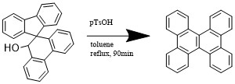
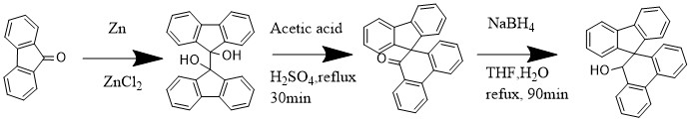
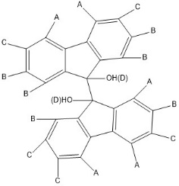
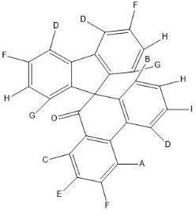
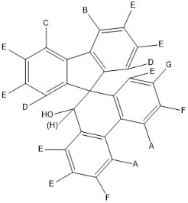
Progress Towards the Synthesis of Dibenzochrysene, a Novel Nonplanar Aromatic Compound
Evangelos Rossis, Richard P. Johnson, Caitlin Hoffman er1@wildcats.unh.edu, Department of Chemistry, University of New Hampshire, Durham, NH
12/09/2016
Introduction:
Knowing the mechanistic pathways by which dibenzochrysene can be used: such as in the synthesis of polymers for lithographic film making can be useful in creating more resistant and less degradative materials¹. Also, it is used as transporting emissive material in fabricated highly efficient organic light-emitting diodes(OLEDs^{)2.} Past methodologies for manufacturing dibenzochrysene, have proved more difficult and less efficient, producing small amount of product. However, the new methodology will not only revolutionize and further develop more resistant products and materials, it will also shed light into further uses for dibenzochrysene in building materials and alternative products.
Experimental Design:
A multistep synthesis was performed starting with 9-fluorenone to yield 9,9’-bifluorenyl-9-9’-diol through pinacol coupling. A pinacol rearrangement reaction yield spiro[9H-fluorine-9,9’(10’H)-phenanthren]-10’-one, which was then reduced to give the spiro[9H-fluorine-9,9’(10’H)-phenanthren]-10’-ol. For the final step stone-wales rearrangement could be used for the synthesis of dibenzochrysene. Each product was analyzed with H NMR to verify purity and reaction.
Scheme . 1 Proposed Synthetic Route to dibenzochrysene.
Results and Discussion:
The pinacol coupling with zinc chloride and zinc powder yield 57%, while the pinacol rearrangement yield 61%. The reduction of spiro[9H-fluorine-9,9’(10’H)-phenanthren]-10’-one had to repeated because it didn’t come to completion the first time. On the second try it formed the right product according to H NMR with 74 % yield, but the amount of product was not enough to continue the last reaction.
Scheme 2. Completed Experiment Work Toward Synthesis
Future Work:
Maximize the scale used in order to have more product for the stone-wales rearrangement with p-toluenesulfonic acid.
Coclusions:
The synthesis of spiro[9H-fluorine-9,9’(10’H)-phenanthren]-10’-ol completed, however, the final product requires further studies.
Acknowlegements:
I would like to thank Mr. Johnson’s research group and the UNH Department of Chemistry.
References:
(1)Kato, H.; Takatori, M. Dibenzo[g,p]chrysenes and polymers manufactures 2001
(2) Shizuo Tokito,Koji Noda,Hisayoshi Fujikawa,Yasunori Taga,Makoto Kimura,Kou Shimada,Yasuhiko Sawaki. Highly efficient blue-green emission from organic light-emitting diodes using dibenzochrysene derivatives, Appl. Phys. Lett. 77, 160 2000
(3) Li, Z. R. Organic Light-Emitting Materials and Devices, 2nd ed.; CRC Press: London, 2015, 374
3
D
A
D
F
G
H
1
2
B
C
I
A
B
C
E
I
Figure 1. H NMR of 2
Figure 2. H NMR of 3
5
4
Figure 3. H NMR of 4
A
E
H
C
F
D
G
B

