Slide 1


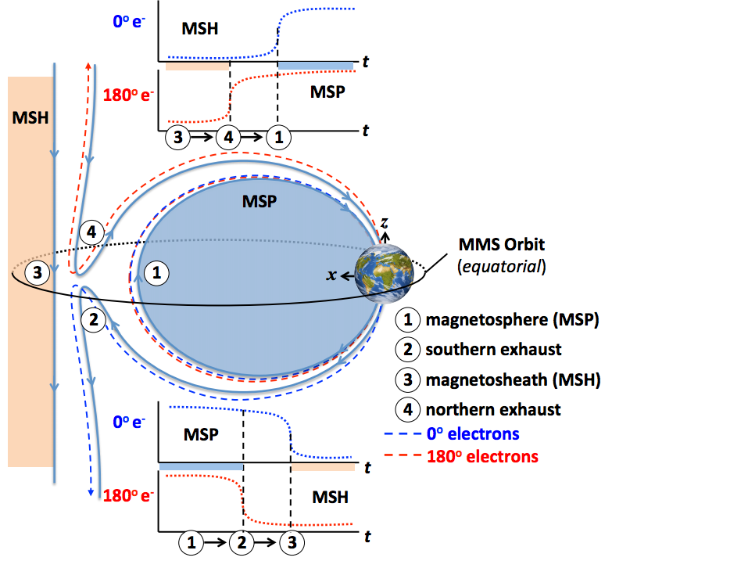
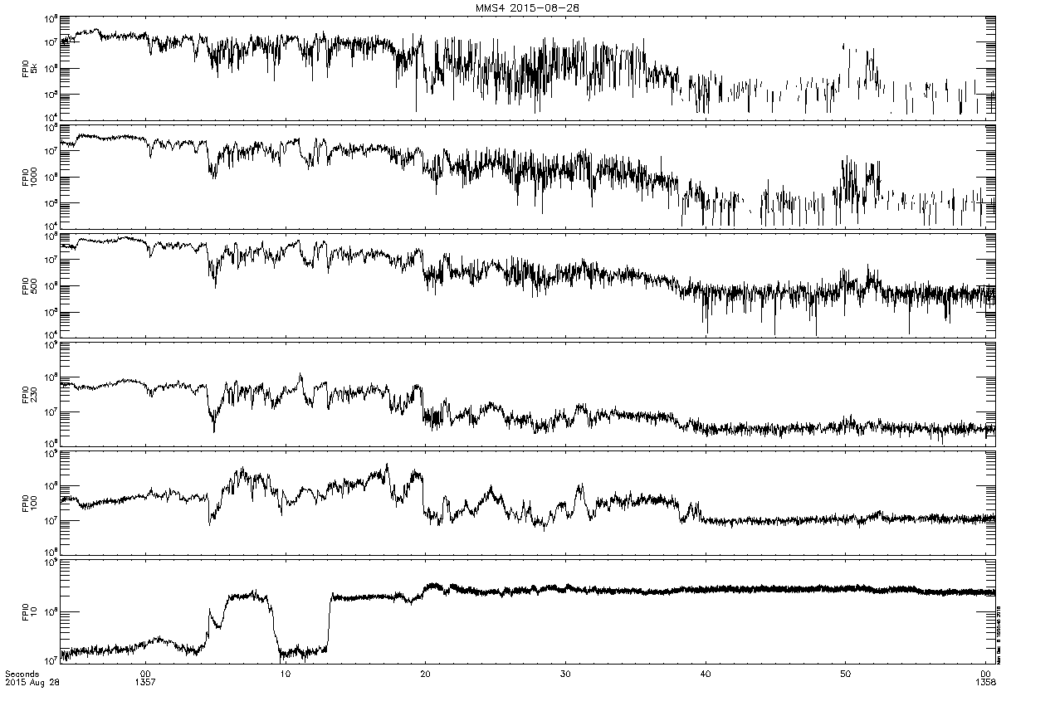
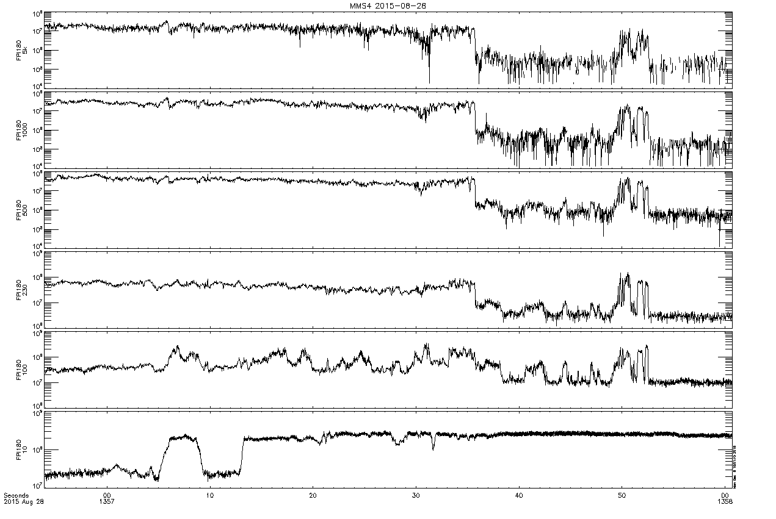
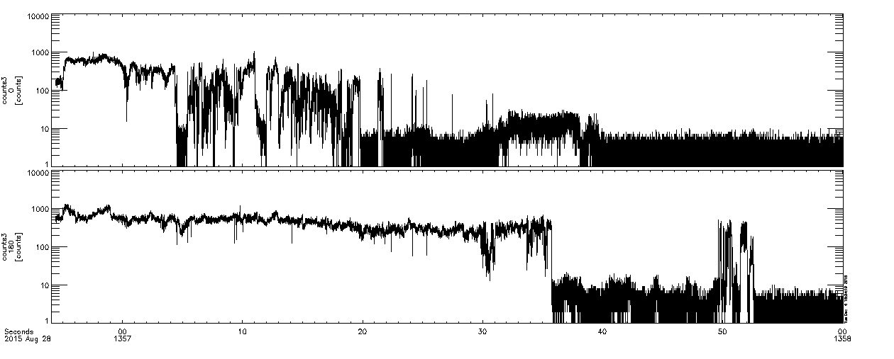
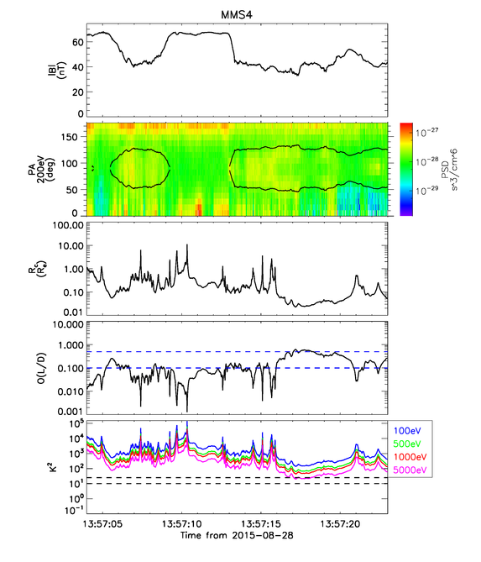
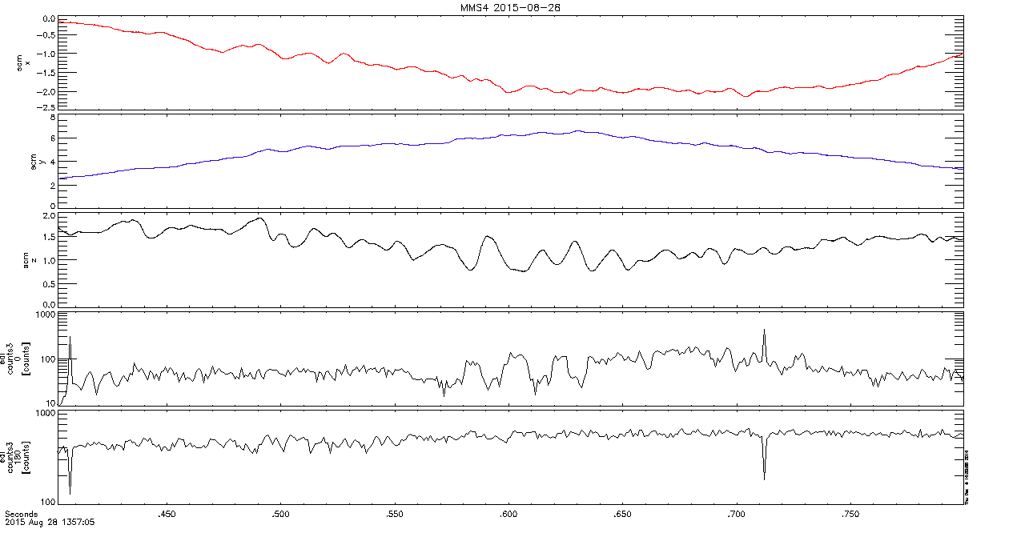
Characterization of Field Line Topologies Near the Magnetopause Using Electron Pitch Angle Measurements
D. S. Payne¹, M. Argall¹, R. Torbert¹, I. Dors¹, R. Ergun², C. Farrugia¹, B. Giles³, O. Le Contel¹, W. Magnes⁴, C. Russell⁵, H. Vaith¹
1. University of New Hampshire, Durham, NH, 2. University of Colorado, Boulder, CO, 3. NASA Goddard Spaceflight Center, Greenbelt, MD,
4. Space Research Institute, Austrian Academy of Sciences, Graz, Austria, 5. University of California, Los Angeles, CA
Abstract
Pitch Angle Gap & EDI Observation
Energy Comparisons with FPI
The electron drift instrument (EDI) on the Magnetospheric Multiscale (MMS) mission detects 0 and 180 degree pitch angle electrons on millisecond timescales. Using this data, we observe rapid variation of these electron fluxes in regions close to the magnetopause boundary. These variations in flux provide key insights into the dynamic field line configurations that arise from reconnection. These variations in the field detected by the spacecraft may be indicative of rapid reconnection or oscillations in the position of the boundary itself. By investigating these fluctuations near the magnetopause, we may be able to discover which of these processes, if any, are occurring. The results of this investigation may provide further insight into the process of reconnection and its effect on magnetic field topologies in the magnetosphere.
Gaps between changes in flux of parallel and antiparallel electrons
General Trend observed with EDI Data
Image credit *
Parallel
Antiparallel
Introduction
Parallel
Electron flux (from top to bottom): 5000 eV, 1000 eV, 500 eV, 230 eV, 100 eV, 10 eV
On either side of the magnetopause boundary lie two different particle populations that can be distinguished by their measured energy and flux. A spacecraft traversing this border from the magnetosphere into the magnetosheath should observe a distinct drop in the electron flux as it encounters the magnetosheath population. If the transition from the closed field lines of the Earth’s magnetosphere to the IMF were instantaneous, we should observe this drop in flux for electrons both parallel and antiparallel to the magnetic field simultaneously. However, we know that in between these two regions, magnetic reconnection between the IMF and the magnetosphere gives rise to reconnected field lines that have not yet convected toward the tail. Assuming a simple reconnection event, one end of these field lines extends into the IMF and the other is anchored to either the geomagnetic north or south pole. A spacecraft crossing this field line moving away from Earth should therefore observe a magnetospheric electron population going one direction along the field line, and a magnetosheath population going the opposite direction. It is only when the spacecraft finally crosses completely into the magnetosheath that it sees magnetosheath electron populations moving both parallel and antiparallel to the magnetic field. This method has also been utilized in previous publications
(e.g. Fuselier et. al. 1995, 2012)
Utilizing this principle within the regions where these electron populations mix, it should be possible to determine the dynamic magnetic field structures in these regions, where the reconnection events are often not as simple as an idealized case. The rapid oscillation of 500 eV electron fluxes near the magnetopause observed in high resolution EDI data is indicative of this. To use this pitch angle characterization method to make conclusions about what drives this phenomenon, it is important to eliminate any ambiguities such as signatures of scattering in the data that may be misinterpreted to be correlated with magnetic field structures. This study uses data from EDI, the Fast Plasma Investigation (FPI), and the Search-Coil Magnetometer (SCM) all on board the MMS spacecraft.
Field Curvature and the Scattering Parameter
Antiparallel
Comparison of magnetic field curvature radius to scattering parameter κ for various energies
κ is given by the ratio of the magnetic curvature radius to the gyroradius of the particle
Particles will tend to scatter at small values of κ
5 keV electrons close to scattering limit
This places an upper limit energy for electrons to be used as effective field line tracers
Parallel and Antiparallel electron data at a magnetopause crossing on August 28th, 2015
Comparison with SCM Magnetic Field Data
Conclusions
The electrons detected by EDI seem to be strong indicators of magnetic field structures on timescales beyond a few seconds. Comparison with SCM data seems to suggest that this may be the case on much smaller timescales as well. However, to what extent this correlation holds and what it may reveal about the causes of these fluctuations remains to be seen. By comparison of electron flux at various energies in FPI data, we can see that there are lower limits in energy where electrons can adequately describe dynamic field structures. By investigating the scattering parameter for various energies, we can also see that there exist upper limits in energy as well, beyond which this method may no longer be valid. Further study of this phenomenon at various other magnetopause crossings may help us further narrow our scope on the processes that drive these oscillations. Investigations regarding particles of varying energies, and thus varying gyroradii, and their relation to the scattering parameter may also help us learn more about the configurations of these fields and may even be used to determine the thickness of the magnetopause.
Parallel
Antiparallel
From Top to Bottom: SCM Magnetic field data (x, y, z), and electron data
References
Some observed correlation between B_{Z} and parallel electron fluctuations
Unclear if this is due to a moving boundary
Particle Signatures of Magnetic Topology at the Magnetopause, Fuselier, 1995
Dayside Magnetic Topology at the Earth’s Magnetopause for Northward IMF, Fuselier, 2012
*MMS FIELDS First Results 2015 Chapman CMD, MMS Team, 2015
Email: dsp1007@wildcats.unh.edu, Phone: 856-264-6185

