Slide 1


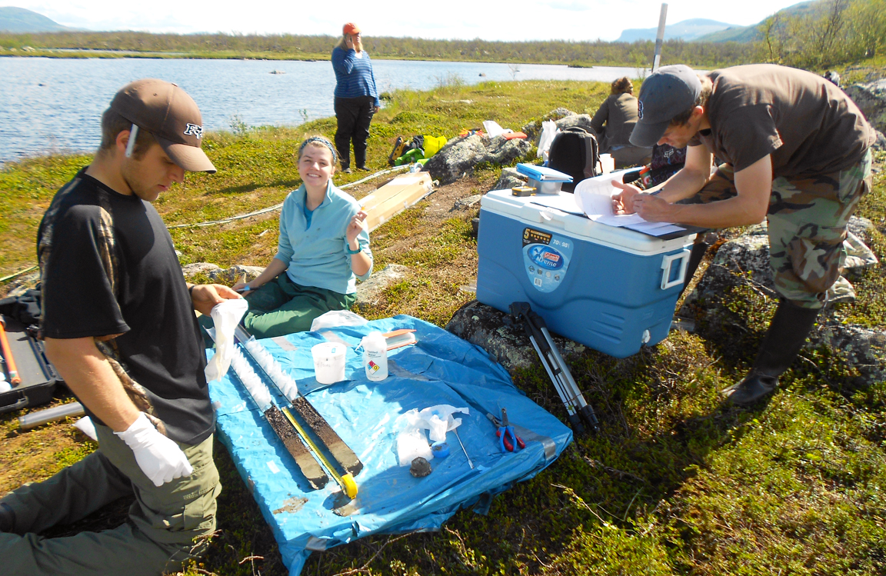
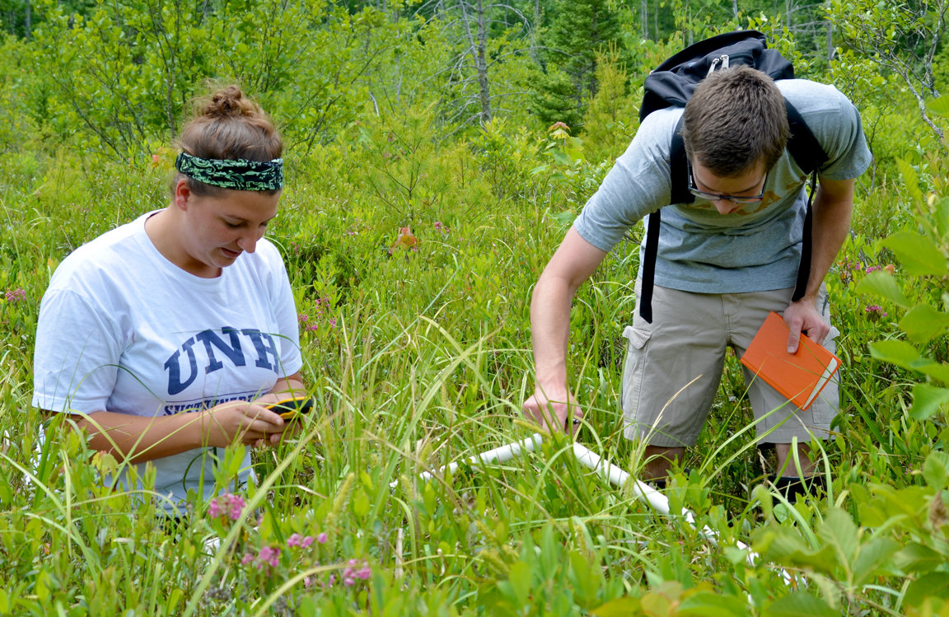
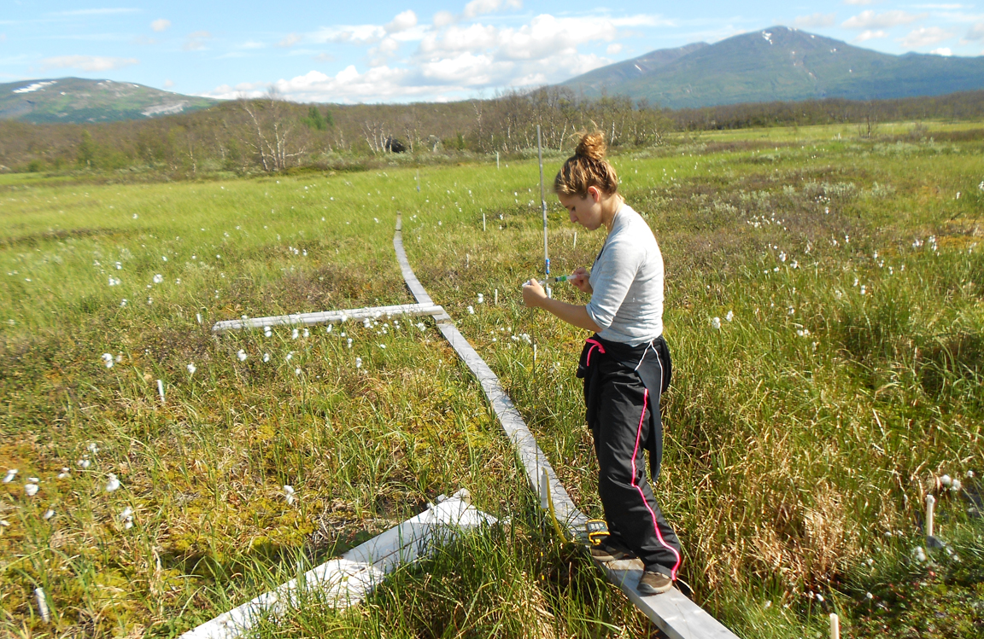
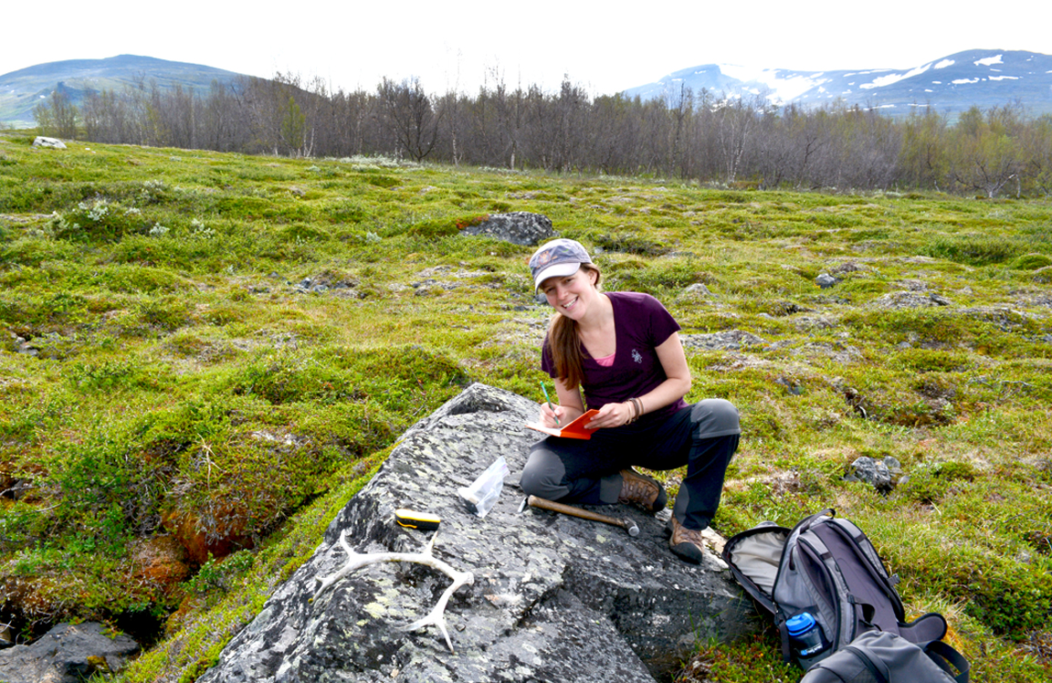


Formative Assessment as a Tool to Benefit the Student/Mentor Relationship in the
Northern Ecosystem Research for Undergraduates (NERU) Project
FROBURG, Erik¹ and VARNER, Ruth^{1,2,3} (1) Joan and James Leitzel Center for Mathematics, Science, and Engineering Education, University of New Hampshire, Durham, NH 03824, erik.froburg@unh.edu, (2) UNH Institute for the Study of Earth, Oceans, and Space, and (3) Dept. of Earth Sciences, UNH
Introduction
Summary
Partners in the Northern Ecosystem Research for Undergraduates (NERU) project, funded by the NSF Research Experience for Undergraduates (REU) program, have developed a multi-instrument formative assessment approach aimed at maintaining a responsive relationship between undergraduate participants and their research mentors. All evaluation is conducted independent of the NERU scientific/mentor team, by the Joan and James Leitzel Center for Mathematics, Science, and Engineering Education.
The 10-week summer research experience has 3 components: 1) REU fellows spend the first three weeks at the University of New Hampshire, where they acquire background knowledge of Earth System Science and biogeochemistry; 2) students spend the following 4-weeks at the Abisko Scientific Research Station conducting research, co-mentored by UNH-based and ANS-based scientists; and 3) fellows return to UNH to complete any additional analytical work, synthesize their results, and prepare their projects for presentation.
Taken as a whole, our formative assessment allows the project team to respond immediately to specific participant concerns, and to also make longer-term programmatic changes reflective of trends in survey and focus group responses.
Early mentor/student pairings were based, almost entirely, on student desires to conduct research on specific research topics, and the mentors’ interpretation of students’ strength and experience related to the topic. Focus groups with the early NERU cohorts indicated that, although the participants were finding success by normal academic measures, there were a number who did not feel a strong collegial connection with their research mentor. However, there was not consistency in how mentors were perceived, with some participants citing positive relationships with mentors that others had less success with. Probing questions in the focus groups suggested that both personal characteristics of the students and mentors, and the affective components of the research being conducted played a large role in the mentoring relationship. Although the sample size was very small, and we did not design our assessment intending to produce anything more than formative guidance, focus groups conducted with the final cohort seem to indicate greater participant satisfaction with the mentor/student relationship. Future work might include a more robust evaluation of this approach.
Provides summative program metrics
Provides baseline understanding of student preparation and perspectives
Pre-Survey
Added with the final cohort
Matches research goals, skills, and personalities
Mentor Pairing Survey
Approach
Two sessions held during the summer research experience
Provide immediate feedback and response
Based on our understanding of the importance of mentoring for undergraduate student growth in the sciences (Handelsman et al, 2005), particularly in intensive research experiences (Hunter et al, 2007), the formative evaluation of the NERU program was focused primarily on ensuring a high-quality mentor/student relationship.
We utilized pre- and post-surveys to establish a broad measure of our students’ experience, particularly in relation to self-efficacy in the various components of the scientific research process. We chose focus groups as our primary method for determining effectiveness in our mentor/student pairings. This choice was based on the strength of the instrument in eliciting aspects of social relationships, as well as its utility in promoting richer, more nuanced discussions than individual interviews or surveys (Morgan, 1988).
Based, in part, on situated learning theory (Lave & Wenger, 1991), and driven by our recognition that subtleties in personalities, and also affective components of the actual scientific research being conducted, were coloring the overall student experience, we developed and implemented a mentor pairing survey in the final year of the project.
Focus Groups
Post-Survey
Citations:
Handelsman, J., Pfund, C., Lauffer, S. M., & Pribbenow, C. M. (2005). Entering Mentoring. Madison, WI: The Wisconsin Program for Scientific Teaching.
Hunter, A.-B., Laursen, S. L. and Seymour, E. (2007). Becoming a scientist: The role of undergraduate research in students' cognitive, personal, and professional development. Sci. Ed., 91: 36–74.
Lave, J., & Wenger, E. (1991). Situated learning: Legitimate peripheral participation. Cambridge university press.
Morgan, D. L. (1988). Focus groups as qualitative research. Newbury Park, CA: Sage.
Acknowledgements: Support for this program is from the National Science Foundation’s REU-Site program grant EAR-1063037:
“REU Site: The influence of climate change on biogeochemical processes in northern ecosystems: An international perspective in Earth System Science”

