Slide 1


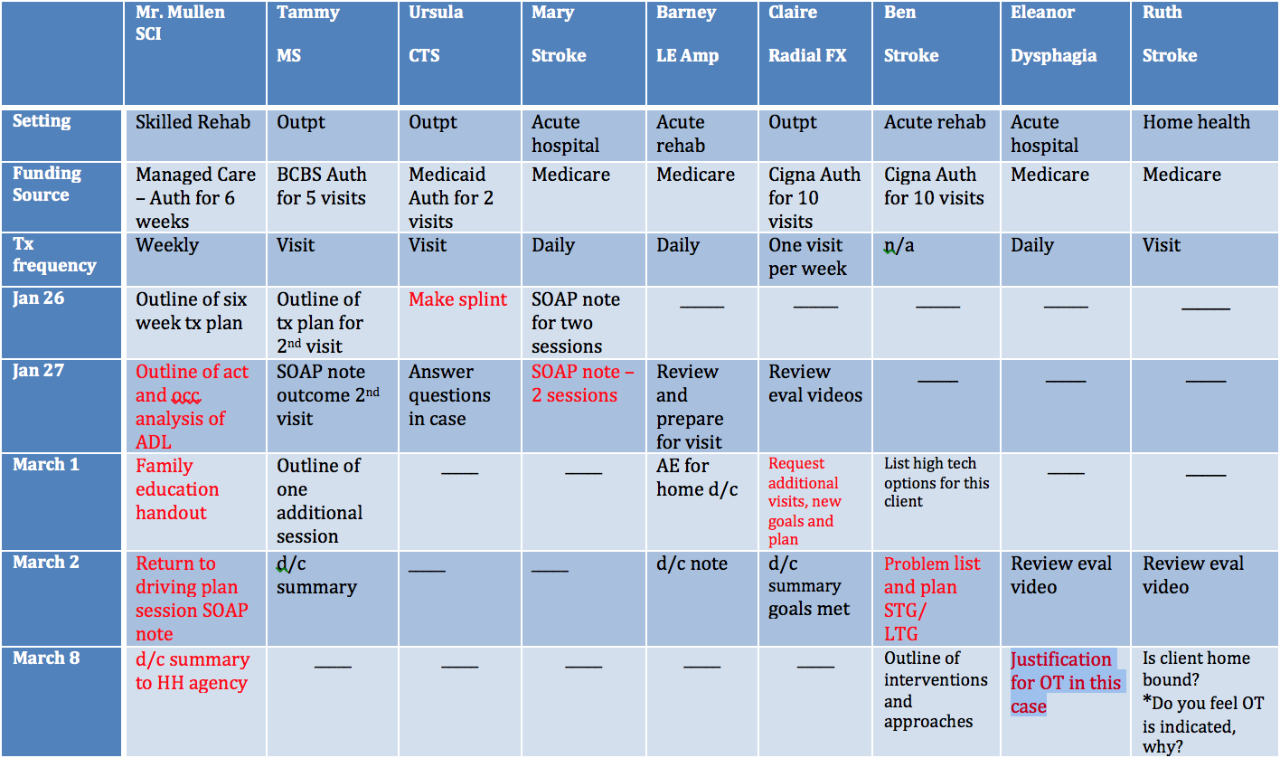
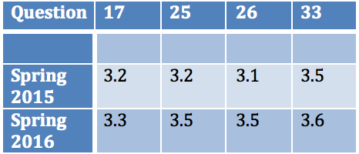
Small Change, Big Results: Using Case-Based Learning to Enhance Students’ Competence With Documentation Skills
During level II Fieldwork
Gabby Petruccelli, MS, OTR/L, BCPR and Tammy Bickmore, OTD, OTR/L
background
intervention
Student reflections
This 7 week course is situated in the final semester before level II FW and focuses on occupational performance and physical disabilities in adulthood. The case based content was designed to support enhancing skills in clinical reasoning and documentation as well as provide an intentional transition to the skills required for successful level II FW experience.
“I thought this class was extremely useful in increasing my skills for documentation. It gave me more confidence in my documentation skills and I learned a great deal by having to do the cases.”
“Loved how this course was designed. The work load was really heavy but I learned so much.”
“I really like the cases even though it was a lot of work. I feel more confident in my abilities and clinical reasoning with the population.”
“I appreciate how intensely clinically oriented this course was. The amount of clinical reasoning we were expected to do will really aid us come fieldwork.”
Problem Statement
  Students need to be better prepared with documentation and clinical reasoning skills to enter their level II experiences.
results
Literature review
Increased expectations for student to meet the varied demands of health care environments, while being prepared for documentation and clinical reasoning skills
Case based learning (CBL) offers an alternative learning approach to traditional classroom lectures, focusing on creative problem solving
Students and faculty share responsibility for understanding learning points.
Focuses the learner on the key points of a clinical case, including documentation, to better prepare students for clinical placements.
Future directions
Present cases weekly vs. assigning all at beginning of semester
Students will be competent to present full cases prior to beginning level II fieldwork. Focus of presentation will include documentation and clinical reasoning
Students will use instructors for real-time feedback (vs. grading) as this mimics supervisor/student relationship in clinical setting
Questions on AOTA Fieldwork Performance Evaluation
(17) Documents results of evaluation
(25) Updates, modifies, or interprets intervention plan
(26) Document’s clients response
(33) Produces clear documentation
References available upon request

Slide 2
This poster template provided courtesy of
UNH ESRC Poster Printing Services
Trust us to make your poster look GREAT!
Website: http://posters.unh.edu
Poster Guide: http://goo.gl/1E7TJY
DELETE THIS SLIDE BEFORE PRINTING

