Slide 1

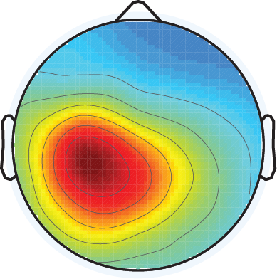
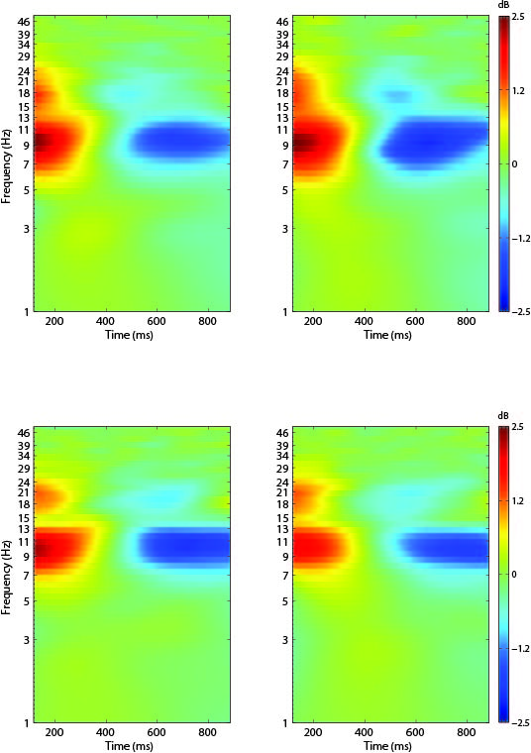
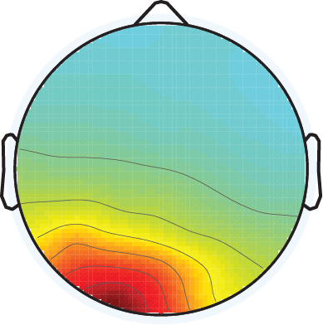
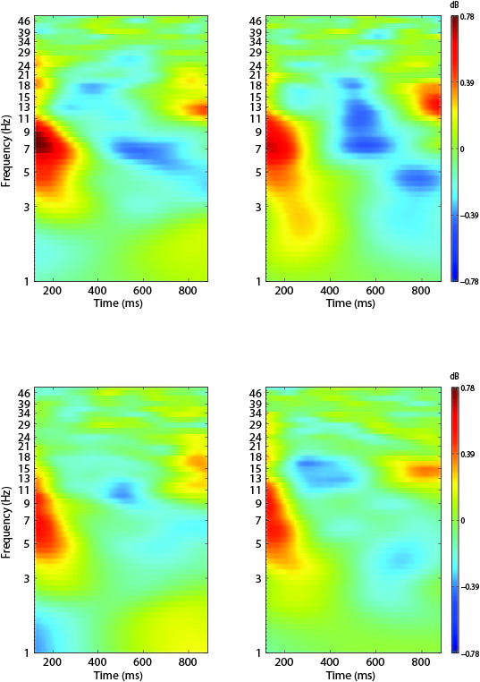
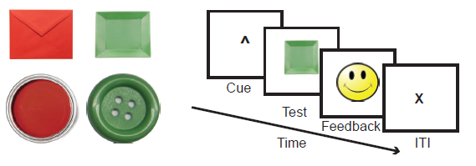
Variations in Oscillatory Power During Rule Switching
Paolo Medrano¹ and Robert S. Ross^{1,2}
University of New Hampshire, ¹Psychology, ²Neuroscience and Behavior
Background
Event Related Spectral Perturbation Results
Cognitive control allows for goal-directed selection of the appropriate action within a given context.
Cognitive control processes are hypothesized to operate as a function of dopamine release in dopaminergic circuits between the striatum and prefrontal cortex (Cools and D’Esposito, 2010).
Rule-switching is a cognitive control process related to flexibly switching tasks and maintaining cognitive state.
EEG research has associated alpha (8-12 Hz) and beta (13-30 Hz) activity with cognitive control processes.
The density of dopamine transporters vary based on genetic polymorphisms (Fuke et al. 2001).
Synaptic dopamine levels are hypothesized to vary as a function of these polymorphisms.
The present study investigated the influence of genetic differences in the dopamine transporter gene (DAT) on alpha and beta oscillations during a rule switching task.
DAT 9-carrier Switch
DAT 9-carrier Maintain
DAT 9-carrier Switch
DAT 9-carrier Maintain
Left Parietal Component Cluster
Left Occipital Component Cluster
Behavioral Paradigm
DAT 10/10 Switch
DAT 10/10 Maintain
DAT 10/10 Switch
DAT 10/10 Maintain
3s 2s 0.75s 2-4s
73 healthy individuals (36 9-carriers and 37 10/10 homozygotes) participated in this study
Participants were asked to differentiate stimuli based on two rules: color (red or green) or shape (square or circle)
Cues presented prior to stimulus presentation determined what rule the participant followed, and changed every few trials
Trials where cues changed from color to shape or vice versa were labeled switch trials
Trials that repeated the previous cue were labeled maintain trials
EEG Analysis
Behavioral Results
Conclusions
EEGLAB (Delorme et al. 2004) was used to preprocess the data.
Data was filtered from 1-50 Hz for oscillation analysis
Data was epoched in segments from -1000 ms pre-cue to 2000 ms post-cue and sorted into bins based on trial type (Switch, Maintain)
Trials were manually inspected for artifacts and removed accordingly.
Independent Component Analysis was run on participant data. Activity not fully separated by the initial ICA was manually removed and ICA was run again on the dataset.
ADJUST 1.1 (Mognon et al. 2011) was used to automatically remove artifactual components.
Component datasets were entered into EEGLAB, and STUDY was used for component clustering and analysis.
Accuracy and response time by trial type
Polymorphisms involving the dopamine transporter gene (9-carrier and 10 repeat) do not affect behavioral measures of task accuracy and reaction time.
Within a left parietal component cluster, 10/10 homozygotes display decreased theta power from about 150 ms to 200 ms post-cue presentation.
Increased dopamine transporter transcription in 10/10 homozygotes may be playing a role in the decreased theta power in the early 150-200 ms time frame.
Within the left parietal cluster, a greater decrease in theta power is observed in 9-carriers from roughly 400 to 600 ms post cue presentation.
Decreased dopamine transporter transcription may be playing a role in the significant decrease in theta power observed in 9-carriers in the 400 to 600 ms time frame.
In a left occipital component, differences in delta power were observed in 9-carriers’ switch and maintain trials
Previous studies have shown that 10/10 homozygotes display better cognitive stability while 9-carriers display better cognitive flexibility (Garcia-Garcia et al., 2010)
9-carriers decrease in theta at 400-600 ms post-cue presentation may be related to their ability to perform at the same level as 10/10 homozygotes.
Trial type | Accuracy ± SD | RT (ms) ± SD
Switch | 0.91 ± 0.08 | 870.87 ± 142.30
 | 0.91 ± 0.06 | 843.69± 180.59
Maintain | 0.96 ± 0.04 | 831.84± 159.71
 | 0.95 ± 0.04 | 809.99± 181.01
Maintain +1 | 0.96 ± 0.04 | 829.60± 152.39
 | 0.97 ± 0.03 | 811.82± 190.13
Maintain +2 | 0.96 ± 0.04 | 832.90± 162.57
 | 0.97 ± 0.03 | 787.84± 174.44
Maintain +3 | 0.97 ± 0.05 | 836.54± 150.44
 | 0.95 ± 0.05 | 797.42 ± 184.95
Switch
Maintain
Switch
Maintain
Gray: 9-carriers
White: 10/10 Homozygoes
References
Cools, R., & D’Esposito (2010). Dopaminergic modulation of flexible cognitive control in humans. In: Dopamine handbook. Eds A. Björklund, S. Dunnett, L. Iversen, S. Iversen. Oxford University Press. pp 249-260
Delorme, A., & Makeig, S. (2004). EEGLAB: An open source toolbox for analysis of single-trial EEG dynamics including independent component analysis. Journal of Neuroscience Methods, 9-21.
Fuke, S., Suo, S., Takahashi, N., Koike, H., Sasagawa, N., & Ishiura, S. (2001). The VNTR polymorphism of the human dopamine transporter (DAT1) gene affects gene expression. The Pharmacogenomics Journal, 152-156
Lopez-Calderon, J., & Luck, S. (2014). ERPLAB: An open-source toolbox for the analysis of event-related potentials. Frontiers in Human Neuroscience.
Garcia-Garcia, M., Barceló, F., Clemente, I. C., & Escera, C. (2010). The role of the dopamine transporter DAT1 genotype on the neural correlates of cognitive flexibility. European Journal of Neuroscience, 31(4), 754-760.
Mognon, A., Jovicich, J., Bruzzone, L., & Buiatti, M. (2010). ADJUST: An automatic EEG artifact detector based on the joint use of spatial and temporal features. Psychophysiology, 229-240
Rossato, J. I., L. R. M. Bevilaqua, I. Izquierdo, J. H. Medina, and M. Cammarota. Dopamine Controls Persistence of Long-Term Memory Storage." Science (2009): 1017-020.
Acknowledgements
Many thanks to Taylor Picard, Sara White, Stephanie E. Barlow, Timothy Gray, Cassandra Raphel, and all current and past members of the Laboratory of Brain Science and Cognition for your support in making this presentation.

