Slide 1


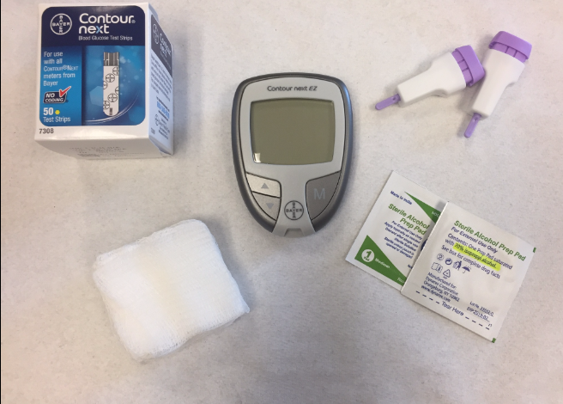
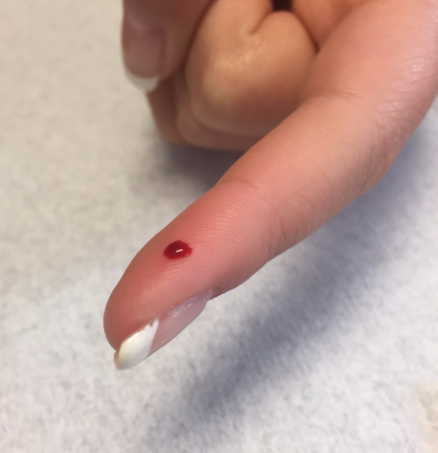
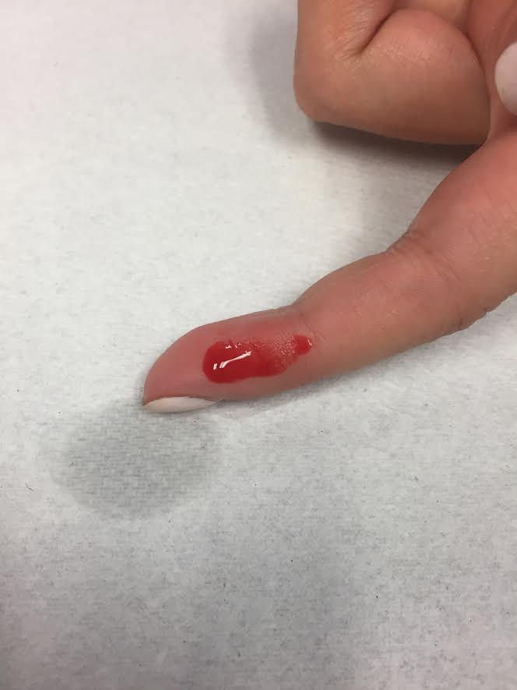
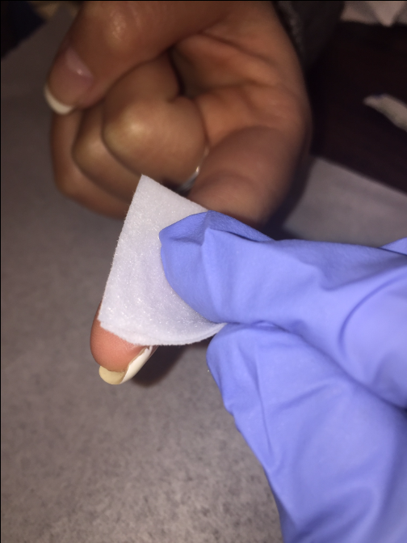
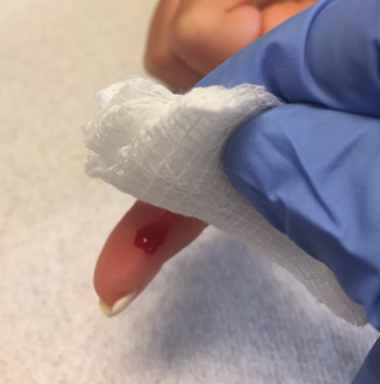
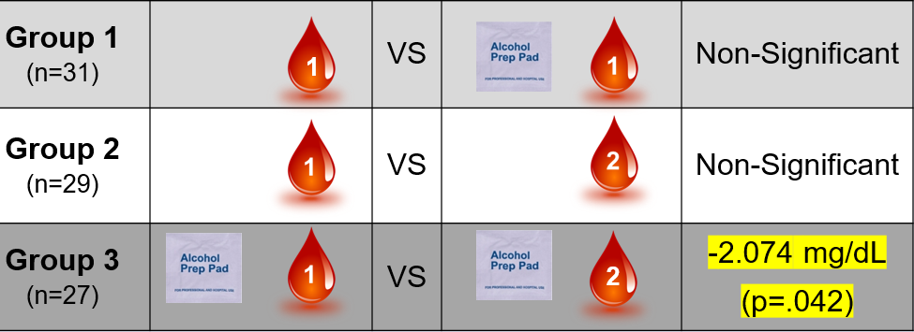
The Effect of Alcohol Prep Pads and Blood Drop Number
On Capillary Blood Glucose Values
Joanna Foos  University of New Hampshire  Department of Nursing
Background
Methods
Discussion
  Capillary blood glucose testing is a common nursing procedure that leads to critical patient care decisions.
  After cleaning the fingertip with a 70% isopropyl alcohol prep pad, some nurses wipe away the 1st drop of blood, and test the 2nd drop, to lessen the impact of alcohol.
  No consensus exists on the impact of alcohol or the necessity of wiping away the 1st drop of blood.
  Quantitative, quasi-experimental design
  96 volunteers randomly assigned to 3 groups
  Each group underwent a pair of blood glucose tests
  Group 1: no alcohol + 1st blood drop VS. alcohol + 1st blood drop
  Group 2: no alcohol + 1st blood drop VS. alcohol + 2nd blood drop
  Group 3: alcohol + 1st blood drop VS. alcohol + 2nd blood drop
  Neither alcohol prep pads alone, nor blood drop number alone, affect blood glucose values.
  A 2.074 mg/dL difference is clinically insignificant.
  Data from 2 subjects was eliminated due to failure to form round blood drops. Values from these blood drops showed alcohol dilution.
Rounded blood drop
Diluted blood drop
Testing supplies
Conclusions & Implications
Alcohol prep pads do not significantly affect capillary blood glucose values.
It is not necessary to wipe away the 1st drop of blood, even when alcohol is used to prepare the fingertip.
Future studies should investigate whether poorly formed blood drops impact blood glucose values.
Results
Research Questions
Do 70% isopropyl alcohol prep pads affect capillary blood glucose values (Group 1)?
Is there a difference between blood drop 1 and blood drop 2 when no isopropyl alcohol is used (Group 2)?
Is there a difference between blood drop 1 and blood drop 2 when isopropyl alcohol is used (Group 3)?
  ANOVA revealed no difference between Groups 1-2, 2-3, or 1-3 regarding mean values.
Acknowledgements
Many thanks to Dr. Sue Fetzer, faculty advisor; Dr. Joanne Samuels, honors program coordinator; and Dr. Beth Evans, laboratory coordinator. This project was funded by Sigma Theta Tau, Eta Iota Chapter.

