Slide 1
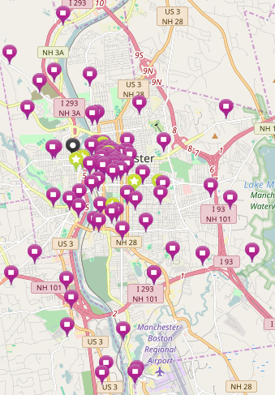
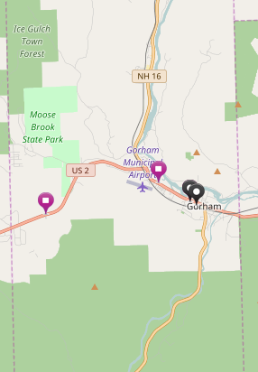

New Hampshire's Healthy Families America (HFA) Program: Rural versus Urban Community Networks
Laurissa Galipeau, B.S. Communication Sciences and Disorders Trainee
BACKGROUND INFORMATION:
The Carsey School of Public Policy at the University of New Hampshire conducts research, policy education, and leadership engagement. In collaboration with the Institute on Disability, they are currently evaluating New Hampshire's Healthy Families America (HFA) maternal, infant, and early childhood home visiting program for families facing multiple challenges to their health and well-being. This program is aimed at promoting child well-being and preventing the abuse and neglect of children throughout the country through intensive home visiting services. Carsey is specifically looking at the systems level of program implementation and operation of the program at eleven sites in New Hampshire.
Approximately 1 mile/2 KM view
RESULTS:
There are 20 different service categories that were included in coding community partners for this project. In Gorham, NH, a rural northern town, there are only five services/community partners available to residents within the town. All five of these sites were community partners of the HFA site located in Gorham. Two of the partners were located within the HFA site itself. This HFA site is networked with many other organizations and service providers, but they are widely dispersed throughout the North County region. The remainder of service providers were an average of 27.3 miles away from the HFA site.
In Manchester, NH, an urban city, there were 106 community partners that families could use within the city. They represented a large variety of services available and 105 out of 106 sites were linked with the HFA located in Manchester. The average distance from the HFA site was 1.82 miles.
PROJECT DESCRIPTION:
This LEND leadership project has involved coding community organizations and service providers that are networked with New Hampshire’s HFA program site locations. The networked organizations and providers were coded based on the types of services that they provide for families. We are evaluating the availability of services located in rural versus urban regions and comparing the distance of these services across settings. Additionally, we are determining how many community partners each of these HFA sites currently connect within their region.
Locations of 106 community partners of the Manchester HFA site that provide services HFA families may need. Note that they cluster in a small geographic area.
Locations of 5 community partners of the Gorham HFA site that provide services that HFA families may need. Note that there are only a few partners within the town
IMPACT ON LEADERSHIP EDUCATION:
This program has given me a new perspective concerning the different system levels within this project. I have learned a lot about the increased barriers facing low income families in rural areas. It is immensely important that the HFA sites are connected to connect these to resources in their areas to ensure that these families connect with the resources that they need. This is vitally important in rural areas where there are fewer resources and they are much more spread out. They may have to travel across different towns to get the services that they need for their families.
FOR MORE INFORMATION PLEASE CONTACT:
Eleanor M. Jaffee, Ph.D.,
Evaluation Program Director
eleanor.jaffee@unh.edu

