Slide 1
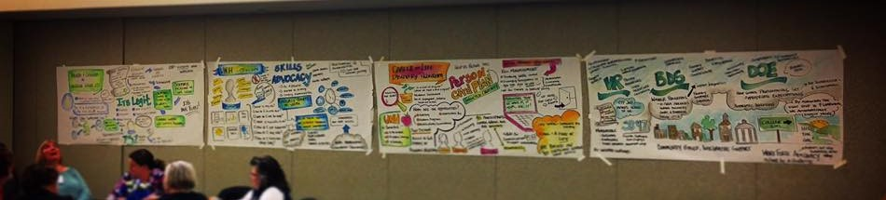
What It Takes: Levels of Leadership
Julia Williams B.S. Nutrition and Dietetics
Goals:
Observe and document the different levels of leadership needed to become a Comprehensive Transition Program (CTP). A CTP is a degree, certificate, or non-degree program for students with intellectual disabilities.
New Hampshire does not currently have an inclusive higher education program for Students with Intellectual Disabilities (ID) anywhere in the state.
Background:
Currently in NH there is no inclusive higher education program for Students with ID.
The initiative at UNH has been to develop a plan to implement a CTP program that will not only benefit Students with ID but students, employees, and community members around the University.
People with disabilities have the lowest rates for education, work, or prep for work post high school.¹
In August 2016 the labor force participation rate for people without disabilities was 76.3% vs. people with disabilities at 30.4%.¹
From 2010-2014 employment trends for adults with ID remained between 14-16%. Rates for students who exited an inclusive higher education program have risen from 16% (2010) to 40% (2015).²
Access to higher education through programs like a CTP has shown the impact that further learning can have on competitive employment for Students with ID.⁵
Institute on Disability (IOD):
The Institute on Disability at UNH (IOD) envisions and promotes full access equal opportunities, and participation for all persons through strengthening communities and advancing policy and systems change, promising practices, education, and research. The IOD is working toward a future where all people are fully engaged within their communities while providing appropriate supports to encourage a satisfying quality of life. ³
NH-ME LEND Program:
The Institute on Disability at UNH (IOD) envisions and promotes full access equal opportunities, and participation for all persons through strengthening communities and advancing policy and systems change, promising practices, education, and research. The IOD is working toward a future where all people are fully engaged within their communities while providing appropriate supports to encourage a satisfying quality of life. ⁴
My Contributions:
Documentation of the different levels of leadership that go into receiving a CTP credential.
Attending a CTP retreat, sitting in on the President’s Commission on the Status of People with Disabilities meeting at the University, analyzed employment data, and sat in on advancement meetings.
Overall I met and engaged with the many leaders involved in initiating this program at the University of New Hampshire and learned why there is such a need for inclusive higher education for Students with ID, not only at UNH but nation wide..
Campus Resource
Faculty Mentors
Community Resources
Area Agencies
Transition Coordinators
Funding
Vocational Rehab
Parents
UNH Deans
High Schools
Parents
Students
Think College
UNH Financial Aid Office
Development / Advancement
Bureau of Developmental Services
Institute on Disability
Students
Leadership Takeaways:
Engaging in this project has taught me that leadership is never just one person or group of people, it is a construct that takes many different inputs and aspects to have better outcomes.
Watching the work being done to bring the comprehensive transition program to UNH has reiterated this for me.
In my studies we have called the transition from high school to post high school life for persons with disabilities falling off the cliff. As I see it, this program is the bridge from high school to postsecondary education.
This placement has shown me the opportunities and leadership capability needed to close gaps within the disability field.
Notes:
^

