Slide 1


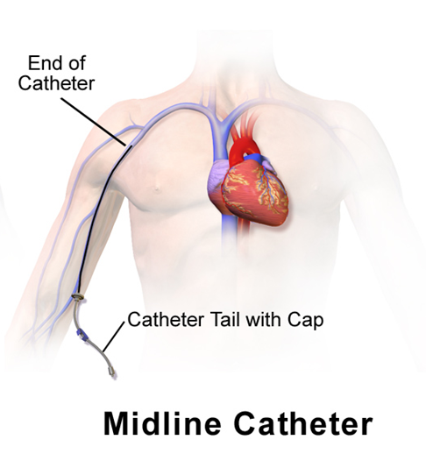
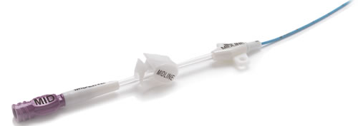
Midline Catheters at Portsmouth Regional Hospital
Joanna Foos  Senior Nursing Student  University of New Hampshire
Background & Purpose
Policy Summary
Supporting Evidence
  Midline catheters are peripheral, venous access devices that enter through a large vein near the antecubital (AC) fossa and extend no further than the axilla.
  Recently, Portsmouth Regional Hospital has increased its reliance on midline catheters.
  Nursing personnel are relatively unfamiliar with midline catheters and unsure of how to care for them.
  The purpose of this poster is to review and summarize the current policy on midline catheters.
  This poster will also review the literature on midline catheters make evidence-based recommendations for Portsmouth’s policy.
  Research Questions: In a acutely ill adults, does the midline catheter policy increase adequate venous access while decreasing complication rates at Portsmouth Regional Hospital?
Indications | Patients requiring standard peripheral intravenous therapy. Therapy expected to last more than 5, but less than 29 days.
Insertion and Removal | Inserted by Interventional Radiology Removed by RN only
Days Indwelling | ≤29 Days
Assessment & Documentation | Assess q4 hours Document insertion, removal and shift assessment (NOT central line daily note)
Medication Administration & Flushing | Scrub the hub 15-20 seconds Flush with 10 mL before & after each use Flush Q12 hours Always use 10mL syringe or larger
Infusion Therapy | Do NOT use midline catheters for: TPN Vesicant drugs Dextrose >10% or osmolality >900mOsm/L
Dressing Change | Every 7 days and PRN Use sterile dressing kit Apply a Biopatch and StatLock
Blood Draw Indications | Phlebotomy is the best option Midline catheters may be used for blood draws when: Known failed phlebotomies/poor venous access Poor skin condition (skin tears) Coagulopathy Palliative care comfort measures Blood culture draw when a diagnosis of infected line is being considered
Blood Draw Procedure | Stop infusion 5 minutes prior Wash hands & don gloves Scrub the hub for 15-20 seconds Aspirate and discard 5mls of blood Aspirate blood sample Flush lumen with 20mls of saline
Miscellaneous | No venipuncture or blood pressure in the arm with the midline. Midlines at PRH have 1 lumen Midlines are NOT central lines
  Midline catheters cannot accommodate rapid fluid infusion; they are also unreliable when infusing via gravity tubing and should always be used with an infusion pump (Griffiths, 2007).
  In some studies, midline catheters have remained patent for >200 days. Strict removal guidelines are unhelpful (Griffiths, 2007).
  Midlines are experiencing a resurgence because of an improved material quality. The improved materials can accommodate higher pressures and do not require 10mL + syringes (Moreau, 2016).
  In a ventilator unit, the use of midlines (vs. central) significantly decreased rates of line-associated bacteremia (Pathak, 2015).
  Under indications, emphasize that midlines are not a good option for patients who may require rapid fluid infusion or infusion via gravity/pressure bag.
  Seek guidance from the midline manufacturer on the necessity of using a syringe ≥ 10mL; Likely unnecessary.
  The number of days indwelling should not be a firm 29; rather, the days indwelling should be dictated by the patient’s required length of therapy and midline condition.
  Educate staff on the benefits of midlines including decreased rates of bacteremia.
  Educate staff to question before administering anything through a midline: could I administer this through a peripheral? Only continue if the answer is YES.
  Future research should evaluate PRH’s experience with midlines.
Recommendations & Implications
*See PRH policy stat for full policy*
Notes:
In

