Slide 1


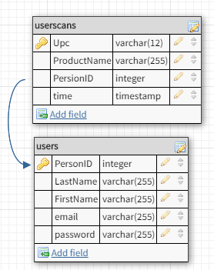
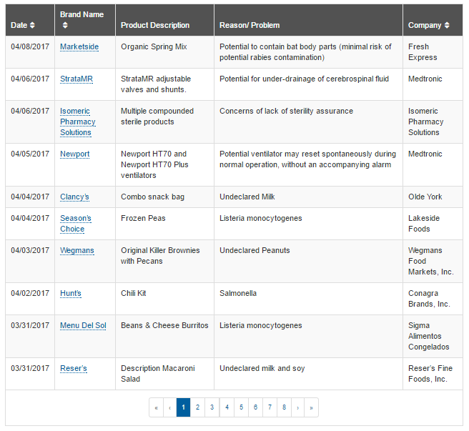
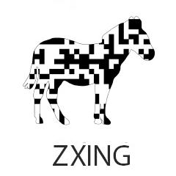


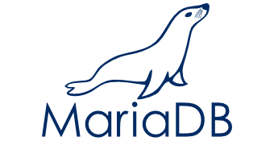

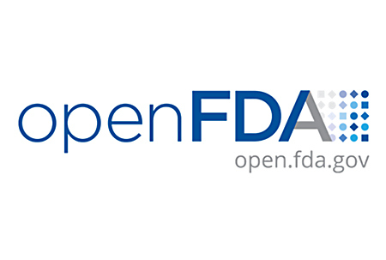
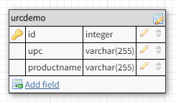


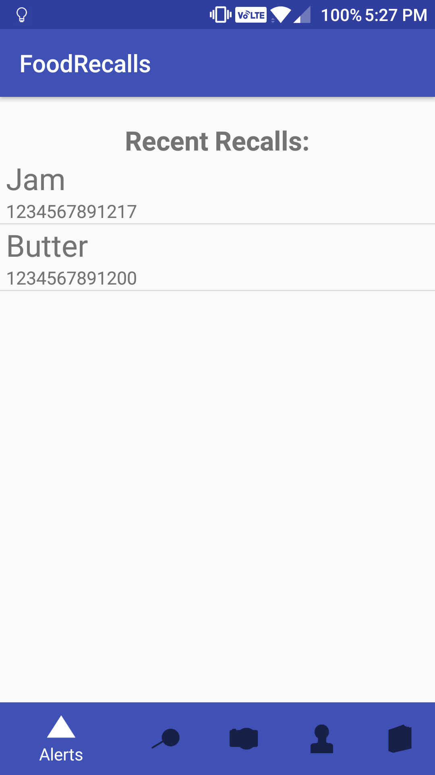
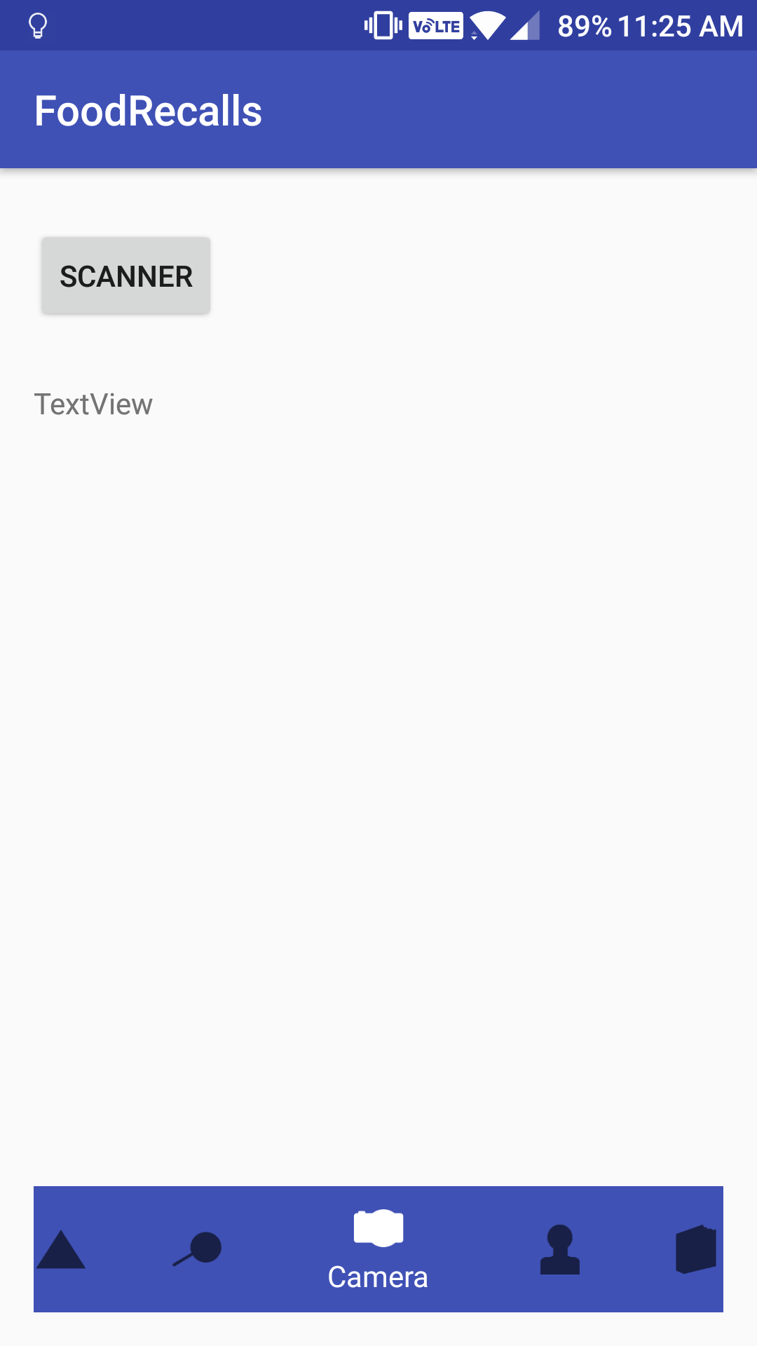
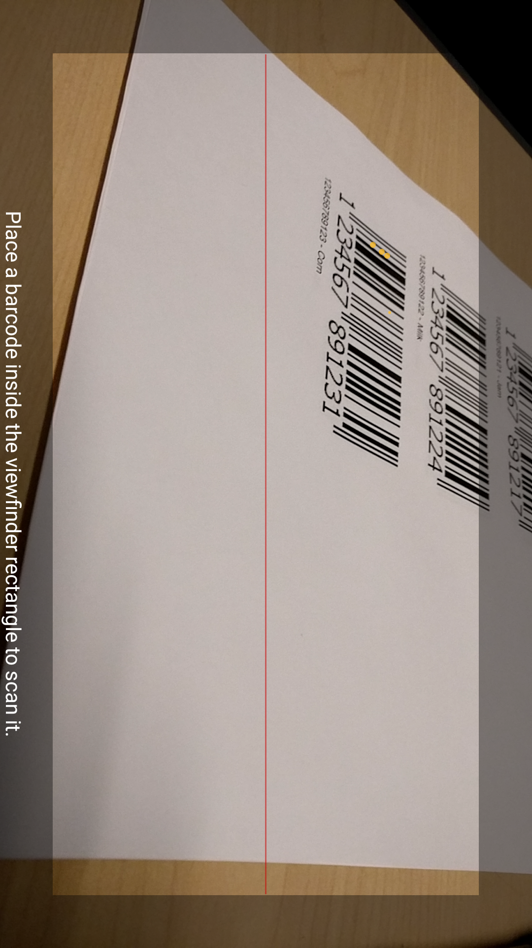
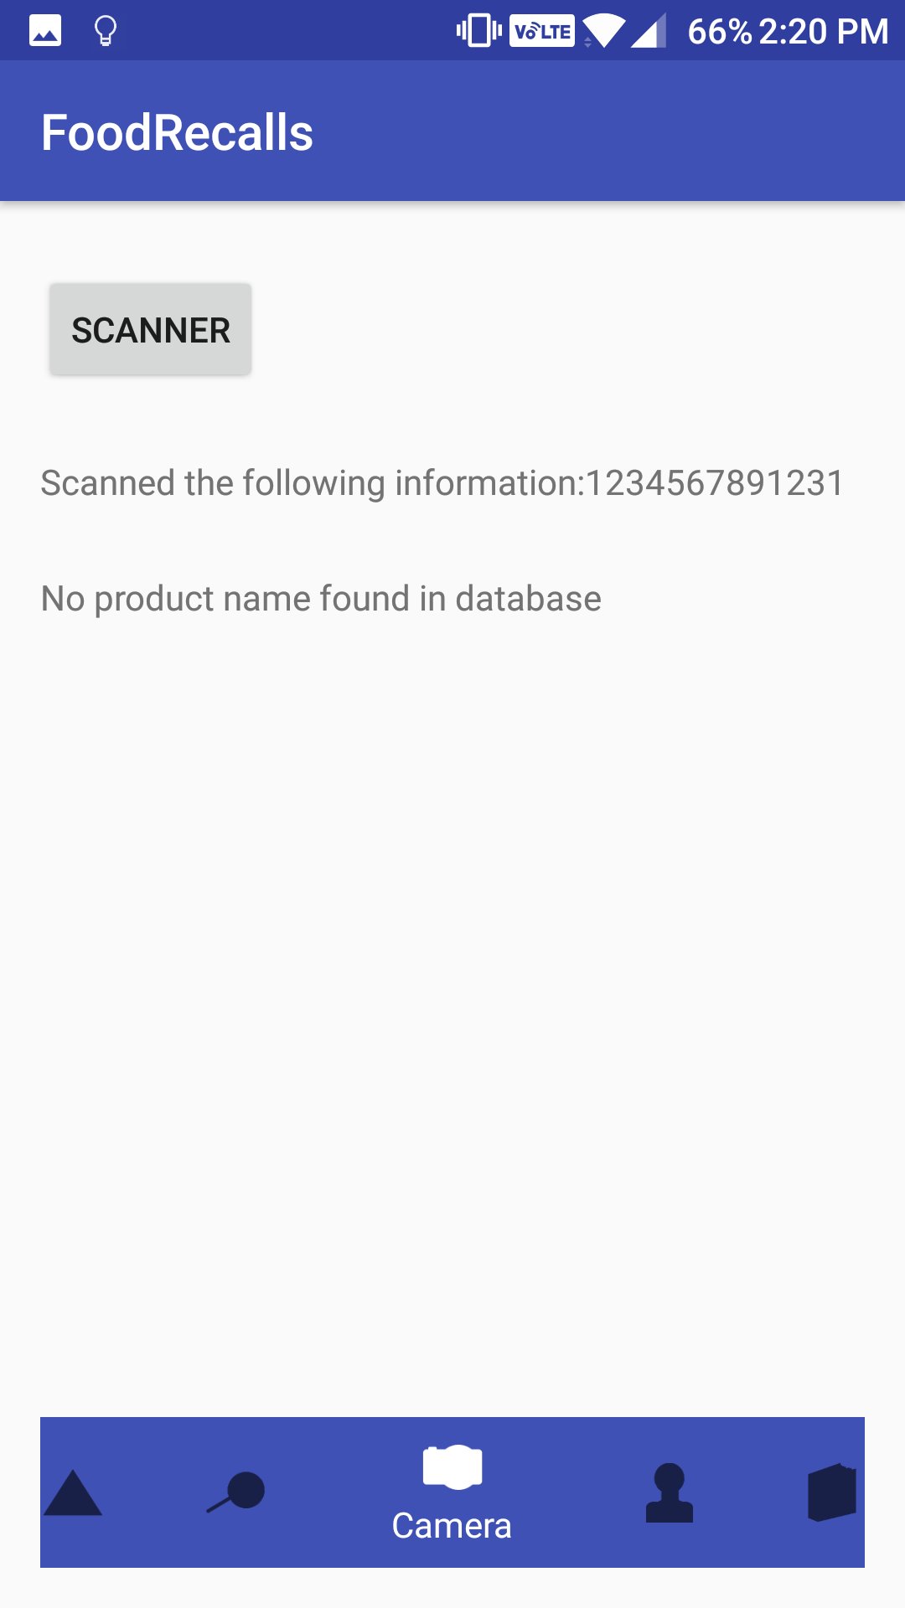
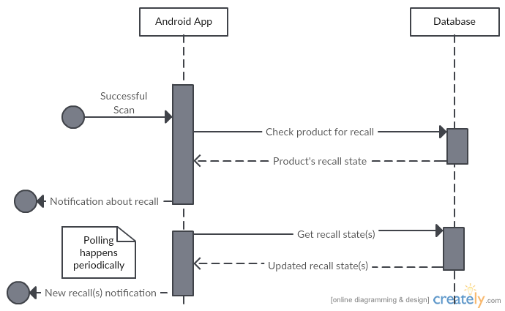
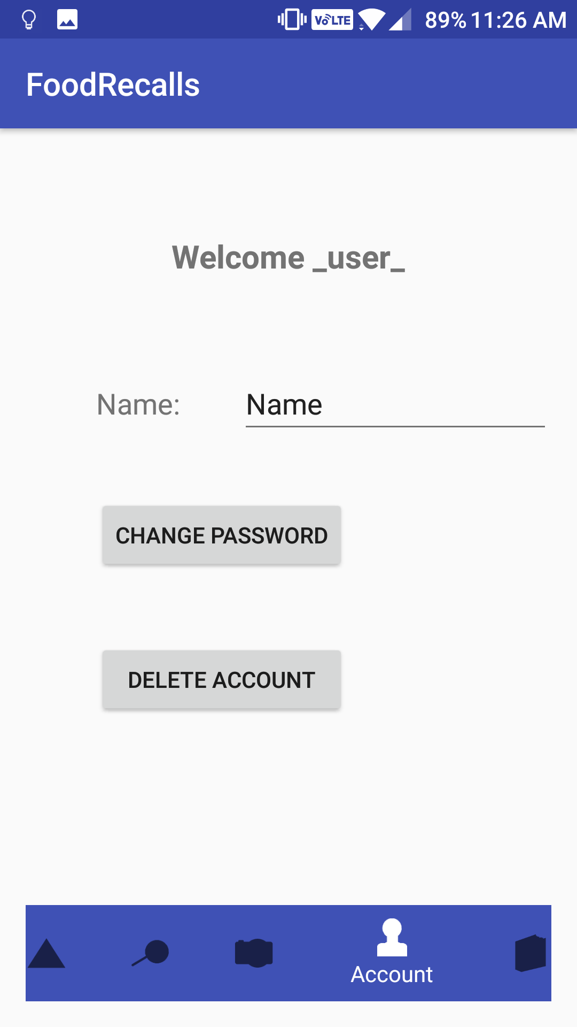
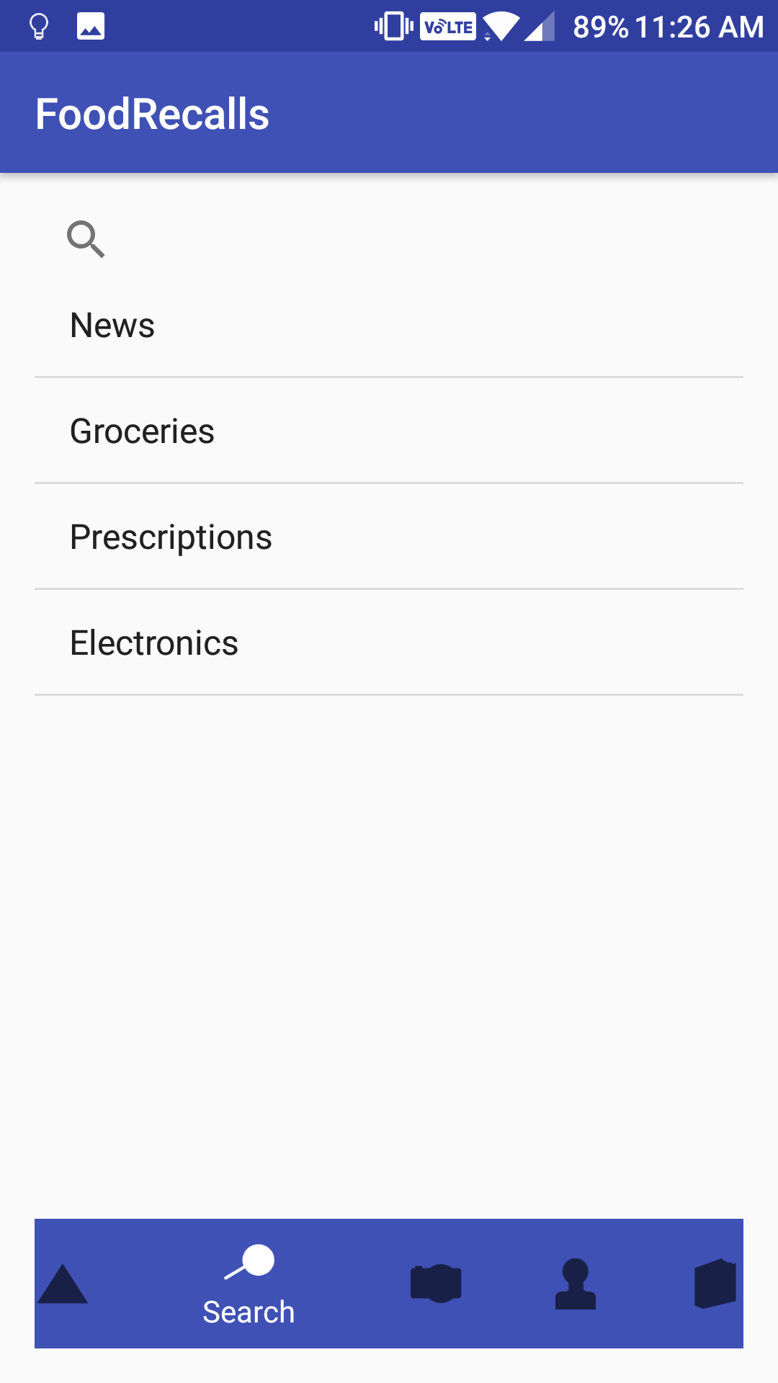
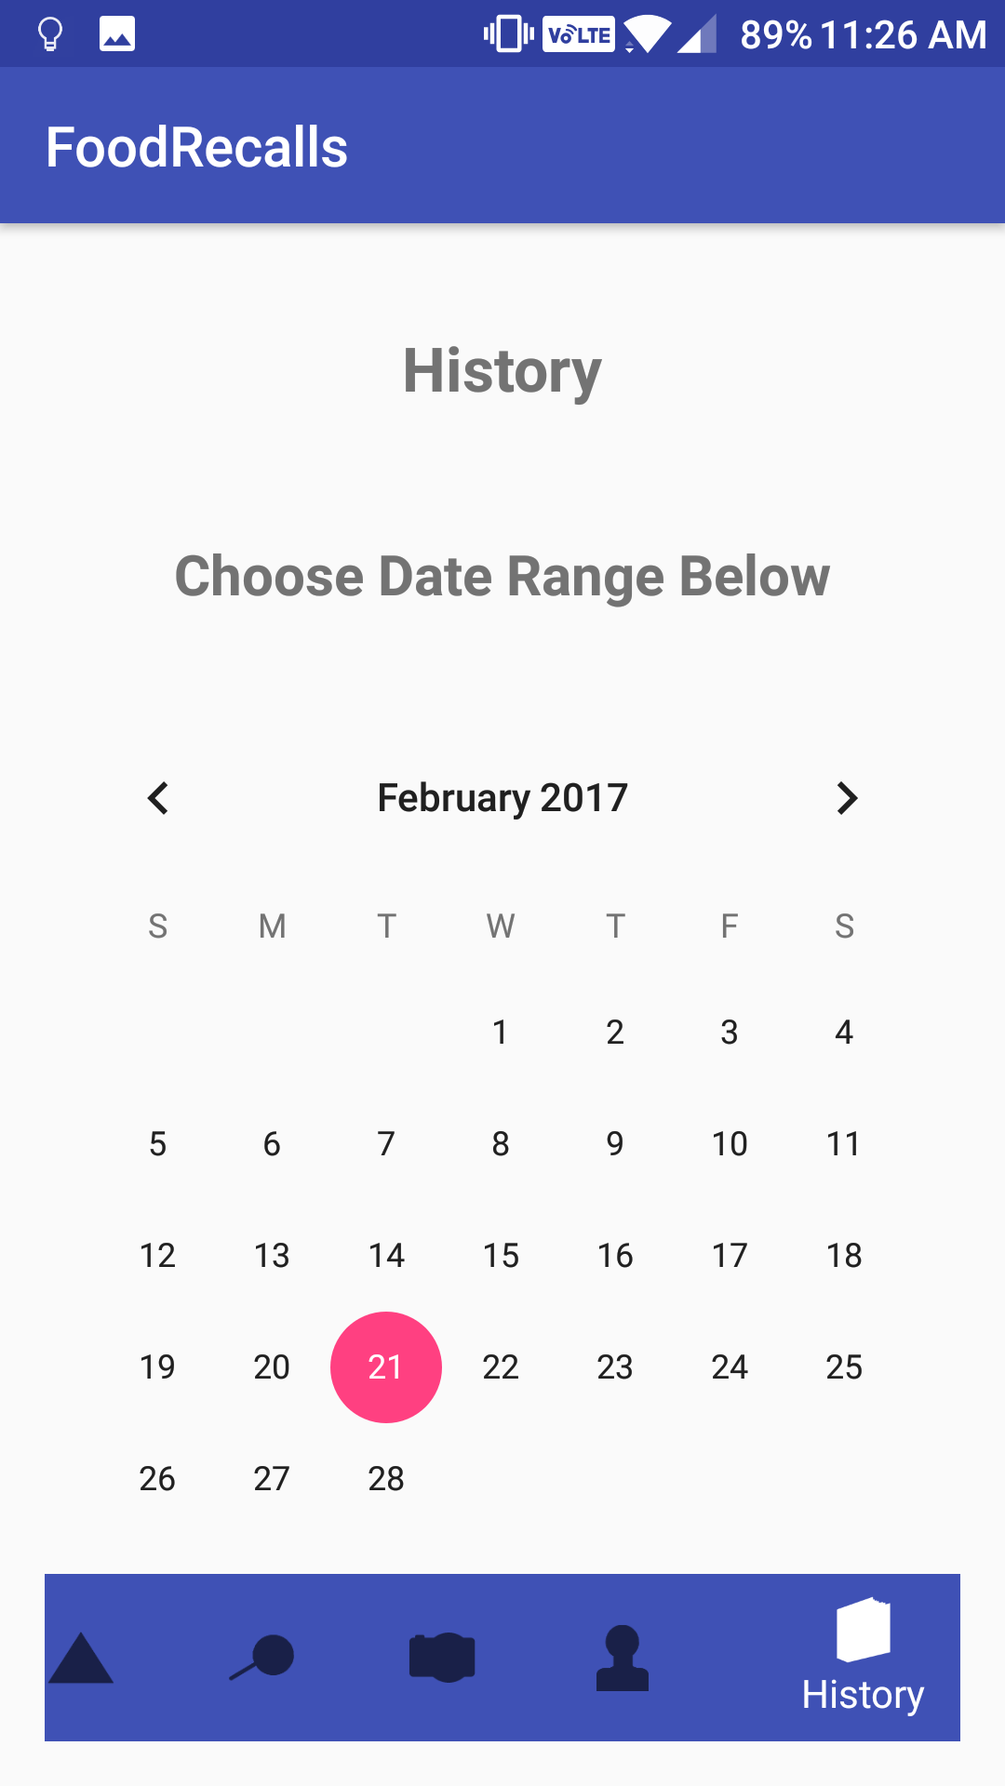
University of
New Hampshire
Food Recall Application
Jasdeep Singh | Zachary Mailhot | Advisor: Matt Tonelli
Department of Computer Science and Information Technology, University of New Hampshire, Durham, NH
Database
Problem
Software & Libraries
· Database engine: Mariadb
· Two tables: users info & user scans. Demo table for URC called urcdemo
· Use of Apache & MySQL from XXAMP for hosting
· Export databases created in Mariadb and imported into phpMyAdmin
Recall information is not targeted to individuals
Best way to keep track is of recall information is through FDA recall table seen to the left
Searching through tables on webpages on a mobile device can be time consuming and frustrating
Recalls are not common knowledge unless explicitly stated by media
Alerts
How it works
· It will contain all recalls that are relevant to the users scan history
· The application will have an in-app recall notification but also a push notification to alert users of a recall that is relevant to them
· Even if the application is not actively open they will receive information about their products
Scanner
Press scan button
Successful scan
Recent
Recalls
· Implemented using “ZXing” or “Zebra Crossing”. Chosen because of its ability to be multi-platform, which will be important for later use
· Successful scan of the UPC number is mapped to a product name using upcdatabase.org
Scan in a UPC of any product
Receive updates on the recall status of that product
Unique history and notifications based on your scan data
My Account
Search/History
· History page is used to select a date range to display items scanned within that range
· Search page has items that have been recalled or allows the user to search for the most recent recalls on a particular product
· Account based system allows application to provide a unique experience based on what each user has scanned
· The user is also able to change their account information and/or delete their account
· Accounts allow for each user to have a personalized report of recalls as opposed to being alerted by every recall that is released
Conclusion
Future Plans
Finding recalls that may not be communicated by media
Users only receive recall notifications on products they find important
Simple UI compared to alternative options
Bar code on bottom of receipt to scan in all products at once
Partnership that allows us to get more information from UPC’s
Expanding to different platforms

