Slide 1


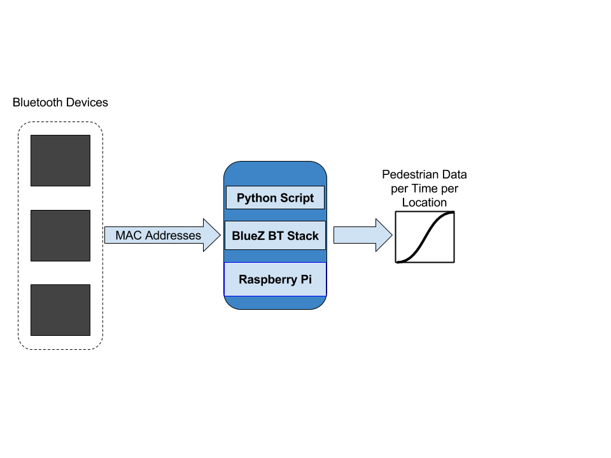
Detecting and Modeling People Using Bluetooth
Cameron Devine – Computer Engineering Undergraduate
Nicholas Kirsch – Faculty Advisor – Connectivity Research Center
Electrical and Computer Engineering, University of New Hampshire, Durham, NH 03824
Purpose
Experiments
Experiment Statistics
Results
To make transportation more efficient and safe
Tracking pedestrians vital piece of information to achieve this goal
  Design better traffic patterns and traffic management
  Pinpoint highly traveled areas to cleanup for quicker recovery from storms
  Avoid densely packed areas for quicker commute
Conducted in front of Thompson Hall at the intersection of Garrison Ave. and Main St
Two experiments of 50 samples each
  Count devices every minute for 30 seconds
  Keep unique addresses and return the count
  Compare the devices to the actual amount of people
 | Devices per Person
 | Experiment 1 | Experiment 2
Mean | 1.86 | 0.74
Median | 1.22 | 0.62
Standard Deviation | 1.61 | 0.41
Correlation Coefficient | 0.49 | 0.48
A lognormal probability distribution can be used to fit the data
  Chi 2 Goodness of fit test proves a good fit to use
One device equals one person around 50% of the time
1.5 devices as an upper bound can predict the amount of people around 80% of the time with 90% confidence level
  More confident prediction than one for one relationship
Problem
Plotted Data per Experiment
Conclusions
Current solutions are power heavy and expensive
Detecting Bluetooth will solve both of these problems while creating another one
  Not all Bluetooth devices on a person will be active and detectable
Conduct experiments to create a probability model
  Correlate devices and actual population
  Accurately predict devices per person with high confidence
Detecting Bluetooth devices can be used to predict the amount of people in an outdoor space
A strong probability model can make predictions more accurate
Deployment around a city can now have extended battery life
Connecting this device to a low powered network would allow information to be collected for analysis of foot traffic in a city
sTAMD Simulations
Design
Device Detection Analysis
Future Work
Upgrade to a lower power module that supports Bluetooth
Use LoRaWAN to connect to a server
Use this probability distribution to give real time predictions of population to users
Widescale deployment across Durham
Acknowledgements
Doctor Nicholas Kirsch – Professor Advisor
Chris Dube – Connectivity Research Center
Broadband Center of Excellence

