Slide 1

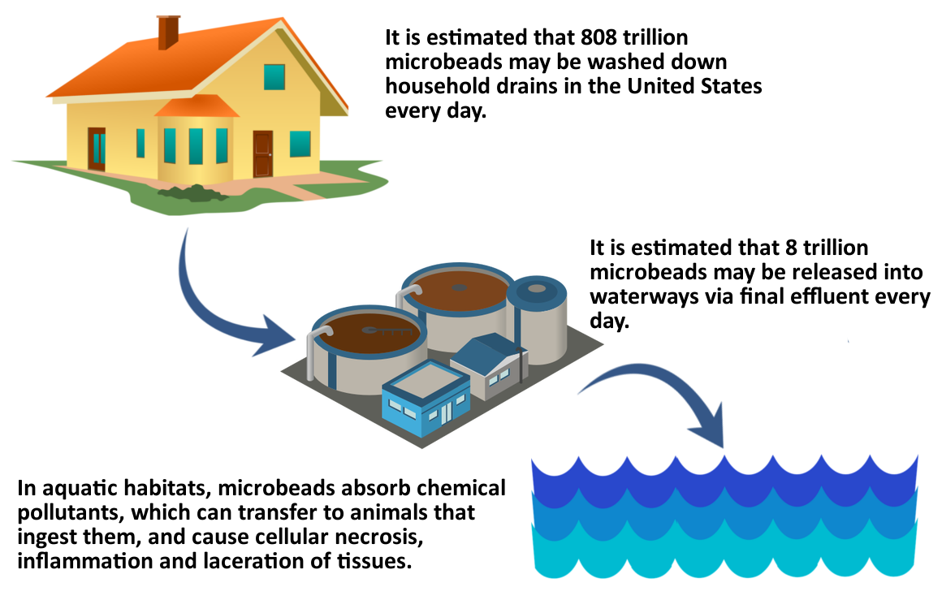
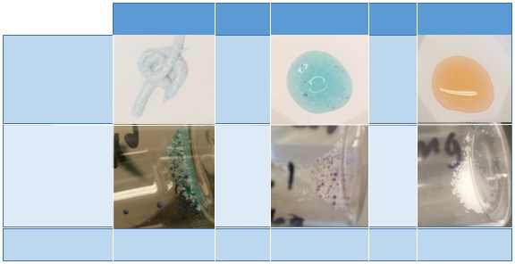

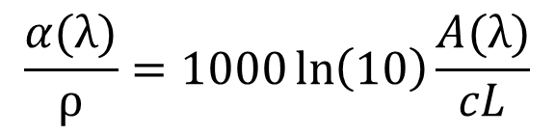
Isolation and Characterization of Microplastics Used in Soaps and Cosmetics
Cynthia R. Gerber and Margaret E. Greenslade
cry85@wildcats.unh.edu; Parsons Hall, 23 Academic Way, Durham, NH 03824
April 19th, 2017
Introduction
Microplastics are small (<5 mm), synthetic plastic particles most often composed of polyethylene (PE), poly(methyl methacrylate) (PMMA), and poly(ethylene terephthalate) (PET).
These microplastics gained interest and became widely used ~ten years ago.¹
Microplastics are found in soaps and other products that are rinsed off, allowing them to be easily introduced into the aquatic environment (Figure 1).²
A bill was passed in the US in 2015 that will prohibit the sale and distribution of products containing microplastics beginning in 2018.
Mie Theory
It describes the interaction of light with particles.
It is a series of equations that calculates the extinction at an indicated wavelength from the refractive index and size of the particle.
It returns an extinction cross-section in units of cm²/particle that was used in this project to estimate an ideal particle concentration for UV/Vis analysis.
Extinction refers to total amount of light blocked by particle and is a sum of absorption and scattering.
The refractive index is complex, meaning it contains a real portion (n) and an imaginary portion (k).
Results and Discussion
A smooth spectrum was expected rather than sharp peaks, which could be attributed to stirring the suspension of plastics while gathering the spectrum.
The peaks could also be due to reflection or scattering of the microplastics.
Figure 4. UV/Vis spectrum of polyethylene microplastics isolated from Neutrogena Deep Clean.
The calculated k values for these microplastics are very small, showing that they are not very absorbing.
To compare, soot particles are reported to have a value of k = 0.63 – 0.79 at λ = 550 nm.³
IR Analysis
Figure 5. Plot of k calculated from UV/Vis data in Figure 4.
Calculations
Equations used to plot imaginary portion of refractive index (k) from UV/Vis data:
Figure 1. Schematic showing the route that microplastics take from our homes to the aquatic environment.²
Figure 2. IR spectrum of polyethylene microplastics isolated from Clean&Clear. This spectrum is exactly what would be expected for polyethylene. The band at 2915 cm⁻¹ is due to the asymmetrical C-H stretch, while the band next to it at 2848 cm⁻¹ is due to the symmetrical C-H stretch. The band at 1472 cm⁻¹ is from the scissoring of the methylene protons and the remaining band at 718 cm⁻¹ is caused by the rocking of the methylene protons.
$$\frac{α(λ)}{ρ}=1000\ln\left(10\right)\frac{A(λ)}{cL}$$
α = absorption coefficient (cm⁻¹)
ρ = density (g/cm³)
A = absorbance
L = optical path length (cm)
c = concentration (g/L)
$$α=4πk/λ$$
Acknowledgments
Special thanks to Meg Greenslade and the other members of the Greenslade group as well as to the Chemistry department and Hamel Center at UNH for funding.
Results of Isolation
Table 1. Comparison of the microplastics with the amount of soap from which they were isolated.
Neutrogena Clean&Clear Dial
References
1. Thompson, R. C.; Olson, Y.; Mitchell, R. P.; Davis, A.; Rowland, S. J.; John, A. W. G. Science 2004, 304, 838.
2. Rochman, C. M.; Kross, S. M.; Armstrong, J. B.; Bogan, M. T.; Darling, E. S.; Green, S. J.; Smyth, A. R.; Verissimo, D. Environ. Sci. Technol. 2015, 18, 10759 – 10761.
Bond, T. C.; Bergstrom, R. W. Aero. Sci. Tech. 2006, 40, 27 – 67.
Conditions | TON | Yield (%)
Normal* | 12 | 40
Half H₂O₂** | 8 | 26
Double catalyst | 7 | 46
1 h** | 2 | 6
1.5 h | 12 | 41
*Normal conditions are 500 mg anthracene, 25 mg catalyst, 20 mL ethyl acetate, 15 mL 30% of hydrogen peroxide solution at reflux for 2 h. **Performed by Martin.
Soaps
Isolated
Plastics
Figure 3. IR spectrum of polyethylene microplastics isolated from Neutrogena Deep Clean. This spectrum contains the same peaks indicative of polyethylene as the spectrum in Figure 2, with some extra peaks that are likely due to the dye. The composition of the dye is currently being investigated.
Average Yield per Gram of Soap
31.6 mg 25.2 mg 3.3 mg

