Slide 1

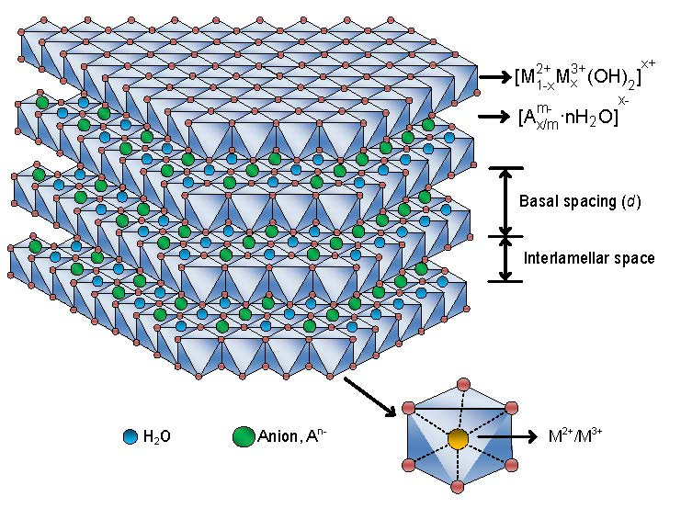
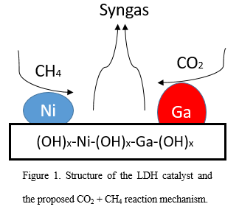
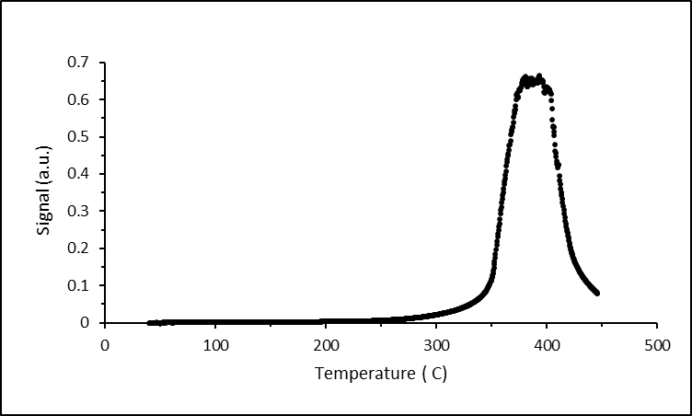
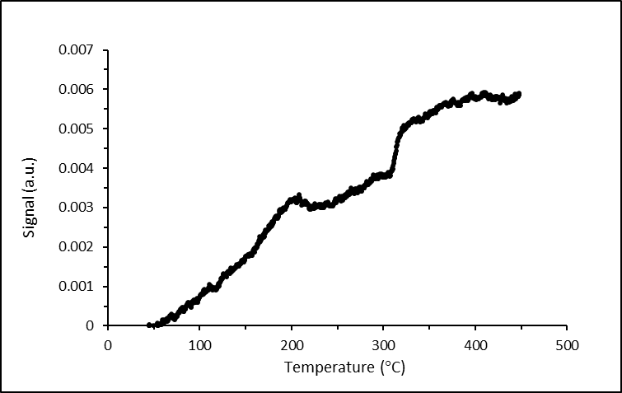
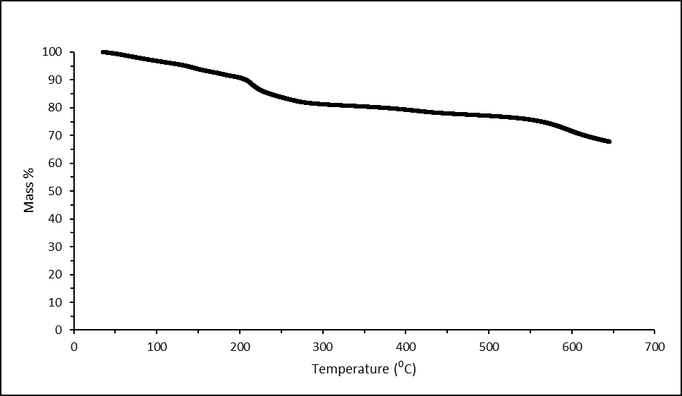
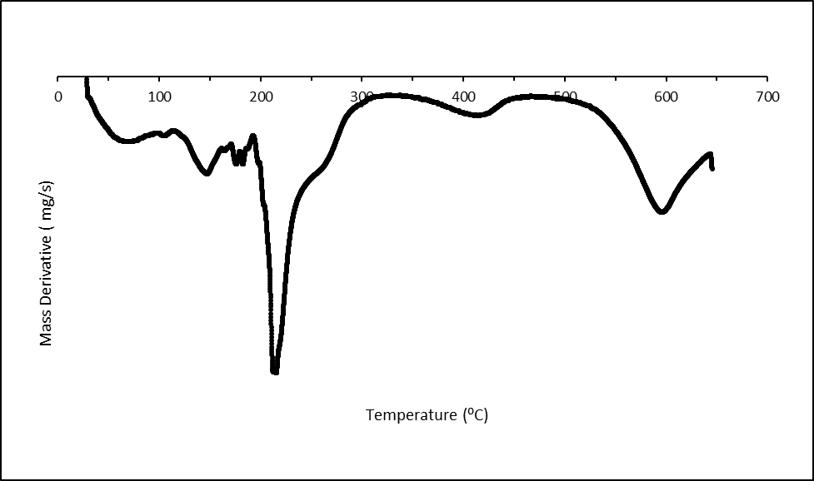
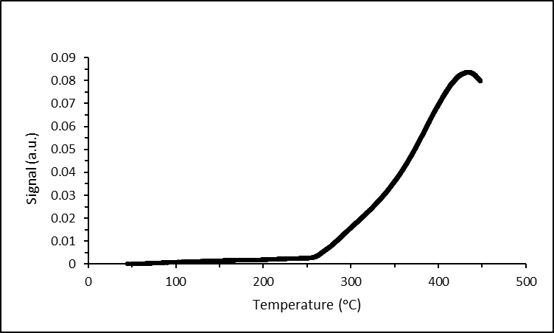
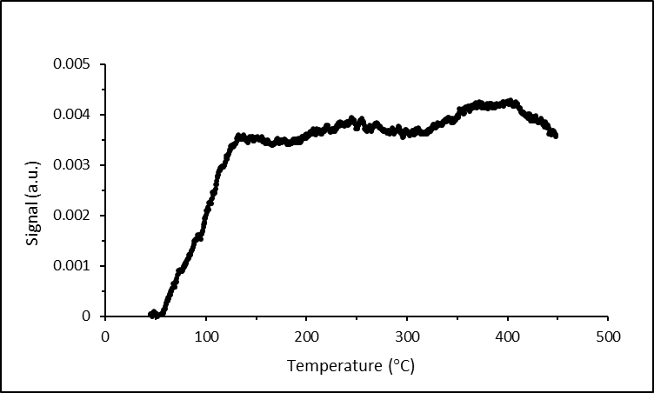
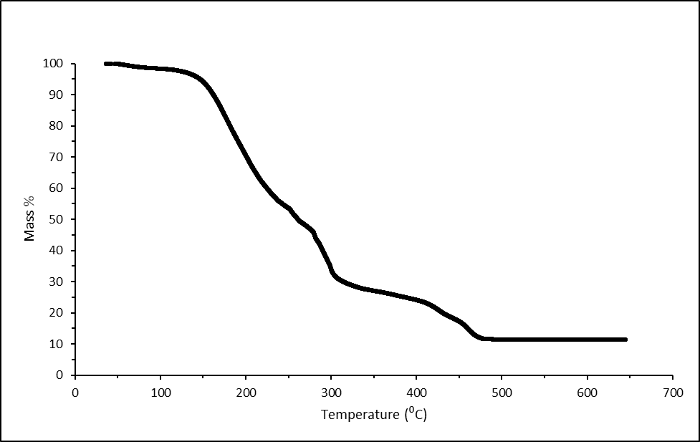
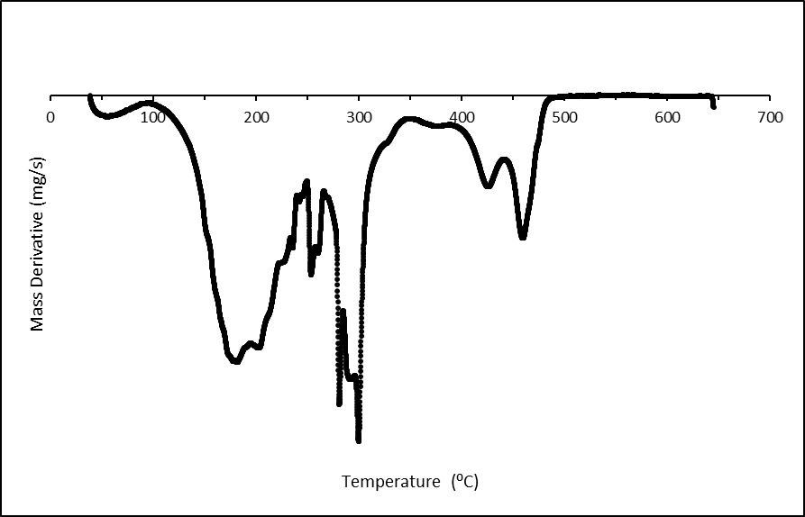
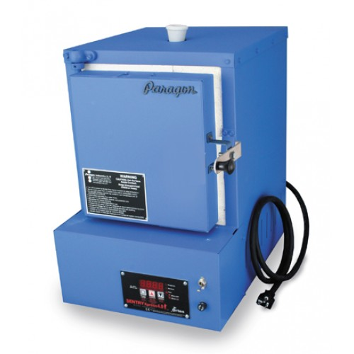
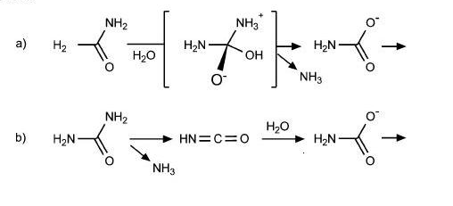
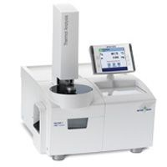
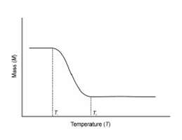
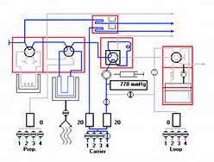
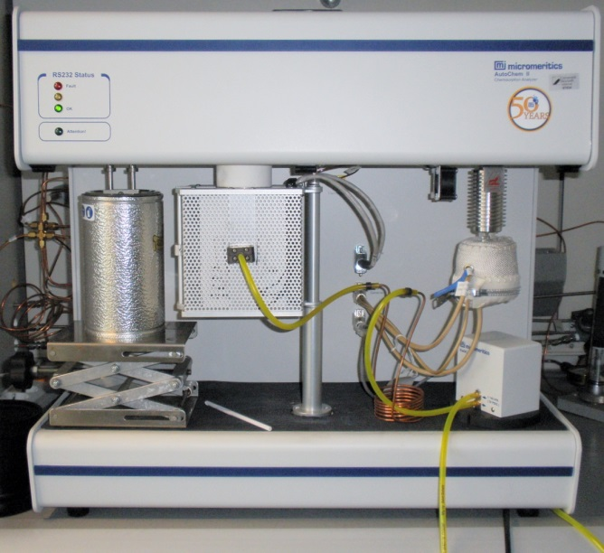
Nickel-Gallium Layered Double Hydroxides: Synthesis and Characterization
Lorenzo Milani and Dr. Nan Yi
Department of Chemical Engineering, University of New Hampshire
Introduction
Results
Layered Double Hydroxides (LDHs)^{[1]}
LDHs are a class of ionic solids that could be used as catalysts for different applications
LDHs are characterized by a layered structure
Each layer is composed by combinations of two or three metal cations
The spacing between each layer is filled with anions and hydroxides groups
This Project
The chosen metal cations were Ni²⁺ and Ga³⁺
Two different synthetic approaches
Nickel/Gallium molar ratio = 3
Goals
Understand the structure and surface properties
Optimize parameters for each synthetic method
Characterize the LDH catalyst
Thermogravimetric Analysis (TGA)
Hydrogen-Temperature Programmed Reaction (H₂-TPR)
Test Conditions:
heating rate of 5 ᵒC/min from room temperature to 650 ᵒC
pure nitrogen flow of 30 mL/minute
Test Conditions:
pretreat samples with pure helium at 150 °C, 30 min
heating rate of 5 ᵒC/min from room temperature to 450 ᵒC
10%H₂/Ar flow of 30 mL/minute
a)
b)
Figure 1. Thermogravimetric (TG) curve of Gallium Nitrate Hydrate (Ga(NO₃)₃•x H₂0).
The number of moles of water in the gallium nitrate hydrate was determined to be 6.
a)
b)
Possible application for Ni-GA LDHs:
Carbon Dioxide Reforming of Methane to form Syngas
Methods
Figure 4. Hydrogen-Temperature Programmed Reduction (H₂-TPR) profiles of Nickel-Gallium LDHS prepared by Hydrothermal Method and calcined at a) Air, 500 ᵒC and b) 30%H₂/He, 500ᵒC.
Two different procedures were used to synthetize the Nickel-Gallium Layered Double Hydroxides:
Hydrothermal Method^{[2]}
Urea Decomposition Method^{[3]}
Two different calcination conditions:
500 ᵒC in 30%H₂/He
500 ᵒC in ambient air
Figure 2. Nickel-Gallium LDH prepared by Hydrothermal method. a) Thermogravimetric (TG) Curve and b) Differential Thermal Analysis (DTA) Curve.
a)
b)
a)
b)
Hydrothermal
The hydrothermal method involves:
slowly mixing of nickel nitrate (Ni(NO₃)₂) and
gallium nitrate (Ga(NO₃)₃)
sodium carbonate (Na₂CO₃) and sodium hydroxide (NaOH)
125 ᵒC, 24 hr in a hydrothermal autoclave
Urea Decomposition
The Urea decomposition method involves:
using urea (CH₄N₂O) to precipitate the nickel
and gallium nitrates
continuous stirring in a silica oil bath
90 ᵒC, 24 hr
Kiln Paragon Xpress Model E12T
Figure 5. Hydrogen-Temperature Programmed Reduction (H₂-TPR) profiles of Nickel-Gallium LDHS prepared by Urea Decomposition Method and calcined at a) Air, 500 ᵒC and b) 30%H₂/He, 500ᵒC.
Urea decomposition mechanism in water^{[4]}
Figure 3. Nickel-Gallium LDH prepared by Urea Decomposition method. a) Thermogravimetric (TG) Curve and b) Differential Thermal Analysis (DTA) Curve.
Instruments
Conclusions
Thermogravimetric Analyzer (TGA)
The thermogravimetric analyzer (TGA) measures the mass of a sample in a defined atmosphere as it is submitted to a selected temperature program.
Applications
TGA could be used to gain understanding of any process with an accompanying change in mass, including:
Phase changes
Study of polymers
Dehydration
Catalysis-calcination/adsorption
Micrometrics AutoChem II 2920
Micrometrics AutoChem II 2920 performs temperature programmed reactions by flowing a specified gas flow through a sample. The composition of the gaseous mixture is measured at the exit of the sample container with appropriate detectors.
Applications
Micrometrics could be used to gain information about:
Gas-catalyst interaction
Light-off temperature
Catalyst structure
Surface area
The sample prepared by Urea Decomposition Method contains a large amount of water
Calcination in 30%H₂/He did not contribute to the formation of oxides
Enhanced reduction peak intensity for samples prepared by Hydrothermal Method
Reduction peak around 400 ᵒC is attributed to the reduction of Nickel (II) Oxide (NiO)
Ni-Ga LDHs synthetized by Hydrothermal Method and calcined in air show potential applications in catalytic reactions
Future Work
Optimize Ni/Ga molar ratio
Characterizations including Fourier Transform Infrared Spectroscopy (FTIR)
Catalytic performance for Carbon Dioxide Reforming of Methane
b)
a)
References
[1] F. Li, X. Duan, “Applications of layered double hydroxides”. Structure and Bonding 119 (2005).
[2] U. Costantino, F. Marmottini, M. Nocchetti, R. Vivani, “New synthetic routes to hydrotalcite-like compounds, characterization and properties of the obtained materials”. European Journal of Inorganic Chemistry 10 (1998) 1439-1446.
[3] A. Alvarez, R. Trujillano, V. Rives, “Differently aged gallium-containing layered double hydroxides”. Applied Clay Science 80-81 (2013) 326-333.
[4] B.P. Callahan, Y. Yuan, R. Wolfenden, "The Burden Borne of Urease“. Journal of the American Chemical Society 127 (2005) 10828-10829.
Mettler Toledo TGA with STARe System
Typical single stage decomposition thermogravimetric curve
Micrometrics AutoChem II 2920.
a) Instrument and b) Gas flow chart
Acknowledgement
Special Thanks to:
  The Hamel Center for Undergraduate Research
  Department of Chemical Engineering
  Guoqiang Cao, Ph.D Student, University of New Hampshire

