Slide 1


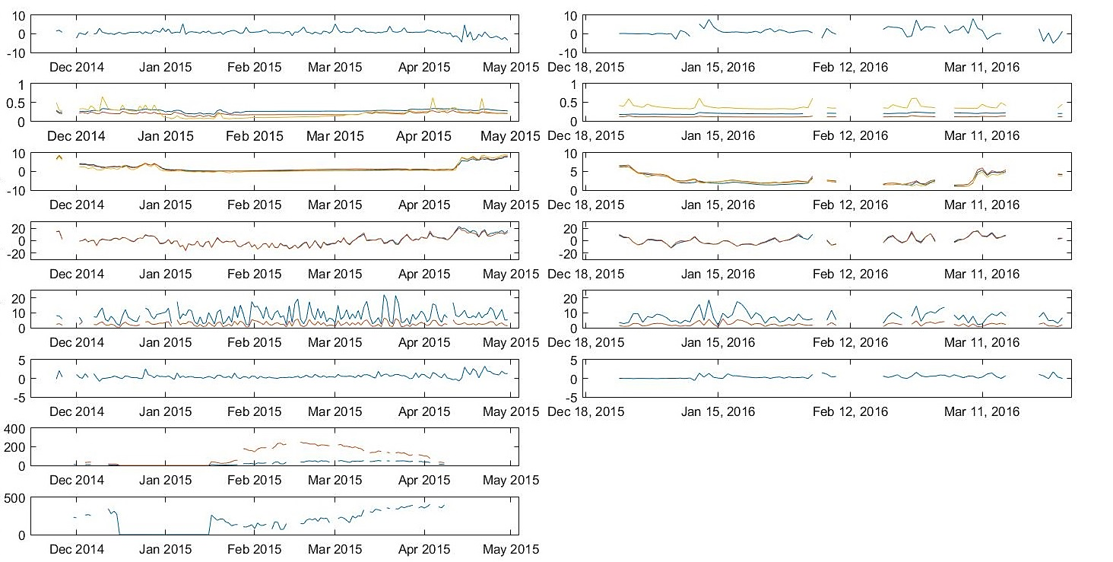
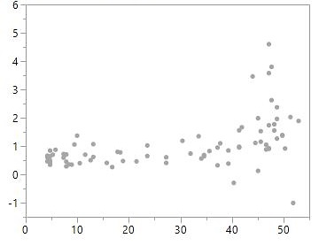
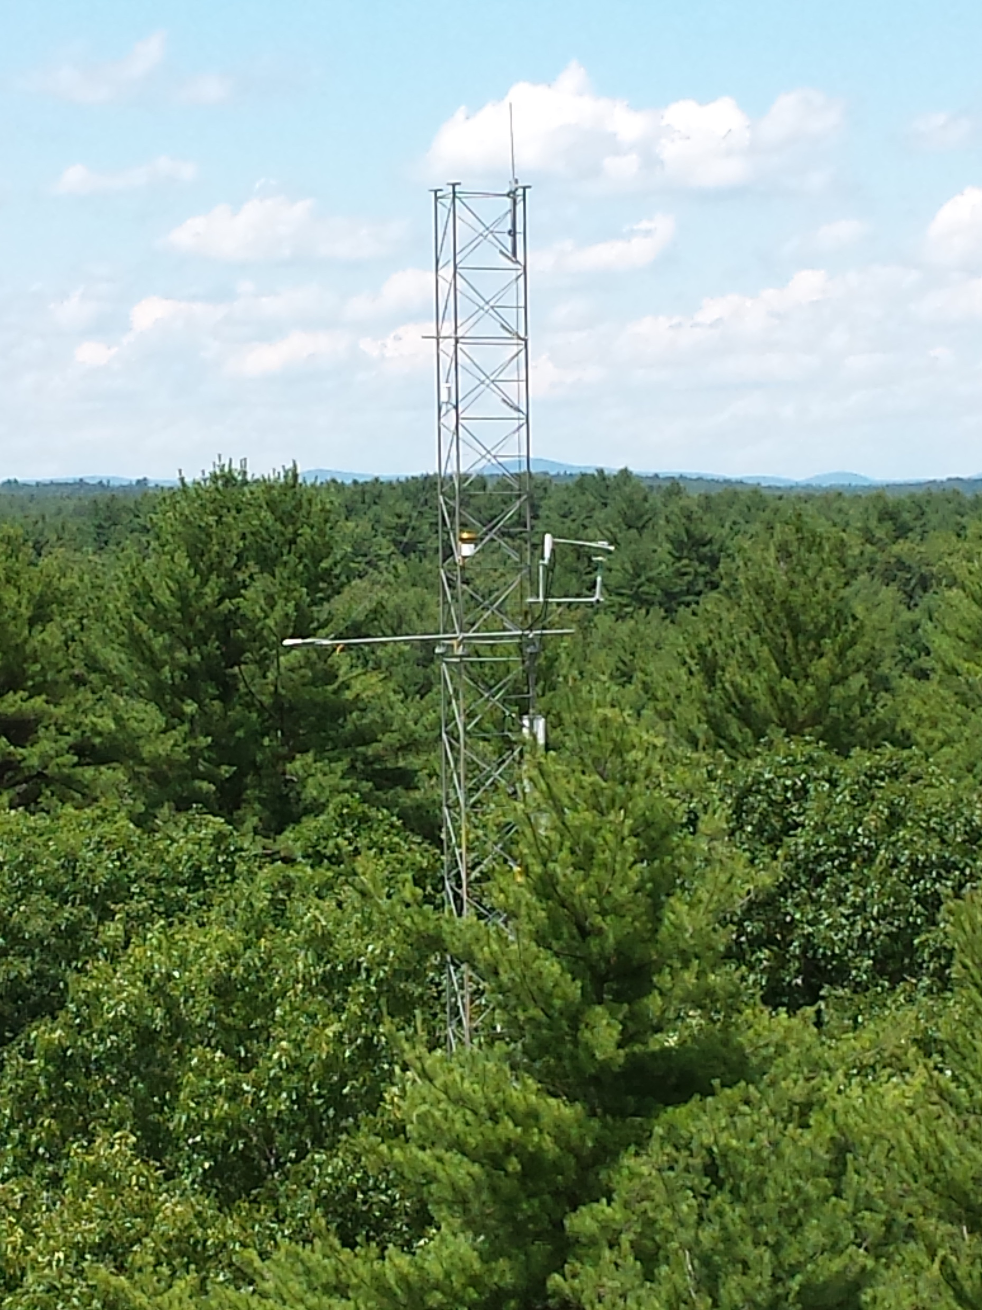
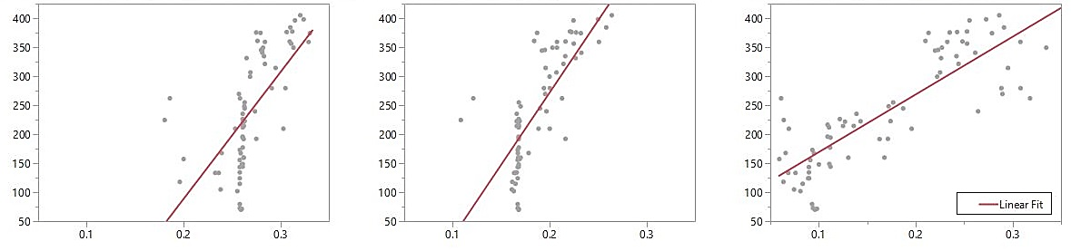
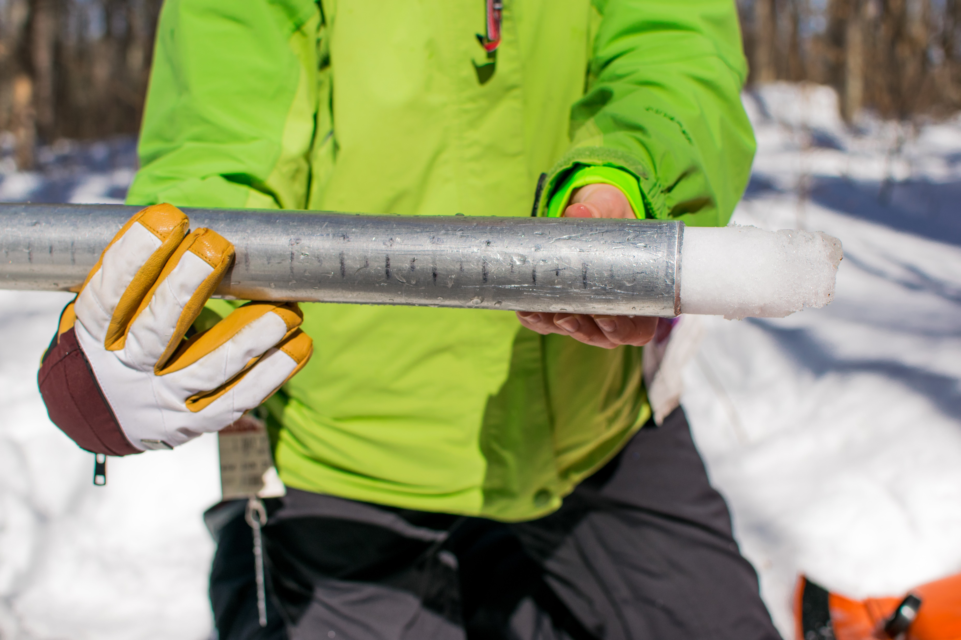
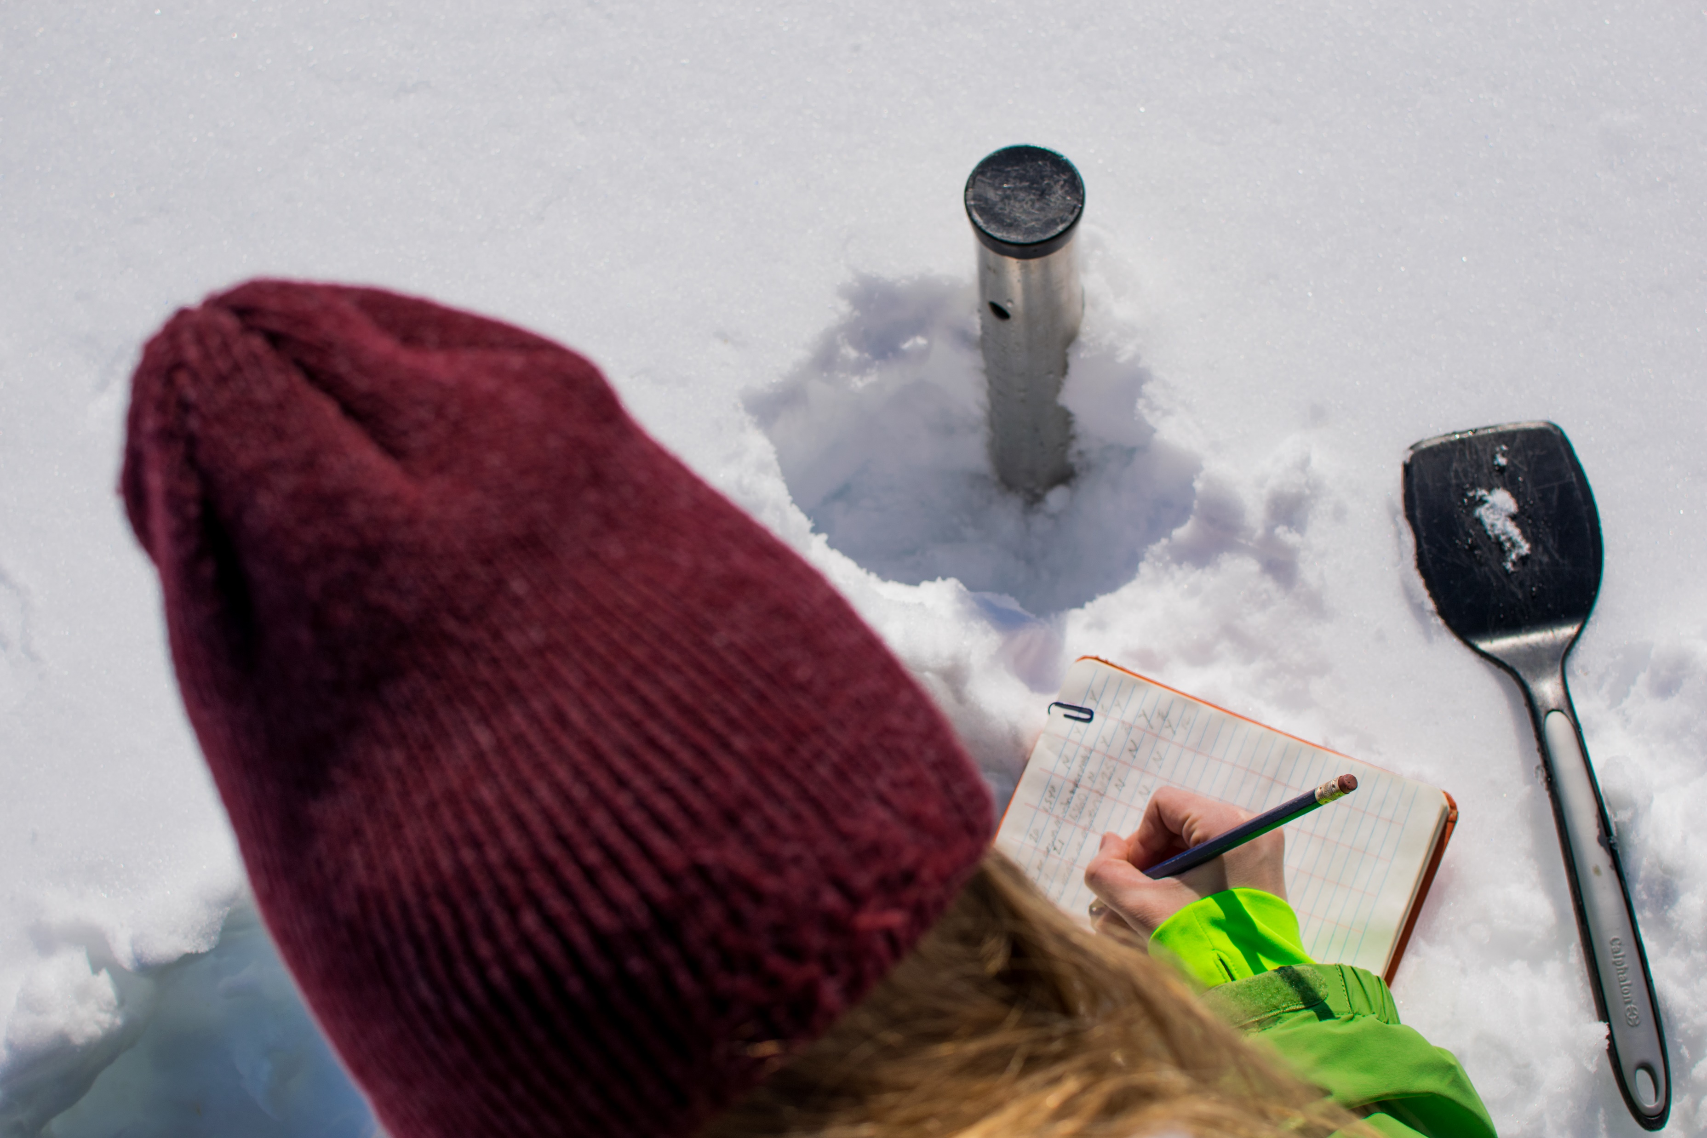
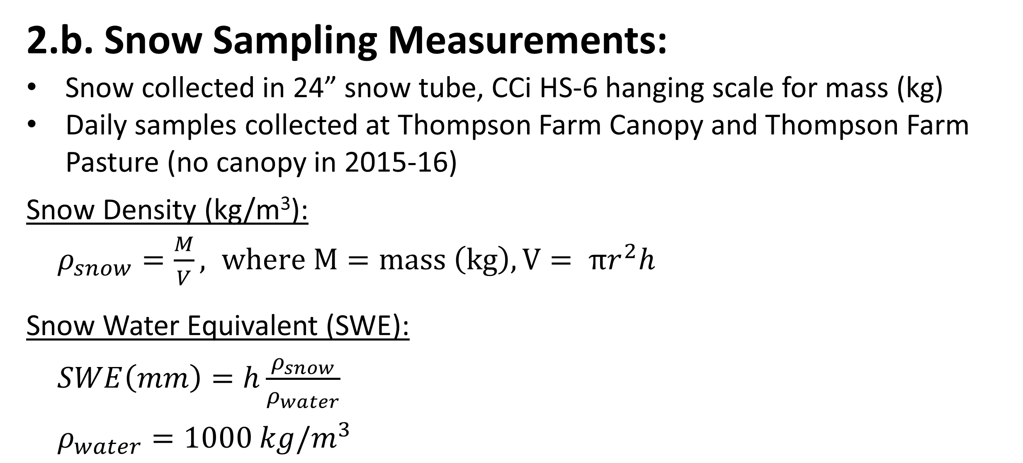
The Influence of Snow Density on CO₂ Flux Measured with Eddy Covariance over a Forested Canopy
Taylor Conte¹, Elizabeth Burakowski²
Department of Natural Resources and the Environment, University of New Hampshire, Durham, NH
Institute for the Study of Earth, Oceans, and Space and Department of Earth Sciences, University of New Hampshire, Durham, NH
UNH Undergraduate Research Conference
COLSA & ISE, Durham, NH
04/17/2017-04/22/2017
Winter carbon dioxide (CO₂) flux in temperate forest canopies is critical to determining ecosystem respiration. New Hampshire winters in the Seacoast region in recent years have been characterized by alternating periods of snow cover accumulation and melt, and less continuous snowpack coverage through the winter season. Mid-winter disappearance of snowpack may have important impacts on CO₂ flux and the ability to accurately predict its part in ecosystem modeling. Future projections of winter climate suggest ephemeral snowpacks will become the norm, thus there is a need for high quality snow, CO₂ flux, and ecosystem data to improve the understanding of dynamic ecosystem health and carbon cycling.
Main Objective: To explore the influence of snow properties on temperate forest CO₂ flux, soil moisture, & soil temperature.
4. Results
1. Introduction
CO₂ Flux(m²/s)
a.
b.
Soil Moisture(%)
c.
1 (5cm depth)
2 (5cm depth)
3 (5 cm depth)
d.
CO₂ Flux (m²/s)
Temperature
(˚C)
1 (5cm depth)
2 (5cm depth)
3 (5 cm depth)
CO₂ Flux (m²/s)
e.
f.
Temperature
(˚C)
g.
h.
Air
Surface
Wind Speed
(m/s)
i.
j.
Max
Average
Snow Water Equivalent (mm)
H₂O
Flux(m²/s)
Figure 2. In situ measurements of snow water equivalent explains ~26% of the variation shown in carbon dioxide flux data averaged over a day for the 2014-15 season.
k.
l.
Surface
Air
Max
Average
Soil -5cm
Soil -5cm
Soil -5cm
2. Methods
Snow(mm)
m.
SWE
Depth
Figure 1. Solar noon averaged soil and meteorological variables, 2014-15 (left) and 2015-16 (right).
2.a. Eddy Covariance Measurements:
In situ measurements of CO₂ flux above the canopy were continuously taken at 30-minute intervals using a tower-mounted eddy covariance system during the 2014-2015 and 2015-2016 winter seasons at Thompson Farm in Durham, NH.
Environmental and meteorological data included:
soil moisture
soil temperature
surface temperature
Snow
Density(kg/m³)
n.
Theta Probe ML2x
r² = 0.432
Depth = 5 cm
Theta Probe ML2x
r² = 0.570
Depth = 5 cm
Steven’s Hydra Probe II
r² = 0.698
Depth = 3 cm
air temperature
H₂O flux
wind speed
SM2
SM3
TOWER
Snow Density(kg/m³)
Snow Density(kg/m³)
Snow Density(kg/m³)
SM1
SNOW
Soil Probes in relation to snow sampling and tower location.
2.b. Snow Sampling Measurements:
Snow collected in 24” snow tube, CCi HS-6 hanging scale for mass (kg)
Daily samples collected at Thompson Farm Canopy and Thompson Farm Pasture (no canopy in 2015-16)
Snow Density (kg/m³):
$ρ_{snow}=\frac{M}{V}, where M=mass \left(kg\right), V= πr^{2}h$
Snow Water Equivalent (SWE):
$SWE\left(mm\right)=h\frac{ρ_{snow}}{ρ_{water}}$
$ρ_{water}=1000 kg/m^{3}$
Soil Moisture 1 (%)
Soil Moisture 2 (%)
Soil Moisture 3 (%)
Figure 3. Snow density compared to solar noon averaged soil moisture at three locations.
r
Snow density and snow water equivalent not found to have a strong correlation with carbon dioxide flux data possibly due to lack of snow/surface interface CO₂ concentration data
The relationship between snow density and soil moisture at spatially varying plots did show to be significant implying that the insulation effect of the snow pack largely influences how water is retained in the soil of mixed temperate forest
Using snow data alone with sub-canopy carbon dioxide flux data does not provide enough information to accurately predict ecosystem fluxes and thus more data is needed to accurately predict carbon fluxes in temperate snow covered forests
6. Conclusions
h
3. Data Processing
Daily Averaged Data
Thank you Cameron Wake and Jack Dibb for the funding, Steven Galante for the pictures, Rebecca Sanders-Demott and Alexandra Contosta for the Eddy Covariance data set, Annette Schloss for help with the panorama and Liz for being a great advisor.
Contosta, A. R., E. A. Burakowski, R. K. Varner, and S. D. Frey (2016), Winter soil respiration in a humid temperate forest: The roles of moisture, temperature, and snowpack, J. Geophys. Res. Biogeosci., 121, 3072–3088, doi:10.1002/2016JG003450.
McDowell, N.G, Marshall, J.D, Hooker, T.D, and Musselman, R. (2000), Estimating CO₂ flux from snowpacks at three sites in the Rocky Mountains. Tree Physiol 2000; 20 (11): 745-753. doi: 10.1093/treephys/20.11.745.
Williams, C. J., McNamara, J. P., and Chandler, D. G. (2009), Controls on the temporal and spatial variability of soil moisture in a mountainous landscape: the signature of snow and complex terrain, Hydrol. Earth Syst. Sci., 13, 1325-1336, doi:10.5194/hess-13-1325-2009.
Snow Sampling Measurements
Quality Flags
Java CSV File Processor Program
References
Eddy Covariance Measurements
**Java comma separated value (CSV) File Processor uses a scanner to open CSV files and iterates through data, while saving non flagged data to an array list. It then creates a new averaged data set from the saved array list data.
Solar Noon Averaged Data

