Slide 1

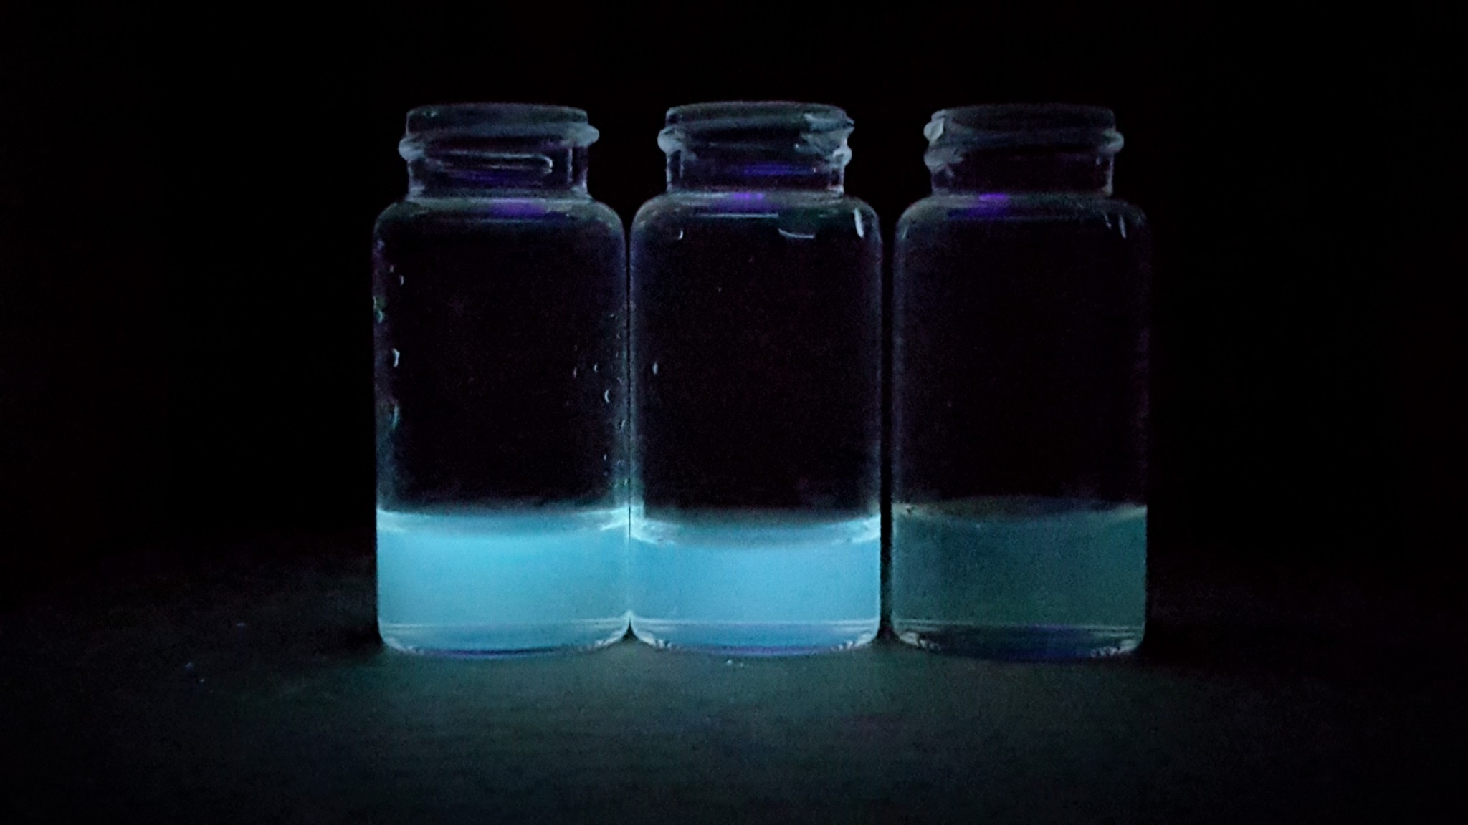
Development of New Fluorescent Materials: Putting Carbon Dots to Work
Ian Smith, Miriam Velasquez Hernandez, Anthony Lemieux, Christine A. Caputo
imw8@wildcats.unh.edu, Department of Chemistry, University of New Hampshire, Durham, NH 03823
4/14/2017
Introduction:
Figure 1. Fluorescence of CD under UV light irradiation
A control for the CD silicon based putty was created through the suggested manner of creating normal silly putty. The control is made through the process of combining boric acid B(OH)₃ and PDMS at a ratio of 0.3 g to 1.0 mL respectively. The ratio of reactants mixed to a homogenous mixture of a white semitransparent solution and then gradually heated to ~180°C. This solution is left to stir for 1hr and then left to cool. This reaction allows the dehydrogenation reaction to occur with boric acid and PDMS, which allows the chains of PDMS to be crosslinked to each other by the boric acid groups (Scheme 2).^{2,4}
(4) (3)
(5)
Scheme 2. Synthesis of silicon polymer (5) with boric acid (4) as a crosslinker using polydimethylsiloxane (3) (PDMS).
Once completed, characterization of the CD crosslinked PDMS product will be carried out and conductance and fluorescence studies will be performed to show differences between boric acid silicon putty and the CD silicon based putty that will be quantified. ^{1,3,5}
Carbon Dots (CDs) are a relatively new carbon nanomaterial and have garnered attention for their numerous applications in multiple fields. This project aims to develop a CD based silicon putty in order to determine if changes in fluorescence occur upon surface functionalization of the CD. This could lead to interesting applications and progress towards the use of the fluorescent CD based materials. Carbon Dots are known for their strong fluorescence in aqueous solution and great ability to be easily tuned for applications in sensing, imaging, and photo catalysis. Due to their straightforward synthesis and relative low toxicity, CDs have replaced many conventional semiconductor quantum dots in multiple scientific fields such as medicine, biology, and chemistry. This project aims to develop a CD based silicon putty. Progress toward this goal will be presented.
The synthesis of carbon dots is performed by thermolysis of citric acid. The citric acid is placed into a furnace/oven and left for up to 40 hrs at 180°C. This allows for the creation of acidic CDs, at pH 3-4.
(1) (2)
Scheme 1. Synthesis of CDs (2) from Citric Acid (1)
The synthesis of carbon dots and boron doped carbon dots have had successful results. (Figure 1). Characterization of the CD has been carried out by Anthony Lemieux.
Current work is focused on the synthesis of a control silicon putty using boric acid as a cross linking agent and small scale sample of the CD silicon putty. (Schemes 2 & 3)
Results and Discussion:
(2) (3)
(6)
Scheme 3. This shows the proposed reaction pathway for the Carbon Dot (2) with a silicon chain (PDMS) (3) to form the desired product (6).
The research is still underway for creation of a CD-PDMS based putty. The research progress thus far has provided us with many more possibilities to make such a polymer and increased the drive for this research likewise. Development of the polymer will hopefully lead to new synergies in the scientific community. However, conclusions can’t be made at this time due to the research being in the starting phases.
Anthony, Miriam, and Professor Caputo of the Caputo research group and UNH Chemistry Department are graciously acknowledged.
Barman, M. K.; Jana, B.; Bhattacharyya, S.; Patra, A. The J. Phys. Chem. C, 2014, 118, 20034–20041.
Boland, C. S.; Khan, U.; Ryan, G.; Barwich, S.; Charifou, R.; Harvey, A.; Backes, C.; Li, Z.; Ferreira, M. S.; Mobius, M. E.; Young, R. J.; Coleman, J. N. Science 2016, 354, 1257–1260.
Ma, Y.; Li, Y.; Ma, S.; Zhong, X. J. Mater. Chem. B 2014, 2, 5043.
Martindale, B. C. M.; Hutton, G. A. M.; Caputo, C. A.; Reisner, E. J. Am. Chem. Soc., 2015, 137, 6018–6025.
Mishra, M. K.; Chakravarty, A.; Bhowmik, K.; De, G. J. Mater. Chem. C, 2014, 3 , 714–719.
Conclusions:
Experimental Work:
Acknowledgements:
References:
Future Work:

