Slide 1


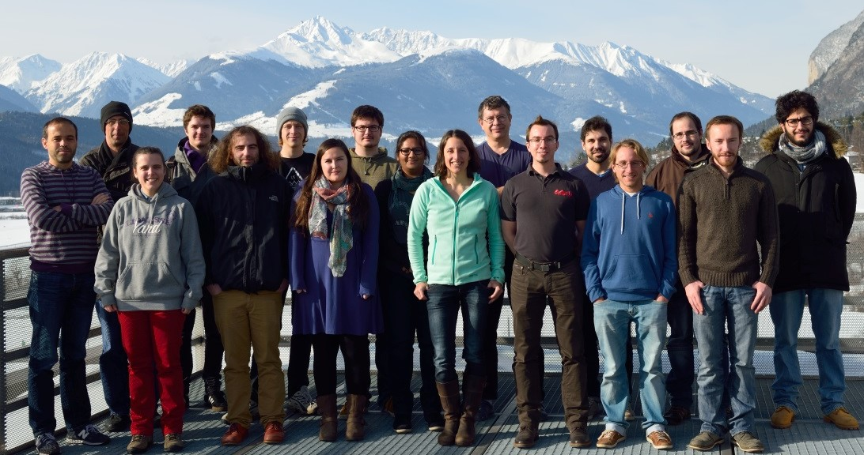

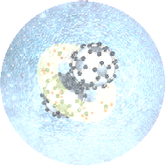
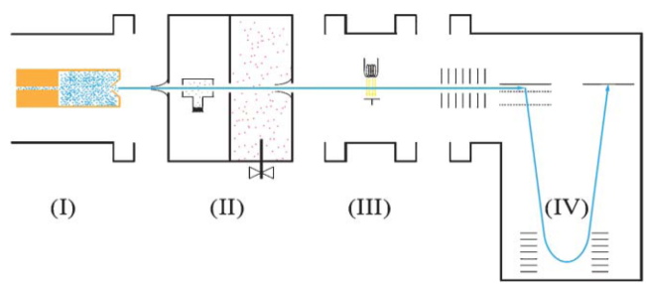
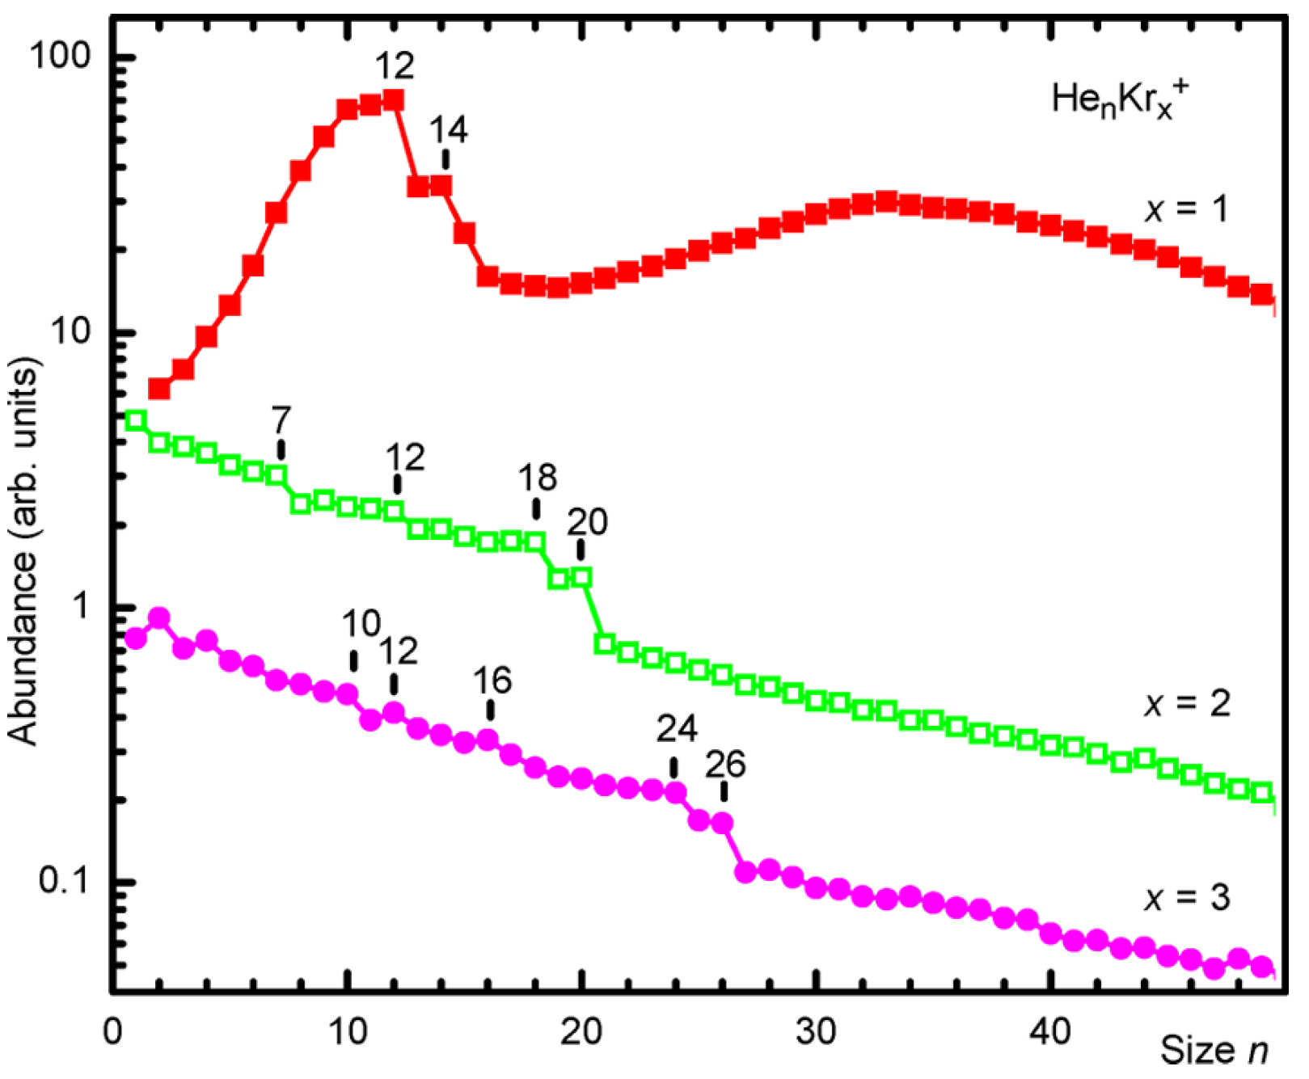
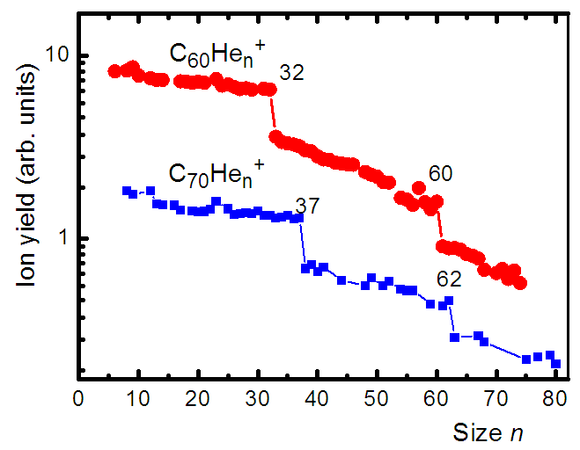
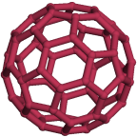
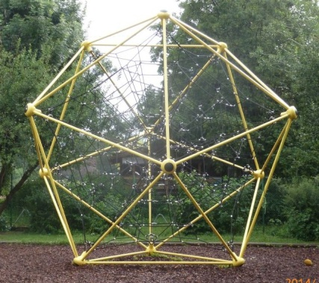
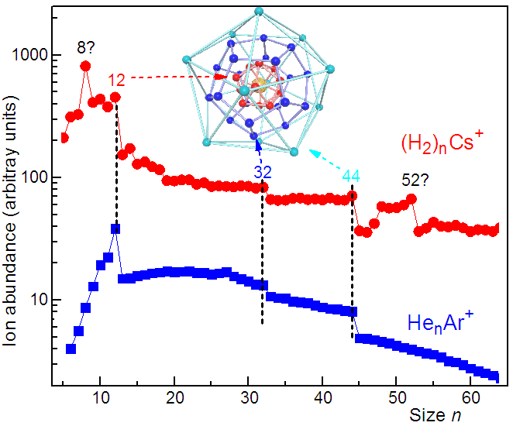
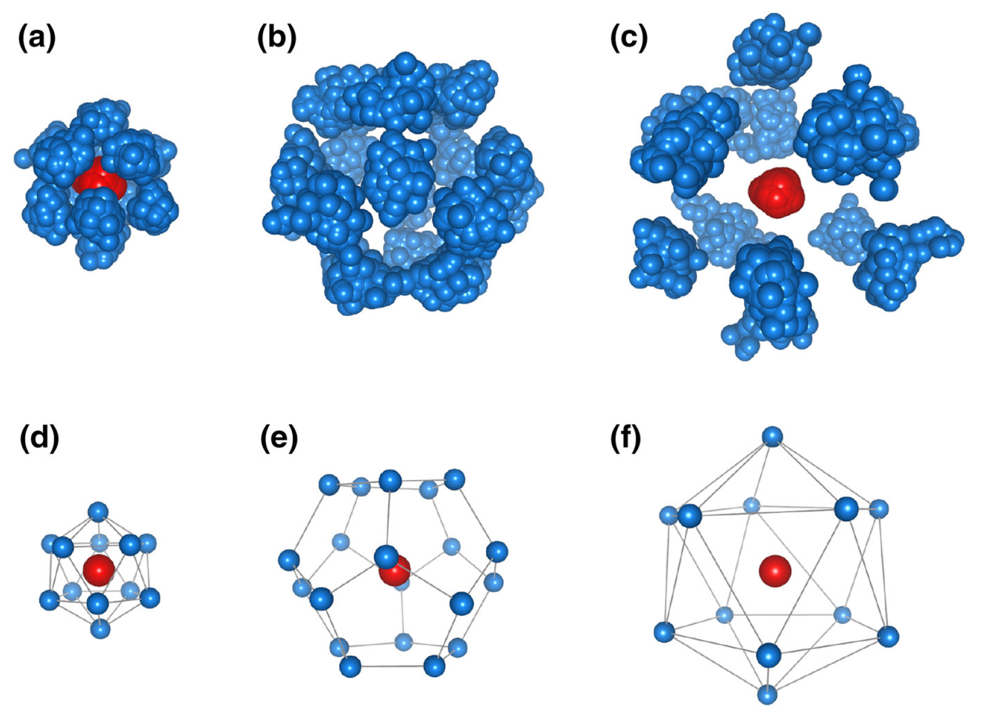
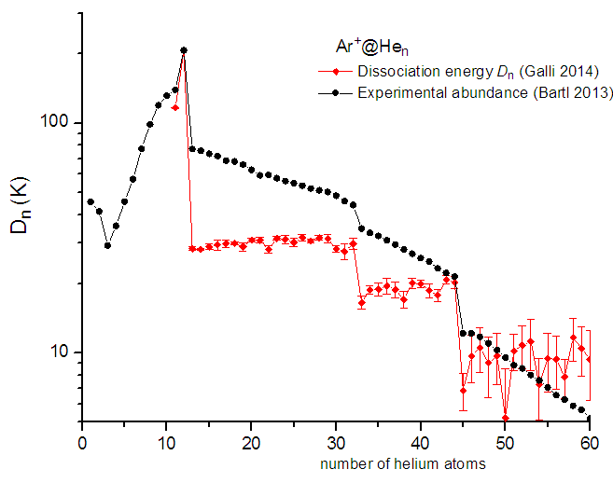
Solvation of Ions in Quantum Fluids
Martin Kuhn, Marcelo Goulart, Tilmann Märk, Paul Scheier, Olof Echt,* and many others from Innsbruck
Institute for Ion Physics and Applied Physics, University of Innsbruck, Technikerstr. 25, Innsbruck, Austria
* Department of Physics, University of New Hampshire, Durham NH, USA
The authors: Paul Scheier and co-workers (Innsbruck, 2016) Olof Echt & Tilmann Märk with Will‘s group at PennState (1982)
Background
Experiment
Ion solvation in clusters was one of Will’s favorite topics.
The mobility of cations in superfluid helium is much lower than one may (naively) expect; electrostriction leads to formation of solid-like snowballs.¹
Does the bosonic nature of He, H₂ prevent the formation of ordered layers beyond the 1st shell?
Anomalies in abundance distributions of He_{n}X⁺ or (H₂)_{n}X⁺ (X = rare gas, alkali,..) reflect anomalies in dissociation energies
- up to 3 icosahedral solvation shells?
Helium
droplet
source
Pick-up cells: adding
C₆₀, Cs, H₂
Ionization by
electrons
Preparing Helium nanodroplets: Expansion of He → Droplets with 10⁵ – 10⁶ atoms, T = 0.37 K.
Doping the droplets: The droplets pass through cells filled with C₆₀ or alkali vapor or Ar or H_{2.}
Mass spectrometer: Ionization by electron impact. TOF with reflectron, resolution Δm/m = 1/5000
TOF
Mass Spec
Results and Discussion: Abundance distributions of ions solvated in He and H₂
Example 1: Kr_{x}⁺ in He Example 2: C₆₀⁺ in He, H₂, CH₄
First solvation layer around Kr monomer, dimer and trimer closes at 12/14, 18/20, 24/26?? ²
No evidence for 2nd layer
Commensurate layer requires 32 He for C₆₀⁺,
37 for C₇₀⁺. Same numbers for solvation in H₂ (not shown).³
First solvation layer closes at n = 60 for C₆₀⁺,
n = 62 for C₇₀+.
For solvation in H₂ the corresponding numbers are 49, 51.³
Proliferation of icosahedral structures: Innsbruck, Playground
Example 3: Cs⁺ in H₂ and Ar⁺ in He
Anomalies at n = 12, 32, 44 common to both systems:⁴
3 solvation shells of icosahedral symmetry – see right.
Origin of anomalies at (H₂)₈Cs⁺ and (H₂)₅₂Cs⁺ ?
Results of path integral MC study of Ar⁺ in He by Galli and co-workers.⁵ Top panels: polymers associated with He of the 1st, 2nd, or 3rd shell (a to c). Bottom panels: each polymer is replaced by its center of mass.
Dissociation energies of Ar⁺ in He: Computed values (red dots, Galli⁵) versus values derived from abundance distribution (Bartl et al. ²)
References: 1) Atkins, K. R. Ions in Liquid Helium. Phys. Rev. 1959, 116, 1339-1343; 2) Bartl, P.; Leidlmair, C.; Denifl, S.; Scheier, P.; Echt, O. J. Phys. Chem. A 2014, 118, 8050–8059. 3) Echt, O.; Kaiser, A.; Zöttl, S.; Mauracher, A.; Denifl, S.; Scheier, P. ChemPlusChem 2013, 78, 910-920. 4) Kranabetter, L.; Goulart, M.; Aleem, A.; Kurzthaler, T.; Kuhn, M.; Barwa, E.; Renzler, M.; Scheier, P.; Echt, O. J. Phys. Chem. C 2017, in print. 5) Tramonto, F.; Salvestrini, P.; Nava, M.; Galli, D. E. J. Low Temp. Phys. 2015, 180, 29–36.

