Slide 1

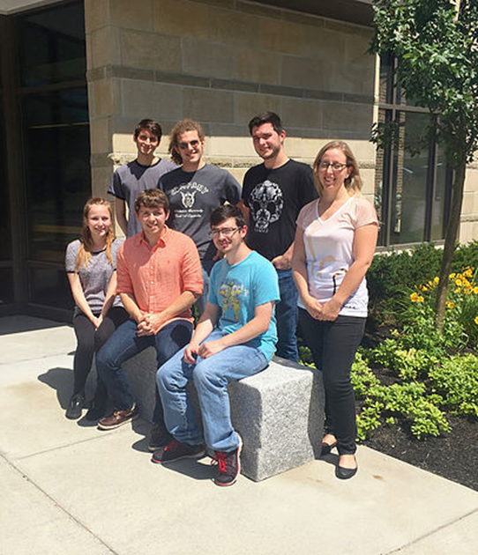
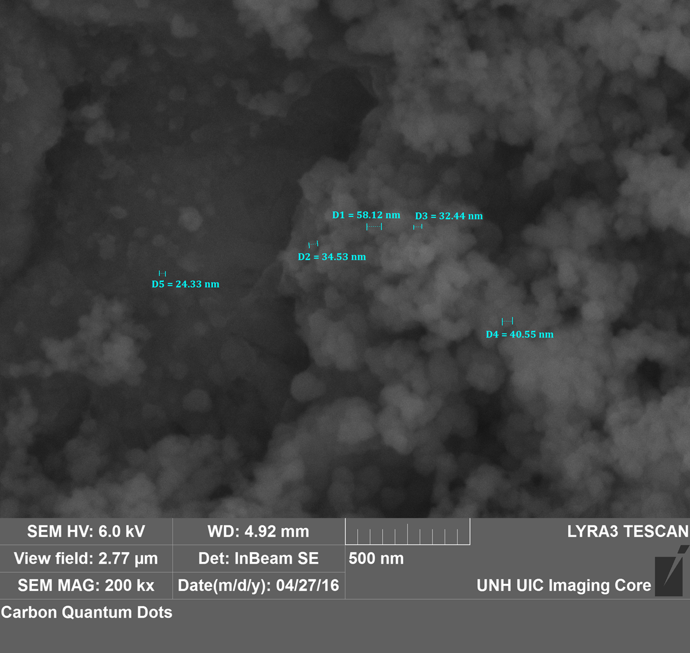
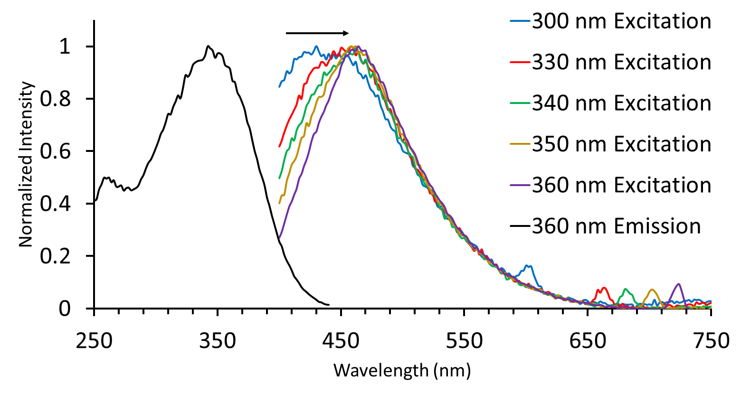
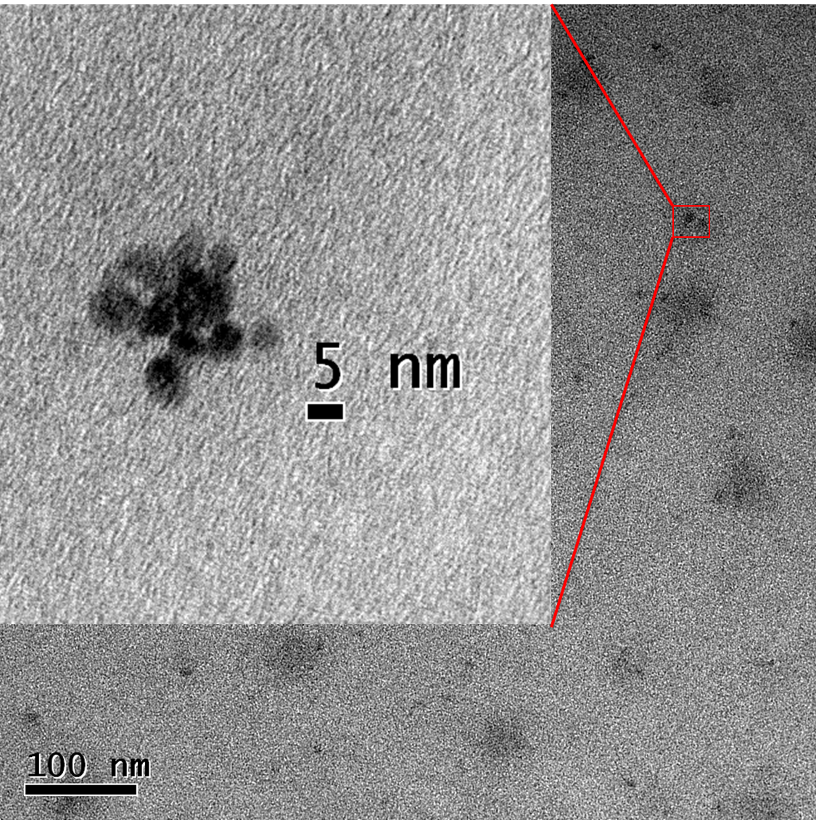
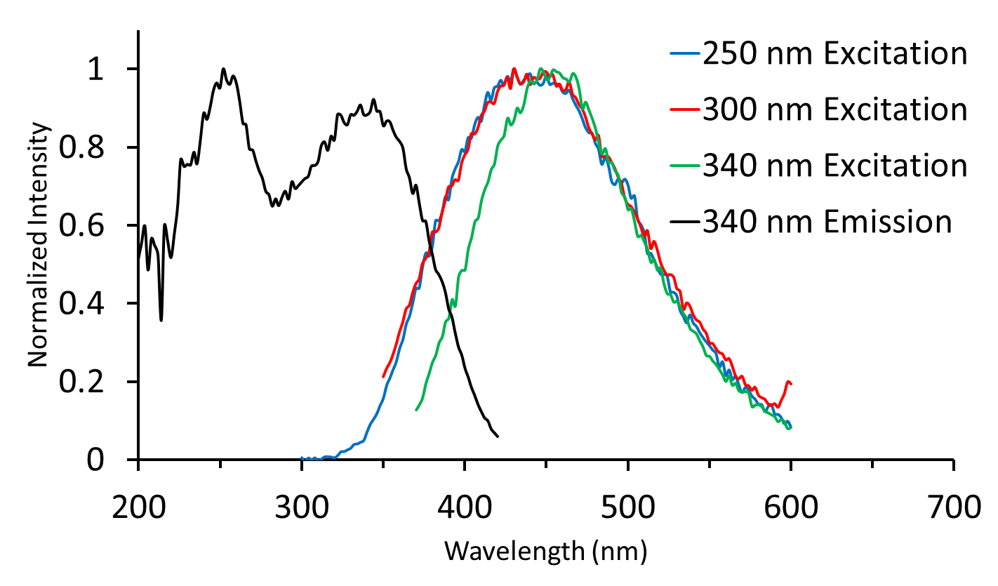
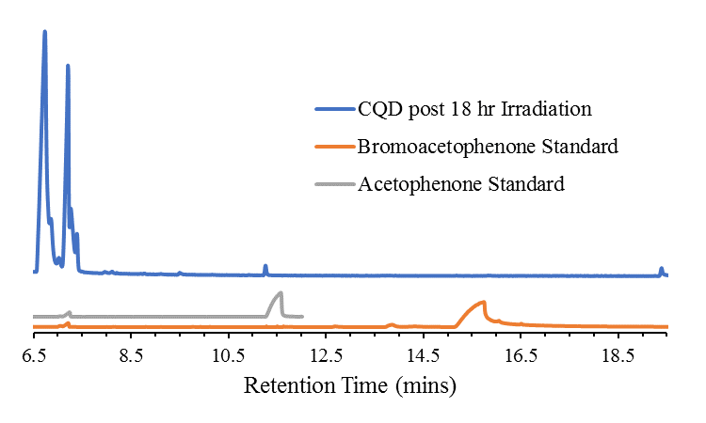
Light Induced Dehalogenation of Halobenzene using Carbon Dots
Anthony J. Lemieux, Christine A. Caputo
Department of Chemistry, University of New Hampshire, Durham, NH 03824
Introduction
Figures and Data
Conclusions
Carbon Dots (CDs) are fluorescent nanoparticles that consist of a graphitic carbon core with a passivated surface and are typically 2-10 nm in diameter.^{1,2} CDs are non-toxic and can be made from inexpensive materials such as citric acid. CDs possess unique electronic, redox, and optical properties which can be exploited for use in photocatalytic systems for energy conversion.² As such, CDs are most often used in biochemical sensing, drug delivery, bio-imaging, and catalysis.¹
Interestingly, CDs show great potential to replace other expensive photosensitizers, including organic and transition metal dyes, which are short-lived due to photodecomposition and are toxic.^{1,2} It is also possible to dope CDs with group 13 and 15 elements such as boron and nitrogen to improve or further tune the photoluminescent properties.¹
To this end, un-doped CDs and boron-doped CDs (B-CDs) have been synthesized and characterized using various spectroscopic methods. As CDs have been shown to mediate highly selective oxidation reactions using NIR light, likely via a radical mechanism, it is possible that CDs may also mediate photo-dehalogenation reactions.³
Fluorescent doped and un-doped CDs have been synthesized and characterized. Un-doped CDs have been applied to various dehalogenation reactions with mixed results. Results suggest that CDs do not have enough driving force to dehalogenate unsubstituted aryl rings. This can be attributed to the low reduction potential of CDs to act as both the photosensitizer and electron transport mechanism.
In order to dehalogenate an aryl ring using CDs as the photosensitizer, it may be necessary to activate the aryl ring with various electron donating groups to reduce the potential needed to carry out the reaction.
Additionally, it may also be possible to dope and otherwise functionalize the CDs to increase their reduction potential. At the present moment, CDs have the inability to proceed with radical mediated dehalogenation of aryl rings, but can photocatalyze the dehalogenation of an α-bromide via a hydride donation mechanism.
Figure 1. Fluorescence of various types of CDs under a handheld UV lamp. From left to right: un-doped CDs, boron-doped CDs, zinc-doped CDs, “sour patch kids”/potential phosphorous-doped CDs.
Figure 4. SEM images of un-doped CDs deposited via drop casting and allowing the solvent to evaporate.
Future Work
Results and Discussion
Further dehalogenation reactions, via different mechanisms, will need to be performed to probe the ability and efficacy of CDs as replacements to traditional photosensitizers. Additional doping and surface functionalization will be conducted to study the effects this has on the electronics and reduction potential of CDs.
Acknowledgements
Figure 2. The fluorescence emission spectra of CDs showing the excitation wavelength-dependent emissions of un-doped CDs.
Special thanks to the Department of Chemistry, UNH for funding. Dr. Caputo for taking me on and allowing me to pursue this project. Dr. Planalp and Dr. Pazicni for their input on Raman Spectroscopy. Dr. Berda and Dr. Boudreau for use of their instruments. As well as Ashley Hanlon, Sharon Song, and Lea Nyiranshuti for their assistance with instrumentation.
Figure 5. TEM images of un-doped CDs showing the approximate size regime of a batch of acidic un-doped CDs.
References
¹ Cayuela, A; Soriano, M. L.; Carrillo-Carrión, C.; Valcárcel, M. Chem. Commun. 2016, 52, 1311-1326.
² Martindale, B. C. M.; Hutton, G. A. M.; Caputo, C. A.; Reisner, E. J. Am. Chem. Soc. 2015, 137, 6018-6025.
³ Li, H.; Liu, R.; Lian, S.; Liu,Y.; Huang, H.; Kang, Z. Nanoscale. 2013, 5, 3289-3297.
⁴ Shiral Fernando, K. A.; Sahu, S.; Liu Y.; Lewis, W. K.; Guliants, E. A.; Jafariyan, A.; Wang, P.; Bunker, C. E.; Sun, Y. P. ACS Appl. Mater. Interfaces 2015, 7, 8363-8376.
⁵ Neumann, M.; Füldner, S.; König, B.; Zeitler, K. Angew. Chem. Int. Ed. 2011, 50, 951-954.
⁶ Discekici, E.H.; Treat, N.J.; Poelma, S.O.; Mattson, K.M.; Hudson, Z.M.; Luo, Y.; Hawker, C.J.; Read de Alaniz, J. Chem. Commun. 2015, 51, 11705-11708.
Figure 3. The fluorescence emission spectra of B-CDs showing the shift from excitation dependent emissions of doped CDs.
Figure 6. Gas chromatogram of the dehalogenation of bromoacetophenone using CDs as photosensitizers after simulated solar irradiation.

