Slide 1


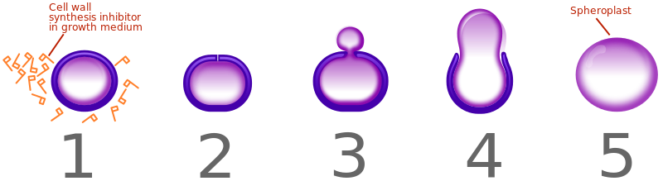
Synthesis of carbapenem β-lactams containing bulky hydrophobic C-6 side chains as potential inhibitors of carbapenemases
Bryanna Dowcett, Marc Boudreau
Department of Chemistry, University of New Hampshire, Durham, NH 03824
Introduction
What is a Carbapenem?
Results
β-Lactam antibiotics disable cell-wall synthesis resulting in bacterial cell death. They are among the most successful antibiotics ever introduced to combat bacterial infections, however the rise of resistance has called for new methods of fighting against infection. This has resulted in the introduction of the carbapenem class of β-lactams into the clinic, however resistance to this class has emerged as well. β-Lactamases are the major defense mechanism of pathogenic bacteria against β-lactam antibiotics as they are able to hydrolyze the β-lactam ring, destroying its antimicrobial activity. One approach to hindering this resistance mechanism has been through the development of β-lactamase inhibitors. It is hypothesized that by introducing a bulky, hydrophobic, C-6 side chain to a carbapenem, β-lactamases will be unable to hydrolyze the β-lactam. Progress has been made towards the synthesis of the potential inhibitor as shown in Scheme 1 and future efforts will be made to complete the synthesis and test it against several β-lactamases.^{2,3}
.
Last resort antibiotic
Used when multi-drug resistant infections are of a concern
Resistant to inactivation by many β-lactamases
β-lactamases are able to hydrolyze the β-lactam ring, disabling the function of the antibiotic.
B
E
DMF
A
D
C
C
H₂O
DMF
A
B
D
E
Figure 2. Representative carbapenem structure.
Figure 3. Mechanism of β-lactam hydrolysis by a β−lactamase.
Figure 5. H¹NMR (CDCl₃) spectrum of methyl 6,6-dibromopenicillanate.
Future Work
Complete homolygation of aldehyde using an alternative base, and more of it.
Continue the synthesis to couple aldehyde to methyl 6,6-dibromopenicillanate.
Complete synthesis of compound 2.
Test compound against several β-lactamases to examine inhibitory activity of new compound.
Figure 4. β-lactam mechanism of action: inhibition of cell-wall synthesis.⁴
Experimental
Scheme 1. Multi-step synthesis of new compound with hydrophobic C-6 sidechain.
Acknowledgements
β5-β6 Loop
I would like to gratefully acknowledge the McNair Scholars program, my McNair 2016 cohort, Dr. Marc Boudreau’s research group, Christian Tooley, and the chemistry department at the University of New Hampshire for their support and help with my research project.
Displacement of the β5-β6 loop by oxacillin
References
Scheme 2. Progress towards the synthesis of compound 2 via bromination, methylation, and coupling of the aldehyde.⁵
Brown, E. D., & Wright. Nat. 2016, 529 (7586).
(2) Santillana, E., Beceiro, A., Bou, G., & Romero, A.; Proc. Natl. Acad. Sci. U.S.A., 2016, 104 (13).
(3) Luca, F. D., Benvenuti, M., Carboni, F., Pozzi, C., Rossolini, G. M., Mangani, S., & Docquier, J; Proc. Natl. Acad. Sci. U.S.A., 2016, 108 (45).
(4) Zeng, X., & Lin, J.; Front. in Microbio., 2013, 128 (4).
(5) Micetich, R. G.; Maiti, S. N.; Tanaka, M.; Yamazaki, T.; Ogawa, K. J. Org. Chem. 1986, 17 (34).
Figure 1. Close-up of active site. There is strong evidence that suggests that the loop plays an important role in the inactivation of β-lactams.^{2,3}
Scheme 3. Synthesis of homologated 5-methyl-3-phenylisoxazole-4-carboxaldehyde.

