Slide 1
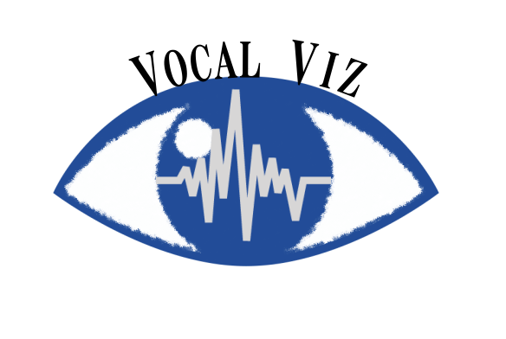

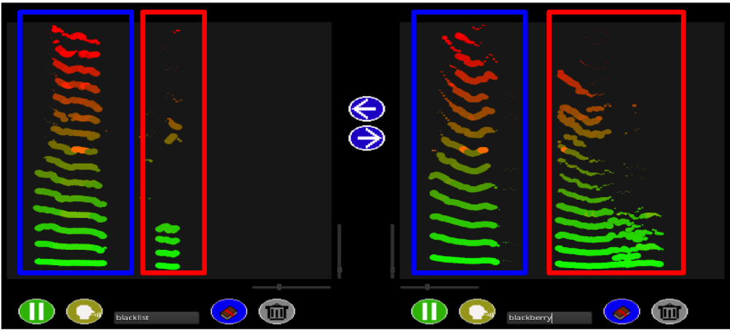
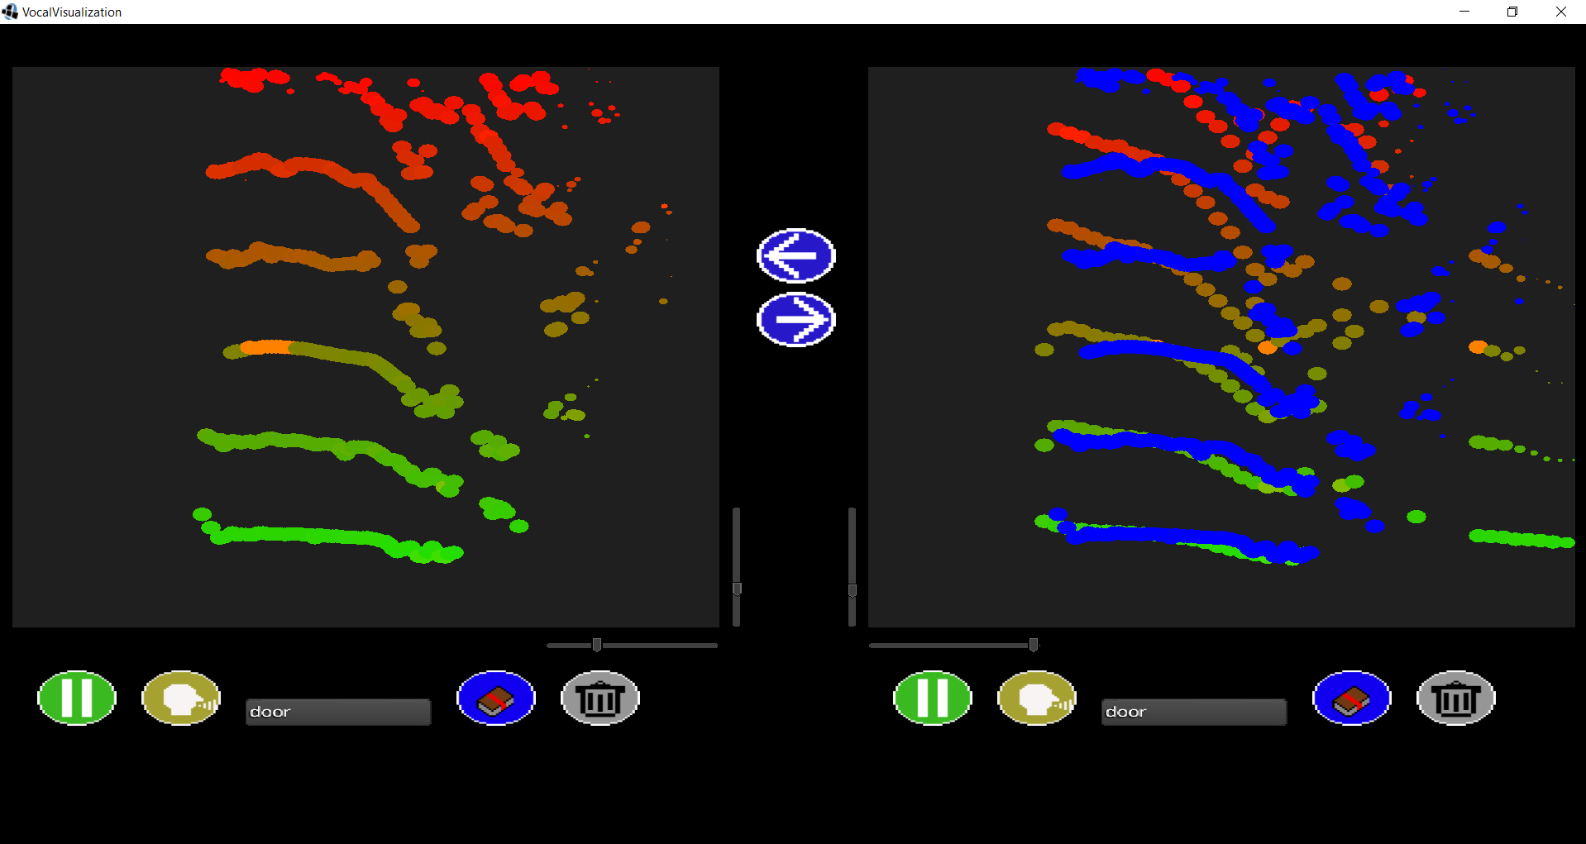
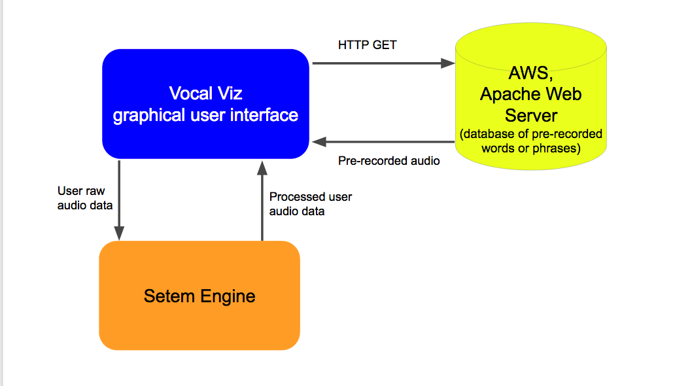
    Vocal Visualization
Alex Caruso | Brandon Bryant | Eric Warner | George Ruseski | Advisor: Kevin Short
Department of Computer Science and Information Technology, University of New Hampshire, Durham, NH
Introduction
Application
  Learning new languages is made more difficult by the lack of effective methods for instant feedback about the student’s pronunciation. In particular, tonal languages present an especially difficult challenge since the student must rely on a domain expert (e.g., native speaker) for feedback about pronunciation.
  Vocal Viz aims to solve this problem by providing visual feedback to the user. This goal of this project is to build a multi platform application that visualizes the user’s voice in real time as the user is learning and practicing the new language.
  Viewing this information in comparison to a pre-recorded correct pronunciation provides the user with a better understanding of how to correctly pronounce words through instant visual feedback, making the process of learning a new language a little bit easier.
The top figure is a screenshot of two compound words being compared, blacklist and blackberry pronounced by the same speaker. The blue boxes highlight the “black” portion of the word. The red boxes highlight the differences between “list” and “berry”.
Technologies Used
Setem Technology API, processes and cleans audio being analyzed
LIbGDX, framework for multi-platform applications
Amazon Web Services, Apache server hosts database of pre-recorded phrases
Java sound library, used for audio capture
Gradle Build System
In the bottom figure, a user’s voice is being visualized on the left panel. On the right panel the user’s voice is being compared to a pre-recorded version of the same word.
Analysis
Color mapping
Display
Transpose and overlay for comparison
Future Workings
Portability across all platforms; continue developing for all platforms iOS, android, Linux etc,,,
Support multiple languages
Extend to include phrases and sentences
Automatic analysis, implementing machine learning algorithms to compare user’s voice and recordings
Figure 1: Application workflow

