Slide 1


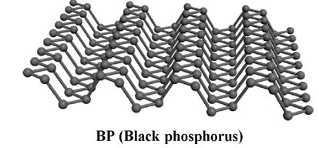
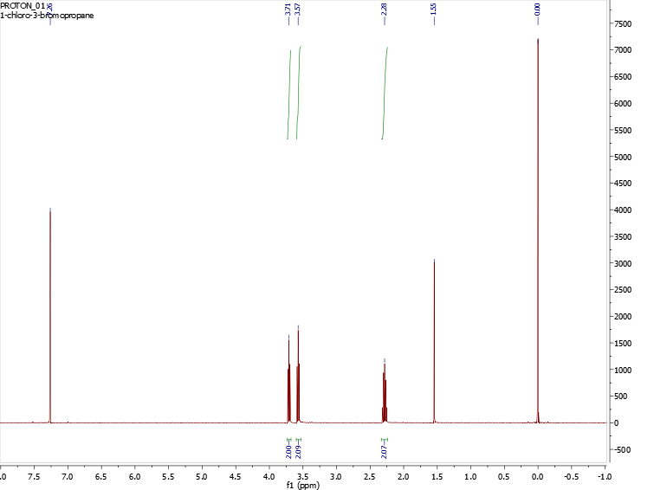
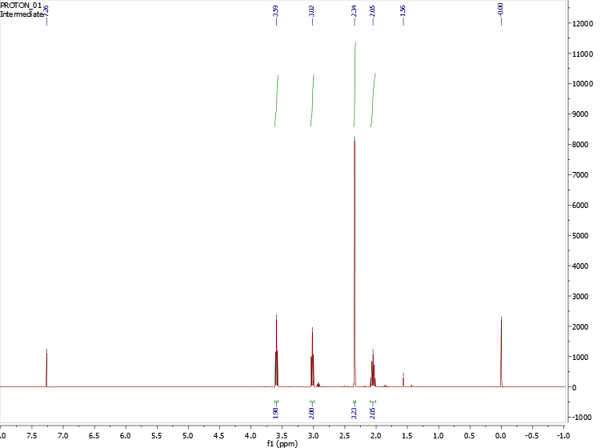
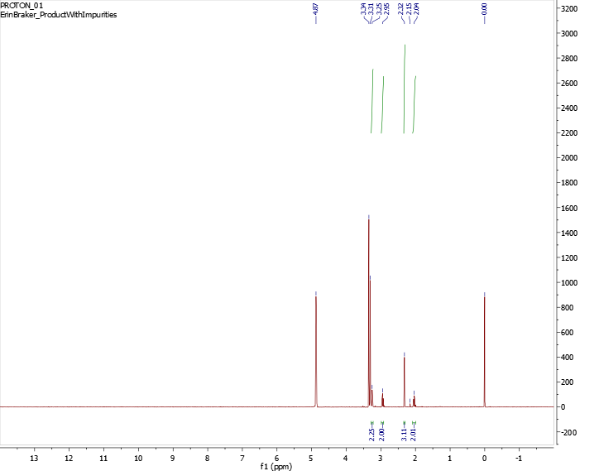
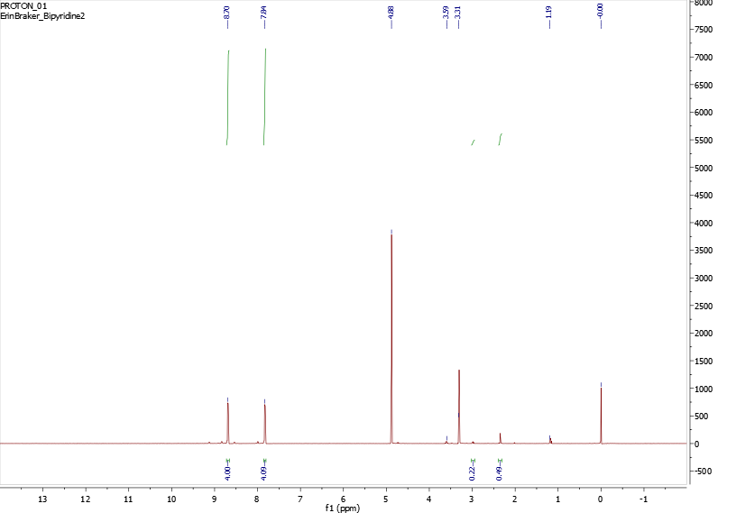
Synthesis of Hydrogels for the Protection of Phosphorene
Erin E. Braker, Charles A. Ayotte, Christine A. Caputo
University of New Hampshire, Department of Chemistry
_{eb2018@wildcats.unh.edu}
_{4/19/2017}
Introduction
Results & Discussion
Future Work
Phosphorene
Black phosphorus, or phosphorene, is a semiconducting 2D layered material¹ that has just become of interest to chemists. This semiconductor is similar in physical characteristics to graphene², but phosphorene demonstrates layer dependent band gap and is tuneable.
Fig. 1 A cartoon depiction of a phosphorene sheet.
Synthesis of thioacetic acid S-(3-iodopropyl) ester
The synthesis of this ester^{4,5} involved two sequential substitutions under reflux, and extraction that were successful. An 82% yield of the ester was achieved. The proton NMR showed that the reaction was successful.
Scheme 2 The basic skeleton for the synthetic route to the first substituent
Synthesis and Addition of 1-Bromo-3-isothiocyanatopropane
This synthesis was considered, but a true route was never really tested as time did not allow. This substituent was less important to synthesize as it is commercially available, though costly. With this substituent synthesized and added to 1-(3-(acetylthio)propyl)-[4,4′-bipyridin]-1-ium iodide, it would be possible to polymerize the hydrogel and to use it in further research involving phosphorene.
Scheme 4 Proposed synthetic route to the second linking group, 1-Bromo-3-isothiocyanatopropane.
Synthesis of 1-(3-(acetylthio)propyl)-[4,4′-bipyridin]-1-ium iodide
Following a literature procedure, addition of 4,4′-Bipyridine to thioacetic acid S-(3-iodopropyl) ester could be achieved.³
The proton NMR (Fig. 5) showed small peaks that resembled the first substituent with bipyridine, but they were not strong enough to make conclusions. This was suspected as what should have been a recrystallization solvent, as listed in the procedure³ , dissolved the material at room temperature.
Synthesis of a Redox Active Hydrogel
Phosphorene decomposes in the presence of H2O, light, and O2, but if one is removed from the system phosphorene can be used for further research. Since the Caputo group pursues nanoparticles of black phosphorous through liquid exfoliation techniques, it is beneficial to pursue their protection. A redox active violegen is able to protect phosphorene from oxygen because it is capable of reducing oxygen if it penetrates the gel³. In the hydrogel in question, bipyridine will create the polar environment necessary of the gel. With 4,4’-bipyridine acting as a viologen moiety, cross linking groups also need to be included. One was synthesized (thioacetic acid S-(3-iodopropyl) ester) and added to the viologen moiety as seen in step one of Scheme 1. This hydrogel should allow use of black phosphorous nanoparticles as photosensitizers for the generation of solar fuels, with the advantage being that it can be used in an aerobic and aqueous environment while being exposed to sunlight.
Scheme 3 The route of synthesis described by Plumere, N. et al. ³
Conclusion
An efficient route to synthesize and purify the first substituent, thioacetic acid S-(3-iodopropyl) ester was developed with an 82% yield. Adding the substituent to bipyridine following the literature was not successful, according to NMR. Further research would hope to add the first substituent to 4,4’-bipyridine by isolating each step in Scheme 3 to decipher what went wrong. Microwave synthesis will be attempted rather than reflux to make the process more efficient. It would be in best interest to pursue a way of synthesizing the second substituent and attaching it to the 1-(3-(acetylthio)propyl)-[4,4′-bipyridin]-1-ium iodide as well as having the hydrogel interact with phosphorene incorporated. If this hydrogel is successful in protecting phosphorene from degradation caused by O₂, further research in it’s use as a photosensitizer material for solar fuels generation will be implemented.
Proton NMR Spectroscopy
Fig. 2 Proton NMR of Starting Material
Fig. 3 Proton NMR of Intermediate in first Synthesis
c
TMS
c
b
a
b
a
d
d
water
chloroform
c
chloroform
TMS
a
b
c
a
water
b
Fig. 4 Proton NMR of Iodo Substituent Fig. 5 Proton NMR of addition to bipyridine step
References
e
f
Jeon, P.J.; Lee, Y.T.; Lim, J.Y.; Kim, J.S.; Hwang, D.K.; Im, S.; Nano Letters. 2016. 16 , 1293-1298.
Dexter, J.; IEEE Spectrum. 2015.
3. Plumere, N.; Rudiger, O,; Oughli, A.A.; Williams, R.; Vivekananthan, J.; Poller, S.; Schuhmann, W.; Lubitz, W.; Nature Chemistry, 20142. Pascale, R.A. J. Am. Chem. Soc., 1999, 121, 727 733.
4. Block, E.; Dikarev, E.V.; Glass, R.S.; Jin, J.; Li, B.; Li, X.; Zhang, S.Z.; J. Am. Chem. Soc, 2006. 128, 14949-14961
5. Cooke, M.P.J.; J. Org. Chem. 1993. 58, 2910-2912
c
c
b
a
d
b
d
water
methanol
a
water
TMS
methanol
TMS
d
f
e
ethanol
ethanol
Acknowledgements
Scheme 1 The synthetic route to 1-(3-(acetylthio)propyl)-1′-(3-isothiocyanatopropyl)-[4,4′-bipyridine]-1,1′-diium iodide bromide³
c
a
b
a
d
A special thanks to the Caputo Group, Christine Caputo, Charlie Ayotte, Bill Butler, and the Department of Chemistry at UNH for support.

