Slide 1
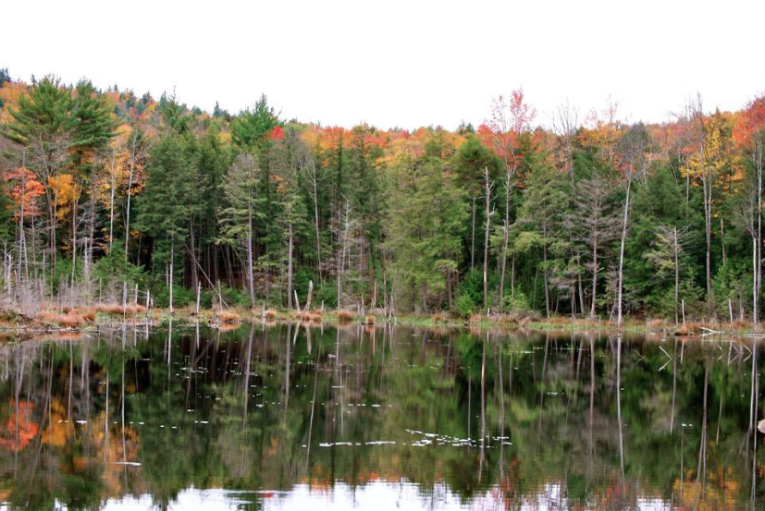


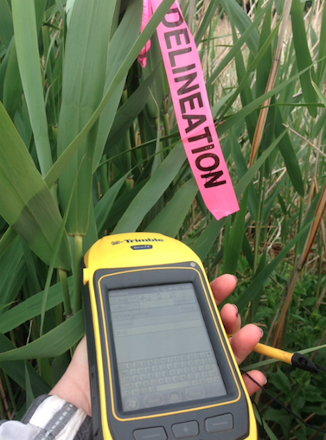
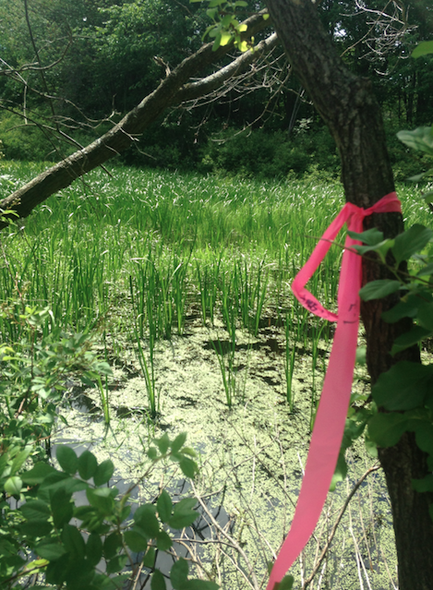
Environmental Regulations:
Experiences of an Environmental Consulting Intern
Colleen Brothers
University of New Hampshire, Earth Sciences Department
Motivation
An internship at Epsilon Associates in Maynard, Massachusetts provided experiences on environmental projects. A constant between projects was the influence environmental regulations had on the design, construction and monitoring of projects.
Environmental regulations are a great resource in protecting our environment. Humans have a significant impact on the environment which was specifically seen in this internship through development. While development is important for economic and social growth it is also important to preserve and protect the environment for current and future generations.
The goal of this project was to examine how environmental regulations influence development and protect the environment.
Data Collected
Projects began with data collection in the field, followed by either map making, report writing or permit writing.
Data collected included:
Soil characteristics
Hydrologic Indicators
GPS Points
Species
Town By-Laws and
permitting processes
Regulatory Impacts
Design, construction and monitoring of projects were influenced by environmental regulations triggered by the permitting process.
Impacts included:
Wetland resource protection
Moving of construction boundaries
Wetland mitigation or restoration
Invasive species tracking
Rare species monitoring
Project cancellation
Fines
Projects
The internship provided experiences on a variety of environmental projects, specifically in the wetland ecology group.
Projects included:
Delineation Construction Planning
Restoration
Mitigation
Wildlife Habitat Assessments
Wildlife Hazard Assessments
Invasive Species Tracking
Surface Water Degradation
Pipeline Expansion
Environmental Considerations
Projects worked on created plans to minimize or mitigate adverse affects due to development. Without environmental regulations human activities would destroy our environment and without environmental consultants to plan and permit development could not occur.
Regulations
There are various environmental regulations that influence permitting, design, construction and monitoring.
Regulations included:
Clean Water Act
Section 404: Dredge and Fill Permits
Massachusetts Wetland Protection Act
Endangered Species Act
Acknowledgments
Special thanks to Mike Howard of Epsilon Associates, the Wetland Ec0logy group at Epsilon, Professor John Aber of UNH and to my faculty advisor Tom Lippmann.

