Slide 1

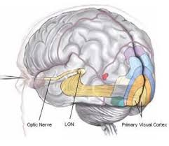

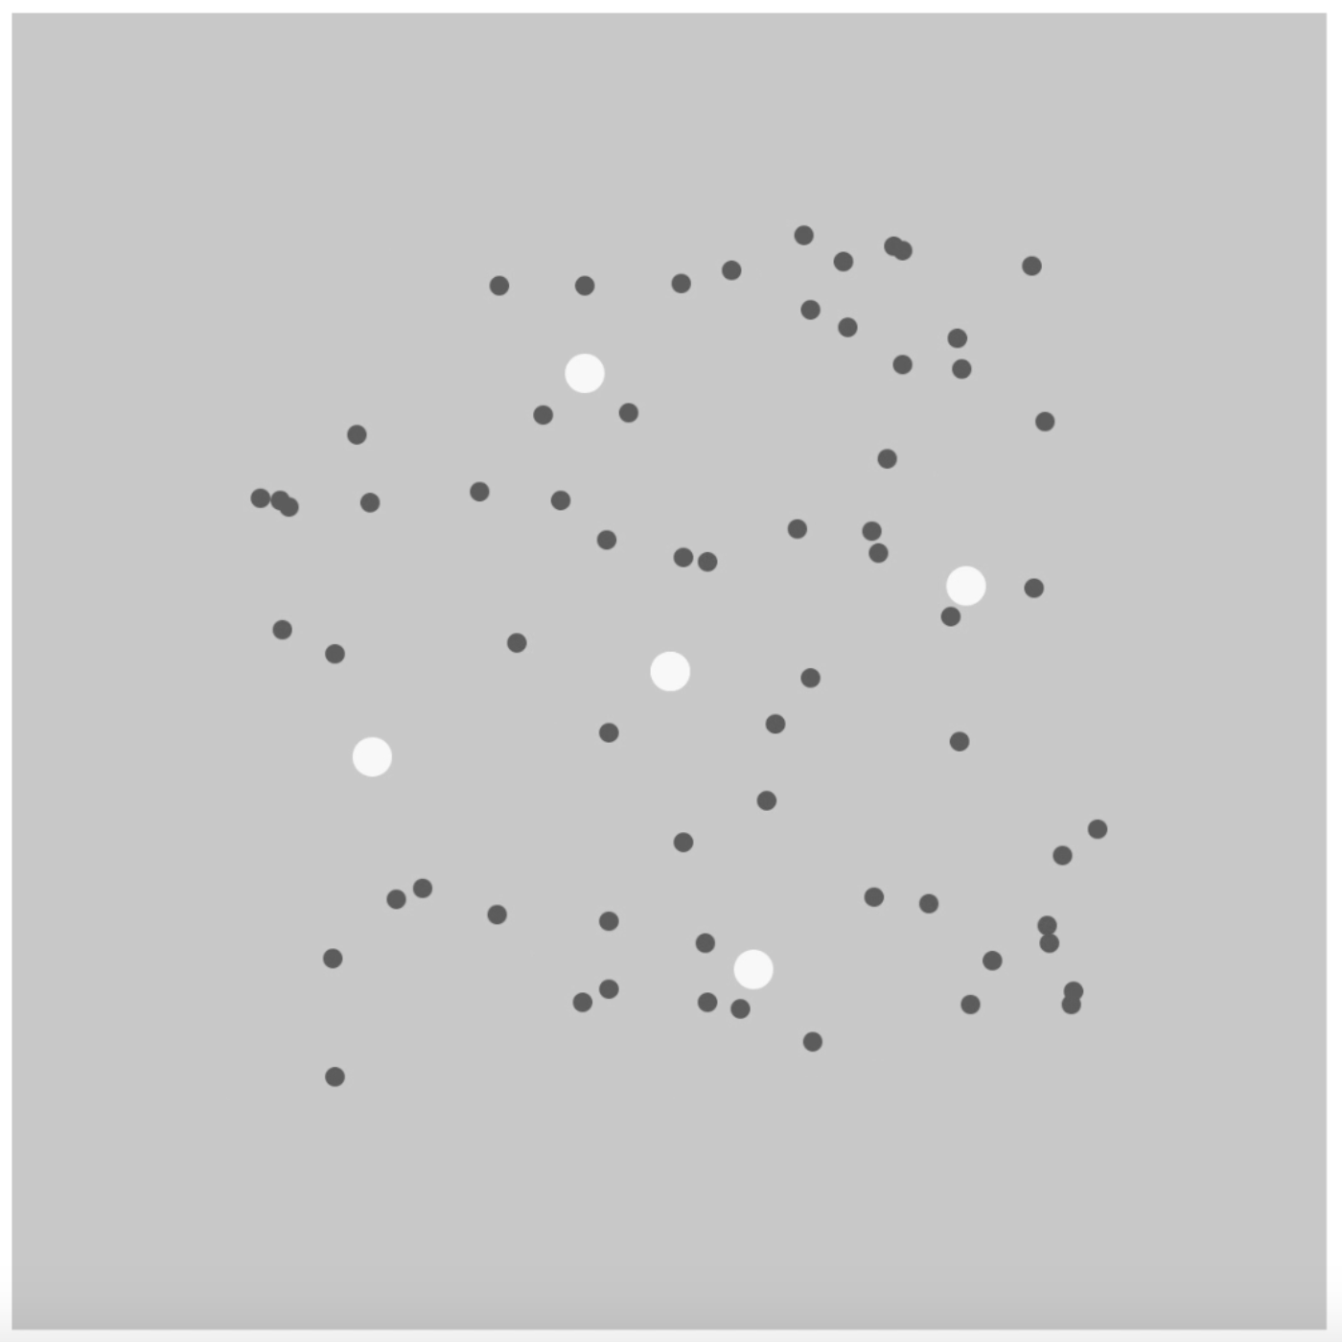
Measuring the Influence of ON- and OFF- Cell Contrast Asymmetries on Motion Induced Blindness
Amanda LeBel, Hanne Hansen, Emma DePierro, Nicholas Duggan, Alison Meurer, William Stine, & Andrew Kitt
Psychology Department, University of New Hampshire, Durham, NH
Introduction
Results
Motion Induced Blindness is a natural phenomenon where a salient target seems to disappear when a moving mask is presented with it (Bonneh et al., 2001)
ON- and OFF- cells are ganglion cells thought to be responsible for measurement of light increments and decrements, respectively
These pathways synapse in the Lateral Geniculate Nucleus (LGN) before continuing on to V1
The OFF pathways is considered to be stronger until V1, where they are thought to be equal in strength (Westheimer, 2007), however some research has found differences past this point
The purpose of this study is to measure the contrast response of ON and OFF channels in MIB
http://brainmind.com/BrainLecture9.html
Methods
Discussion
Subjects were placed in a dark room 0.91 m away from a MacBook pro with their chin resting on a chin rest
An MIB stimulus was presented using Mathematica with one of 4 different 2-frame motion luminance masks equally spaced on a logarithmic scale of 15 cd/m², 61.3 cd/m², 84.3 cd/m², 95.9 cd/m², 119.1 cd/m², 130.6 cd/m², 153.8 cd/m², and 200 cd/m², and 1 of 5 different lengths
Subjects responded whether or not the stationary dots seemed to disappear
Each subject ran for a total of 15 runs with 160 trials per run
  Each point on a psychometric function was estimated by 30 trials
  The confidence intervals around the psychometric functions are score confidence intervals
  The error bars on the mean plots are standard error bars, estimated using bootstraps
Results corroborated previous results in lab (Stine et al., 2017)
  Dark mask always more effective than light over dark and light targets
Higher contrast took less time for disappearance than comparable low contrast
As contrast decreased, time to disappear increased significantly
Shows that low level processing such as contrast plays a role in MIB
Suggests that the ON- and OFF- cell pathways maintain some differences up through V5
Works Cited:
Bonneh et al. (2001). Motion Induced Blindness in Normal Observers. Nature. 411, 798-801.
Stine et al. (2017). MIB Using Luminance Increments and Decrements. Submitted for Publication.
Westheimer, G. (2007). The On-Off Dichotomy in Visual Processing: From Receptors to
Perception. Progress in Retinal and Eye Research. 26, 636-648.
Notes:
Percent = (contrast – background contrast) background contrast

