Slide 1

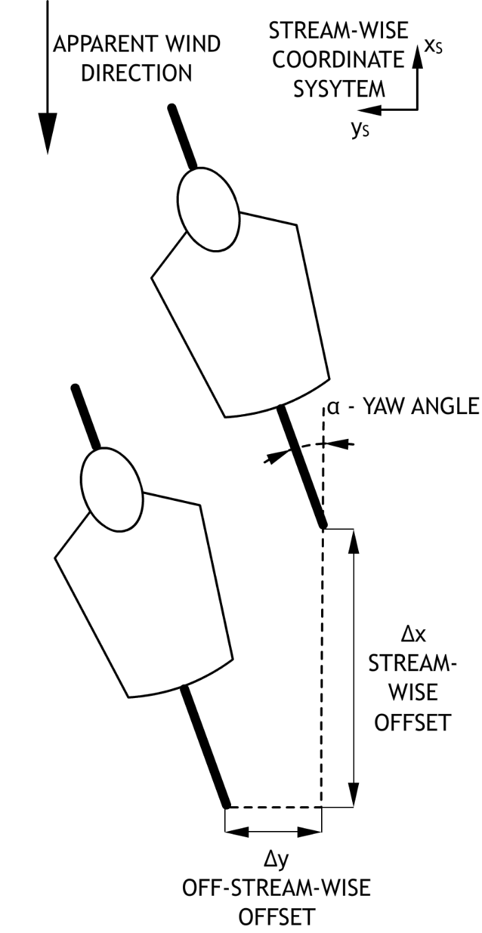
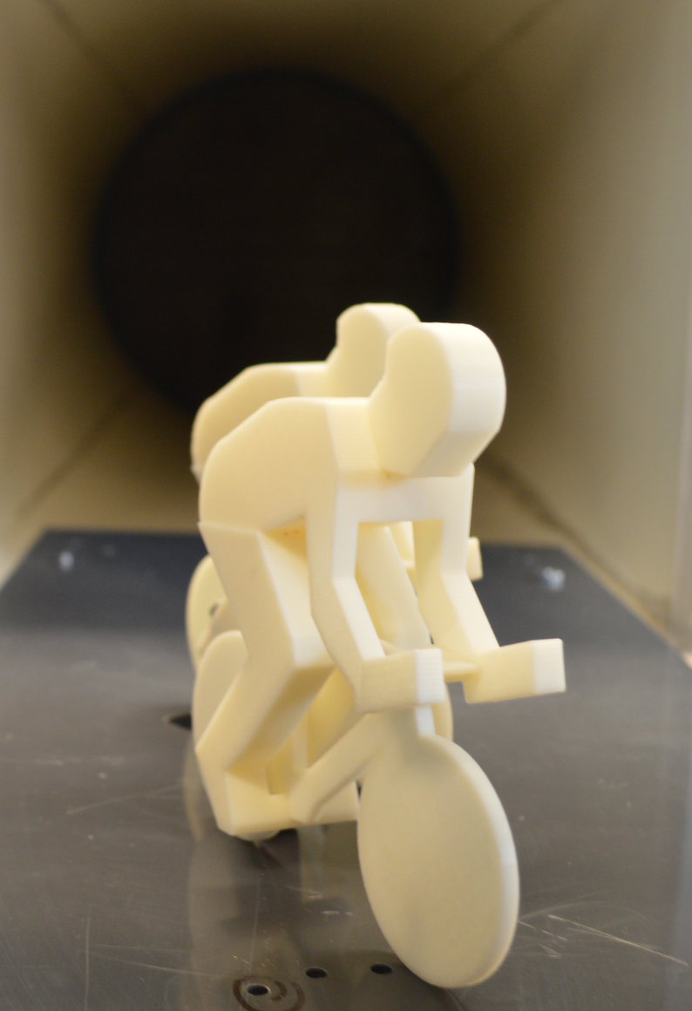
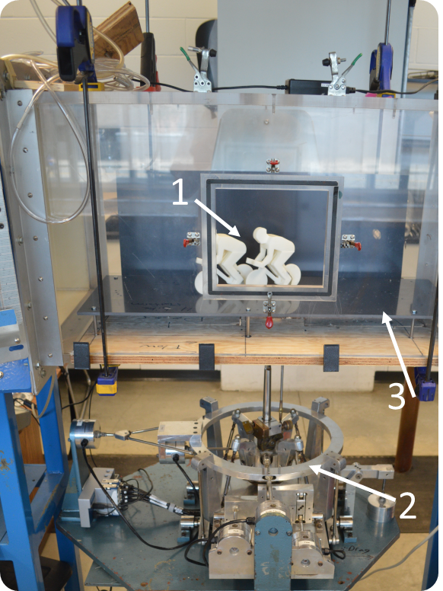
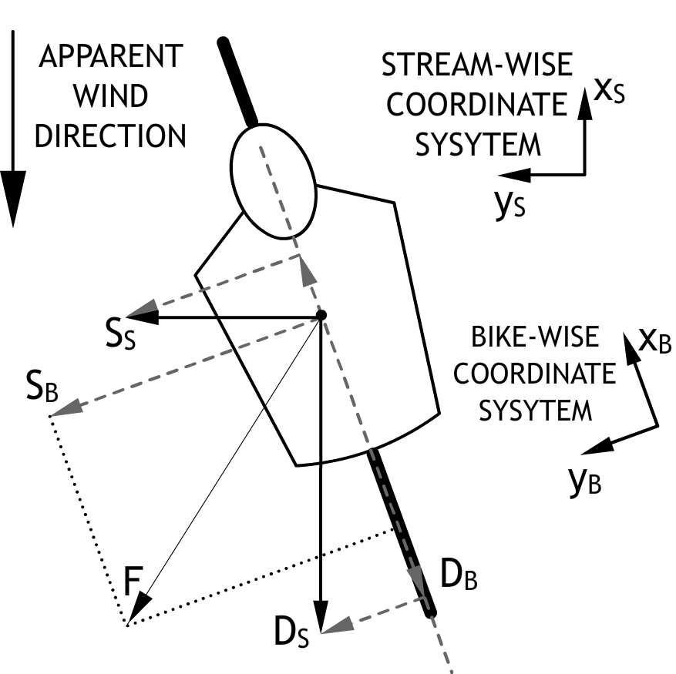
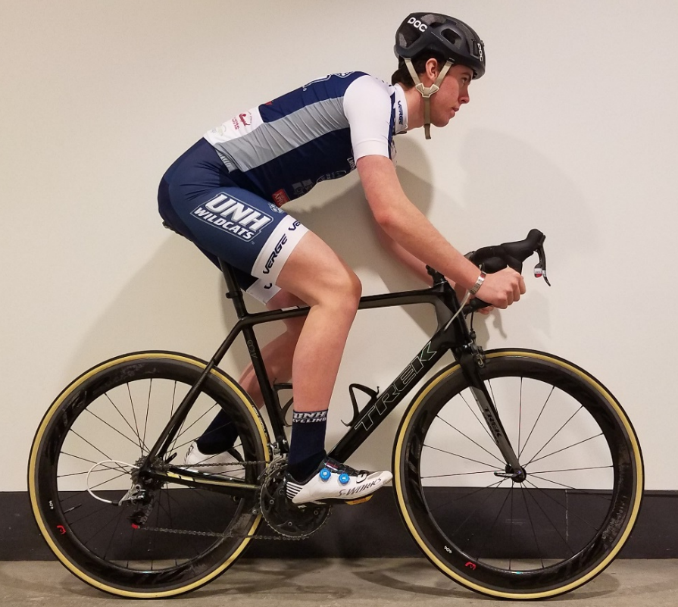

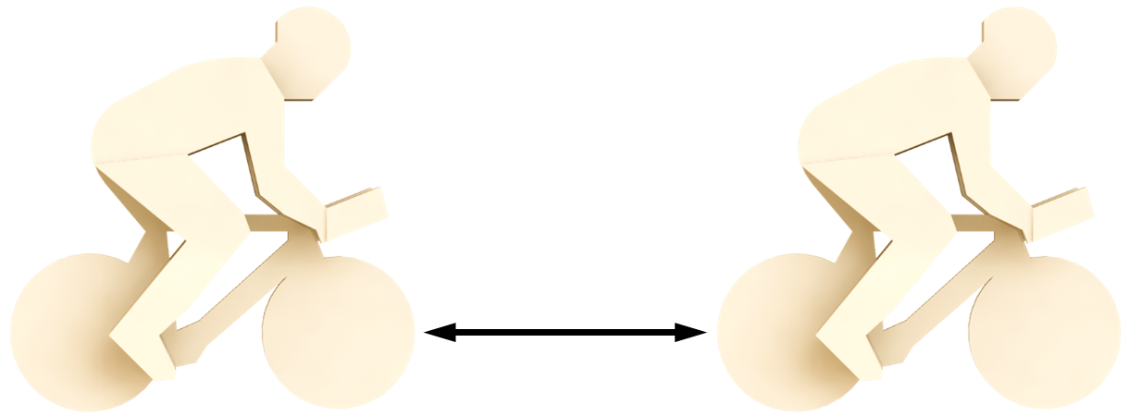
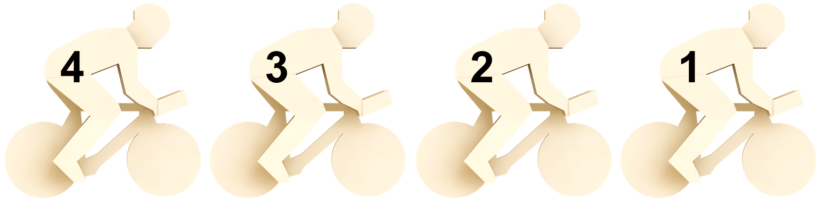
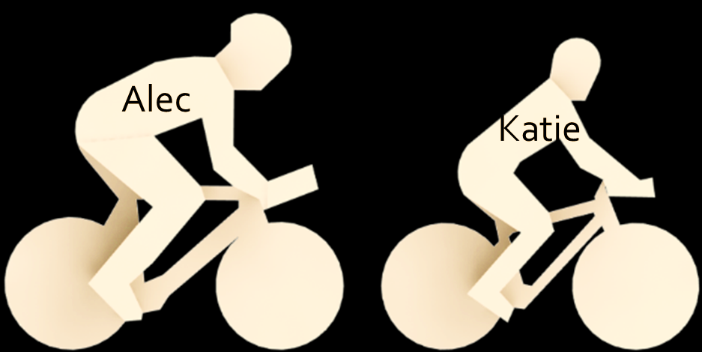
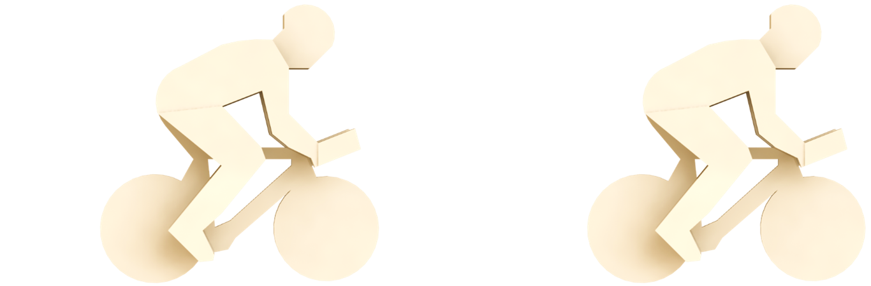
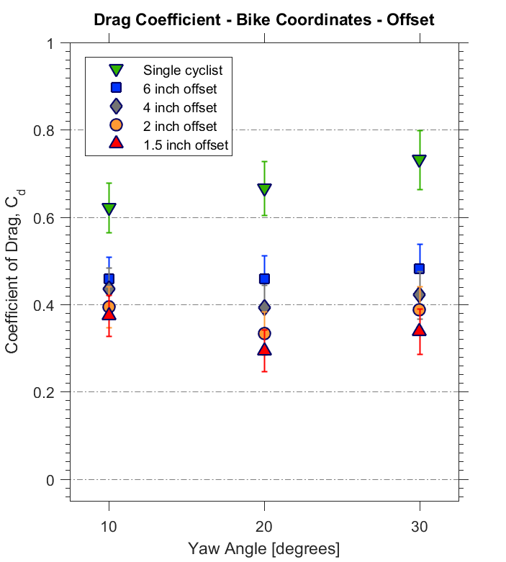
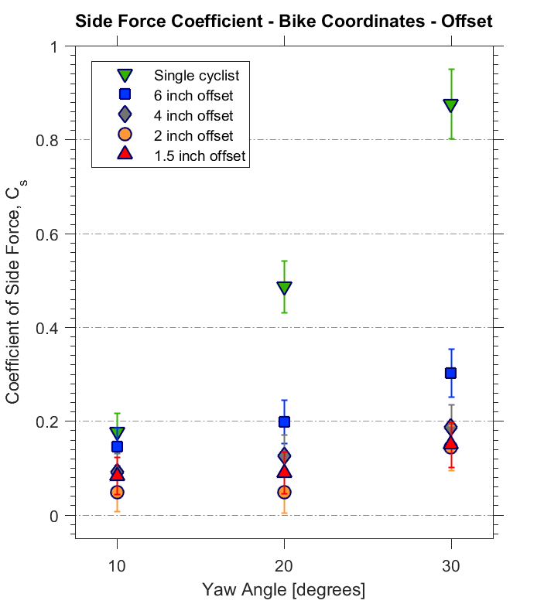
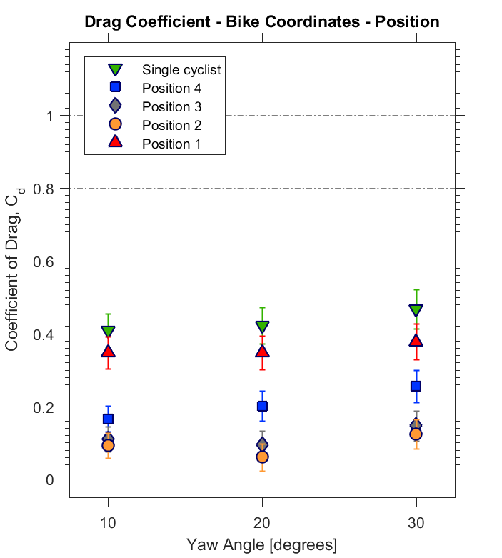
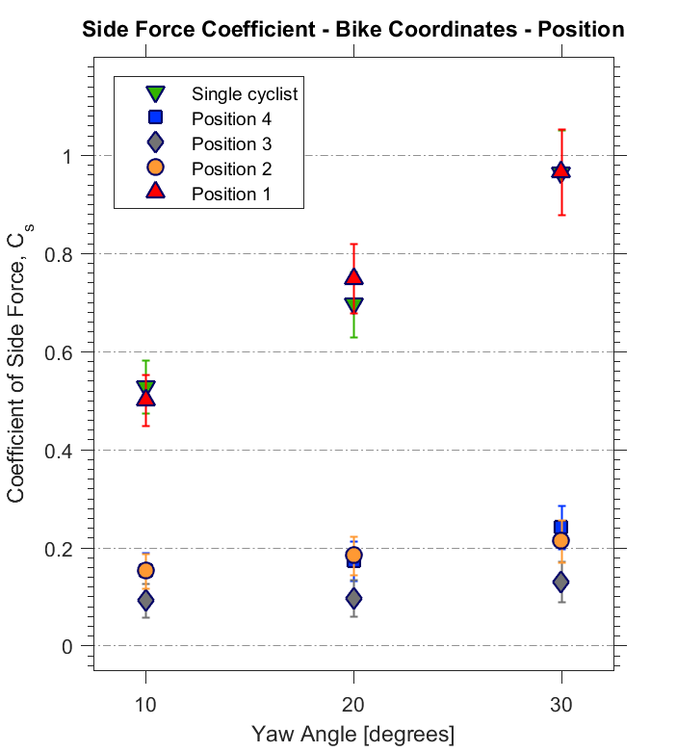
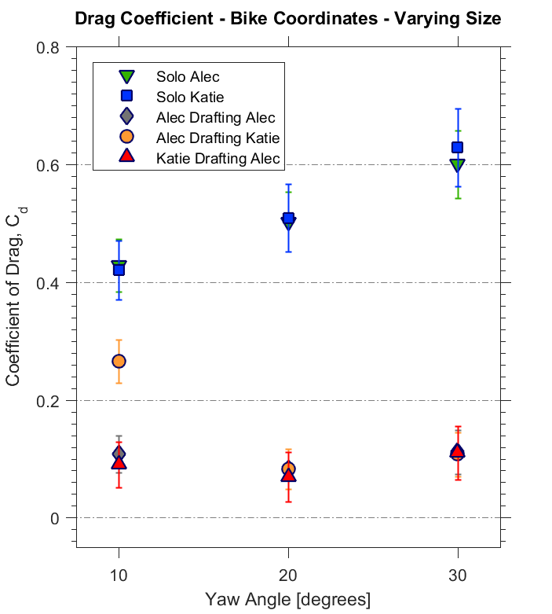
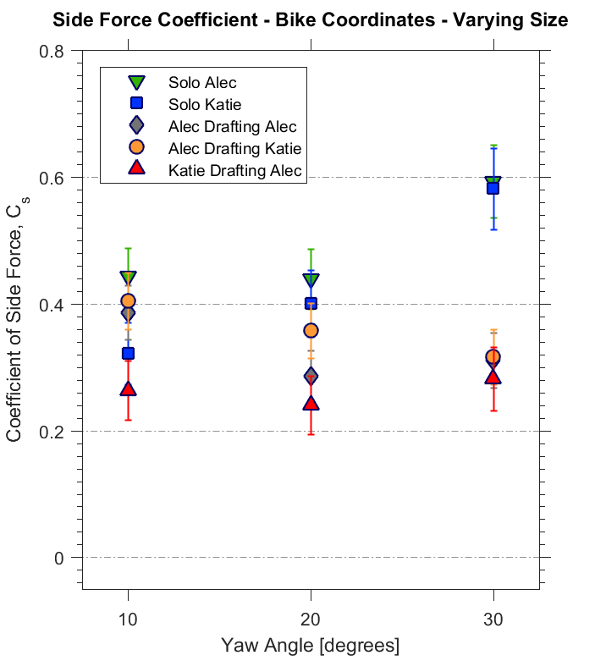
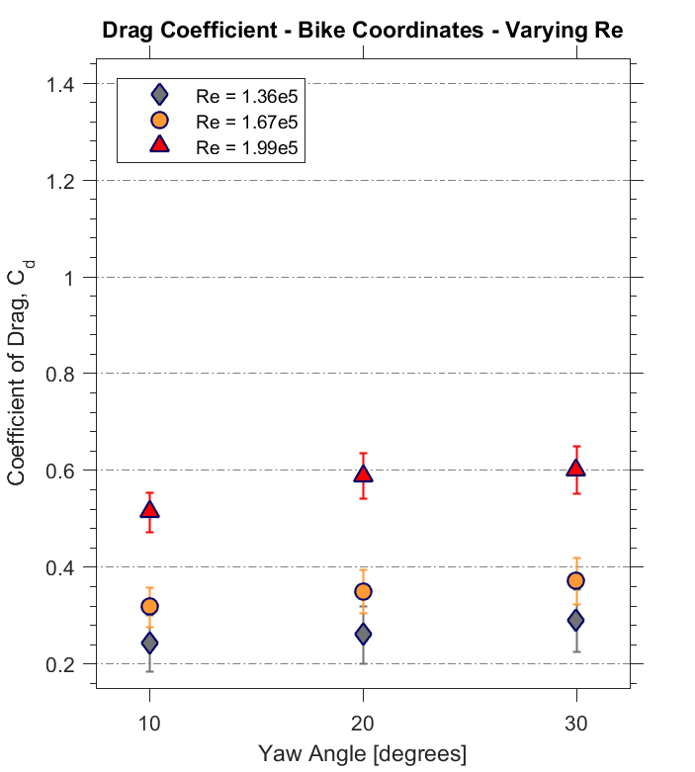
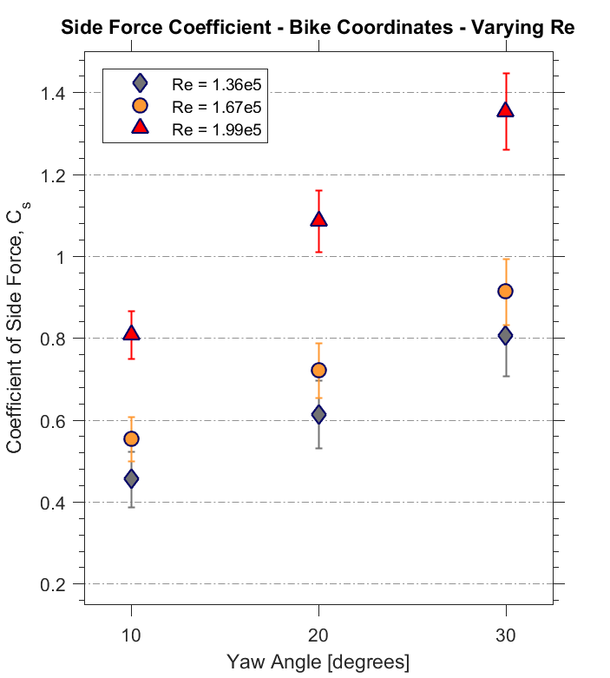
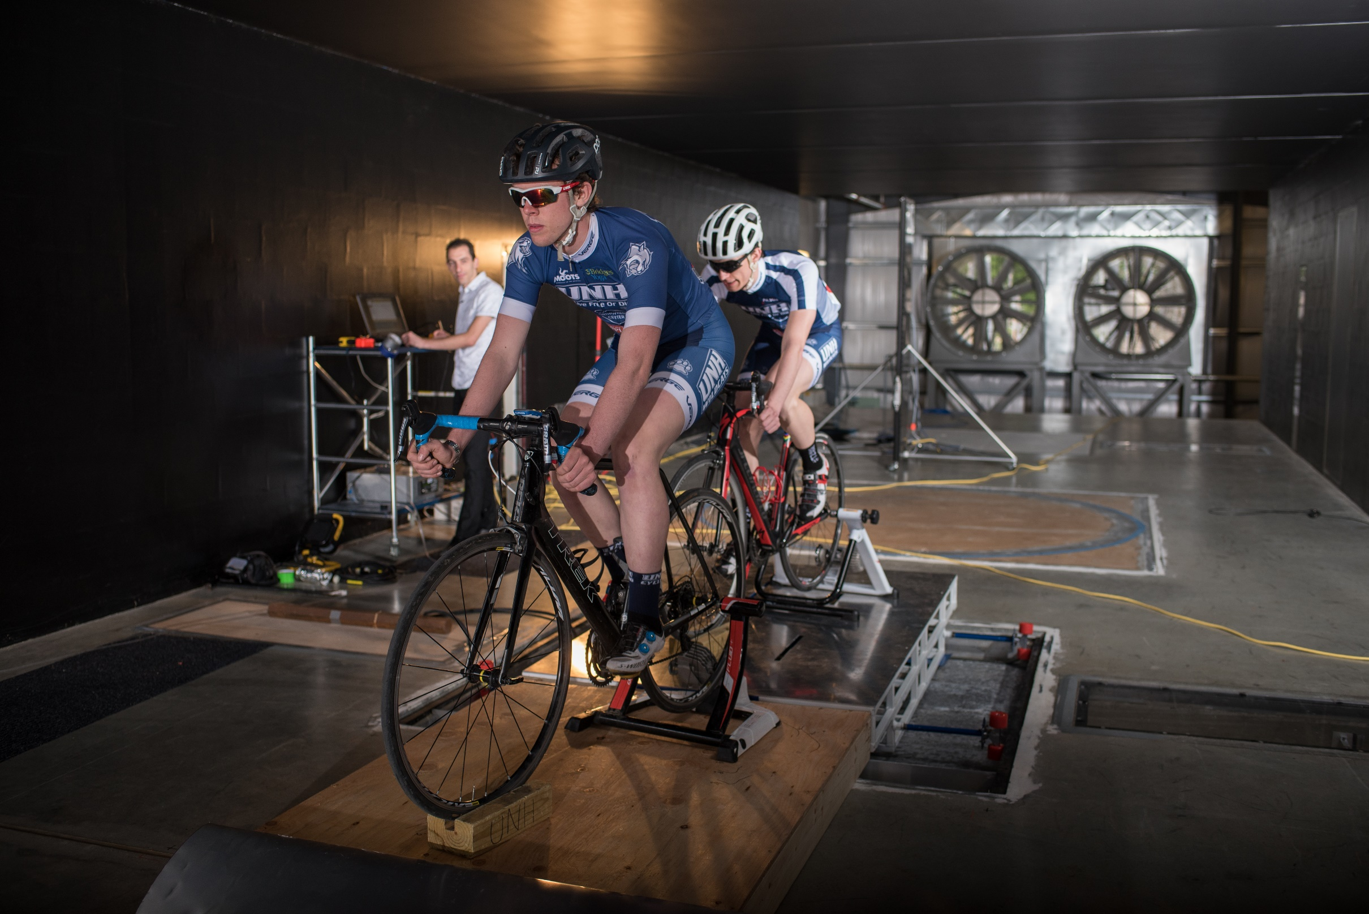
Cyclist Aerodynamic Analysis in Cross Wind
Alec Cunningham and Adam Lovell Advisor: Ivaylo Nedyalkov
Department of Mechanical Engineering, University of New Hampshire
Introduction
Cyclist Models
Student Wind Tunnel Tests
Studies suggest 90% of a rider’s energy is used to overcome drag [1], but drafting reduces drag forces by 30% when riding directly behind another cyclist [2]
Drafting formation in cross wind is called an echelon
Not much data available for
drafting in a cross wind [3]
Riding in a cross wind changes the
positioning necessary for optimal
drafting [3]
Riding in an echelon decreases
  side force [3] which is the cause
  of 5% of the single-cyclist accidents [4]
Models of UNH cyclists Alec and Katie
  Alec is 15% taller than Katie
Models were scaled 1:11
2 cyclists with 2, 4, 6 inch stream-wise displacements and yaw angles of 10°, 20°, 30°
Offset of 2 inches both to the right and left in the
off-stream-wise direction
Varied speeds to determine the dependence on Reynolds Number
Using the models of Alec and Katie, determined
how the cyclist’s size affects drag reduction
Using results from 2 cyclist platform, each bike
was separated 1.5 inches for a
4-cyclist setup
Human versus 3-D printed model
Models in the Student
Wind Tunnel
Test Subject
Aerolab Pyramidal Force Balance
Student Wind Tunnel Test Section
Offset
Group Position
Rider Size Dependence
Reynolds Number Dependence
Drafting significantly decreases both drag and side force
  Riding in-line with one another results in the greatest force reduction [3]
  Riding as close to one another results in larger force reduction
  At lower yaw angles, positioning is not as important compared to larger yaw angles.
In an echelon, the 1st cyclist experiences the most drag and the last rider experiences the next highest drag
Except for the 1st rider the side force is significantly lower for all cyclists in the formation
Little to no difference for drag force between Katie and Alec when riding alone
The size of the leading cyclist matters only if the drafting cyclists is larger than the leader
Results depend on Reynolds number for Re < 2e5
Side force is affected more than drag
Higher Re numbers will be investigated in small and large scale testing
References
[1] Barry, N., et al., 2012, "Effect of Crosswinds and Wheel Selection on the Aerodynamic Behavior of a Cyclist." Procedia Engineering, 34, pp. 20-25.
[2] Noerstrud, H., 2010, Sport Aerodynamics, Wien: Springer, Print.
[3] Nedyalkov I., Lovell A., Cunningham A., 2017, “Experimental Investigation of a Drafting Cyclist in Cross-Wind.” In Proceedings of American Society of Mechanical Engineers 2017 Fluids Engineering Division Summer Meeting. Paper number FEDSM2017-69398 [accepted]
[4] Fintelman, D.M., at al., 2015 "CFD Simulations of the Flow around a Cyclist Subjected to Crosswinds," Journal of Wind Engineering and Industrial Aerodynamics, 144, pp. 31-41.
Flow Physics Facility Tests
Using previously built drag balance, drag was measured to validate the small scale testing
Preliminary tests show:
  there is very little difference in drag force between pedaling and not pedaling
  riding as close as possible to the front rider results in the smallest drag in the stream-wise direction
Tests will be continued to verify the group positioning, as well as size and Reynolds Number dependence
Acknowledgements
We would like to thank Chase Klewicki, John Turner,
John Abare and the rest of the UNH technical staff.
Also, a final thank you to the senior project team that created the force balance used to conduct some of our experiments.
Photo courtesy of Jeremy Gasowski, Communications and Public Affairs UNH

