Slide 1
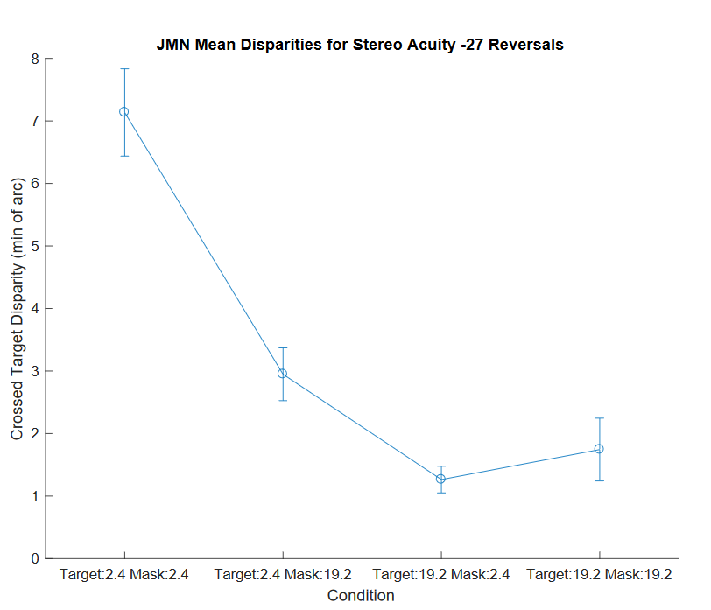
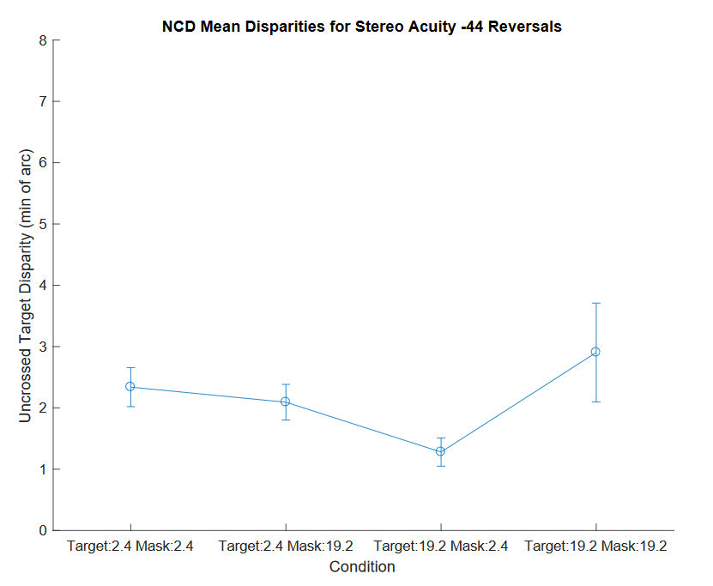
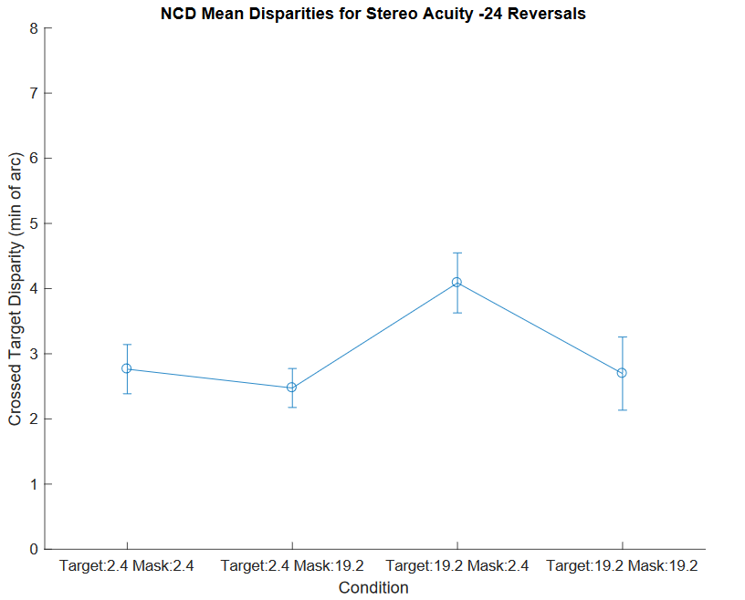
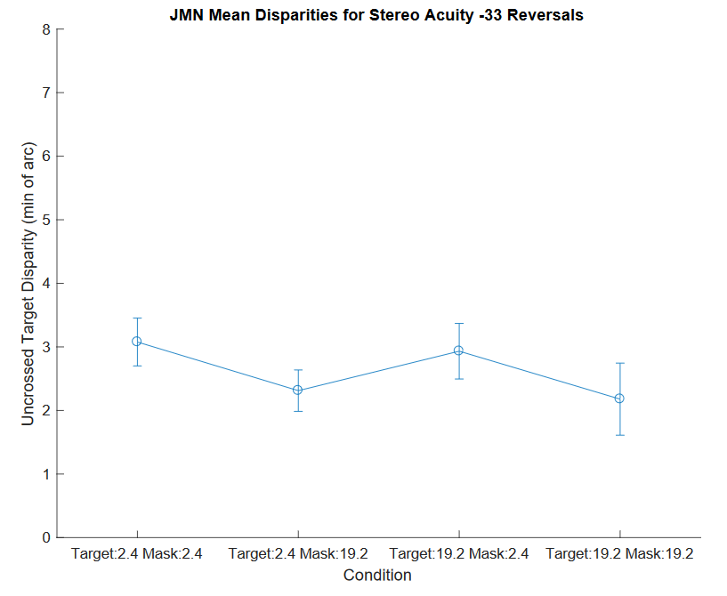
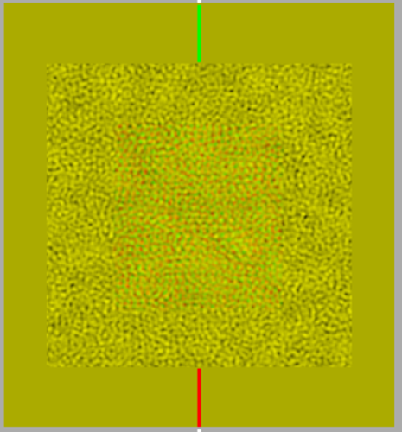
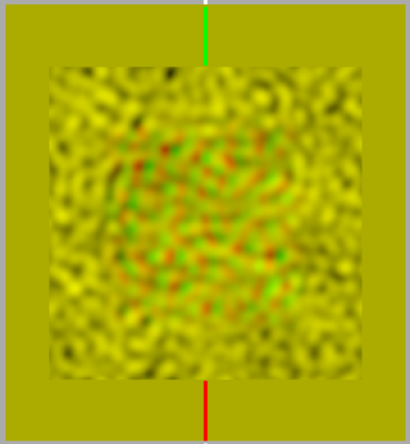
Exploring Spatial Frequency Channels in Stereopsis
Nicholas C. Duggan, Jonathan Neilio, Olivia C. Rebel, Sarah Meier, Andrew J. Kitt, and Wm Wren Stine
University of New Hampshire, Psychology Department, Durham, NH
Definitions
Method of Limits: A gradual increase or decrease in stimulus level until it can be perceived
Sensitivity Threshold: The lowest level of disparity that can be detected.
Results
Introduction
Stereopsis is the perception of depth as a result of receiving visual inputs from two eyes. Humans or other animals that use two visual inputs to create a single perceived image are using binocular vision (McColl, Ziegler, & Hess, 2000). For humans who have normal binocular vision, there is a limit to the smallest possible difference in depth we can perceive. This is known as the depth disparity threshold (Ujike & Ono, 2001).
Depth is seen over a wide range of angles, recorded with the unit arc min. Depth disparity can be either crossed or uncrossed. Crossed disparity occurs when the object is in front of the fixation point and uncrossed disparity occurs when the object is behind the fixation point. (Ogle, 1952)
Cormack, Stevenson, & Schor (1993) found that there are a large number of disparity channels or narrow band channels. Each channel is corresponds to the size of the element in the image. Some channels are tuned to a higher spatial frequency or small elements, while lower spatial frequency channels are tuned to larger elements. All of the channels account for both crossed and uncrossed disparity.
We hypothesize that the narrow band channels are essentially independent because they are tuned to different sized stimuli. If this is true, the narrow band channels should have different disparity thresholds and elements of one spatial frequency should not affect the detection of elements of a different spatial frequency. Our objective for this study is to the map out the architecture of each channel in order to determine the minimal amount of difference in depth that can be detected.
Discussion
The top two graphs show our anticipated results. A random dot stereogram with a noise mask at the same spatial frequency as the target should be more difficult to detect than one with a non-matching mask. This should result in a matching-mask RDS having a smaller disparity threshold than a non-matching RDS. Yet, the bottom two graphs do not display this trend. One reason for this irregularity may be that the method of limits does not accurately illustrate the effect of a noise mask on disparity threshold. One could also speculate that only having only two subjects running the experiment could possibly produce unusual results.
Methods
A set of random dot stereograms (RDS) for two spatial frequencies were generated with MATLAB to test a subject’s stereoacuity. Each set of random dot stereograms was displayed with a noise stimulus at a matching spatial frequency or at a non-matching spatial frequency. Subjects observed these random dot stereograms through a Maxwellian view system.
Subjects were shown two pairs of random dot stereograms. One would have crossed or uncrossed disparity and the other would have zero disparity. Subjects would press a key to indicate whether the first or second stimulus had disparity.
Subjects would receive feedback on the correct answer. If the subject chose correctly, the next stimuli would have a smaller disparity, making depth more difficult to perceive. For an incorrect answer, the opposite would occur.
_{Anaglyphs}
References
Cormack, I. K., Stevenson, S. B., & Schor, C. M. (1993). Disparity-tuned channels of
the human visual system. Visual Neuroscience, 10, 585-596.
McColl, S. L., Ziegler, L., & Hess, R. F. (2000) Stereodeficient subjects demonstrate
non-linear stereopsis. Vision Research 40 1167-1177.
Ogle, K. N. (1952). Disparity limits of stereopsis. Archives of Ophthalmology. 48, 50-
60.
Ujike. H., Ono, H. (2001). Depth thresholds of motion parallax as a function of head
movement velocity. Vision Research 41 2835-2843.
Notes:
E15JCY15- Psychology Department
-Stereoacuity: how good you are at stereopsis
-local stereopsis: DOG
-global stereopsis: RDS
-spatial frequency: light across spatial dimension, graphing amount of light across space
-creates black and white bars
-Maxwellian view system: controls amount of light entering the pupil and also aligns the subject (using bite bar)
-Method of constant stimuli: all possible permutations are presented randomly and data is statistically analyzed after
-Define crossed and uncrossed disparity

