Slide 1



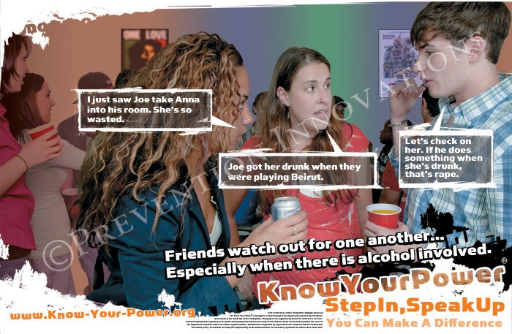
Rates of Sexual Victimization and Perpetration: The Impact of a Campus Bystander Intervention Program
Sarah Unruh, Sharyn Potter, Alison Cares (Assumption College), Linda Williams, Vicki Banyard, Mary M. Moynihan, and Jane G. Stapleton
Department of Sociology, University of New Hampshire
Introduction
Demographics
Conclusion
An estimated one in four college women will be the victim of an attempted or completed incidence of sexual assault during their five years in college (Krebs et al, 2007 and 2016). These rates have remained the same since the first prevalence study administered by Mary Koss in 1982 (Koss and Oros, 1982). In recent years, there has been a shift towards engaging the broader community and emphasizing the importance of bystander intervention rather than the historic dichotomy of victims and perpetrators. This emphasis has resulted in the creation of the Bringing in the Bystander® In-Person Prevention Program and the Know Your Power® Bystander Social Marketing Campaign. The present study examined the impact of these two prevention strategies on the rates of sexual victimization and perpetration at a mid-size public institution in the Northeast.
We compared the demographics from the 2008 and 2010 samples including participant age, race, and gender. There were minor differences in the categories of race and age. A larger discrepancy was apparent in the gender distribution of the study participants. In 2008, male participants comprised 42.9% of the sample, whereas in 2010 the male participants made up only 33.4% of the sample. Finally, each sample year was compared with demographic data provided by the institution. There were minimal differences between race and age. However, there were proportionately fewer male participants in the sample than in the population.
Using the Sexual Experiences Survey (Koss and Oros, 1982), rates of sexual victimization and perpetration were measured for a total of 5023 students at a mid-size public university in years 2008 (n = 2937) and 2010 (n = 2077). During this time span, the Bringing in the Bystander® Program was administered to less than 1% of the student population and the Know Your Power® Campaign was administered campus-wide for two consecutive years for a six-week period. While there was a decrease in self-reported victimization rates when comparing 2008 and 2010 data, this decrease was not significant. Though reported perpetration rates remained essentially the same, the decrease in victimization rates shows that the efforts were promising. Future comprehensive prevention efforts need to include a larger percentage of the campus population. As campuses continue work to reduce sexual violence victimization and perpetration, these results indicate the need for further investigation.
Results
Methods
The researchers were awarded a grant from the Centers for Disease Control and Prevention to study the administration and evaluation of a bystander sexual and relationship violence in-person prevention program and a social marketing campaign. In 2008, prior to the dissemination of the prevention strategies, the researchers conducted a baseline study of student attitudes towards sexual and relationship violence and students’ experiences as victims and perpetrators of this type of violence. Undergraduate students were recruited to participate in the Bringing in the Bystander® In-Person Prevention Program and for two consecutive years the Know Your Power® Bystander Social Marketing Campaign was strategically circulated for a six-week period on the campus. In 2010, following the culmination of the administered prevention strategies, a posttest was conducted to determine if the presence of these campus-wide prevention strategies impacted victimization and perpetration rates.
ACKNOWLEDGMENTS
Acknowledgements go to: Mary Frederick, Robert Eckstein, Angela Borges for their contributions to this project and to Rebecca Warner for her work as a statistical consultant. Preparation of this analysis was supported by the Centers for Disease Control and Prevention by grant number 5 R01 CE001388-02 (PI: Banyard). The content is solely the responsibility of the authors and does not necessarily represent the official views of the Centers for Disease Control and Prevention.
REFERENCES
While the percentages for acts of female victimization declined in each of the five categories, this decrease was not statistically significant. Male perpetration was slightly reduced in all but one category, attempted coercion, though no significant decline was noted in the preliminary analysis.
Koss, M.P., & Oros, C.J. (1982). “Sexual Experiences Survey: A Research Instrument
Investigating Sexual Aggression and Victimization.” Journal of Consulting and Clinic
Psychology, 50, 455-457.
Krebs CP, Lindquist CH, Warner T, Fisher BS, Martin S. Campus Sexual Assault (CSA)
Study. Washington, D.C.; 2007.
Krebs CP, Lindquist C, Berzofsky M, et al. Campus Climate Survey Validation Study Final
Technical Report. Washington, D.C.; 2016.

