Slide 1

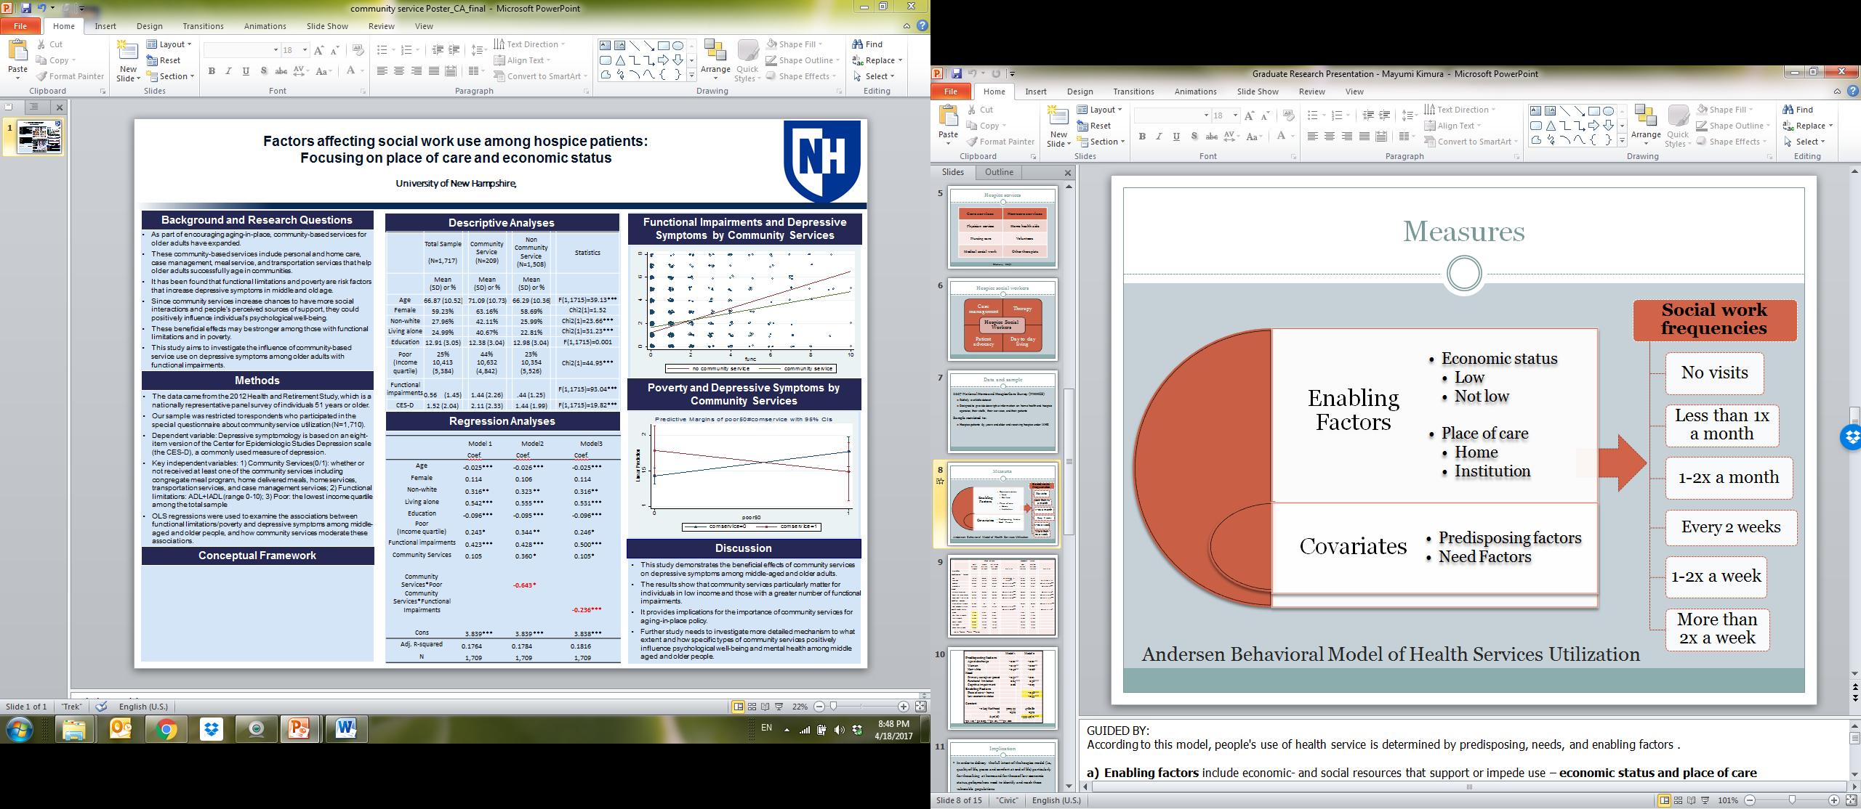
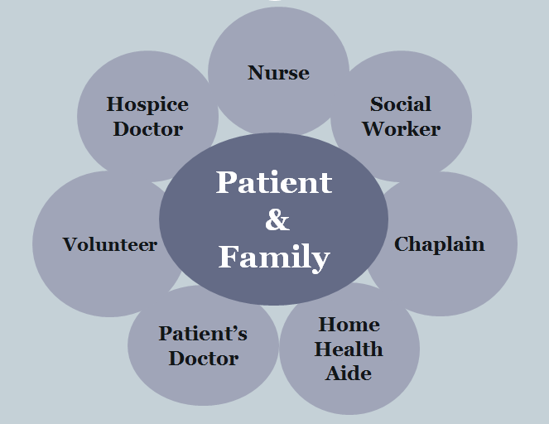
Factors affecting social work service use among hospice patients:
Focusing on place of care and economic status
Mayumi Kimura, MSW Candidate 2017 & BoRin Kim, PhD
Department of Social Work, College of Health and Human Services, University of New Hampshire
Background and Research Questions
Conceptual Framework and Measures
Ordinal Logit Regression Analyses
Hospice care
Specialized care for hospice patients facing terminal illness and their families.
Hospice providers are required to provide three core services – physician oversight, nursing, and social work services.
The multidisciplinary hospice care model addresses the special physical, emotional, and spiritual needs that are often present at the end of life.
 |  |  |  | Model 1 |  | Model 2
Predisposing factors
 | Age at discharge |  |  | -0.01 | ** | -0.01 | **
 | Women |  |  | -0.19 | ** | -0.20 | **
 | Non-white |  |  | -0.40 | ** | -0.26 | ǂ
Need
 | Primary caregiver present |  |  | -0.37 | ** | -0.21
 | Functional limitation |  |  | 0.64 | *** | 0.56 | ***
 | Cognitive impairment |  |  | 0.06 |  | -0.03
Enabling Factors
 | Place of care - home |  |  |  |  | -0.58 | ***
 | Low economic status |  |  |  |  | -0.35 | ***
-2 Log likelihood |  |  |  | 3225.33 |  | 4780.82
N |  |  |  | 2579 |  | 2579
 |  |  | ∆χ2(df) |  |  | 1555.49(2) | ***
ǂp<.10; * p<0.05; **p<.01; ***p<.001
Dependent Variable: Frequency of social work visits (6 categories)
Key independent variables:
    Place of care: Home vs. Institution
    Economic status: Medicaid eligibility - income less than 3 times the SSI payment amount (Federal Benefit Rate)
Covariates: Age, Gender, Race, Primary caregiver, Functional and Cognitive health
Hospice social work services
With their unique set of skills, hospice social workers provide the interdisciplinary team valuable insight into the patient’s, caregiver’s, and families’ psychosocial needs.
The involvement of social work at end of life has been associated with improved quality of life, better pain management, increased patient and family satisfaction, and evidence of cost savings for patients, their family, and society in general
However, unlike physician and nursing, patients can choose not to use or fully use hospice social work,
There is a need to investigate what factors positively or negatively affecting social work service use in hospice
Research questions
What factors affect social work service use among hospice patients?
In particular, do the enabling factors such as place of care and economic status impact social work service use?
Hospice patients at home tended to use social work services less than patients in institutions (Coef.=-0.58, p<.001, Model 2)
Hospice patients of low economic status tended to use social work services less than not-low economic status peers (Coef.=-0.35, p<.001 , Model 2)
When comparing model fits between Models 1 and 2, Model 2 which included enabling factors explains social work service use significantly better than Model 1 (∆χ2(df)=1,555.49(2), p<.001)
For predisposing factors, hospice patients who were older, who were women, and who were non-white used social work services less than their counterparts
For need factors, hospice patients with functional impairment used social work more frequently when compared to patients without.
Descriptive Analyses
 |  |  |  |  |  | Place of care |  |  |  |  | Economic status
 |  |  |  | Total N = 2579 (100%) |  | Home N = 1573 (61.0%) |  | Institution N = 1006 (39.0%) |  | Statistics | Low N = 535 (20.7%) |  | Not low N = 2044 (79.3%) |  | Statistics
 | Variables
Predisposing factors
 | Age (65-100) |  |  | 82.33 (8.27) |  | 80.90 (8.12) |  | 84.56 (8.01) |  | F(1, 8220.99) = 125.95*** | 82.48 (8.67) |  | 82.29 (8.17) |  | F(1, 15.30) = .22
 | Women |  |  | 56.6% |  | 52.2% |  | 63.5% |  | Chi2(1) = 32.04*** | 68.6% |  | 53.5% |  | Chi2(1) = 39.49***
 | Non-white |  |  | 7.4% |  | 8.6% |  | 5.5% |  | Chi2(1) = 9.04 ** | 15.7% |  | 5.2% |  | Chi2(1)67.73***
Need
 | Primary caregiver |  |  | 92.7% |  | 96.8% |  | 86.7% |  | Chi2(1) = 95.47*** | 90.8% |  | 93.4% |  | Chi2(1) = 4.20*
 | Cognitive impairment |  |  | 70.5% |  | 61.8% |  | 84.0% |  | Chi2(1) = 145.31*** | 80.7% |  | 67.8% |  | Chi2(1) = 34.36***
 | Functional limitation |  |  | 92.2% |  | 88.4% |  | 98.2% |  | Chi2(1) = 82.06*** | 95.9% |  | 91.3% |  | Chi2(1) = 12.52***
Enabling Factors
 | Place of care - Home |  |  | 61.0% |  | na |  | na |  |  | 39.4% |  | 66.6% |  | Chi2(1) = 131.81***
 | Low economic status |  |  | 20.7% |  | 13.4% |  | 32.2% |  | Chi2(1) = 131.81*** | na |  | na
Social work visits |  |  |  |  |  |  |  |  |  | Chi2(1) = 90.60*** |  |  |  |  | Chi2(1) = 11.28*
 | None |  |  | 3.2% |  | 3.4% |  | 3.0% |  |  | 2.4% |  | 3.4%
 | Less than 1x month |  |  | 11.8% |  | 13.3% |  | 9.5% |  |  | 13.3% |  | 11.4%
 | 1-2x a month |  |  | 22.3% |  | 22.7% |  | 21.8% |  |  | 25.0% |  | 21.6%
 | Every 2 weeks |  |  | 30.0% |  | 33.2% |  | 25.0% |  |  | 30.7% |  | 29.8%
 | 1-2x week |  |  | 16.3% |  | 16.5% |  | 16.1% |  |  | 16.3% |  | 16.3%
 | More than 2x week |  |  | 16.3% |  | 11.0% |  | 24.6% |  |  | 12.3% |  | 17.3%
 |  | ǂp<.10; * p<0.05; **p<.01; ***p<.001
Methods
Discussion
Data: 2007 National Home and Hospice Care Survey (NHHCS).
Sample: hospice patients 65 years and older and receiving hospice under the Medicare Hospice Benefit
Analytic Strategies:
    Bivariate analyses were done using chi-square and one-way ANOVA tests to determine differences in characteristics of our sample between place of care location (home vs. institution) and between different economic status groups
    Ordinal logistic regressions were used to examine to what extent and how enabling factors such as:
      place of care (home vs. institution) and
      economic status are associated to hospice social work service utilizations
Patients in institutions may have easier access to social work due to proximity and the requirements placed on institutions to have social workers available. Further, patients at home may be resistant to having more people in their home, thus declining any additional services beyond what is required
Patients of lower economic status may use social work less frequently because they may feel their needs are being met by other services. Additionally, lower economic status has been associated with lower health literacy, difficulty communicating needs, and having a general mistrust of the healthcare system
In order to delivery the full intent of the hospice model (i.e., quality of life, peace and comfort at end of life) it is imperative that policymakers and hospice providers identify and reach vulnerable populations, including patients at home and those of lower economic status.

