Slide 1
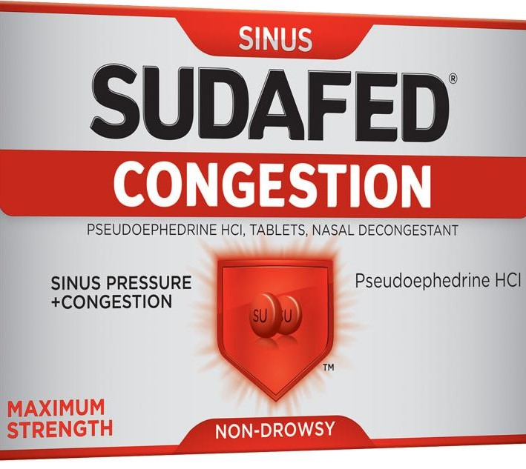


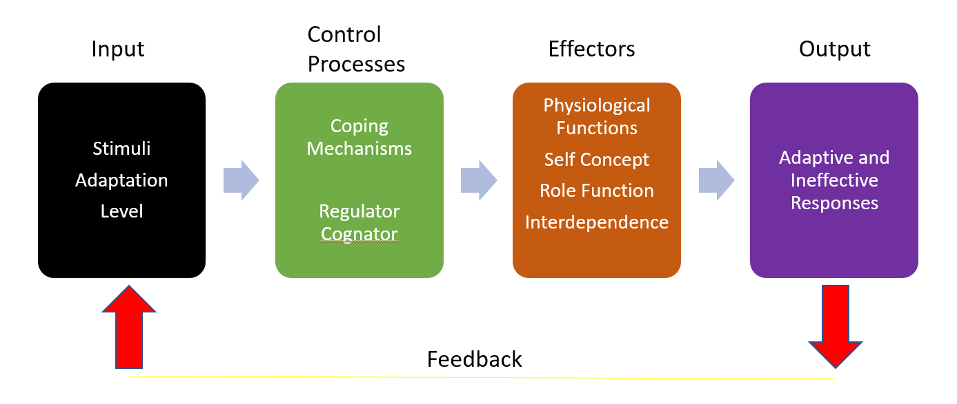

PICO: In patients with cardiovascular disease and sinus congestion of any etiology, does use
of pseudoephedrine versus no pseudoephedrine lead to increased adverse cardiovascular events?
Aaron Corbett
Problem Background
Implications for Practice
Sinus congestion is a common complaint in ambulatory care
Pseudoephedrine is an oral sympathomimetic OTC medication that relieves congestion
The mechanism of action concerns providers regarding safety of use in patients with cardiovascular disease
The FDA encouraged discontinuation of phenylpropanolamine (PPA), another oral sympathomimetic used as a decongestant, after estimates that 200-500 annual cases of hemorrhagic stroke were linked to the drug
While evidence exists to support that patients with controlled hypertension have minimal blood pressure elevation, no evidence exists to support safety in patients with heart disease such as atrial fibrillation. Each provider must ask themselves if the benefit of the medication outweighs the risks, such as those identified in a similar drug, PPA. I discussed this topic and my findings with 3 providers; 2 of the 3
felt that the risk of heart attack or stroke outweighed relief of sinus congestion.
Inclusion and Exclusion Criteria
Inclusion: No age limit on literature, English language, all ages, ethnicities, and genders
Exclusion: Literature not measuring effect of pseudoephedrine on cardiovascular biomarkers
114 articles retrieved, 2 met inclusion criteria
Appraisal and Summary
Article | Level of Evidence | Key Findings
Bilici, M., Turkay, S., Yilmaz, A., Kurtaran, H., Catal, F., Tonbul, A,…Orun, U. (2011). Effect of pseudoephedrine on cardiac rhythm of children with rhinitis. Indian Journal of Pediatrics. Vol 78, p1361-1364. | 6 | Using Holter monitors on 25 children for a day at two intervals, 24 hours before pseudoephedrine and on day 4 of pseudoephedrine. Mean age 8.7 years. This study found that there was no additional dysrhythmia risk in children who were generally healthy with rhinitis.
Salerno, S., Jackson, J., & Berbano, E. (2005). Effect of oral pseudoephedrine on blood pressure and heart rate: A meta-analysis. Arch Intern Med. Vol 165, p1686-1694. | 1 | Meta-analysis analyzed 24 randomized placebo-controlled trials of pseudoephedrine treatment in adults to quantify the effect of the drug on heart rate and blood pressure. Population of 1,285 adults with mean age 34.9. Average SBP elevation of 1 mm Hg Average HR elevation of 3 beats/minute No effect on DBP Average SBP elevation in patients with controlled HTN 1.53 mm Hg Immediate-release formulations cause greater elevations of SBP Sustained-release formulations cause greater elevations of HR Outliers with SBP greater than 20 mm Hg were identified in articles not meeting inclusion criteria, but cases were less than 3% of total population studied
Roy’s Adaptation Model of Nursing
Methods of Data Collection
Online databases used included CINAHL and Cochrane
Lexicomp consulted for drug facts and adverse effects
Search terms were: Pseudoephedrine, pseudoephedrine and cardiac, pseudoephedrine and blood pressure, stimulant and cardiac
Search tools used: Boolean/phrase, full text, and peer reviewed
Six step nursing process
Assess patient behavior
Assess patient’s stimuli
Diagnosis of patient
Set goals for patient
Interventions to meet goals
Evaluation of results

