Slide 1



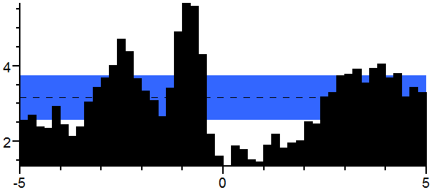
Preventing Cystic Fibrosis-Related Diabetes in the Cystic Fibrosis Population
Elisabeth Jeffcote
Nursing Department - University of New Hampshire
Cohort 13
Problem Background:
Malnutrition is a common problem in patients with CF they either lose weight or do not develop normally
CF demands an exorbitant amount of energy
Providers encourage CF patients to consume a high calorie, high fat, high protein diet
CF patients often consume unhealthy foods that cause a spike in blood sugar which over time leads to CFRD
Glycosuria caused by CFRD is another source of energy loss for CF patients
CFRD can be prevented through a more controlled diet
Article | Level of Evidence | Pro & Con
The American Diabetes Association, 2015 | IV | Has nutrition guidelines / Notes no further research
The Cystic Fibrosis Foundation, 2016 | III | Highlights causes, symptoms and treatment / No quantitative research
McFarlane, Terliesner et. al., 2016 | V | Specifically researches effects of CFRD on CF patients / No cons
Pencharz & Durie, 2000 | II | Depicts a model of the pathogenesis of malnutrition in CF patients / Notes no further research
Van Gool et. al., 2013 | IV | Has quantitative financial research about cost of CF and CFRD / No cons
PICO Question:
In patients with cystic fibrosis, does diet therapy prevent cystic fibrosis-related diabetes and therefore positively impact quality of life?
Nursing Theory:
Nola J. Pender’s Health Promotion Model centers around patients becoming more enlightened about their health
When patients are more informed about their condition, they will change their behaviors to positively impact their health
Health is not simply the absence of disease, but a positive dynamic state
Methods of Data Collection:
Search engines- ScienceDirect, PubMed, NIH, Google Scholar, Medscape and CINAHL
Key phrases – “cystic fibrosis related diabetes”, “diet therapy and cystic fibrosis related diabetes”,, ”diet to prevent diabetes’, and ‘diet to increase energy.”
Practice Implications:
Prevention of CFRD is ideal, but if a CF patient has already breached into diabetes territory, CFRD can be controlled with insulin
In order to prevent CFRD in CF patients a diabetic diet must be followed, this includes foods that are naturally rich in nutrients and low in fats and calories
Patients should be encouraged to consume fruits, vegetables, whole grains and lean proteins
Individuals needed to implement this change are: QI team, hospital administration, stakeholders, providers, nursing staff, nutrition professionals and dietary employees
The CNL can make this important change happen
Inclusion & Exclusion:
Included literature was full text and published in the English language
Research articles used centered around CF patients and those with CFRD as well
Excluded were articles over 20 years old, unreliable resources and inconclusive evidence
Data Summary:
CFRD is the most common comorbidity that exists in people with CF
20% of CF children under the age of 18 have CFRD
40% to 50% of CF adults have CFRD
Height, weight and lung function of CF patients are worse in those with CFRD

