Slide 1

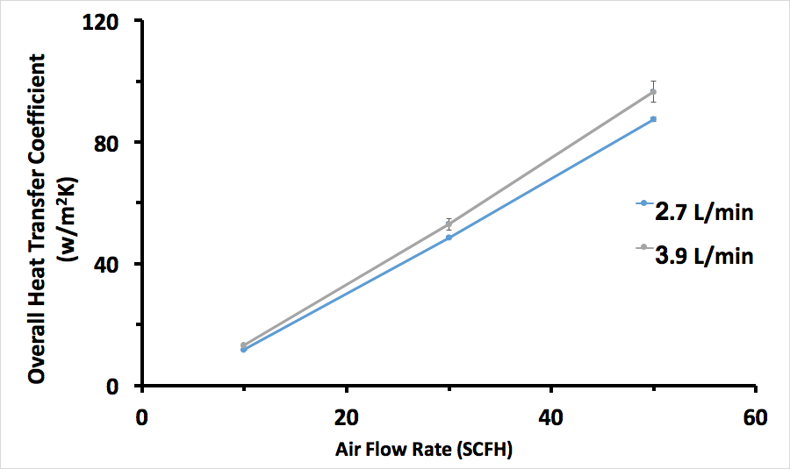
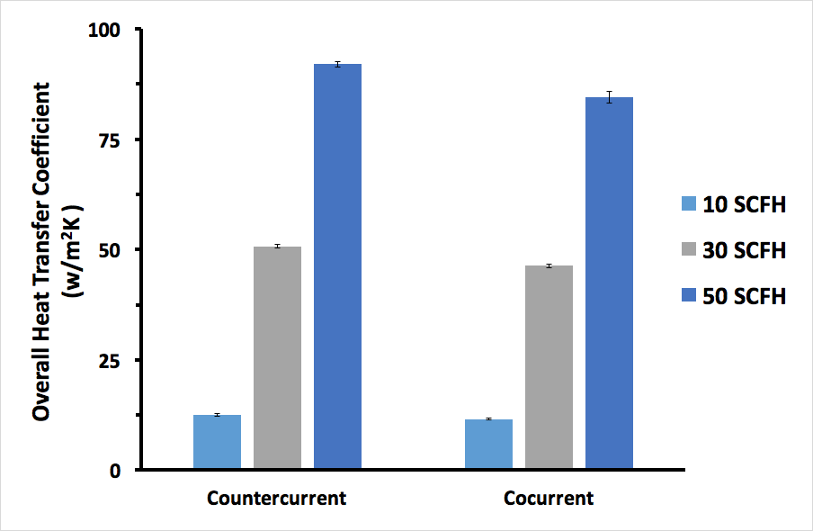
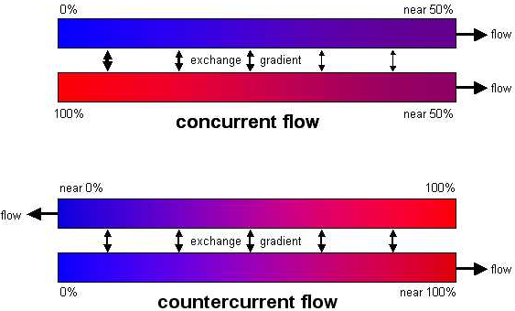
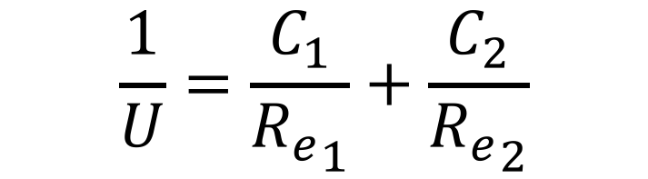
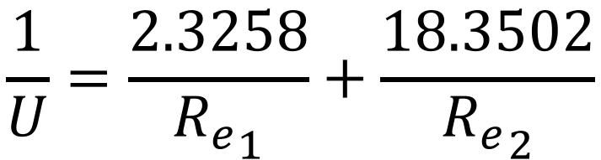
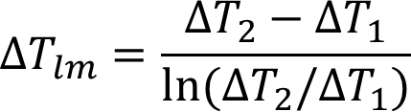
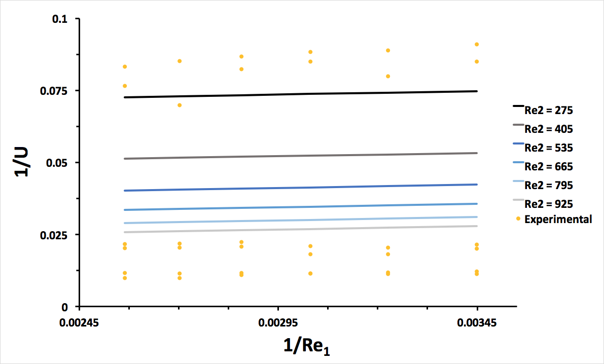

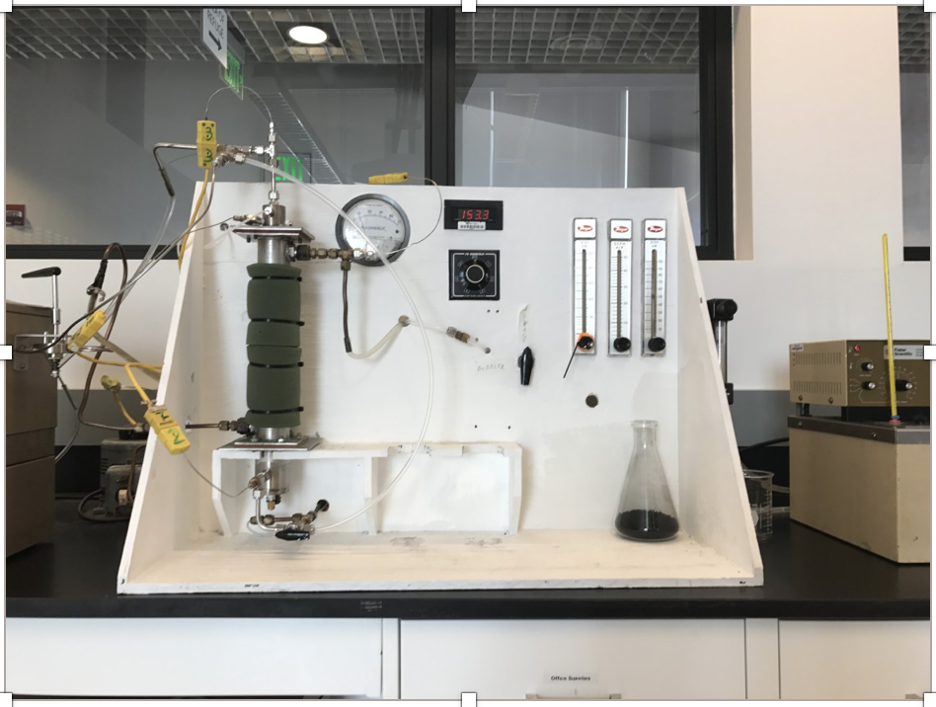
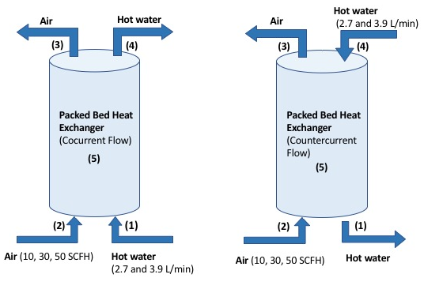
Heat Transfer in a Packed Bed Reactor with Downflow of Air and Water
Lorenzo Milani, Ben Cullen, and Jason Mills
CHE 602: Unit Operations I
Department of Chemical Engineering, University of New Hampshire
Summary
Results
Design Problem
The objective of this experiment is to study the heat transfer inside a packed bed reactor and using the data to solve a design problem.
A water stream is used to heat up a colder air stream.
Overall heat transfer coefficient is affected by increasing flow rates, regardless of flow pattern.
Flow Rates: Figure 1
An increase in either of the flow rates results in a higher overall heat transfer coefficient.
The cold flow rate, that of air, has a greater effect on the heat transfer coefficient than the hot flow rate, that of water.
Flow Pattern: Figure 2
Flow pattern has no significant effect on the value of the overall heat transfer coefficient.
Cocurrent values are on average, 8% smaller than countercurrent values.
Purpose
Determine diameter D and length L of a packed bed heat exchanger that would decrease the temperature of a feed gas from 75˚C to 30˚C.
Gas (100 SCFM) (75˚C)
Packed Bed Exchanger
Gas (100 SCFM) (30˚C)
Introduction
Cooling Water
Cooling Water
Heat Exchange in Packed Beds
Used in heat exchange, absorption, stripping, distillation, and catalytic reactors. [1]
Knowledge of heat transfer parameters is necessary for the design and optimization. [2]
Heat exchange from one hot fluid to a colder fluid in a packed column with a jacket.
Water as the hot stream and air as the cold stream
Cocurrent and countercurrent pattern
Steady state conditions
Overall Heat Transfer Coefficient (U)
U is obtained by Equation 1, where ΔT_{lm} is the log-mean temperature difference (Eq. 2), ΔT₂ and ΔT₁ are the temperature differences of the streams at each end of the heat exchanger. [4]
Goals
Determine the overall heat transfer coefficient for the packed bed reactor for each treatment.
Determine the effects of flow rate and flow pattern on the heat transfer coefficient.
Derive a correlation between relevant parameters for your system.
Collect the appropriate data to use for solving the design problem.
Figure 1. Effect of flow rates on the overall heat transfer coefficient.
Procedure
Estimate D, the flow rate, and inlet T of cooling water
Develop relationship between Reynolds Number and U using multilinear regression
Calculate U (Eq. 3)
Find outlet T of cooling water (Eq. 1)
Calculate ΔT_{lm} (Eq. 2)
Solve for A (Eq. 1)
Obtain L (A = πDL)
Analyze practicality and reasonability
Figure 1. Effect of flow rates on the overall heat transfer coefficient for both flow patterns.
Figure 2. Effect of flow pattern on the overall heat transfer coefficient at both water flow rates.
Contour Plot: Figure 3
Predicted vs. Actual values
Predicted values obtained from derived model
Re₂ has much greater effect than Re₁
Slope of Re₂ is 10 times greater than slope of Re₁
Derived Model
[3]
(Eq. 3)
Observations
Heat transfer rate for hot stream much greater than heat transfer rate for cold stream (heat lost to surroundings)
Decrease in surroundings temperature leads to greater loss of heat from hot stream
Small decrease in hot stream temperature results in large increase of cold stream temp (heat capacity of water vs. air)
Solution
(Eq. 1)
(Eq. 2)
Water Flow Rate (SCFM) | 2
T-In (˚C) | 15
T-Out (˚C) | 16.4
Inner Diameter (m) | 0.16
Outer Diameter (m) | 0.2
Length (m) | 1
Methods
x-
Figure 3. Experimental data versus data predicted from model. Re₁ represents Re-Hot and Re₂ represents Re-Cold.
(3)
Conclusions
Packed Bed Heat Exchanger
Water was used to raise the air temperature inside the column.
The column was packed with charcoal and surrounded by a jacket.
Flow Pattern
Cocurrent and countercurrent flow patterns were used.
Data Collection
Thermocouples were used to measure the temperature of the inlets and outlets of the air and water streams at steady state.
(5)
(4)
(1)
Flow Rate/Flow Pattern
Increasing the flow rate of the water from 2.7 L/min to 3.9L/min led to an increase in the value of the overall heat transfer coefficient (U).
An increase in the air flow rate from 10-50 SCFH increased the value of the overall heat transfer coefficient.
Changing flow type, cocurrent to countercurrent, had no effect on the value of the overall heat transfer coefficient.
Overall Heat Transfer Coefficient (U)
The maximum overall heat transfer coefficient (100.61W/m²K) was obtained at the following conditions:
Hot water flow rate: 3.9L/min
Air flow rate: 50 SCFH
Flow pattern: countercurrent
(2)
References
[1] - D. Wen, Y. Ding, “Heat transfer of gas flow through a packed bed”, Chemical Engineering Science, 61, No. 11, pp 3532-3542, 2006.
[2] - A.S. Lamine, L. Gerth, H. Le Gall, G. Wild, “Heat Transfer in a Packed Bed Reactor with Cocurrent Downflow of a Gas and a Liquid”, Chemical Engineering Science, 51, No. 15, pp. 3813-3827,1996.
[3] - Wikipedia, “Heat exchanger” [online]. Available: https://en.wikipedia.org/wiki/Heat_exchanger
[4] - C.J. Geankoplis, “Principles of Momentum Transfer and Applications” in Transport Processes and Separation Process Principles, 4th ed., Upper Saddle River, NJ, Pearson, 2003, ch. 4, section 4.7.
Acknowledgement
Special Thanks to:
  Dr. Adam St. Jean, Lecturer, University of New Hampshire
  Department of Chemical Engineering

