Slide 1


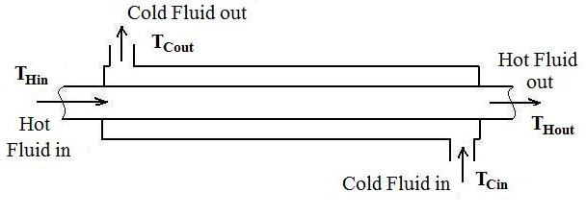
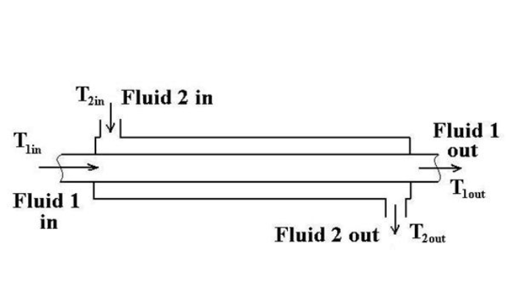
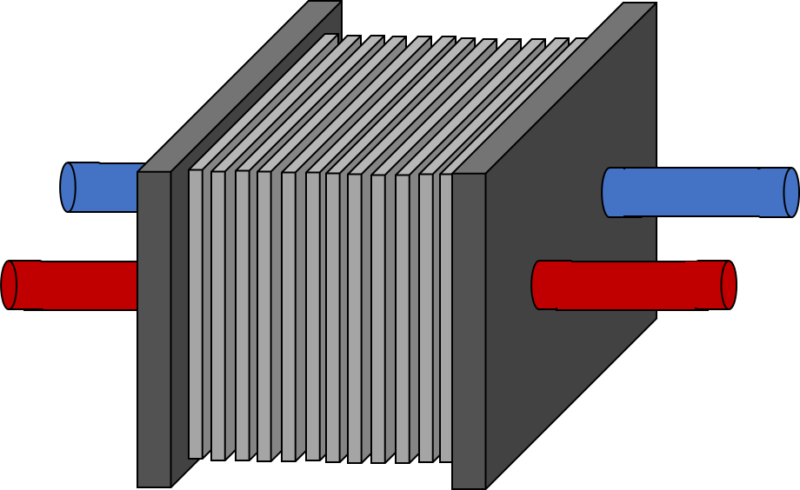
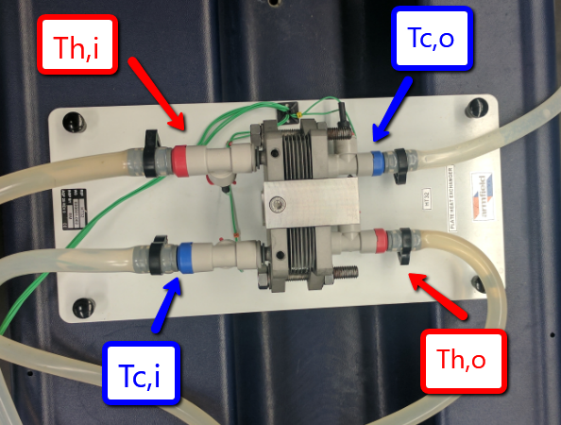
Comparison of the Overall Heat Transfer Coefficient in Heat Exchangers
Jeremy Tilton, Thomas Homer & John Fernald
Chemical Engineering Department, University of New Hampshire, Durham, NH, USA
Introduction
Results & Discussion
Results and Discussion (Continued)
Heat Exchangers are widely used in many different industries to transfer heat between two fluids. [1]
For Example, heat exchangers are essential in our regions rapidly growing craft beer industry.
A Double-Tube, Shell & Tube, and Plate heat exchanger are common types of heat exchangers and were compared against each other in lab.
Wilson Plots are used to determine convection coefficients which are crucial in designing a heat exchanging device. [2]
*
Increasing cold stream flow rate increases the overall heat transfer coefficient as well as convection coefficient.
Plate heat exchangers have the largest overall heat transfer coefficient and convection coefficient.
*The overall heat transfer for each heat exchanger operating coefficient at co-current and counter-current is not statistically different according to a T-test with a 95% confidence interval
Known literature supports our findings that plate heat exchangers are the most efficient out of the tree designs tested. [3]
A
*
Design Problem
B
N=12 plates
T cold in = 20°C
ṁ cold = 3 kg/s
$∆T_{lm}=\frac{∆T_{2}−∆T_{1}}{\ln\left[\frac{∆T_{2}}{∆T_{1}}\right]} (1) q={\left[ṁC_{p}∆T\right]}_{hot} (2) U=\frac{q}{A_{s}∆T_{lm}}$ (3)
T cold out = 50°C
T hot in = 80°C
ṁ hot = 2 kg/s
T hot out = 35°C
Goals
*
3.507m
0.135m
5.404m
The purpose of the lab was to compare the overall heat transfer coefficient of three different heat exchanger types using both counter and co-current flow patterns.
To generate Wilson plots for each specific treatment. This method helps determine the convection coefficient with experimental data.
Obtain enough data to solve the Design Problem.
A hot stream flow rate was chosen to keep the ratio of hot and cold flow rates similar to those in lab. The experimental Reynolds number for the hot stream was found and was kept constant in the scale-up process.
Scale-up values for plate width and distance between plates was found by keeping Reynolds number constant in the hot stream.
The required heat transfer for the process and the temperature leaving the hot stream were found using equation 2.
The height and number of plates were determined by solving for the required area using equations 1 and 3.
C
Figure 1. Comparing the overall heat transfer coefficient at counter and co-current flow patterns at different cold stream flow rates for a double tube heat exchanger (A), shell and tube heat exchanger (B), and plate heat exchanger (C).
Methods & Instrumentation
Conclusion
A
The plate heat exchanger was the most effective heat exchanger.
As flow rate of the cold stream increases, the overall heat transfer coefficient also increases.
Co-current and counter-current do not yield statistically different overall heat transfer coefficients.
The convection coefficient is proportional to the flow rate of the cold stream.
Hot stream flow rate was kept constant at 2 L/min and 40°C.
Cold stream flow rate was varied between 1, 2, and 3 L/min.
Thermocouples were placed in the inlet and outlet of the hot and cold streams to measure temperature.
When the temperatures at each point became steady, the system was assumed to be at steady state.
The temperature was monitored and recorded using the Armfield Heat Exchanger Module.
B
References
[1] C. Geankoplis, Transport processes and separation process principles (includes unit operations), 1st ed. Harlow: Pearson, 2014, pp. 259-270.
[2] 2. J. Fernandez-Seara, F. Uhia, J. Sieres, and A. Campo. “A general review of the Wilson plot method and its modifications to determine convection coefficients in heat exchange devices”. Applied Thermal Engineering. Science Direct. 17 Apr. 2007.
[3] P. Staff, "Which Heat Exchanger Is Best? The Three Main Types Explained...", Academy.paulmueller.com, 2017. [Online]. Available: http://academy.paulmueller.com/different-heat-exchanger-types. [Accessed: 30- Apr- 2017].
Figure 2. Comparing the convection coefficient at different cold stream flow rates for the three different heat exchanger types at counter (A) and co-current (B) flow patterns.
Acknowledgements
University of New Hampshire Department of Chemical Engineering.
Dr. St. Jean and Lev Levintov for training on all techniques involved in the experiment.

