Slide 1

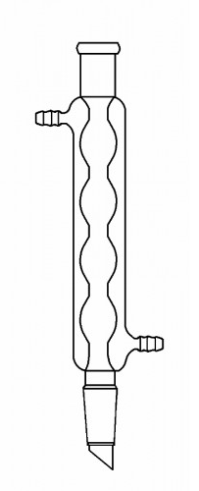
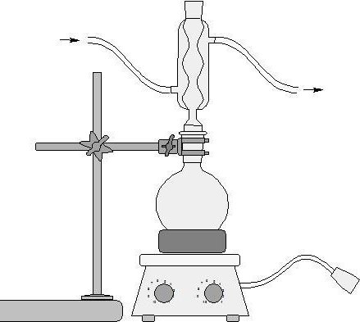
Effects of Flow Pattern and Flow Rate on The Heat Transfer Coefficient in a Condensing System
Sara Duclos, Kayla Eckley, Joseph McGrath, Department of Chemical Engineering, University of New Hampshire
Introduction
Methods
Results
Design Problem
Condensers are involved within systems in order to cool an environment with the evaporation and condensation of a fluid^{[1]}.
Different flow patterns and flow rates affect the heat exchange in condensers.
Countercurrent Flow Cocurrent Flow
Overall heat transfer coefficients can be determined by examining three different flow rates, each with cocurrent and countercurrent flow patterns.
Treatments and Procedures
Condenser examined with cocurrent/countercurrent flow patterns at differing flow rates.^{(Figure 1)}
Temperature of inlet and outlet streams. Temperature of steam and boiling water.
Height of condensate.
(repeated in triplicate)
Problem: Determine flow type, length of a condenser and outlet temperature of coolant to condense 600 SCFM steam at 1 atm.
$$N_{Re}=\frac{Dvρ}{μ}$$
𝑁_𝑅𝑒=𝐷𝑣ρ/μ
Goal seek to match design and experimental N_{ReS}
$$\frac{ṁ_{slab}}{ṁ_{wlab}}=\frac{ṁ_{sdesign}}{ṁ_{wdesign}}$$
ṁ_𝑠𝑙𝑎𝑏/ṁ_𝑤𝑙𝑎𝑏 =ṁ_𝑠𝑑𝑒𝑠𝑖𝑔𝑛/ṁ_𝑤𝑑𝑒𝑠𝑖𝑔𝑛
Use Figure 2 to solve for U_{design}
$$q=ṁ_{wd}C_{p}ΔT$$
$$q=UAΔT$$
𝑞=ṁ_𝑤𝑑 𝐶_𝑝 Δ𝑇
𝑞=𝑈𝐴Δ𝑇
Perform a t-test to find if flow pattern makes a difference
Goal seek with N_{ReW} to find D
$$L=\frac{A}{πD}$$
𝐿=𝐴/π𝐷
$ṁ_{s}h_{fg}=ṁ_{w}c_{p}ΔT$ to solve for T_{f}
ṁ_𝑠 ℎ_𝑓𝑔=ṁ_𝑤 𝑐_𝑝 Δ𝑇 to solve for T_{f}
Figure 1: Comparison of the values of total heat consumed between the two different flow patterns at two different flow rates. The error bars were calculated using the standard error.
T_{steam}
Validated the total heat consumed by the system is dependent on flow rate.
Results:
Condenser Length: 127cm
Outlet temperature: 34.9°C
Condenser Type: Countercurrent
T_{water}
Flow Rate (mL/s) | Flow Pattern | Average Overall Heat Transfer Coefficient (W/K)
1.96 | Cocurrent | 319
 | Countercurrent | 378
1.71 | Cocurrent | 277
 | Countercurrent | 240
1.48 | Cocurrent | 253
 | Countercurrent | 156
Figure 1. Condensing apparatus attached to inlet/outlet streams and thermocouple thermometers for inlet/ outlet, steam, and water. [3]
Conclusion
Data Analysis
Microsoft Excel used to evaluate standard deviation, standard error of the mean and confidence intervals.
Increased flow rates will increase the overall heat transfer coefficient.
Countercurrent flow patterns will increase the overall heat transfer coefficient.
Total heat consumed by system = Overall heat transfer coefficient
Objectives
Results
Table 2: Average overall heat transfer coefficient values for each flow pattern at each different flow rate.
Determine overall heat transfer coefficient for differing flow rates.
Determine effects of flow rate and flow pattern, cocurrent and countercurrent, on the heat transfer coefficient.
Collect sufficient data in order to solve the design problem. [2]
Flow pattern does not have a significant effect on Overall Heat Transfer Coefficient (U).
Flow rates will have a significant effect on U, and therefore the total heat consumed.
References
[1] IEEE GlobalSpec, “Condensers Information,” in Engineering 360, 2017.
[2] A. S. Jean, “Heat Exchange in Condensing Systems.” in CHE 612-Modules, Durham, NH, Adam St. Jean, 2017, p.1
[3] AMK Glass, “Condenser, Allihn,” Vineland, NJ, 2017.
Relationship | p-Value
U of 1.96mL/s v. U of 1.71mL/s | 1.67E-02
U of 1.96mL/s v. U of 1.48mL/s | 1.50E-04
U of 1.71mL/s v. U of 1.48mL/s | 7.09E-05
Figure 2: Comparison of the inverse of Reynold’s Number to the inverse of Overall Heat Transfer Coefficient will be applied to the design problem for scaling.
Table 1: P-values for the two sided t-tests for the effects of flow rate on the overall heat transfer coefficient.

