Slide 1

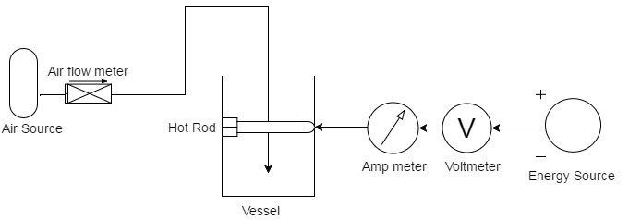
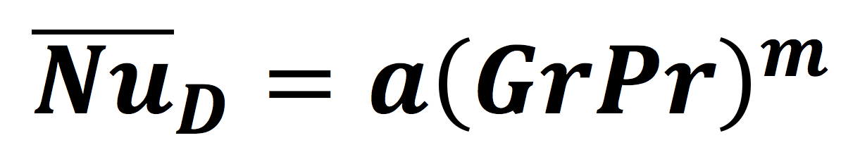
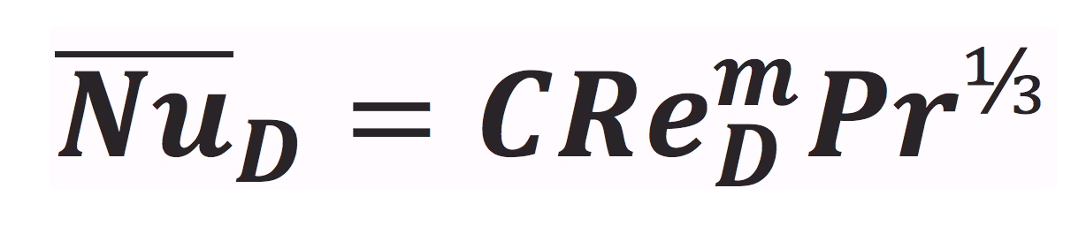
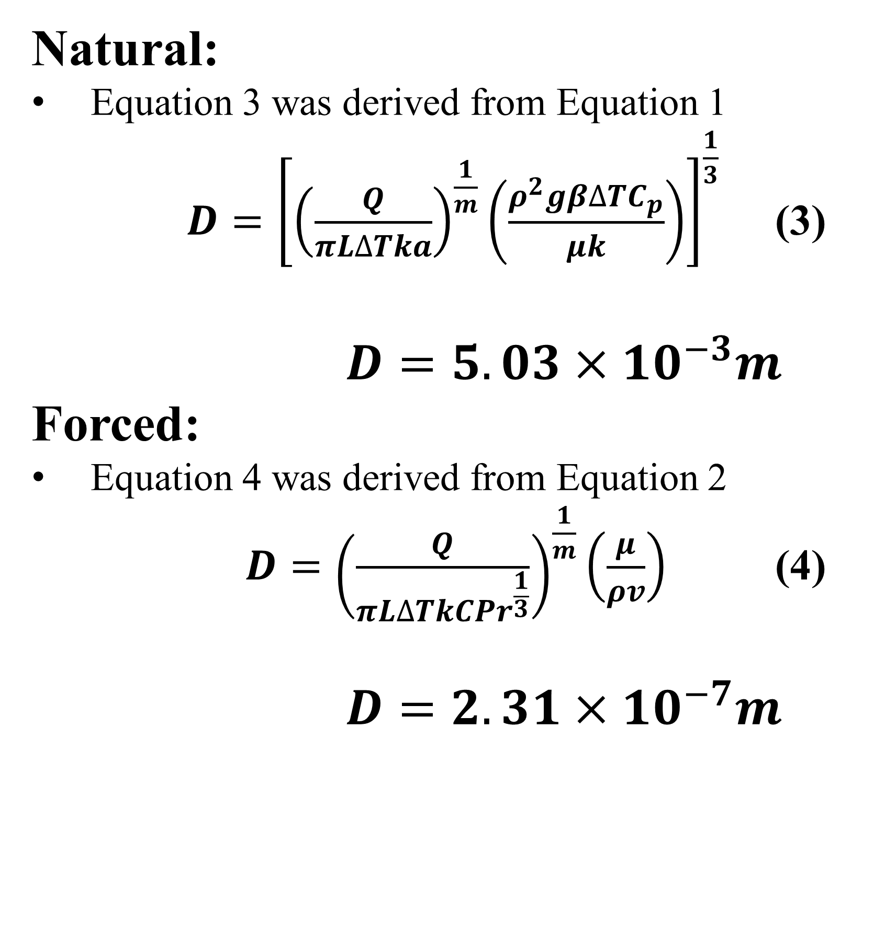
Natural and Forced Convection From Horizontal Cylinders
Ahmed Alzawar, Serge Boucher, Lindsay Eggleston, Thomas Mastorakos
Department of Chemical Engineering, University of New Hampshire
Summary
Methods
Conclusions
Calculated natural and forced convection coefficients
Measured bulk temperature, surface temperature, and power
Forced convection coefficients are larger than natural convection coefficients due to the higher fluid velocity
Amperes along with surface and bulk temperatures were measured for multiple voltages.
A pump was used to force air across the pipe data was collected for different flowrates
Treatments:
Forced convection yields a higher convection coefficient than natural convection.
The largest diameter pipe yields the largest heat transfer coefficient.
Increased fluid velocity results in a higher convection coefficient.
Voltage and heat transfer coefficient are directly proportional
200.03%
84.59%
Introduction
Natural Convection
Driving force: difference in density between hot and cold fluid
Explains sea wind formation, fluid flows around heat dissipation fins and ocean currents.^{[1]}
Forced Convection
The fluid is forced to flow around the cylinder by means of an external force.
Can be utilized in the food making, fertilizer industry, and computer processors.
Literature states that the convection coefficients (h) are higher in forced convection than in natural convection ^{[1]}.
Figure 2. The experimental heat transfer coefficient as a function of air velocity for three different diameter pipes. Percent differences refer to the slopes of the trendlines.
(1)
Design Problem
Natural:
Equation 3 was derived from Equation 1
$D={\left[{\left(\frac{Q}{πL∆Tka}\right)}^{\frac{1}{m}}\left(\frac{ρ^{2}gβ{∆TC}_{p}}{μk}\right)\right]}^{\frac{1}{3}}$ (3)
$D=5.03×{10}^{−3}m$
Forced:
Equation 4 was derived from Equation 2
$D={\left(\frac{Q}{πL∆TkC{Pr}^{\frac{1}{3}}}\right)}^{\frac{1}{m}}\left(\frac{μ}{ρv}\right)$ (4)
$D=2.31×{10}^{−7}m$
Free Convection
Small Pipe | Medium Pipe | Large Pipe
15 V | 15 V | 15 V
30 V | 30 V | 30 V
(2)
Forced Convection (30V)
Small Pipe | Medium Pipe | Large Pipe
8000 mL/min | 8000 mL/min | 8000 mL/min
23000 mL/min | 23000 mL/min | 23000 mL/min
40500 mL/min | 40500 mL/min | 40500 mL/min
Figure 3. Experimental unitless correlations used to determine system constants for forced convection
Results
Acknowledgements
Funded by the Department of Chemical Engineering, UNH
Supported by Dr. Adam St. Jean
Objectives
Determine the heat transfer coefficients for natural and forced convection
Determine effects of element diameter and fluid velocity
Derive correlation between dimensionless groups
Figure 4. Experimental unitless correlations used to determine system constants for natural convection
References
Table 1. Constants were obtained from the slopes and y-intercepts of the trend lines in Figures 3 and 4.
[1] C.J. Geankoplis. Transport Processes and Separation Process Principles 4th Edition (Including Unit Operations), Englewood Cliffs: Prentice Hall, Pearson Education, 1993, 2003.
Figure 1. Experimental heat transfer coefficient for natural convection of different diameter pipes at different voltages. Percentages represent the difference in heat transfer coefficients between different voltages.
 | m | C | a
Forced | 0.537 | 4.98 | --------
Natural | 0.588 | ---------- | 0.0649

