Slide 1

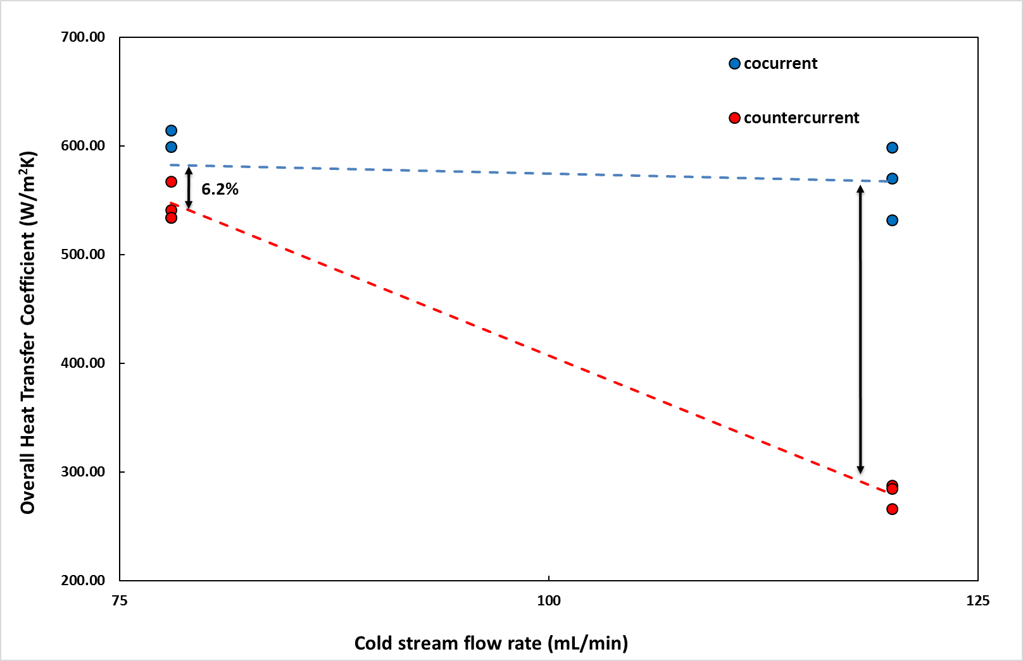
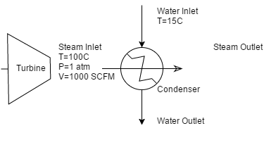
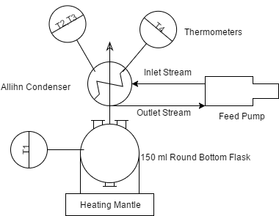
Heat Transfer Rates in a Condensing System
Alexander Karam, Andrew Knight, Joseph Verro, and Joshua Beaudet,
Department of Chemical Engineering, University of New Hampshire
Introduction
Results
Conclusions
Using the temperature difference and mass flow rate, the heat transferred to the cold stream can be determined
Q_{water} = mC_{p} ΔT_{water}
The heat of the water can then be used to calculate the overall heat transfer coefficient for the system
U = Q_{water} A ΔT_{lm}
The Reynold number can then be related to the overall heat transfer coefficient and used for scale-up operations
Re = (DVρ)/μ
Overall Heat Transfer Coefficient (U) is dependent on flow rate and flow pattern.
Cocurrent flow resulted in greater heat transfer
As cold water flow rate increases the difference between flow types appears to increase dramatically
Flow Type | Flow Rate (mL/min) | U (W/m²K)
Cocurrent | 78 | 583
Countercurrent | 78 | 548
Cocurrent | 120 | 567
Countercurrent | 120 | 279
Design Problem Solution
What are the dimensions of the condenser, flow type, and exit temperature of the cold stream?
Methods
Table 1. The average difference in Temperature for each water stream over three measurements
 | Cocurrent |  | Countercurrent
 | 78 (mL/min) | 120 (mL/min) | 78 (mL/min) | 120 (mL/min)
ΔT_{Steam} | 45 | 64 | 43 | 68
ΔT_{Water} | 33.7 | 20 | 41.7 | 17.7
68%
Figure 3: The flow diagram for the scaled-up condensing system.
L=0.512 m
D=0.25 m
V=1.44 m/s
Temperature of Exiting Cold Stream: 53 Celsius
Flow Type: Cocurrent in a Allihn Condenser
Figure 2: Relation between the overall heat transfer coefficient for counter current and co current flow types at a high and low volumetric flow rate.
Discussion
Acknowledgements
The data collected was inconsistent due to the constraints imposed by the inaccurate and imperfect conditions of the condensing system
Other resources do not suggest a 68% difference between the overall heat transfer coefficient for cocurrent and countercurrent flows
Department of Chemical Engineering, University of New Hampshire
Dr. Russell T. Carr
References
Figure 1. Allihn Condenser system fed with cold-water stream (20C) from feed pump and hot stream created with heating mantle.
[1] Geankoplis, C. J. (2014) Transport processes & separation process principles 4th ed. Pearson Education Limited Harlow

