Slide 1

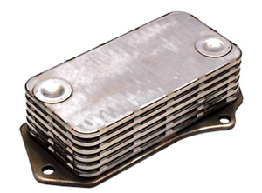
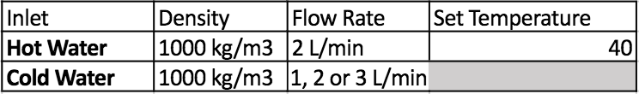
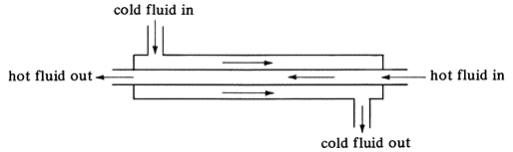
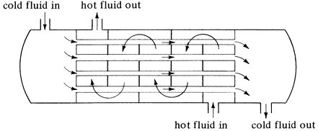
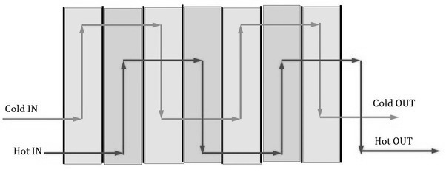
Analysis and Comparison of Heat Exchangers
Double Pipe, Shell and Tube & Plate
Anthony Picone, Colin Graham & MaKenzie Marshall
University of New Hampshire Department of Chemical Engineering
Chemical Engineering Laboratory
Objectives
Results and Discussion
Design Problem
Perform a Wilson Plot analysis to find the
average convection coefficients for each heat
exchanger.
Determine the effect of cooling water and
flow rate on the Overall Heat Transfer
Coefficient for each heat exchanger.
Use the data to find the most effective heat
exchanger and solve the design problem.
Useful Data for Plate Heat Exchangers^{[1]}
Unit
Largest Size | 1520 m²
Number of Plates | Up to 700
Plates
Thickness | 0.5 - 1.2 mm
Size | 0.03 - 2.2 m²
Spacing | 1.5 - 5.0 mm
Operation
Channel Flow Rate | 0.05 - 12.5 m³/hr
Performance
Heat Transfer Coefficients | 3000 - 7000 W/m²K
Introduction
Figure 1. Overall Heat Transfer Coefficient for Double Pipe
Figure 2. Overall Heat Transfer Coefficient for Shell and Tube
Objective: Specify the type and dimensions of a
heat exchanger
Key Equations
R_{ov} = 1 = Ri + Rw + Ro (1)
U A
Q = m Cp ∆T (2)
Q= U A LMTD (3)
LMTD = ∆T2 - ∆T1 (4)
l n(∆T2∆T1)
D_{h} = 4 Ac ^{[1]} (5)
Pw
Overall Heat Transfer coefficient higher
for counter current flow
Overall Heat Transfer coefficient
decreases with cold flow rate
Plate Heat Exchanger has highest Overall
Heat Transfer Coefficient
Shell and Tube has lowest Overall Heat
Transfer Coefficient due to lowest Q (eqn 2).
Given Values for Design Heat Exchanger
Design Solution
Heat Exchanger Type - Plate
Determine heat rate
m ̇c | 3.0 kg/s
Tc,i | 20 ℃
Tc,o | 50 ℃
Th,i | 80 ℃
# of Plates | 15
Length | 0.20 m
Width | 0.1 m
Thickness | 1.2 mm
Effective Diameter | 3.4 mm
Tho | 70.0 ℃
LMTD | 39.15
mh | 3.11 kg/s
Flow Type | Counter Current
Determine overall heat
transfer coefficient
Determine temperature
difference
Determine hydraulic
diameter
Figure 3. Overall Heat Transfer Coefficient for Plate
Materials and Methods
 | Calculated Convection Heat Transfer Coefficient (h_{o}) (W/m²K)
Heat Exchanger | Co-current | Countercurrent
Plate | 5941.46 | 5181.56
Shell | 1541.34 | 1643.31
Double Pipe | 2393.34 | 2346.47
?
T_{h,i}, T_{h,o}, T_{c,i}, and T_{c,o} recorded in triplicate for
counter and co current flow on each heat
exchanger type
Heat Transfer coefficient decreases with
flow rate
Calculated Heat Transfer coefficient for
Plate is highest, Shell and Tube is lowest
Calculated and experimental values for
counter current are most accurate for
Plate
Conclusion
Figure 4. Heat Transfer Coefficient for the cold stream in each heat exchanger with counter current flow
Plate heat exchanger most efficient at exchanging energy
Larger volume flow rate of cold stream, greater overall heat transfer
coefficient
Counter current flow had higher heat exchanged
Using the Wilson Plot, the average convection coefficients for the hot and
cold water side were calculated in both flow patterns
Double pipe ^{[2]}
Shell and Tube^{[2]}
Original Wilson method used
Best fit was found when n = 0.85 (original study n = 0.80)
h calculated using slope and intercept
References
Plate Exchanger^{[3]}
[1] Kakaç, Sadık, Hongtan Liu, and Anchasa Pramuanjaroenkij. Heat Exchangers. 3rd ed.
Boca Raton: Taylor & Francis, 2012. Print.
h_{i} = C₂ v_{r}^{n}
h_{o} = 1 .
(C₁- Rw) A_{o}
C₂ = 1 .
A * slope
Intercept = C₁
[2] Geankoplis, Christie J. Transport Processes And Separation Process Principles
(Includes Unit Operations). 4th ed. Prentice Hall, 2003. Print.
[3] Kushwaha, Ashish. “How Does A Plate Heat Exchanger Work?”. Quora. N.p., 2014.
Web. 30 Apr. 2017
[4] J. Fernandez-Seara, F. J Uhia, J. Sieres and A. Campco, “A general review of the
Wilson plot method,” ScienceDirect, 2007.
Acknowledgements
Dr. Adam St. Jean and the Department
Of Chemical Engineering at UNH
Figure 5. Wilson Plot Analysis for counter current flow in Double Pipe
See Reference [4] for equations

