Slide 1


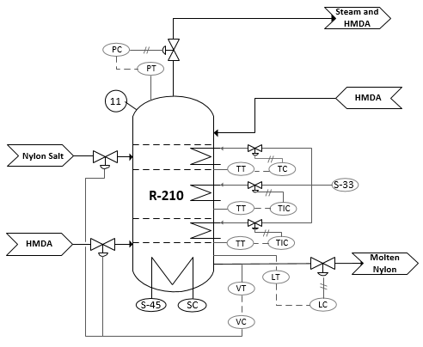
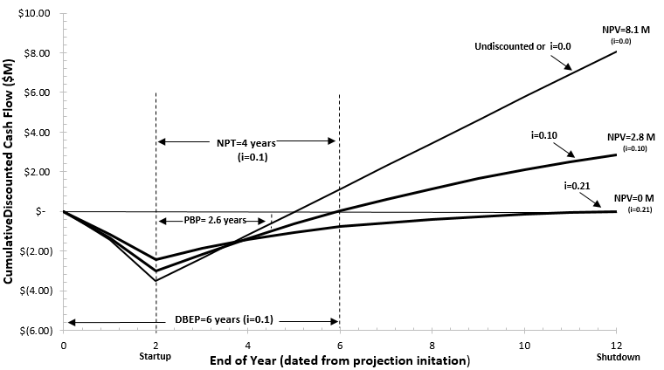
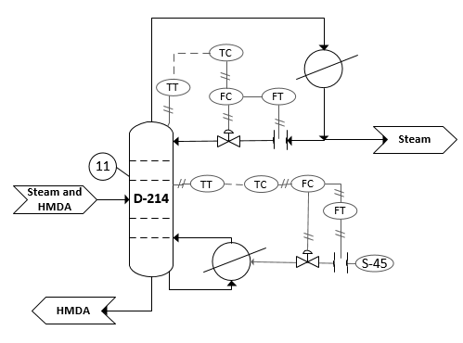
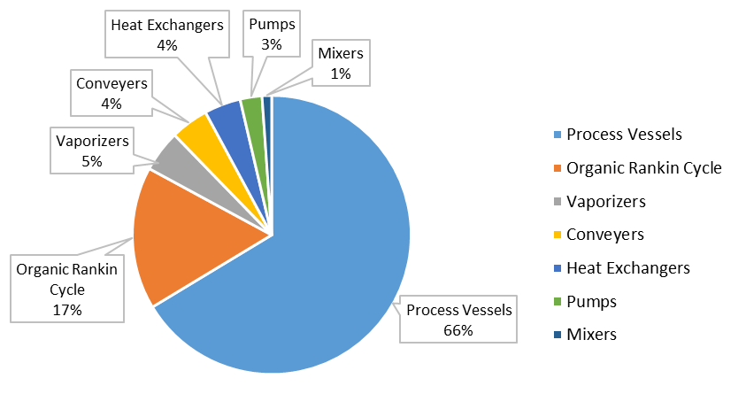
Production of Nylon 66 Using Bio-Based Feedstock
Sofia Diaco, Ami Humphrey, Jeffrey King, Marjorie Steiner
Objectives and C2Q Variables
Process Flow Diagram and Material Balance
Objectives
Continuously and sustainably produce 85,000,000 pounds of nylon 66 per year
Design to run at 100% and 67% capacity
C2Q Variables
High molecular weight
Low moisture content
5 mm granulated pellets
Safety Considerations
Stream | 1 | 2 | 3 | 4 | 5 | 6 | 7 | 8 | 9 | 10 | 11 | 12 | 13 | 14 | 15 | 16 | 17 | 18 | 19 | 20 | 21 | 22 | 23 | 24 | 25 | 26 | 27 | 28 | 29 | 30 | 31 | 32 | 33 | 34 | 35 | 36 | 37
0 | Water | Water | Water | Adipic Acid | HMDA | HMDA | Salt | Salt | Steam | Salt | Salt | HMDA | Water | HMDA Solution | HMDA Solution | HMDA Solution | Nitrogen | Nitrogen | Nitrogen | Nitrogen | Vapor | Steam | HMDA | HMDA | Molten Nylon 66 | Steam | Molten Nylon 66 | Steam | Molten Nylon 66 | Molten Nylon 66 | Nylon 66 pellets | Nylon 66 pellets | Vent gases | Vent gases | Vent gases | Steam | Vent gases
Temperature (C) | 25 | 25 | 55 | 25 | 25 | 25 | 55 | 55 | 155 | 155 | 155 | 25 | 25 | 25 | 25 | 68 | 25 | 75 | 125 | 143 | 190 | 188 | 321 | 321 | 260 | 275 | 275 | 200 | 200 | 200 | 250 | 25 | 222 | 222 | 155 | 155 | 200
Pressure (barg) | 0 | 1 | 0.5 | 0 | 0 | 0 | 0 | 0.5 | -0.2 | -0.2 | 11.5 | 0 | 1 | 0 | 12 | 11.5 | 13 | 12.5 | 12 | 11.5 | 11 | 10 | 10 | 11.5 | 11 | 0 | 0 | 0 | -0.95 | 0 | 0 | 0 | 0 | 0 | -0.20 | -0.20 | 0.00
Vapor fraction | 0 | 0 | 0 | 0 | 0 | 0 | 0 | 0 | 1 | 0 | 0 | 0 | 0 | 0 | 0 | 0 | 1 | 1 | 1 | 1 | 1 | 1 | 0 | 0 | 0 | 1 | 0 | 1 | 0 | 0 | 0 | 0 | 1 | 1 | 1 | 1 | 1
Molar flow rate (mol/hr) | 164,060.5 | 155,104.5 | 155,104.5 | 27,050.5 | 21,512.4 | 9,016.8 | 173,623.9 | 173,623.9 | 140,254.1 | 33,369.8 | 33,369.8 | 12,495.5 | 8,956.0 | 21,451.5 | 21,451.5 | 21,451.5 | 5,000.0 | 5,000.0 | 5,000.0 | 5,000.0 | 44,739.4 | 43,492.4 | 1,247.0 | 1,247.0 | 49,846.0 | 28,175.5 | 21,670.5 | 117.8 | 21,552.7 | 21,552.7 | 21,552.7 | 21,552.7 | 71,667.9 | 71,785.7
Mass flow rate (kg/hr) | 2,955.6 | 2,794.2 | 2,794.2 | 3,143.5 | 2,499.9 | 1,047.8 | 6,985.5 | 6,985.5 | 2,526.7 | 4,458.8 | 4,458.8 | 1,452.1 | 161.3 | 1,613.4 | 1,613.4 | 1,613.4 | 140.1 | 140.1 | 140.1 | 140.1 | 978.7 | 833.8 | 144.9 | 144.9 | 5,378.6 | 507.6 | 4,871.0 | 2.1 | 4,868.9 | 4,868.9 | 4,868.9 | 4,868.9 | 1,341.3 | 1,343.5 | 658.6 | 1,868.1 | 2,002.1
Components (kg/hr) | 0.0 | 0.0 | 0.0 | 0.0 | 0.0 | 0.0 | 0.0 | 0.0 | 0.0 | 0.0 | 0.0 | 0.0 | 0.0 | 0.0 | 0.0 | 0.0 | 0.0 | 0.0 | 0.0 | 0.0 | 0.0 | 0.0 | 0.0 | 0.0 | 0.0 | 0.0 | 0.0 | 0.0 | 0.0 | 0.0 | 0.0 | 0.0 | 0.0 | 0.0 |  |  | 0.0
Adipic Acid | 0.0 | 0.0 | 0.0 | 3,143.5 | 0.0 | 0.0 | 0.0 | 0.0 | 0.0 | 0.0 | 0.0 | 0.0 | 0.0 | 0.0 | 0.0 | 0.0 | 0.0 | 0.0 | 0.0 | 0.0 | 0.0 | 0.0 | 0.0 | 0.0 | 0.0 | 0.0 | 0.0 | 0.0 | 0.0 | 0.0 | 0.0 | 0.0 | 0.0 | 0.0 |  |  | 0.0
HMDA | 0.0 | 0.0 | 0.0 | 0.0 | 2,499.9 | 1,047.8 | 0.0 | 0.0 | 0.0 | 0.0 | 0.0 | 1,452.1 | 0.0 | 1,452.1 | 1,452.1 | 1,452.1 | 0.0 | 0.0 | 0.0 | 0.0 | 145.2 | 0.3 | 144.9 | 144.9 | 0.0 | 0.0 | 0.0 | 0.0 | 0.0 | 0.0 | 0.0 | 0.0 | 0.3 | 0.3 |  |  | 0.3
Water | 2,955.6 | 2,794.2 | 2,794.2 | 0.0 | 0.0 | 0.0 | 2,794.2 | 2,794.2 | 0.0 | 267.5 | 267.5 | 0.0 | 161.3 | 161.3 | 161.3 | 161.3 | 0.0 | 0.0 | 0.0 | 0.0 | 0.0 | 0.0 | 0.0 | 0.0 | 510.5 | 0.0 | 2.9 | 0.0 | 0.8 | 0.8 | 0.8 | 0.8 | 0.0 | 0.0 |  |  | 0.0
Steam | 0.0 | 0.0 | 0.0 | 0.0 | 0.0 | 0.0 | 0.0 | 0.0 | 2,526.7 | 0.0 | 0.0 | 0.0 | 0.0 | 0.0 | 0.0 | 0.0 | 0.0 | 0.0 | 0.0 | 0.0 | 693.4 | 693.4 | 0.0 | 0.0 | 0.0 | 507.6 | 0.0 | 2.1 | 0.0 | 0.0 | 0.0 | 0.0 | 1,201.0 | 1,203.1 | 658.6 | 1,868.1 | 1,861.7
Nylon salt | 0.0 | 0.0 | 0.0 | 0.0 | 0.0 | 0.0 | 4,191.3 | 4,191.3 | 0.0 | 4,191.3 | 4,191.3 | 0.0 | 0.0 | 0.0 | 0.0 | 0.0 | 0.0 | 0.0 | 0.0 | 0.0 | 0.0 | 0.0 | 0.0 | 0.0 | 0.0 | 0.0 | 0.0 | 0.0 | 0.0 | 0.0 | 0.0 | 0.0 | 0.0 | 0.0
Molten nylon | 0.0 | 0.0 | 0.0 | 0.0 | 0.0 | 0.0 | 0.0 | 0.0 | 0.0 | 0.0 | 0.0 | 0.0 | 0.0 | 0.0 | 0.0 | 0.0 | 0.0 | 0.0 | 0.0 | 0.0 | 0.0 | 0.0 | 0.0 | 0.0 | 4,868.1 | 0.0 | 4,868.1 | 0.0 | 4,868.1 | 4,868.1 | 0.0 | 0.0 | 0.0 | 0.0
Nylon 66 |  |  |  |  |  |  |  |  |  |  |  |  |  |  |  |  |  |  |  |  |  |  |  |  |  |  |  |  |  |  | 4,868.1 | 4,868.1 | 0.0 | 0.0
Nitrogen | 0.0 | 0.0 | 0.0 | 0.0 | 0.0 | 0.0 | 0.0 | 0.0 | 0.0 | 0.0 | 0.0 | 0.0 | 0.0 | 0.0 | 0.0 | 0.0 | 140.1 | 140.1 | 140.1 | 140.1 | 140.1 | 140.1 | 0.0 | 0.0 | 0.0 | 0.0 | 0.0 | 0.0 | 0.0 | 0.0 | 0.0 | 0.0 | 140.1 | 140.1 |  |  | 140.1
Inherent Safe Design
Control Loops
Minimize
Substitute
Moderate
Simplify
Economic Analysis
Conclusions and Recommendations
Conclusions
Selling price of $3.24/kg yields DCFRR of 26.9%
Significant market potential (automotive)
Bio-based feedstock and ORC increase sustainability
Recommendations
Lady Power recommends a “GO”
Acknowledgments
Dr. Halpern, Dr. Vasudevan, Chemical Engineering Department, Kingsbury Library
NPT= 4 years
PBP=2.6 years
DBEP= 6 years
DCFRR=26.9%
Equipment Cost
Summary
Notes:
This is only a template. You may chose to use or not use this format. I highly recommend you use a format that works for your group.

