Slide 1


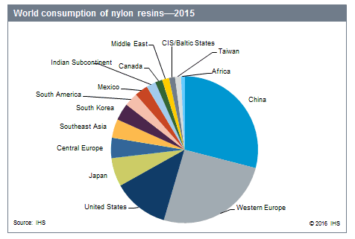
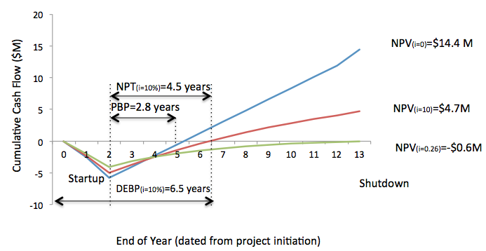
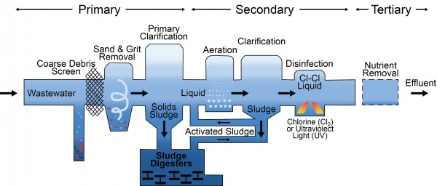
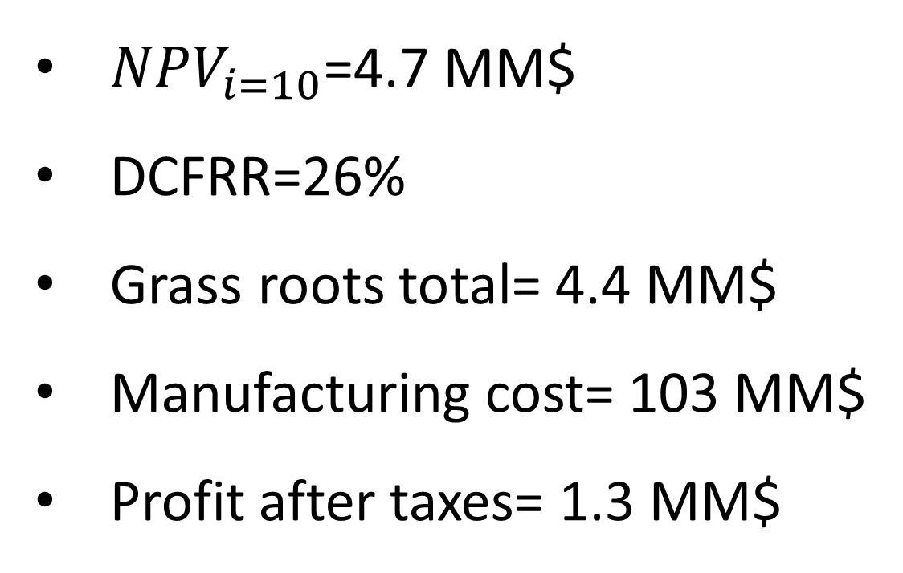
NPVi=10=14.4 million
DCFRR=26%
Manufacturing Facility for Nylon 6 6
2002 Oakland From Moneyball Curtis Lalonde, James DiLiegro, Juanfeng Sun, Meho Kamaric
Objectives:
To design a plant, from the ground up, for manufacturing nylon 6-6
To produce 38.6 million kg of nylon 6,6 yearly.
Market
Price of nylon 6,6 is $1.42 per pound ($3.13 per kg)
Price of nylon is tied to the price of oil
If oil prices increase, the price of nylon will increase as well
Polymerization:
Adipic acid and HMDA are added together to form the nylon 6,6
Adipic acid catalyst, HMDA attaches to the protonated molecule
Creates Dimer + H₂O + H⁺
`
China has the biggest market
Western Europe is second
Together they consume over 50% of the worlds nylon resins
40
https://www.ihs.com/products/nylon-resins-chemical-economics-handbook.html
Mass Balance
Stream | 1 | 2 | 3 | 4 | 5 | 6 | 7 | 8 | 9 | 10 | 11 | 12 | 13 | 14 | 15 | 16 | 17
Pressure | 0 | 0 | 0 | 1 | 1 | 2 | 0 | 0 | 1 | 0 | 1 | 0 | 13 | 0 | 0 | 0 | 0
Temperature | 25 | 25 | 25 | 25 | 60 | 60 | 25 | 25 | 25 | 25 | 25 | 280 | 192 | 27 | 40 | 30 | 55
Vapor Fraction | 0 | 0 | 0 | 0 | 0 | 0 | 0 | 0 | 0 | 0 | 0 | 0 | 1 | 0 | 0 | 0 | 0
Total Mass (kg/batch) | 19000 | 8500 | 26000 | 19000 | 53000 | 53000 | 3000 | 12000 | 3000 | 15000 | 3000 | 42200 | 18000 | 328000 | 328200 | 42000 | 42000
HMDA | 0 | 8500 | 0 | 0 | 0 | 0 | 0 | 12000 | 0 | 12000 | 0 | 0 | 0 | 0 | 0 | 0 | 0
Adipic Acid | 0 | 0 | 26000 | 0 | 0 | 0 | 0 | 0 | 0 | 0 | 0 | 0 | 0 | 0 | 0 | 0 | 0
Water | 19000 | 0 | 0 | 19000 | 23000 | 23000 | 3000 | 0 | 3000 | 3000 | 3000 | 0 | 18000 | 0 | 0 | 0 | 0
Process Water | 0 | 0 | 0 | 0 | 0 | 0 | 0 | 0 | 0 | 0 | 0 | 0 | 0 | 328000 | 328000 | 0 | 0
Nylon Salt | 0 | 0 | 0 | 0 | 30000 | 30000 | 0 | 0 | 0 | 0 | 0 | 0 | 0 | 0 | 0 | 0 | 0
Low MW Nylon Waste | 0 | 0 | 0 | 0 | 0 | 0 | 0 | 0 | 0 | 0 | 0 | 200 | 0 | 0 | 200 | 0 | 0
Nylon 66 total | 0 | 0 | 0 | 0 | 0 | 0 | 0 | 0 | 0 | 0 | 0 | 42000 | 0 | 0 | 0 | 42000 | 42000
Safety and Other Considerations
Adipic acid, hexamethylene diamine pose safety hazard
Minimal equipment and control system impacted design safety
Water was treated with a tertiary water treatment
Quality control was an important factor in safe design
Economic Analysis
Conclusions
38.6 million kg per year capacity is achievable
The process has a 26% return on investment (DCFRR)
At a 10% hurdle rate the NPV of the process is 14.4 $MM
Recommendations
We recommend that the company moves forward with the design process
Acknowledgments
We would like to acknowledge the Chemical Engineering department for teaching the necessary concepts to complete this report.
We would also like to thank Jonah Hill and Brad Pitt for their performance in no particular movie from 2011.
Finally, we would like to thank, Dunkin Donuts, Papa John’s, the local Chinese restaurant, and the Celtic bar downtown for their crucial roles in helping to complete the project. Without the help of this league of extraordinary businesses, the heart and soul behind the project would have been crippled and lackluster.
${NPV}_{i=10}$=4.7 MM$
DCFRR=26%
Grass roots total= 4.4 MM$
Manufacturing cost= 103 MM$
Profit after taxes= 1.3 MM$
http://css.snre.umich.edu/factsheets/us-wastewater-treatment-factsheet
Notes:
This is only a template. You may chose to use or not use this format. I highly recommend you use a format that works for your group.

