Slide 1


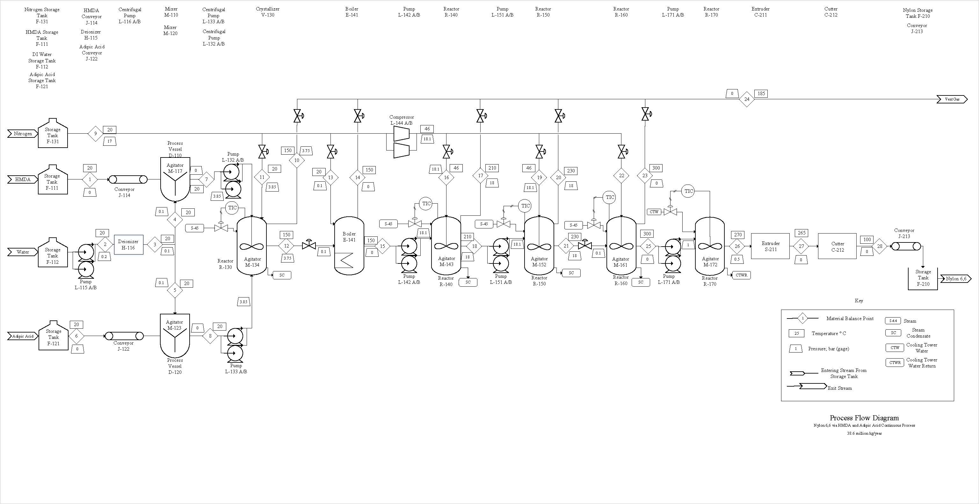
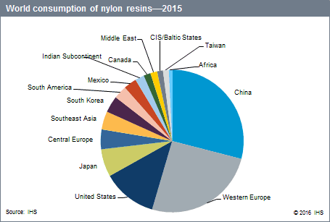
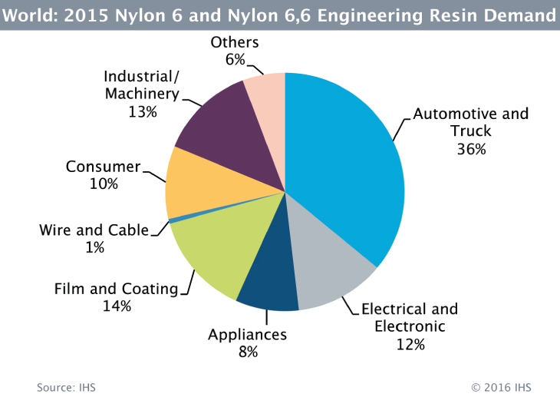
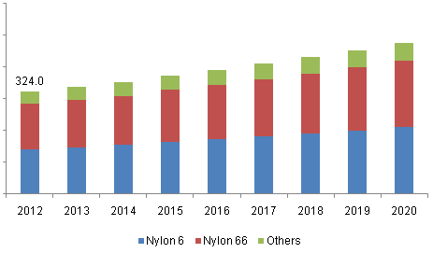
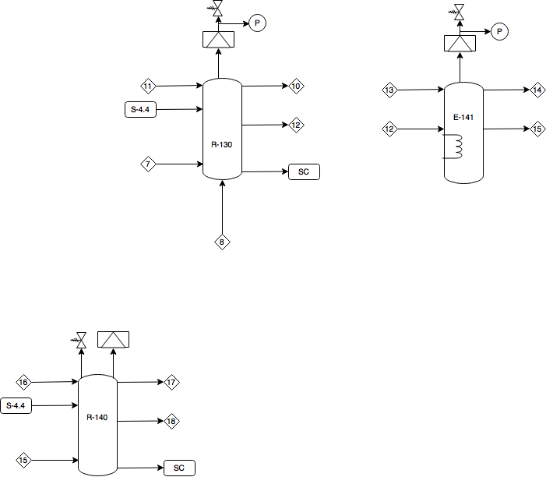
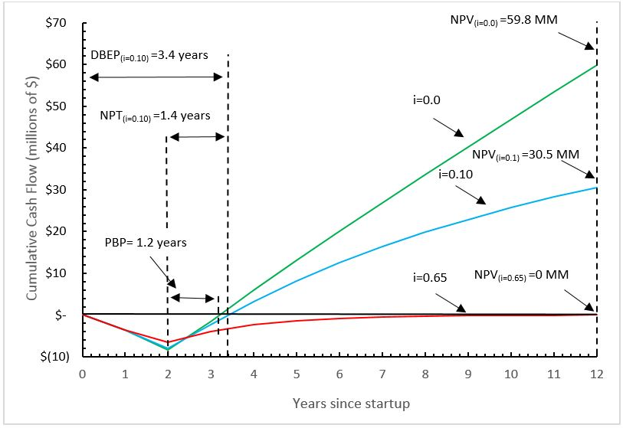
Nylon 6,6 from HMDA and Adipic Acid
Han Solo and the Boys
Zachary Lee, Meghan Moore, Stephen Spiro, Edward Stenovitch,
Department of Chemical Engineering, University of New Hampshire
HS&B
introduction
Process Flow diagram and material balance
Other considerations
Grass roots plant: 38.6 MM kg/yr
Continuous production
Pellets for end-use in automotive textiles
3% market growth per year 2012-2020
100% and 67% analyses completed
Start-up procedure
  Substitution of air for a nitrogen atmosphere
  Leak testing
Quality control
  Equimolar addition of HMDA and Adipic Acid
  Monitor temperatures and pressures to limit thermal degradation
Plant layout
  Pumps should be isolated
  Explosion barricades around reactors
Global Nylon monofilament market volume by product, 2012-2020 (kilotons)
100% Capacity
Stream Number | 1 | 2 | 3 | 4 | 5 | 6 | 7 | 8 | 9 | 10 | 11 | 12 | 13 | 14 | 15 | 16 | 17 | 18 | 19 | 20 | 21 | 22 | 23 | 24 | 25 | 26 | 27 | 28
Temperature (°C) | 20 | 20 | 20 | 20 | 20 | 20 | 20 | 20 | 20 | 150 | 20 | 150 | 20 | 150 | 150 | 20 | 210 | 210 | 20 | 230 | 230 | 20 | 300 | 185 | 300 | 270 | 265 | 100
Pressure (barg) | 0 | 0.2 | 0.1 | 0.1 | 0.1 | 0 | 0 | 0 | 18.1 | 3.75 | 3.85 | 3.75 | 0.1 | 0 | 0 | 18.1 | 18 | 18 | 18.1 | 18 | 18 | 0.1 | 0 | 0 | 0 | 0.5 | 0 | 0
Vapor Fraction | 0 | 0 | 0 | 0 | 0 | 0 | 0 | 0 | 1 | 1 | 1 | 0 | 1 | 1 | 0 | 1 | 1 | 0 | 1 | 0 | 1 | 1 | 1 | 1 | 0 | 0 | 0 | 0
Mass Flow Rate (kg/hr) | 2359.6 | 3857.5 | 3857.5 | 1708.6 | 2169.7 | 2967.5 | 4068.2 | 5116.4 | 25.9 | 10.1 | 10.1 | 9184.6 | 2.1 | 0.0 | 6126.9 | 7.4 | 728.2 | 5406.1 | 6.2 | 575.2 | 4837.1 | 0.1 | 148.2 | 4521.4 | 4688.5 | 4688.5 | 4688.5 | 4688.5
Components (kg/hr)
HMDA | 2359.6 | 0.0 | 0.0 | 0.0 | 0.0 | 0.0 | 2359.6 | 0.0 | 0.0 | 0.0 | 0.0 | 0.0 | 0.0 | 0.0 | 0.0 | 0.0 | 0.0 | 0.0 | 0.0 | 0.0 | 0.0 | 0.0 | 0.0 | 0.0 | 0.0 | 0.0 | 0.0 | 0.0
Deionized Water | 0.0 | 0.0 | 3857.5 | 1708.6 | 2148.9 | 0.0 | 1708.6 | 2148.9 | 0.0 | 0.0 | 0.0 | 0.0 | 0.0 | 0.0 | 0.0 | 0.0 | 0.0 | 0.0 | 0.0 | 0.0 | 0.0 | 0.0 | 0.0 | 0.0 | 0.0 | 0.0 | 0.0 | 0.0
Adipic Acid | 0.0 | 0.0 | 0.0 | 0.0 | 0.0 | 2967.5 | 0.0 | 2967.5 | 0.0 | 0.0 | 0.0 | 0.0 | 0.0 | 0.0 | 0.0 | 0.0 | 0.0 | 0.0 | 0.0 | 0.0 | 0.0 | 0.0 | 0.0 | 0.0 | 0.0 | 0.0 | 0.0 | 0.0
Nitrogen | 0.0 | 0.0 | 0.0 | 0.0 | 0.0 | 0.0 | 0.0 | 0.0 | 25.9 | 10.1 | 10.1 | 0.0 | 2.1 | 2.1 | 0.0 | 7.4 | 7.4 | 0.0 | 6.2 | 6.2 | 0.0 | 0.1 | 0.1 | 25.9 | 0.0 | 0.0 | 0.0 | 0.0
Nylon Salt | 0.0 | 0.0 | 0.0 | 0.0 | 20.8 | 0.0 | 0.0 | 0.0 | 0.0 | 0.0 | 0.0 | 4595.2 | 0.0 | 0.0 | 1471.7 | 0.0 | 0.0 | 724.8 | 0.0 | 0.0 | 158.9 | 0.0 | 0.0 | 0.0 | 0.0 | 0.0 | 0.0 | 0.0
Water | 0.0 | 3857.5 | 0.0 | 0.0 | 0.0 | 0.0 | 0.0 | 0.0 | 0.0 | 0.0 | 0.0 | 4589.4 | 0.0 | 3057.7 | 1531.7 | 0.0 | 720.8 | 810.9 | 0.0 | 569.0 | 241.9 | 0.0 | 148.1 | 4495.6 | 93.8 | 93.8 | 93.8 | 93.8
Nylon 6,6 | 0.0 | 0.0 | 0.0 | 0.0 | 0.0 | 0.0 | 0.0 | 0.0 | 0.0 | 0.0 | 0.0 | 0.0 | 0.0 | 0.0 | 3123.5 | 0.0 | 0.0 | 3870.4 | 0.0 | 0.0 | 4436.3 | 0.0 | 0.0 | 0.0 | 4594.7 | 4594.7 | 4594.7 | 4594.7
TOTAL | 2359.6 | 3857.5 | 3857.5 | 1708.6 | 2169.7 | 2967.5 | 4068.2 | 5116.4 | 25.9 | 10.1 | 10.1 | 9184.6 | 2.1 | 3059.8 | 6126.9 | 7.4 | 728.2 | 5406.1 | 6.2 | 575.2 | 4837.1 | 0.1 | 148.2 | 4521.4 | 4688.5 | 4688.5 | 4688.5 | 4688.5
Safety considerations
Economic Analysis
Conclusions and Recommendations
HMDA identified as most hazardous material
Process hazards associated with high temperatures and pressures.
Parallel relief valve with spring and rupture disk
Profitability Measure | Value
Undiscounted Net Present Value (NPV_{i=0}) | $59.8 MM
Discounted Net Present Value (NPV_{i=10%}) | $30.5 MM
Payback Period (PBP) | 1.2 years
Net Payout Time (NPT) | 1.4 years
Discounted Break Even Point (DBEP) | 3.4 years
Discounted Cash Flow Rate of Return (DCFRR) | 65.1 %
After-Tax Return Rate | 114 %
Recommend that proposed design be carried out for further analysis and eventual construction
Continuous process has higher efficiency and is inherently safer
Continuous production will run for 350 days/year
100 % capacity dedicated to Nylon 6,6 pellet production
Use of high quality raw materials to ensure a high-quality product
Nylon 6,6 pellets will be sold for $3.13 per kg
45
Guide word | Deviation | Cause | Consequence | Action
No | No steam delivered to reactor | Steam supply pipe rupture | Solution will not drive off water and polymerization will not occur | Check to make sure flow rates operate at optimum conditions
No | No nitrogen blanketing | Valve failure | Air can enter the system which can contaminate the salt solution | Maintenance check by process engineers on valve controllers
More | More water in solution | Valve failure | Purity of Nylon 6,6 decreases | Maintenance check by process engineers on valve controllers
More | More steam entering the jacket | Temperature control loop failure | Thermal degradation of monomers | Maintenance check by process engineers on control loops
Less | Less solution leaving the reactor | L-151 A/B failure | Backup and overflow in R-140 | Maintain spare pump (L-151 A/B)
Class 4 Economic Analysis
Selling Price: $3.13/kg
Total Capital Investment: $8.3 MM
Total Expenses: $111 MM
Revenue from Sales: $121 MM
Net Annual Profit After Taxes: $6.3 MM
Acknowledgements
We would like to thank the force for always keeping us on track and our professors, TA, and the UNH Chemical Engineering Department.

