Slide 1



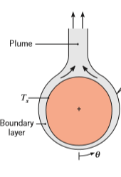
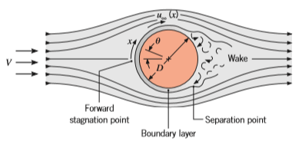

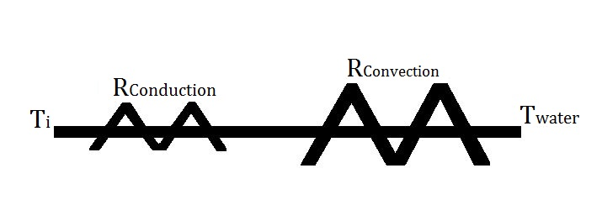
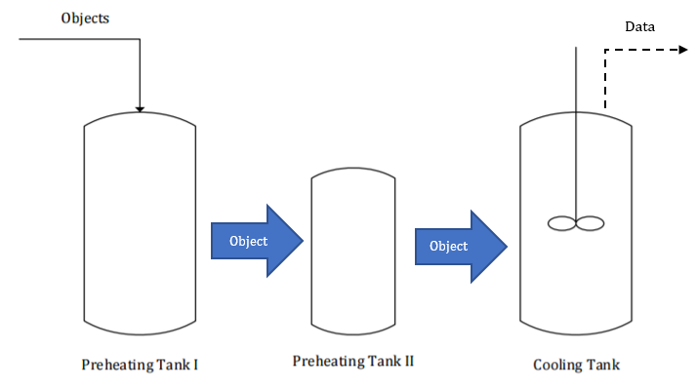
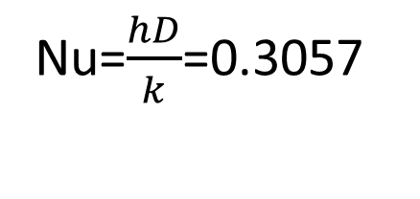
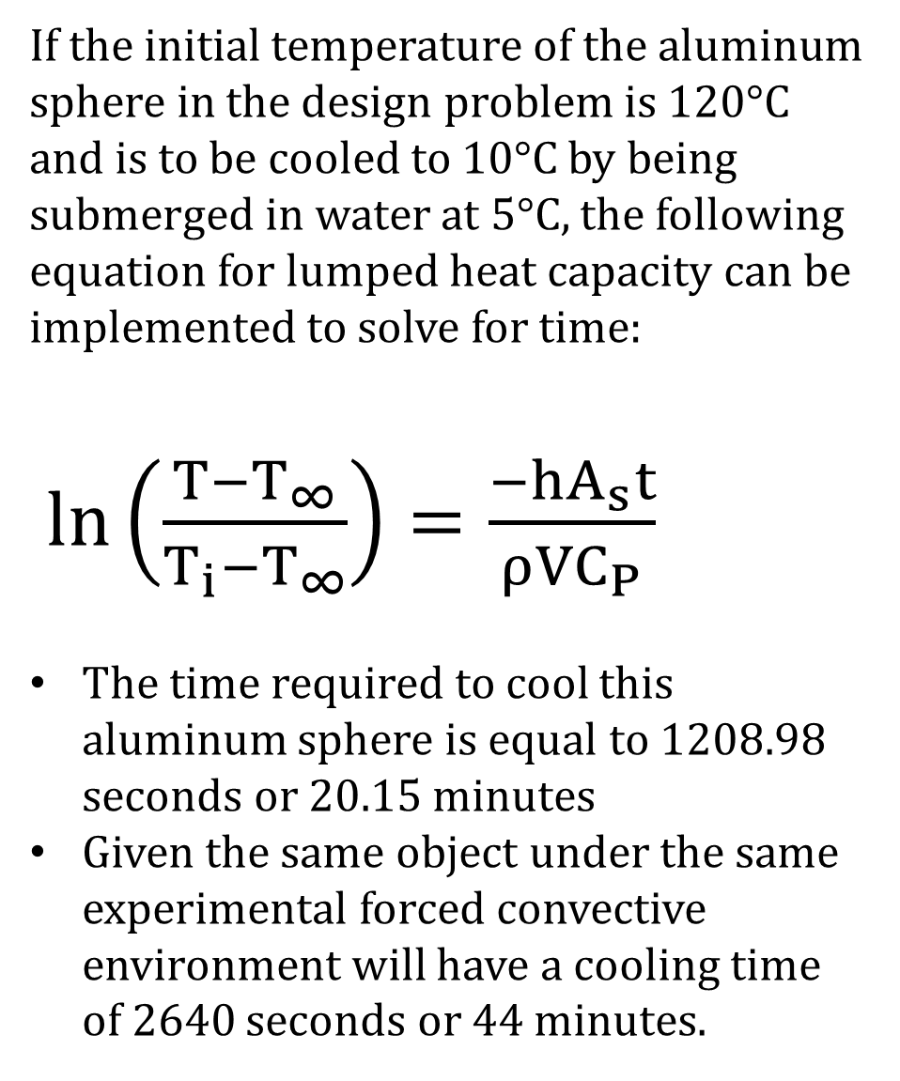
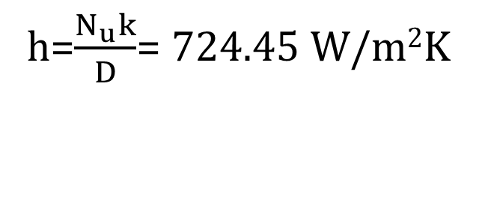
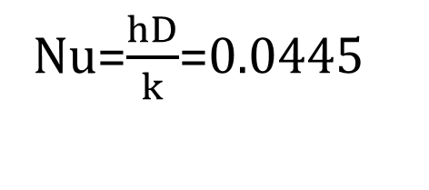
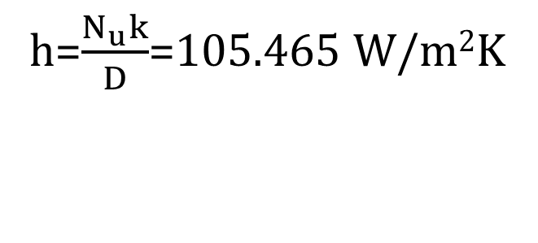
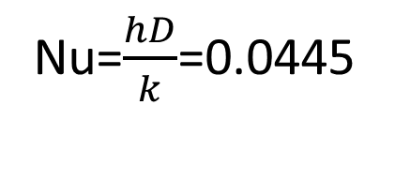
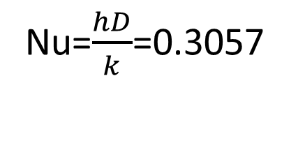
Analyzing the Effects of Convective Environments, Geometry, and Material on Unsteady Convection
Patrick McGee, Nathaniel Horn, and Ryan Bingman
Department of Chemical Engineering, University of New Hampshire, Durham, NH 03824
Goals
Results:
Discussion:
Demonstrate the effects of geometry and material on the convection heat transfer coefficient.
Demonstrate the effects of agitation on the convection of an object over time and compare to the natural convection of that same object.
h_{forced} > h_{natural}
Fluid in motion will wick away more heat and create a higher driving force for convection.
Natural convection only has a density difference as a driving forced for convection. The fluid motion due to this is lower than forced.
h_{Cylinder} < h_{Sphere} > h_{Block}
The sphere has the highest surface area to volume ratio out of all of the objects. This allows more contact with the fluid for convection.
+530%
Introduction
Forced Convection
Natural Convection occurs due to the density of the fluid changing with temperature and Forced Convection is driven by an external force.
The LHCM uses the assumption that the internal resistance of an object is less than the surface resistance to convection and thus the object is considered to have a uniform temperature internally and thus is considered to have a “lumped heat”.
[3]
[3]
+480%
Natural Convection
Block
Cylinder
Sphere
Methods
On average there was a 530% increase and a 480% increase in the convection coefficient between natural and forced environments for Aluminum and Brass Objects respectively.
Using a t-test, it was determined that shape of the object has a significant effect on the convection coefficient in a forced environment. Shape does not have a significant effect in a free convective environment. The convection environment also has a significant effect.
Conclusions:
Objects to be measured include an Al block, Al cylinder, Al sphere, Brass cylinder, and Brass sphere.
Objects measured in triplicate for both forced and natural convection. The objects were returned to Preheat I after cooling.
During forced convection, the pitched impeller was set to 200 RPM.
Objects under forced convection have a higher convection coefficient and are able to reach steady state much faster than objects in a natural convective environment.
The sphere has the highest convection coefficient amongst the tested objects most likely due to it having the highest surface area to volume ratio out of all of the objects.
sTAMD Simulations
Design Problem:
Experimental System:
Design System:
If the initial temperature of the aluminum sphere in the design problem is 120°C and is to be cooled to 10°C by being submerged in water at 5°C, the following equation for lumped heat capacity can be implemented to solve for time:
$\ln\left(\frac{T−T_{∞}}{T_{i}−T_{∞}}\right)=\frac{−hA_{s}t}{ρVC_{P}}$
The time required to cool this aluminum sphere is equal to 1208.98 seconds or 20.15 minutes
Given the same object under the same experimental forced convective environment will have a cooling time of 2640 seconds or 44 minutes.
Natural Convection:
D=5.06 cm
D=10 cm
Acknowledgements
h=208.55 W/m²K
Natural Convection: (Bi=0.015)
Nu=$\frac{hD}{k}$=0.0445
Nu=$\frac{hD}{k}$=0.0445
Professor Adam St. Jean, Lev Levnitov, Dr. Russell Carr and the Department of Chemical Engineering
Forced Convection:
h=$\frac{N_{u}k}{D}$=105.465 W/m²K
References
h=1431.72 W/m²K
Forced Convection: (Bi=0.1019)
Nu=$\frac{hD}{k}$=0.3057
Nu=$\frac{hD}{k}$=0.3057
[1] D. W. Green and R. H. Perry, Perry’s Chemical Engineer’s Handbook. New York, NY: McGraw-Hill, 2008.
[2] C. J. Geankoplis. Transport Processes and Separation Process Principles. Upper Saddle River, NJ: Prentice Hall Press, 2003.
[3] T. L. Bergman, A. S. Lavine, F. P. Incropera, and D. P. Dewitt, Fundamentals of Heat and Mass Transfer. Hoboken, NJ: Jonh Wiley and Sons, Inc, 2011.
[4] “CFD Software,” simFlow CFD. [Online]. Available: https://sim-flow.com/cfd-software/. [Accessed: 01-May-2017].
h=$\frac{N_{u}k}{D}$= 724.45 W/m²K

