Slide 1


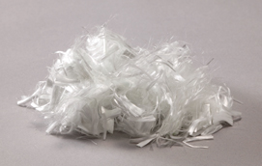
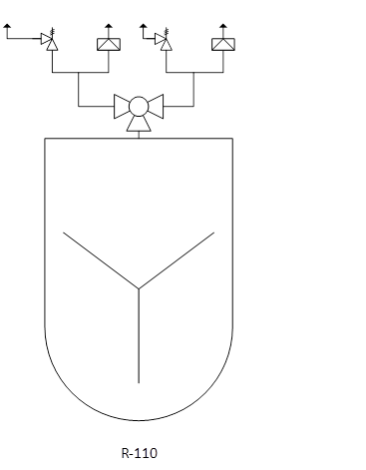
Manufacturing Facility for Nylon 6,6
Insufficient Koalafications
Allison Bickford, Mitchell Juneau, Ryan Lamers, Christopher Reilly
Objectives
Annual production of 38.6 MM kg nylon 6,6
Grassroots plant in Calvert City, Kentucky
Market
Proposed production is 3% of US market
$3.25/kg sale price
Critical to Quality Variables:
MW of 14,300
Dull finish
Strength and stability
Resistant to water
Process Flow Diagram and Gantt Chart
Stream Number | 1 | 2 | 3 | 4 | 5 | 6 | 7 | 8 | 9 | 10 | 11 | 12 | 13 | 14 | 15 | 16 | 17 | 18 | 19 | 20 | 21 | 22
Temperature (°C) | 25 | 25 | 25 | 25 | 155 | 25 | 155 | 152 | 152 | 45 | 155 | 25 | 25 | 25 | 270 | 45 | 270 | 250 | 250 | 250 | 270 | 60
Pressure (barg) | 0.01 | 0.01 | 0.01 | 5.0 | 4.5 | 4.5 | 4.1 | 4.1 | 4.1 | 4.1 | 4.1 | 0.01 | 0.01 | 5.0 | 9.5 | 9.5 | 1.0 | 1.0 | 1.0 | 1.0 | 1.0 | 0.01
Vapor Fraction | 0 | 0 | 0 | 1 | 0 | 1 | 1 | 0 | 1 | 0 | 0 | 0 | 0 | 1 | 1 | 0 | 0 | 0 | 0 | 0 | 0 | 0
Mass Flow Rate (kg/batch) | 32934 | 41417 | 10214 | 22567 | 84565 | 22567 | 20601 | 14029 | 6572 | 6572 | 63965 | 561 | 397 | 41418 | 44327 | 44327 | 62534 | 62534 | 15273 | 47261 | 47261 | 47261
HMDA | 32934 |  |  |  | 4940 |  | 4940 | 4940
Adipic Acid |  | 41417 |  |  | 6213 |  | 6213 | 6213
Water |  |  | 10214 |  | 10214 |  | 9448 | 2876 | 6572 | 6572 | 766 | 103 |  |  | 2909 | 2909 | 5340 | 5340 | 5340
Nylon Salt |  |  |  |  | 63198 |  |  |  |  |  | 63198 |  |  |  |  |  | 9480 | 9480 | 9480
Nylon 6,6 |  |  |  |  |  |  |  |  |  |  |  |  |  |  |  |  | 47256 | 47256 |  | 47256 | 47256 | 47256
TiO2 |  |  |  |  |  |  |  |  |  |  |  | 458 |  |  |  |  | 458 | 458 | 453 | 5 | 5 | 5
Acetic Acid |  |  |  |  |  |  |  |  |  |  |  |  | 397
Nitrogen |  |  |  | 22567 |  | 22567 |  |  |  |  |  |  |  | 41418 | 41418 | 41418
Key
 |  | Material Balance Point
 |  | Pressure, barg
 |  | Temperature, ˚C
 |  | Mass Flow Rate, kg/batch
 |  | Utilities Designation Symbol
Process Flow Diagram Production of Nylon 6,6 via Batch Process 47261 kg/batch
Drawn | 3 Apr. 2017 | By | Group
Rev. | 15 Apr. 2017 |  | Ryan Lamers
Rev. | 28 Apr. 2017 |  | Ryan Lamers
Safety Considerations
Minimize
Size of batches
Substitute
Nitrogen padding
Moderate
Cooling jackets
Simplify
Streamline operator training
Economic Analysis
$6.47MM Capital Investment
A_{NNP}=$5.22MM
DCFRR=60%
2 year construction
10 year operation
Environmental Considerations
Waste Streams
Neutralize or Contain
Water Use
Reduce, Reuse, Recycle
Conclusions
This project is given a GO and it’s recommended to move to the next stage of development
Semi-batch process should be used to produce fibers
Nylon 6,6 can be manufactured safely and economically
Acknowledgements
We want to thank Dr. Halpern, Rhiannon Jacobs and the rest of the UNH Chemical Engineering Department.
NPV_{(i=0)}=$56.9
NPT_{(i=0.10)}=1.6
NPV_{(i=0.10)}=$24.7
DBEP_{(i=0.10)}=3.6
PBP=1.1
NPV_{(i=0.60)}=$0
R-110

